Slide 1
SCE Climate Adaptation Efforts:
Update and Early Trends
Adam R. Smith
Program Manager, Climate Policy

Slide 2
Goals
Assess current vulnerabilities to climate change on our operations and physical assets
  Climate Impact Analysis
  Company-wide exercise in November 2017
  External outreach to understand resilience of others
Address existing vulnerabilities with cost-effective solutions
  DOE Partnership Phase 2
  Work with CA agencies and stakeholders
Integrate climate data into all relevant decisions at the utility
  Risk-informed decision-making
  Tailored climate data for multiple internal clients (Procurement, Planning, T&D)

Slide 3
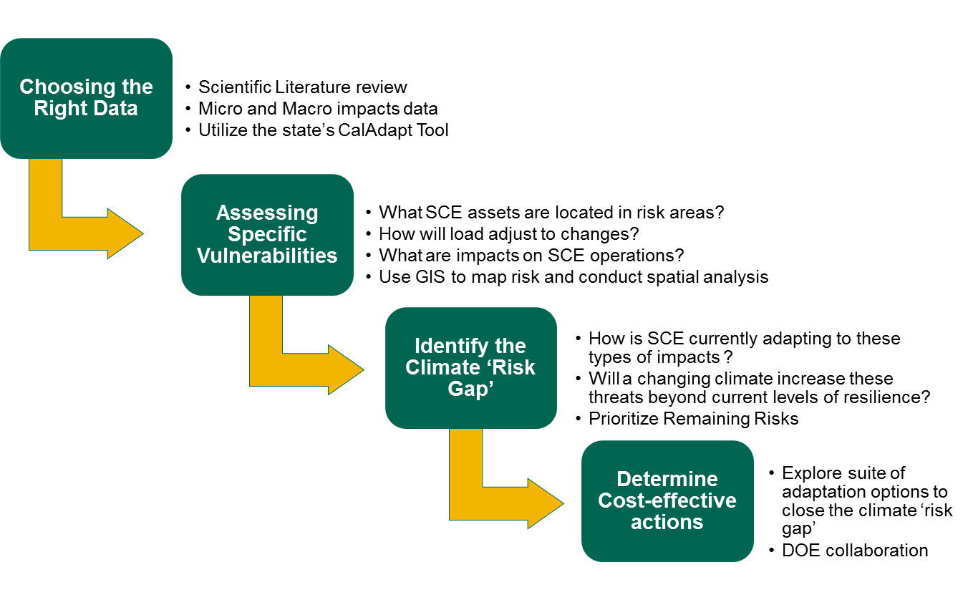
Framework: Climate Impact Analysis
Complete
In Progress

Slide 4
Overview of Impact Analysis Scope
Topic | In Scope
Time | 2030 2050 2085
Scale | Focus on SCE service territory, but have data for all of CA
Infrastructure | Generation – UOG operation for all plants Transmission – all lines greater than or equal to 110kv Substation – all substations Distribution – aggregate high level risks
Climate Impacts | Climate impact maps from CalAdapt Leverage ongoing internal Business Resiliency Initiatives (El Nino, Drought, etc.) Review of existing literature
Outreach | Identification of partnership opportunities and community outreach (MC4, DOE)

Slide 5
Scenarios, Models and Data Used
IPCC Emissions Scenario: A2
Global Circulation Model: CCSM3 (if not available used PCM1)
Time slices: 2030, 2050, 2085
Data Used:
      Avg Temp - Scripps Institution of Oceanography: California Nevada Applications Program (CNAP)
      Fire Risk - UC Merced: Climate Applications Lab
      Max Temp (August) - Scripps Institution of Oceanography: California Nevada Applications Program (CNAP)
      Min Temp (January) - Scripps Institution of Oceanography: California Nevada Applications Program (CNAP)
      Net Surface Radiation - Scripps Institution of Oceanography: California Nevada Applications Program (CNAP)
      Precipitation - Scripps Institution of Oceanography: California Nevada Applications Program (CNAP)
      Runoff - Scripps Institution of Oceanography: California Nevada Applications Program (CNAP)
      Wind - Scripps Institution of Oceanography: California Nevada Applications Program (CNAP)
      Sea-Level Rise - U.S. Geological Survey (USGS)
      Snowpack - Scripps Institution of Oceanography: California Nevada Applications Program (CNAP)

Slide 6
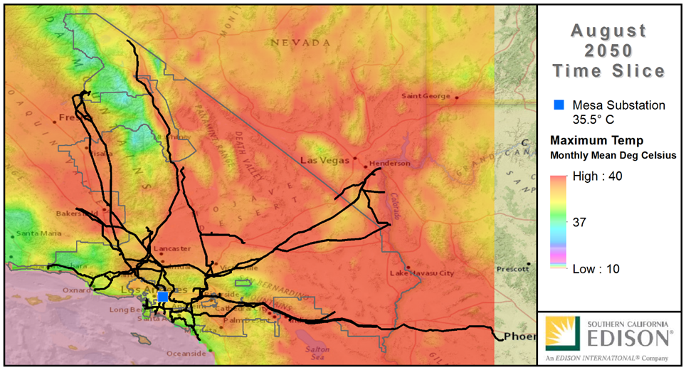
Example of Spatial Analysis

Slide 7
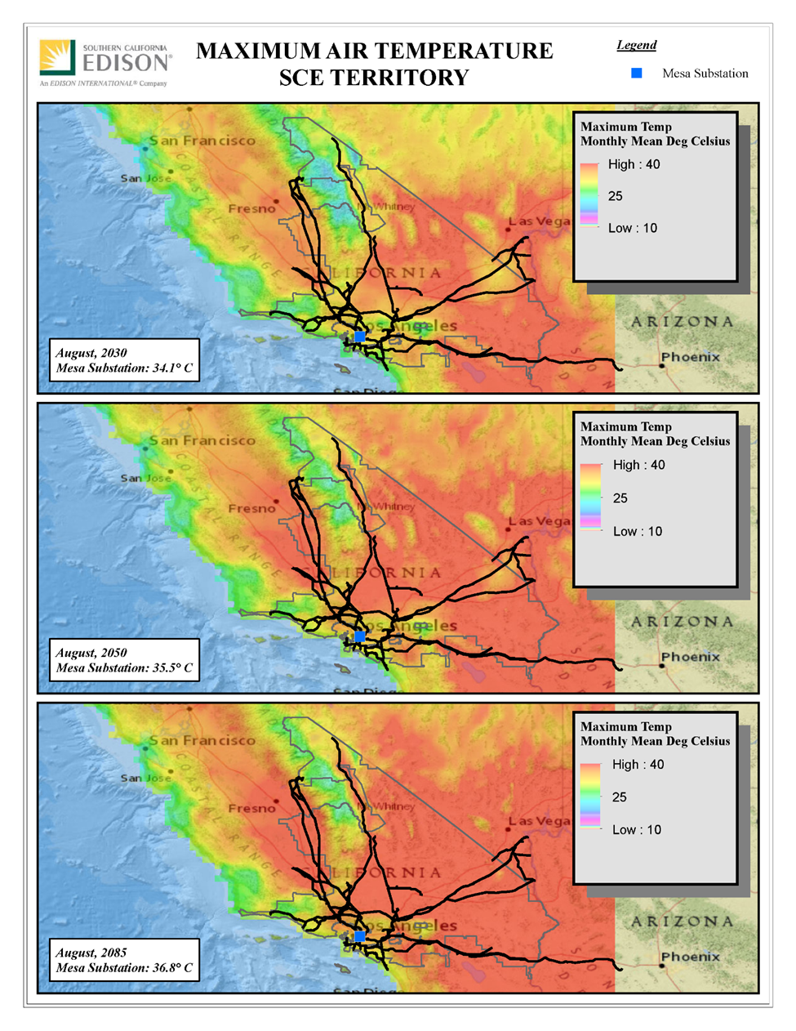
Example of Spatial Analysis

Slide 8
Example of Facility-Level projections
Mesa Substation | 2030 (2020 for Fire Data) | 2050 | 2085
AvgAirTemp (c) Aug | 27 | 28.3 | 29.6
FireRisk Multiplier | 0 | 0 | 0
MaxAirTemp (c) Aug | 34.2 | 35.5 | 36.8
MinAirTemp (c) Jan | 11.9 | 11.2 | 6.5
NetSurfRadi (watt per square meter) | 25 | 25.6 | 28.9
Precip(mm per month) | 0 | 35.4 | 74.2
Runoff (mm per month) | 0 | 1.6 | 5.1
SnowWaterEquiv(mm per month) | 0 | 0 | 0

Slide 9
Key Climate Trends in Southern California
Population centers in Southern California to warm significantly. The Los Angeles region is projected to see annual average air temperatures rise between 4-5 degrees Fahrenheit by mid-century, warming is greater inland, slightly less in coastal regions. (Hall 2013)
Extreme Heat Days (above 95F) may triple in dense urban areas near Los Angeles, the San Fernando Valley, and the San Gabriel Valley by mid-century. Extreme Heat days may quadruple in the mountain and desert regions of SCE Service Territory over the same period. (Hall 2013)
Eastern transmission pathways to see significant warming, and reduced line efficiency. According to SCE analysis and previous studies, average annual air temperature is projected to rise between 7-12 degrees Fahrenheit along the eastern boundary of SCE’s Service territory by the end of the century – subjecting at least 5 key transmission pathways to some of the most extreme warming our state will face. Extreme heat events will exacerbate efficiency losses. (SCE analysis, LBNL 2012)
The geography of wildfire risk changing. According to SCE’s analysis of the data, this could mean tripling of wildfire risk in extreme cases in coastal regions and foothills but also slightly decreasing across the southeastern reaches of SCE’s service territory (possibly due to vegetation migration) by the end of the century.
Sea-level rise and storms present a challenge to coastal infrastructure. By 2100 average sea level along the California coast may rise between 1.0 and 1.4 meters (3.3 and 4.6 feet). 18 SCE-owned substations are at risk from a 100-year flood accompanied by a 1.4m sea-level rise by the end of the century according to the data. (SCE Analysis, LBNL 2012)
Snowpack, drought, and precipitation changes could challenge the historic reliance on hydropower to meet demand in California. Increased variability in water resources serving California is a trend visible in SCE analysis and the scientific literature.

Slide 10
Moving Forward
Further Refine Climate Impact Analysis
  Address the issues raised in CPUC guidance
  Incorporate best practices from DOE Partners
Internal Workgroups
  Procurement, Planning, T&D, Emergency Response, etc.
  Present our findings, gather physical and operational mitigation options and cost estimates
Work with External Stakeholders
  State Agencies, DOE, Regional Adaptation Collaboratives
  Present our findings, share data, seek opportunities to work together
On-Track to meet DOE requirements in November
  Looking forward to continuing discussions well beyond due-date

Slide 11
Early Lessons Learned
Climate Change will likely bring additional risks, but thankfully there is already substantial resiliency built in to our infrastructure and operational/planning practices for near-term climate impacts.
SCE is thinking through how to best integrate climate data into our existing planning processes. Some threat types (like wildfire, extreme heat events, and drought) have an existing planning framework that can be expanded to include this longer-term data.
We need clear and consensus-driven climate impact analysis tools (including impacts maps). This empowers utilities, state agencies and other stakeholders to analyze their own vulnerabilities and work collaboratively.
Probability of extreme events and spatial averaging techniques, are just a few of the remaining data hurdles. Data Sharing needs to be structured in ways that protects critical infrastructure.
We need to talk among the utilities and our regulators to come up with best practices to address projected climate impacts. The DOE Partnership will aid this conversation.

