Slide 1

California Transportation Fuels Market
Refinery Turmoil – A Year in Review
Refining Update Session
Pacific Oil Conference
Los Angeles, California
September 7, 2016
Gordon Schremp
Energy Assessments Division
California Energy Commission
gordon.schremp@energy.ca.gov
California Energy Commission

Slide 2
Presentation Overview
  Western region & California transportation fuels market overview
    California differences - gasoline
  Review of factors contributing to elevated prices
  2015 – year in review
    Outages and uncertainties
    Imports & exports
  Current status of refining
  Closing remarks
California Energy Commission

Slide 3
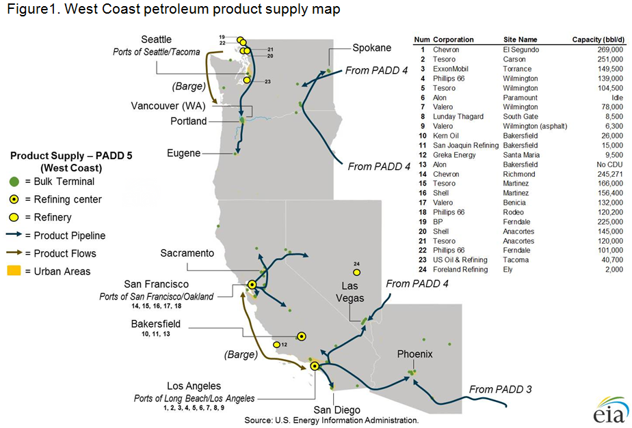
Western States More Isolated than Rest of U.S.
California Energy Commission

Slide 4
California Gasoline Market - Isolated
California’s gasoline market is nearly self-sufficient, so supplies of gasoline from outside of California are not routinely needed to balance out supply with demand
  Imports of gasoline and blending components account for only 3 to 6 percent of supply
The California market is geographically isolated from other locations in the United States that produce refined products
Pipelines connect California refining centers to distribution terminals in Nevada and Arizona, but these pipelines only operate in one direction – sending gasoline and other transportation fuels to these neighboring states
California market is isolated by time and distance from alternative sources of re-supply during unplanned refinery outages
California Energy Commission

Slide 5
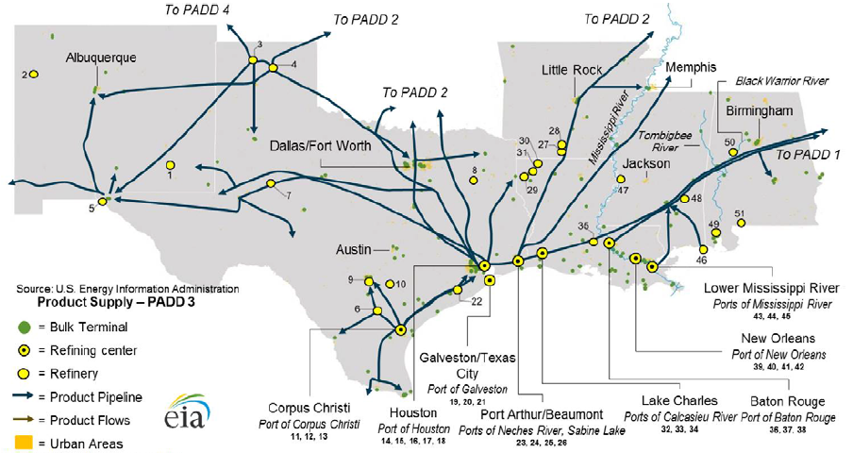
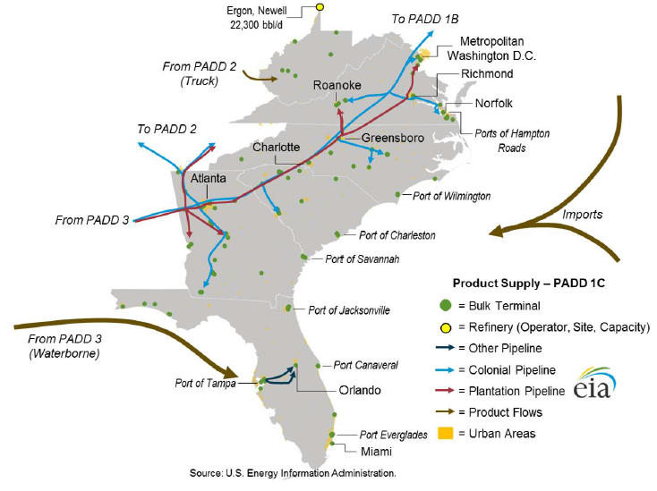
Balance of Other Regions Varies
  Unlike other areas, California is nearly self-sufficient
    Primary sources of transportation fuels originate from inside the state
    More susceptible to price spikes following unplanned outages
  Other regions less prone to price spikes
    Price spikes following significant unplanned refinery outages less common
Large net exporting region
Large net importing region
California Energy Commission

Slide 6
Dominated by distribution rack sales.
California Energy Commission

Slide 7
Dealer Tank Wagon similar to distribution rack sales volume.
California Energy Commission

Slide 8
California Gasoline Market – More Expensive
California has one of the more expensive retail gasoline and diesel fuel prices in the United States
Reasons why California retail prices are more expensive - 2014:
  Greater tax burden – 17 cents
  Higher production costs – 10 cents
  An isolated market – 10 cents and more
Between 2001 and 2014, annual average prices at least:
  17 cents per gallon higher than the average all U.S. retail gasoline prices
  10 cents higher than the average all U.S. reformulated gasoline prices
  12 cents higher than the average all U.S. retail diesel prices
Between 2009 and 2014, differentials have averaged
  35.2 cents per gallon higher for all types of gasoline
  24.4 cents higher for all reformulated gasoline
  19.9 cents higher for diesel fuel
California Energy Commission

Slide 9
  Western region & California transportation fuels market overview
    California differences - gasoline
  Review of factors contributing to elevated prices
  2015 – year in review
    Outages and uncertainties
    Imports & exports
  Current status of refining
  Closing remarks
California Energy Commission

Slide 10
Factors Impacting Fuel Prices
Wholesale fuel prices impacted by:
  Unplanned refinery outages
  Return-to-service delays by refineries undergoing planned maintenance
  Transition from winter to summer gasoline recipe that decreases gasoline production capability of refineries
  Introduction of new environmental fees
  Changes in fuel regulations, such as reformulated gasoline and transition away from MTBE
  Changes in futures contract prices linked to wholesale prices
  Unusually high or low fluctuations of fuel inventory levels
  Changes in the level of taxes on fuels
  Transition from summer to winter gasoline recipe that increases gasoline production capability of refineries
  Resumption of operations by temporarily idled refineries
California Energy Commission

Slide 11
  Western region & California transportation fuels market overview
    California differences - gasoline
  Review of factors contributing to elevated prices
  2015 – year in review
    Outages and uncertainties
    Imports & exports
  Current status of refining
  Closing remarks
California Energy Commission

Slide 12
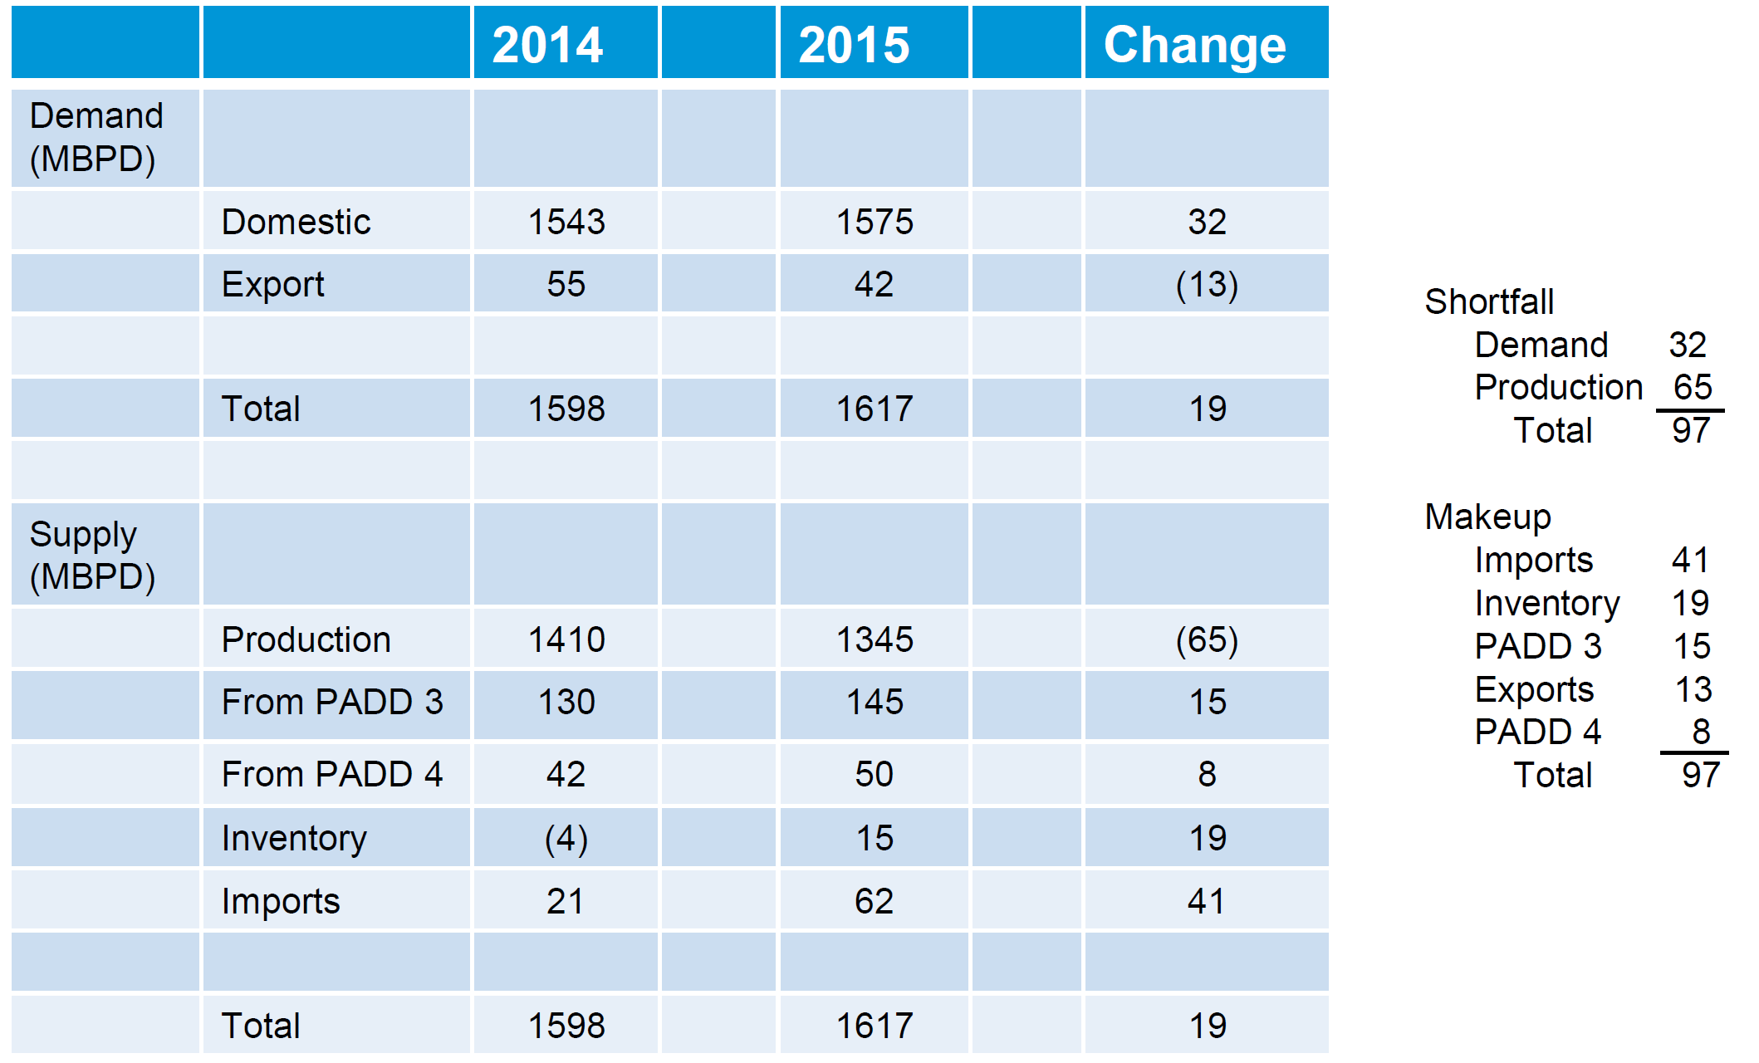
2015 Regional Rebalance Overview
Source: Energy Information Administration.
California Energy Commission

Slide 13
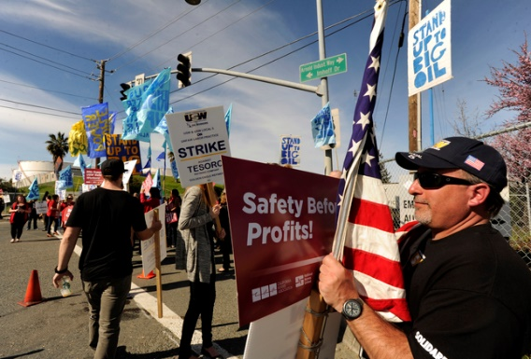
Strike Prevents Refinery Restart – Feb. 1st
Tesoro Golden Eagle refinery in Martinez, CA given strike notice – Feb. 1
Refinery was conducting planned maintenance on half of process units
Company announces decision to idle remaining process units rather than attempt to restart idle units – Feb. 2
Tesoro announces that all refinery units have been safely idled and the facility will be operated as a terminal – Feb. 6
  9.3 percent of state refining capacity
National refinery worker strike reaches a new four-year agreement – March 12
Tesoro workers return to work and begin maintenance & restart operations – March 27
Source: Susan Tripp Pollard/Bay Area News Group.
California Energy Commission

Slide 14
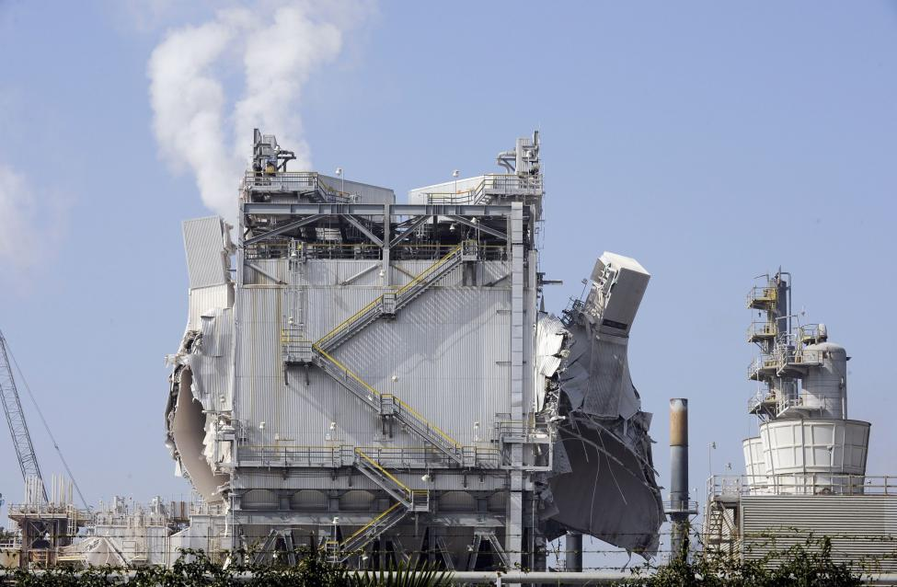
Exxon Mobil Refinery Explosion – Feb. 18th
Explosion occurs at Exxon Mobil refinery in the morning
Involves electrostatic precipitator (ESP), pollution control device
Refinery gasoline units unable to operate following ESP outage
  8.3 percent of state refining capacity
According to company, supplies nearly 10 percent of gasoline to the state
Trade publication reports refinery could resume operation of gasoline units, at reduced rates, using older ESP unit after being refurbished – possibly late July
Never happened…
Source: Bob Riha, Reuters.
California Energy Commission

Slide 15
Refinery Operations – Additional Issues
Other refinery problems:
  BP – Cherry Point begins planned maintenance – April 13
    May 31 – restart commences – delayed by 19 days
  US Refining – Tacoma begins unplanned maintenance – May 7
    Crude unit fire forces planned work moved up by 3-4 weeks
    June 17 - work completed, restart operations commence
  Phillips 66 – Wilmington begins planned maintenance – May 13
    Work commenced 3 weeks earlier than scheduled due to cooling tower issues
    June 9 - restart operations – delayed by 5 to 7 days
  Plains All American crude oil pipeline leak – May 20
    Phillips 66 operations impacted, accelerated planned maintenance & reduced operations
  Chevron – El Segundo refinery maintenance return delayed – June 28
    Previously scheduled completion on June 11 – delayed by 17 days
California Energy Commission

Slide 16
Refinery Operations – Additional Issues
Other refinery problems:
  Tesoro – Golden Eagle planned maintenance – August 16
    Gas oil hydrotreater work longer than planned – delayed by 7 days
  Tesoro – Carson planned maintenance – August 30
    Reformer work longer than planned – delayed by 10 days
  Chevron – El Segundo unplanned maintenance – November 28
    FFC unit impacted – delayed return until December 11
  Tesoro – Anacortes unplanned maintenance – December 8
    Alkylation unit and FFC unit impacted – delayed return until December 24
  Phillips 66 – Ferndale unplanned maintenance – December 18
    Crude unit impacted – delayed return until December 28
  Valero – Wilmington refinery planned maintenance – December 27
    Gas oil hydrotreater, alkylation & FFC work longer than planned – delayed by 11 days
  Chevron – Richmond refinery planned maintenance – December 31
    Alkylation unit and FFC unit work longer than planned – delayed by 14 days
California Energy Commission

Slide 17
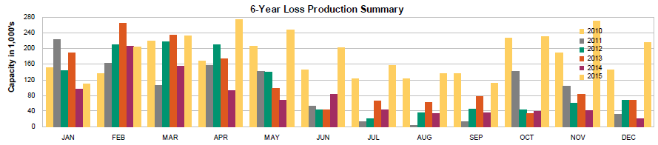
Refinery Operations - 2015
Refinery problems – gasoline impact quantified
  West coast gasoline production capability significantly degraded
  Based on analysis of IIR data, the quantity of gasoline production capacity off-line during April – December averaged nearly 158 thousand barrels per day (TBD) greater than 2014
    October – 205 TBD more, November 220 TBD more and December 290 TBD more than previous year
Source: Industrial Information Resources (IIR) Loss Gasoline Production Report.
California Energy Commission

Slide 18
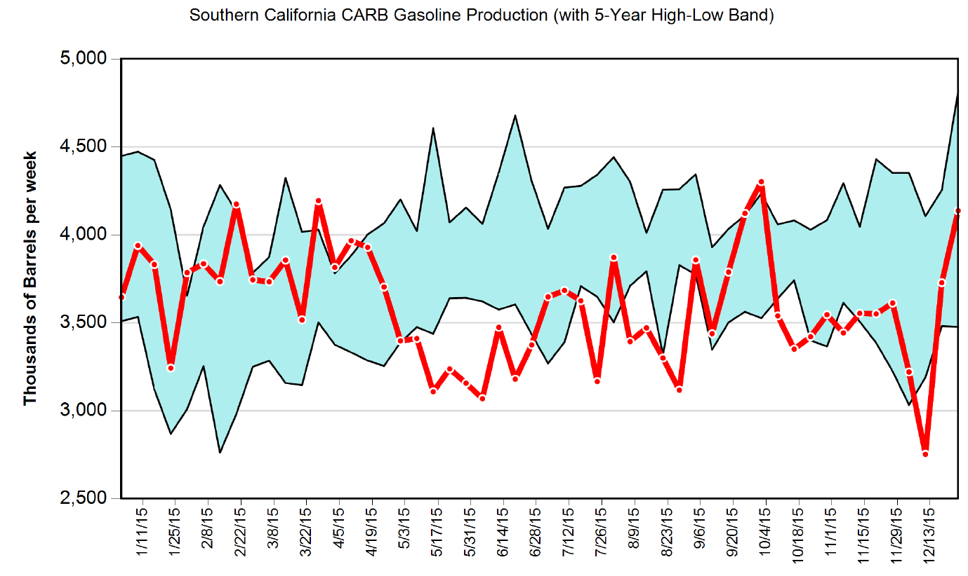
Gasoline Production - South
Los Angeles basin refineries show impacts of Torrance shut-down & higher-than-normal planned and unplanned maintenance.
Source: California Energy Commission.
Data through December 25, 2015
California Energy Commission

Slide 19
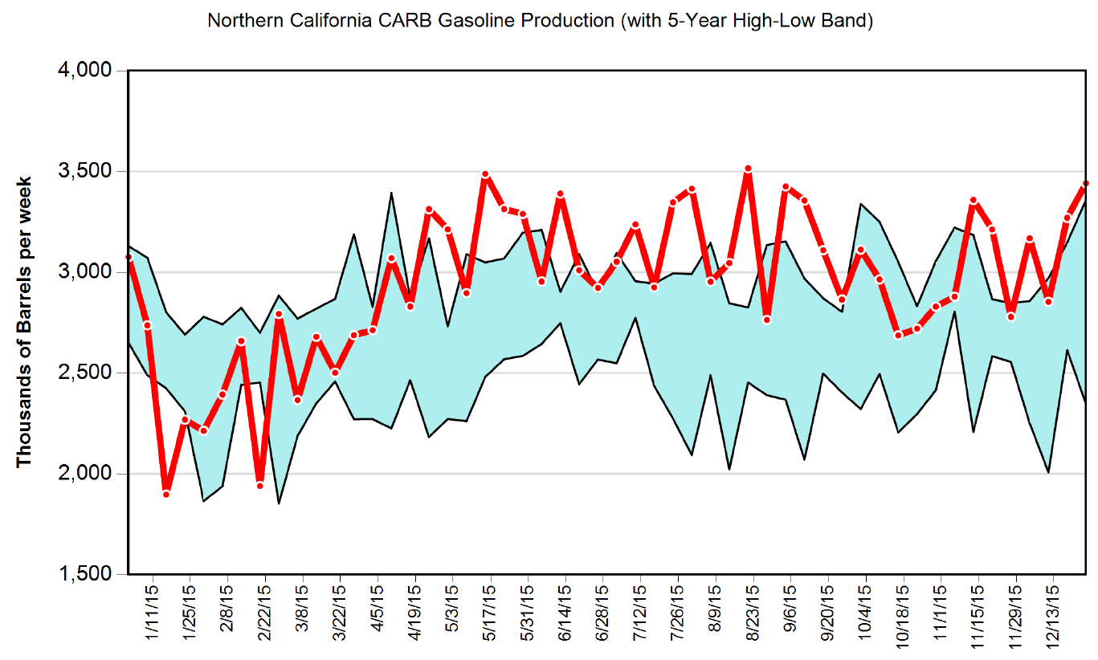
Gasoline Production - North
SF Bay Area refineries react to supply shortfall & higher margins – consistently producing above the high-low historical range.
Source: California Energy Commission.
Data through December 25, 2015
California Energy Commission

Slide 20
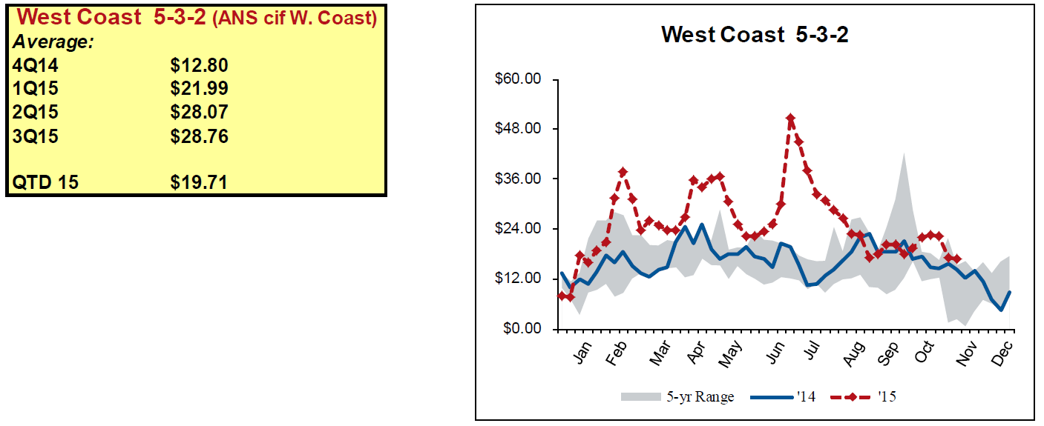
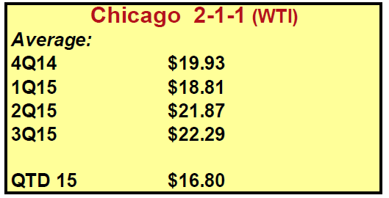
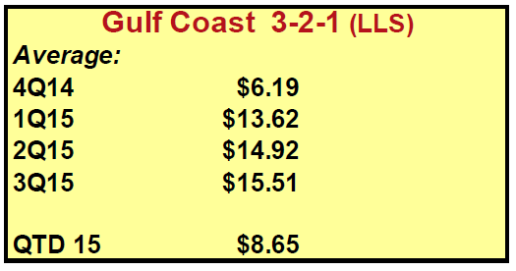
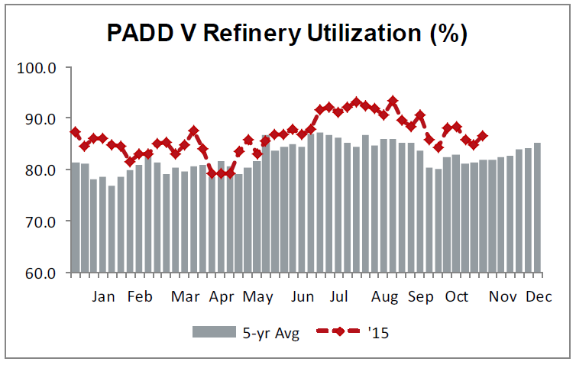
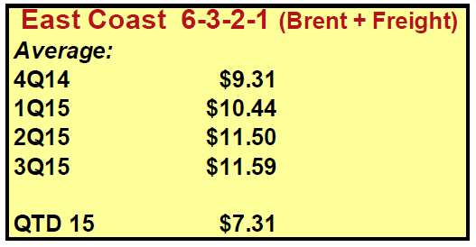
Refinery Operations
Source: Howard Weil – Weekly Refining Indicators Report – Week Ending 11-20-15.
California Energy Commission

Slide 21
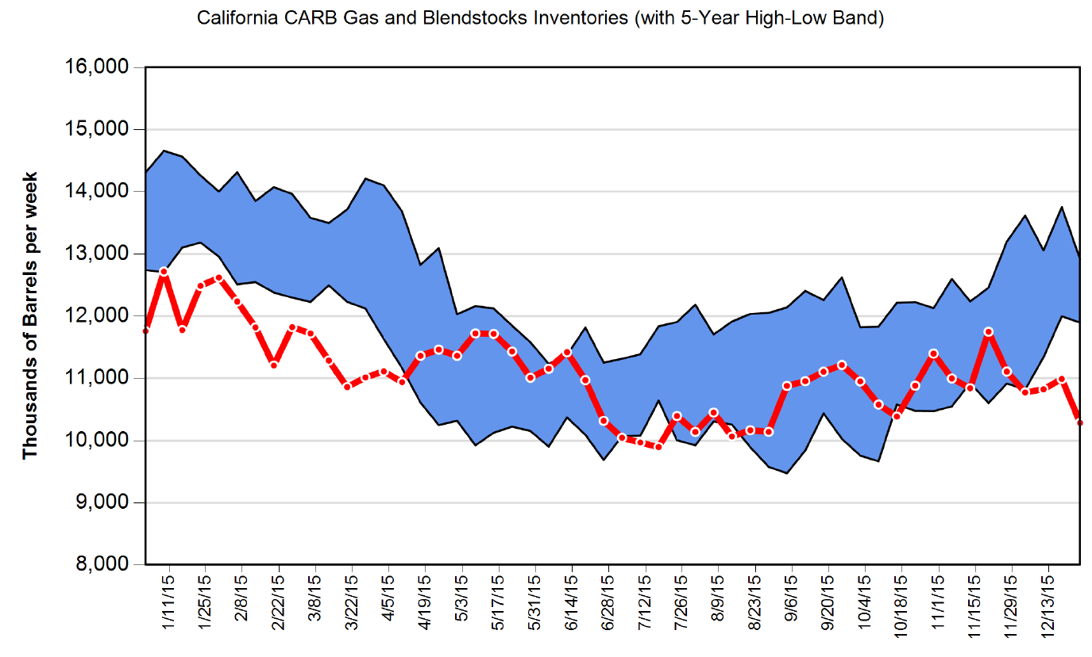
California Gasoline Inventory Levels
California gasoline inventories were lower-than-normal for 1Q 2015 – scarcer stock levels can exacerbate price responses to refinery issues.
Tesoro begins restart process
Marine imports of gasoline start arriving
ExxonMobil refinery outage
Tesoro Golden Eagle refinery strike
Source: California Energy Commission.
Data through December 25, 2015
California Energy Commission

Slide 22
West Coast Foreign Gasoline Imports
California Energy Commission

Slide 23
California Foreign Gasoline Exports
Gasoline exports decline 50.0 percent after February, compared to same period in 2014.
29.8 TBD
14.9 TBD
California Energy Commission

Slide 24
Pacific Northwest Foreign Gasoline Exports
22.7 TBD
21.9 TBD
However, PNW gasoline exports remain nearly unchanged, compared to same period in 2014.
California Energy Commission

Slide 25
California Energy Commission

Slide 26
California Energy Commission

Slide 27
California Retail Gasoline Components
California Energy Commission

Slide 28
Increase of 35.3 cents
California Energy Commission

Slide 29
Increase of 27.6 cents
California Energy Commission

Slide 30
  Western region & California transportation fuels market overview
    California differences - gasoline
  Review of factors contributing to elevated prices
  2015 – year in review
    Outages and uncertainties
    Imports & exports
  Current status of refining
  Closing remarks
California Energy Commission

Slide 31
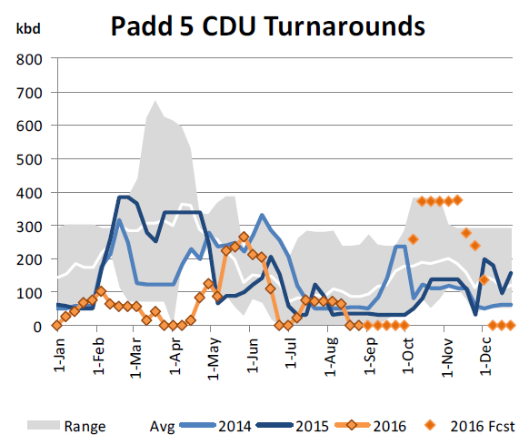
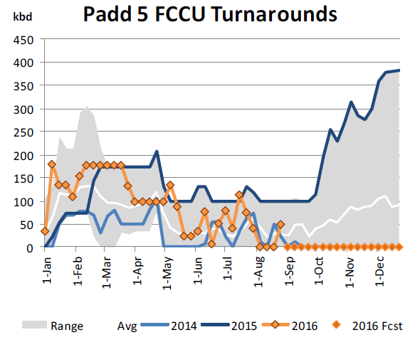
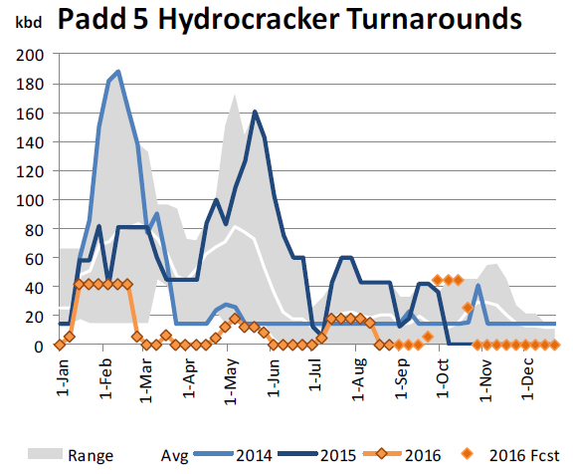
West Coast Refinery Operations
Refinery problems – 3rd Quarter 2016 light
  West Coast gasoline production capability continues to improve
  Based on analysis of IIR data, the quantity of gasoline production capacity off-line during January – July 2016 averaged nearly 106 thousand barrels per day (TBD), 79 TBD lower than the same period in 2015
    August 2016 gasoline production capability off by only 14 TBD, a dramatic improvement compared to nearly 125 TBD for August 2015
Source: Industrial Information Resources (IIR) Loss Gasoline Production Report.
California Energy Commission

Slide 32
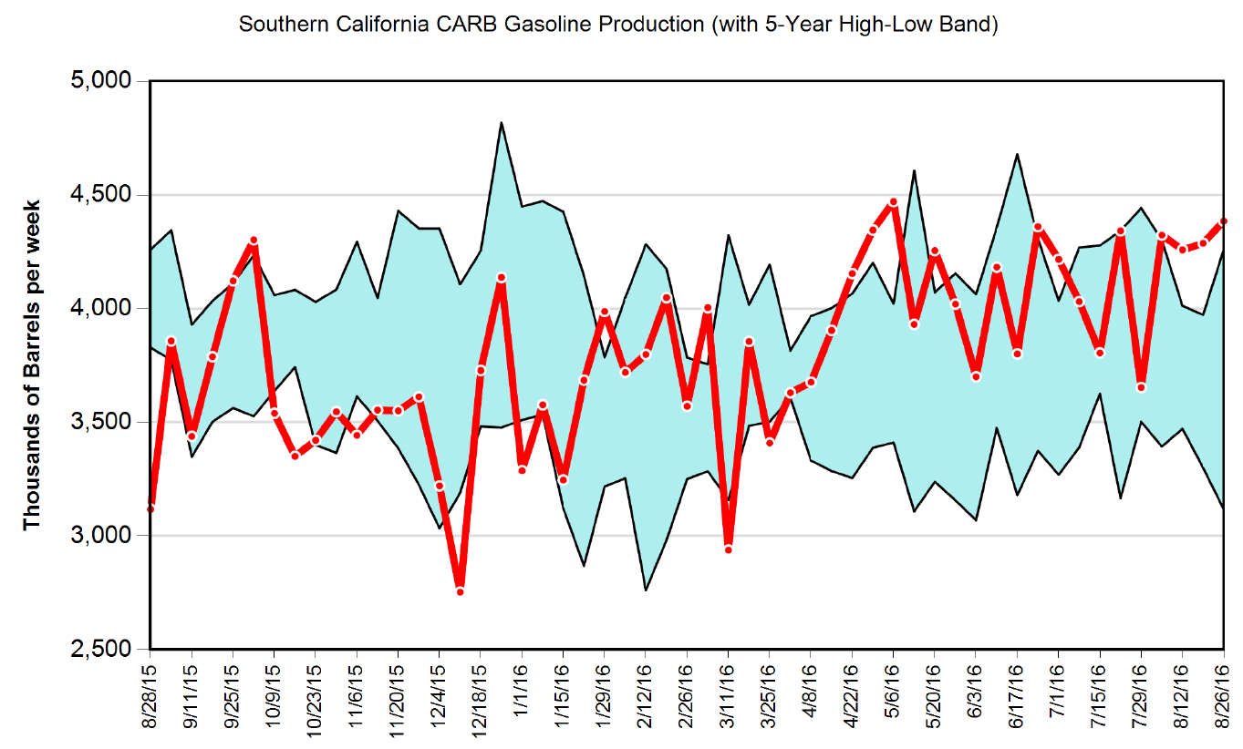
Gasoline Production - South
Los Angeles basin refineries begin recovery by mid-April.
Source: California Energy Commission.
Data through August 26, 2016
California Energy Commission

Slide 33
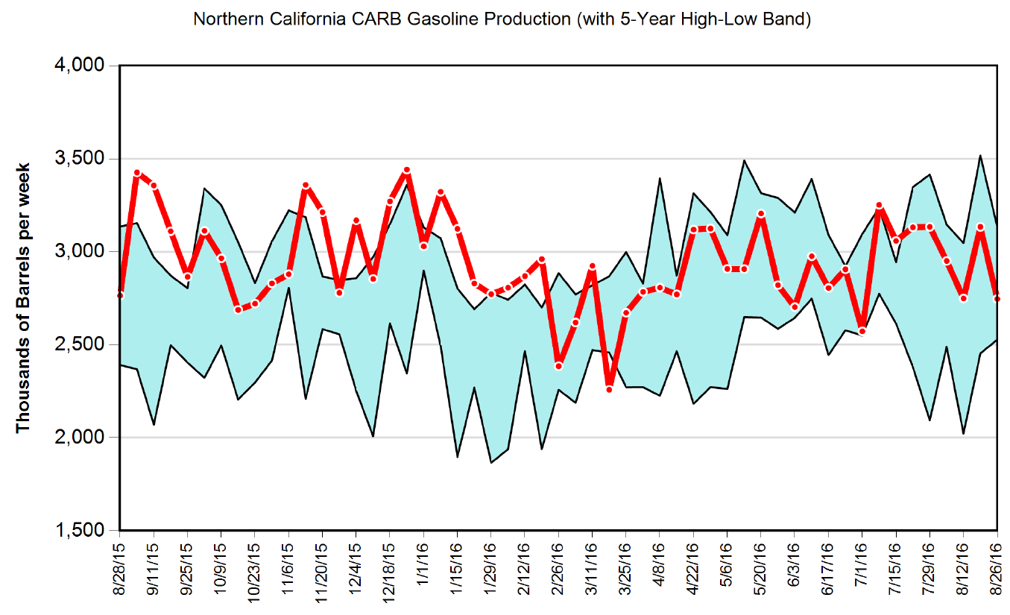
Gasoline Production - North
SF Bay Area refineries throttle back to within their historical range.
Source: California Energy Commission.
Data through August 26, 2016
California Energy Commission

Slide 34
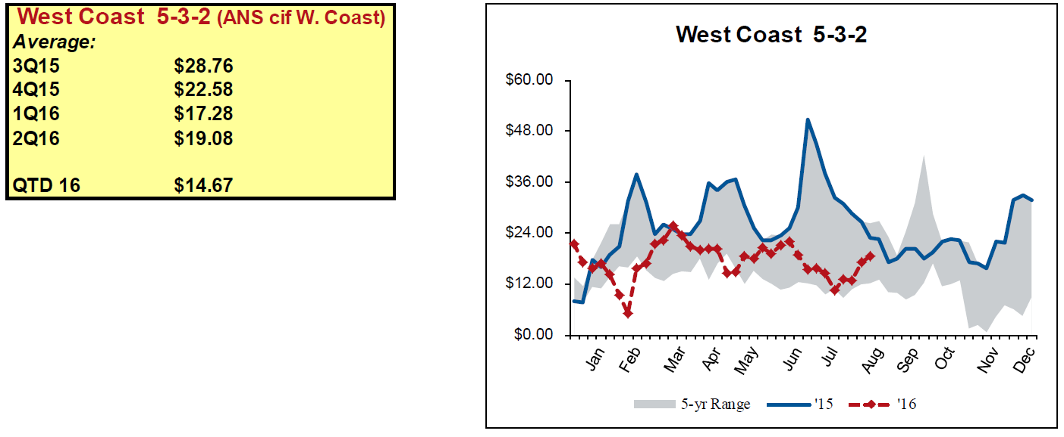
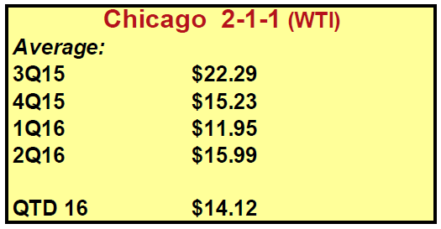
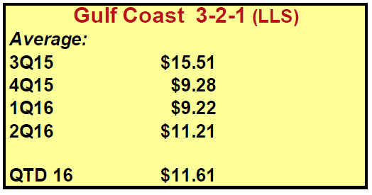
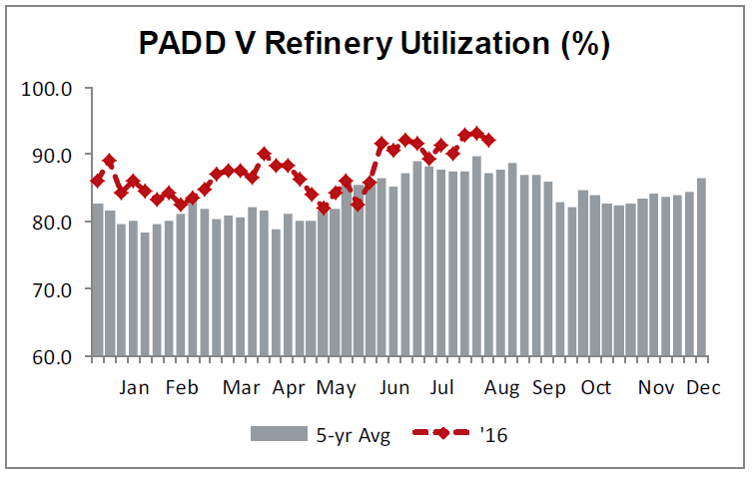
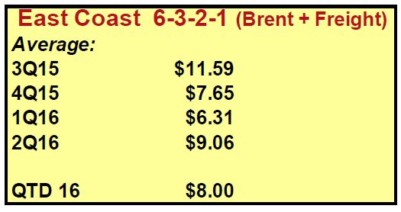
Refinery Operations
Source: Howard Weil – Weekly Refining Indicators Report – Week Ending 8-26-16.
California Energy Commission

Slide 35
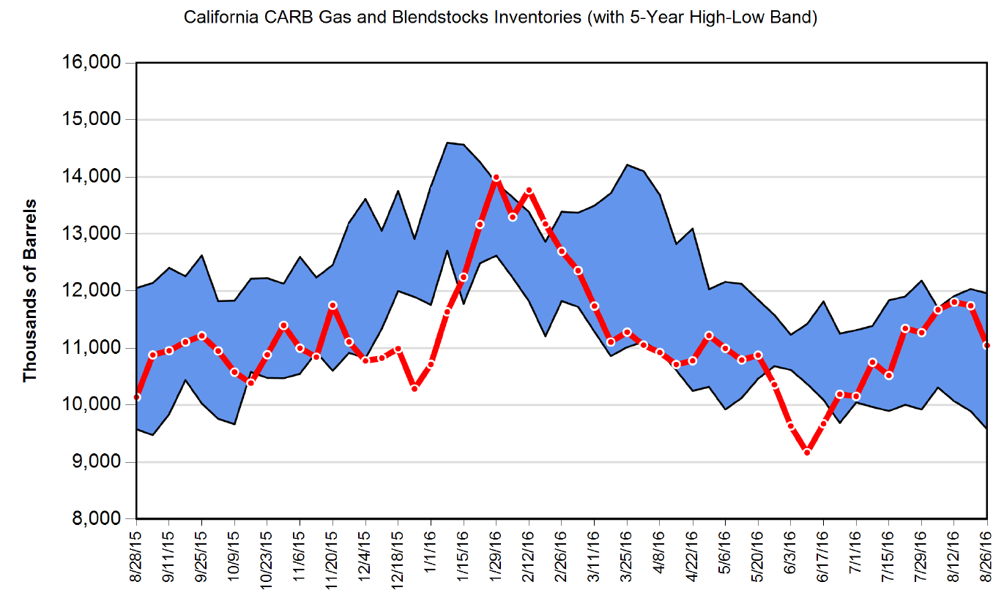
California Gasoline Inventories
Improved production & continued higher-than-normal imports help to rebuild inventories.
Source: California Energy Commission.
Data through August 26, 2016
California Energy Commission

Slide 36
West Coast Foreign Gasoline Imports
Unseasonal high imports continue.
California Energy Commission

Slide 37
California Foreign Gasoline Exports
2016 Y-T-D gasoline exports 30.6 TBD, 26 percent higher compared to same period in 2015.
California Energy Commission

Slide 38
Pacific Northwest Foreign Gasoline Exports
2016 Y-T-D gasoline exports 34.0 TBD, 116 percent higher compared to same period in 2015.
California Energy Commission

Slide 39
California Energy Commission

Slide 40
California gasoline market returns to equilibrium as refinery operations continue to improve.
California Energy Commission

Slide 41
Decrease of 13.4 cents
Since full restart of Torrance units – differential has averaged 54.4 cents per gallon, 47.2 cpg as of 8/29/16, back to new “normal” differential when accounting for CAR & LCFS
California Energy Commission

Slide 42
Decrease of 8.4 cents
Since full restart of Torrance units – differential has averaged 40.9 cents per gallon, 36.8 cpg as of 8/29/16, back to new “normal” differential when accounting for CAR & LCFS
California Energy Commission

Slide 43
California Retail Gasoline Components
California Energy Commission

Slide 44
Retail Brand Relationship Trends - North
Source: CEC analysis of OPIS card-swipe data.
California Energy Commission

Slide 45
Retail Brand Relationship Trends - South
Spike accentuated in Southern California – epicenter of refinery problems.
Source: CEC analysis of OPIS card-swipe data.
California Energy Commission

Slide 46
Retail Trends - Regional Differences
Refinery problems put south-north differential into new levels before settling back to normal levels.
Source: CEC analysis of OPIS card-swipe data.
California Energy Commission

Slide 47
High Brand Premium Trends - North
Premiums increasing over time, even after the significant refinery problems have been resolved.
Source: CEC analysis of OPIS card-swipe data.
California Energy Commission

Slide 48
High Brand Premium Trends - South
Premiums even higher in Southern California during the latter portion of 2015.
Source: CEC analysis of OPIS card-swipe data.
California Energy Commission

Slide 49
Closing Remarks
Refinery problems during 2015 were an extraordinary confluence of events
  Torrance unable to operate gasoline processing units for nearly 17 months
  Much higher-than normal gasoline-related planned and unplanned maintenance
Market signals work – significantly higher prices…
  Attracted a four-fold increase of foreign gasoline imports – arb window was open for most of the year
  Resulted in a 50 percent reduction in foreign gasoline exports
  Encouraged an increase of gasoline production for Northern California refineries compared to same period in 2014
    Between March and December – 7.3 percent increase
    Between March and September – 10.3 percent increase
California gasoline market is now back in balance
  But at a higher price level relative to gasoline prices outside the state
California Energy Commission

Slide 50

Additional Questions?
Source: Hollywoodreelindependentfilmfestival.com.
California Energy Commission

