Slide 1
Refining Production Planning
December 16, 2015
By
Lynn D. Westfall
Director- Office of Energy Markets and Financial Analysis
Energy Information Administration

Slide 2
Lynn Westfall- Background & Credentials
Industry Experience- 38 Years
- Degrees in Chemical Engineering & MBA
- Operational Assignments:
Process Engineer
Crude Buyer
Product Supply- California
Product Marketing – California
Strategic Planning
- Retired as Senior Vice President, Tesoro Corporation
Current Assignment
- Director Energy Markets & Financial Analysis- Energy Information Administration,
Department of Energy
- Charged with monitoring and analyzing domestic petroleum markets
- Provide insight on petroleum product prices

Slide 3
Refinery Production Planning Criteria
Production planning involves:
- Crude selection
- Unit operations
- Overall run rates
- Product slate – result of above decisions
Planning Tool: individual refinery simulation model- LP model
Planning Objective: maximize refinery profitability

Slide 4
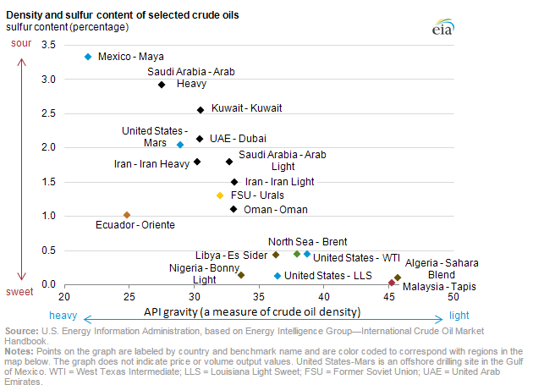
Crude oils have a wide variety of qualities
Bakken
Eagle Ford

Slide 5
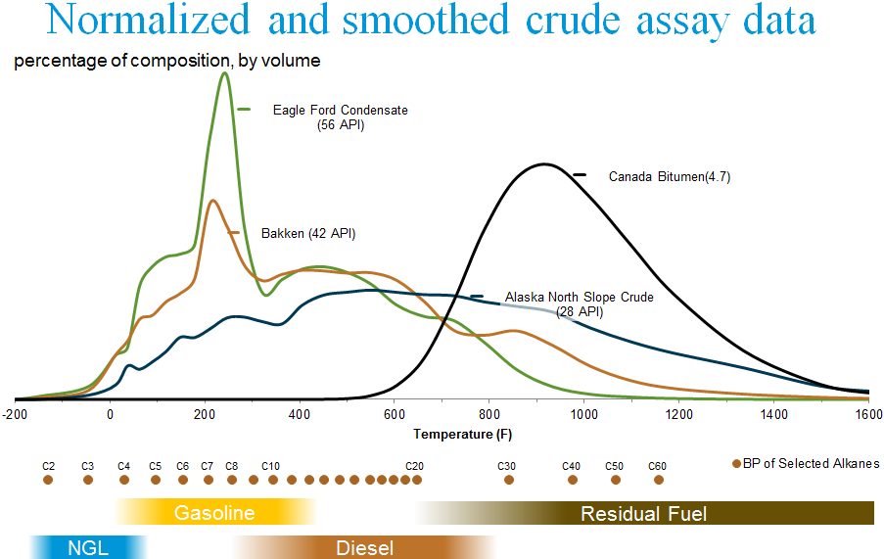
Crude oils exhibit a wide variation in the size and distribution of hydrocarbon molecules
Boiling Point
# Carbon
Atoms
Source: EIA Estimates

Slide 6
California refineries run a wide variety of crude types
California Refinery Crude Runs- December 2014
Crude Gravity
Crude Sulfur
Foreign
Domestic
Foreign
Domestic
Source: EIA Company Level Imports/ EIA Estimates

Slide 7
The same crude can have widely different values to different refineries
Crude values vary with:
Crude cost- price plus transportation
Product yields- based on refinery configuration, seasonal specifications
Product prices – markets served, transportation cost
WTI Transportation Cost- 4Q 2014
WTI Product Yield Values- 4Q 2014
Source: EIA Estimates

Slide 8
Refinery unit operations and overall run rates are also part of production planning
Even with the same crude slate, unit operations offer some flexibility to change product yields
- Can change gasoline vs diesel yield by approximately 10%
- Can change diesel vs jet yield by approximately 15%
Overall run rates increase until incremental profit reaches close to zero
- Incremental rates carry no increase in fixed costs
Fixed costs = approximately 45% total costs
Higher run rates lowers cost per barrel
- Incremental production may sell for a lower price
Must be sold in markets with higher transportation cost
Sold into different priced markets- export, unbranded vs branded

