Slide 1
Setting the Stage:
Review of 2013 IEPR Nuclear Recommendations
Danielle Osborn Mills
Former Senior Nuclear Policy Advisor to the California Energy Commission

Slide 2
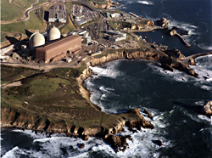
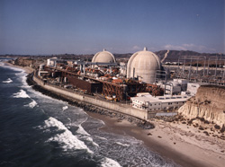
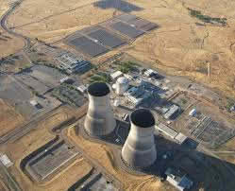
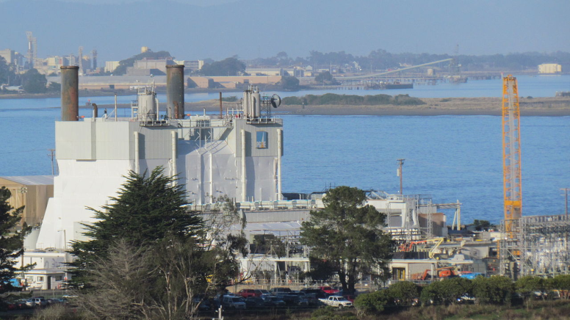
California’s Nuclear Power Plants
Diablo Canyon Power Plant
San Onofre Nuclear Generating Station (SONGS)
Rancho Seco Power Plant
Humboldt Bay Power Plants, Units 1 and 2

Slide 3
2013 IEPR Recommendations
15 recommendations overall
Seismic uncertainty
Safe operations and emergency planning at Diablo Canyon
Decommissioning San Onofre
Spent fuel management at Diablo Canyon and San Onofre

Slide 4
Seismic Uncertainty
AB 1632 Report (2008) recommended biennial reports on a seismic vulnerability, among other topics.
2013 IEPR recommendation: PG&E should make its findings and conclusions available to the CEC, CPUC, and the NRC during reviews of the Diablo Canyon license renewal application.

Slide 5
Seismic Uncertainty
September 2014: PG&E released the Central Coastal California Seismic Imaging Project
  Feedback from the Independent Peer Review Panel (IPRP) meetings and reports not yet incorporated.
March 2015: PG&E submitted its reassessment of potential seismic and flooding hazards at Diablo Canyon to the NRC
  IPRP and NRC reviews underway
  Comparisons to licensing basis ongoing

Slide 6
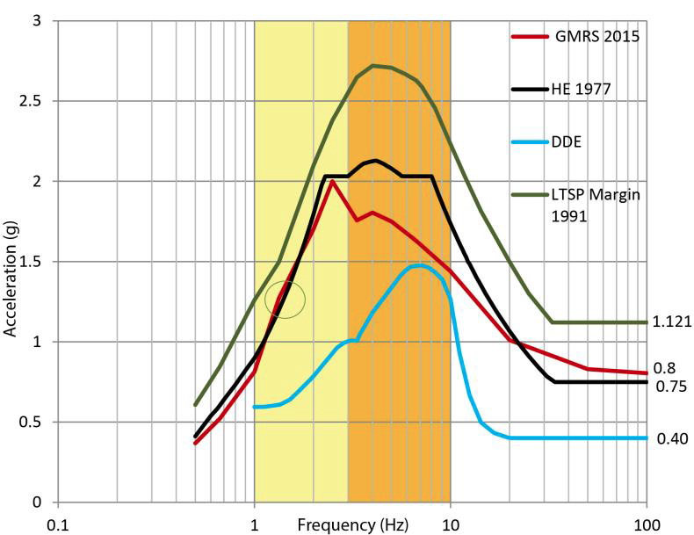
Seismic Uncertainty
2013 IEPR Recommendation: PG&E should evaluate the seismic hazard analysis against the licensed design of the plant to ensure plant reliability and minimize costs to the ratepayer.

Slide 7
Seismic Uncertainty
2013 IEPR Recommendation: SCE should complete the SONGS seismic studies and provide results of the studies to the Energy Commission and CPUC.

Slide 8
Safe Operations and Emergency Planning
2013 IEPR Recommendation: PG&E should provide updated evacuation time estimates, including the real-time evacuation scenario following a seismic event, and submit it to the Energy Commission as part of the IEPR reporting process.

Slide 9
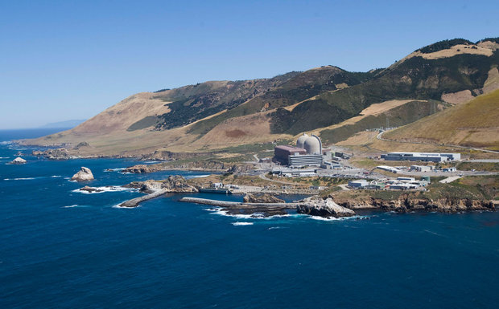
Safe Operations and Emergency Planning
February 2015: NRC determined that an unauthorized change to emergency plan procedures for areas over the ocean at Diablo Canyon were of low to moderate safety significance.

Slide 10
Safe Operations and Emergency Planning
June 2013: PG&E submitted a license amendment request to the NRC, transitioning the Diablo Canyon fire protection program to a risk-informed performance-based alternative.
2013 IEPR Recommendation: PG&E should bring Diablo Canyon into compliance with applicable 2004 National Fire Protection Agency fire protection regulations and report to the Energy Commission until full compliance is achieved.

Slide 11
Safe Operations and Emergency Planning
2013 IEPR Recommendation: PG&E should provide to the CEC and CPUC a comprehensive study on whether the Price-Anderson liability coverage for a severe event at Diablo Canyon would be adequate to cover liabilities resulting from a large offsite release of radioactive materials and identify and quantify any funding sources that would be necessary to cover any shortfall.

Slide 12
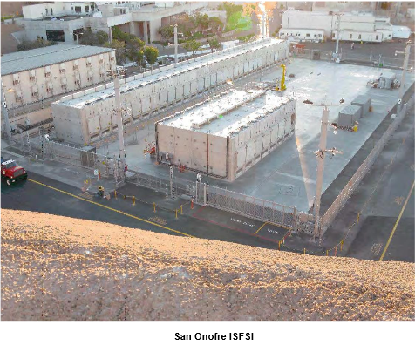
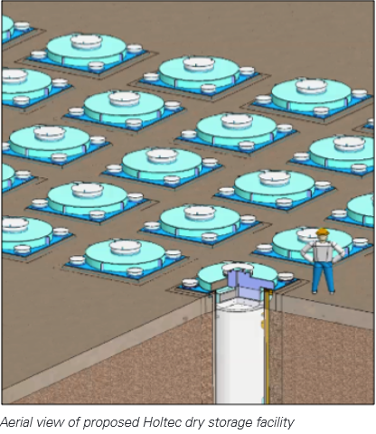
Decommissioning San Onofre

Slide 13
Decommissioning San Onofre
2013 IEPR Recommendation: SCE should submit a decommissioning plan to the NRC and proceed swiftly with decommissioning, providing progress updated to the Energy Commission until decommissioning is completed.

Slide 14
Decommissioning San Onofre
June 2013: SCE announced it would permanently retire SONGS Units 2 and 3
June and July 2013: Fuel was removed from reactors
September 2014: Post-Shutdown Decommissioning Activities Report submitted to the NRC
March 2015: NRC voted to approve exemptions from emergency planning requirements

Slide 15
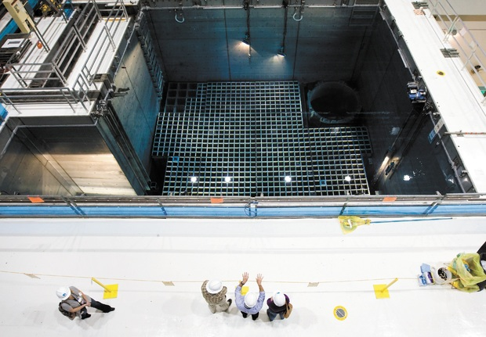
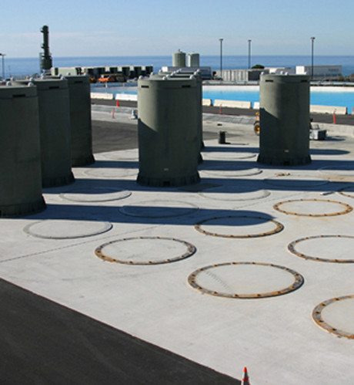
Spent Fuel Management
Photo: SLO Tribune
Photo: Bloomberg

Slide 16
Spent Fuel Management
2013 IEPR Recommendation: Evaluate potential long-term impacts and projected costs of spent fuel storage in pools vs. dry cask storage of higher burn-up fuels in densely packed pools, and the potential degradation of fuels and package integrity during long-term wet and dry storage and transportation offsite.

Slide 17
Spent Fuel Management
Ongoing Energy Commission engagement
  Monitoring federal nuclear waste management program activities
  Represent California in Yucca Mountain licensing proceeding
  Support federal efforts to develop an integrated system for management and disposal of nuclear waste

Slide 18
Next steps
Discussions around continued storage of nuclear waste at operating and decommissioned power plants
  Minimize risk and maximize safety
  Plan for thoughtful transport to an interim storage facility or final repository

Slide 19
Next steps
Uncertainty about Diablo Canyon’s future
  Seismic uncertainty
  Once-through cooling policy
  Contingency planning
Continued coordination with state and federal agencies, utilities, and the public on nuclear power plant safety, transport, and waste policy

Slide 20
Thank you
Written Comments due May 11, 2015
2015 IEPR is using e-filing:
  http://www.energy.ca.gov/2015_energypolicy/
  Click on the “Submit e-Comment” link in the “Proceeding Information” box
  Select 15-IEPR-12 Energy Efficiency
  Enter your contact information and title of the comment
  Select “IEPR 2015-04-27 Workshop” and “IEPR Public Comment” for subject
  You may include comments in the box titled “comment text” or attach a file with your comments
  Attached comments must be in a Microsoft® Word (.doc, .docx) or Adobe® Acrobat® (.pdf) formatted file.

