Slide 1

Interim Storage of Spent Fuel
Presentation to
California Energy Commission
David Lochbaum
Director, Nuclear Safety Project
April 27, 2015
Notes:
Good afternoon. On behalf of the Union of Concerned Scientists and its members and supporters in California, I thank you for this opportunity to share our views on interim spent fuel storage.

Slide 2

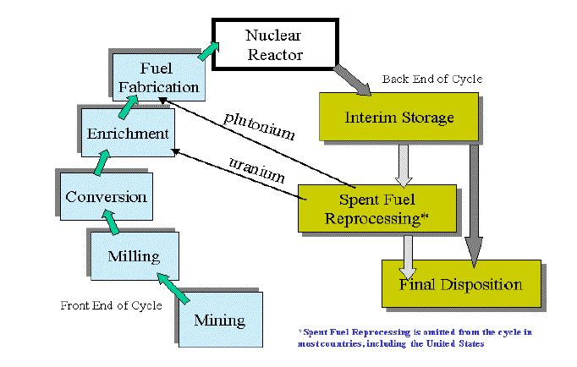
Nuclear Fuel Cycle
Image Source: American Physical Society, 2005
Notes:
Interim storage is a step in the nuclear fuel cycle. Uranium dug from the ground is processed into fuel for use in nuclear power reactors.
The United States does not reprocess spent fuel from nuclear power reactors, so it goes into interim storage pending final disposition.

Slide 3
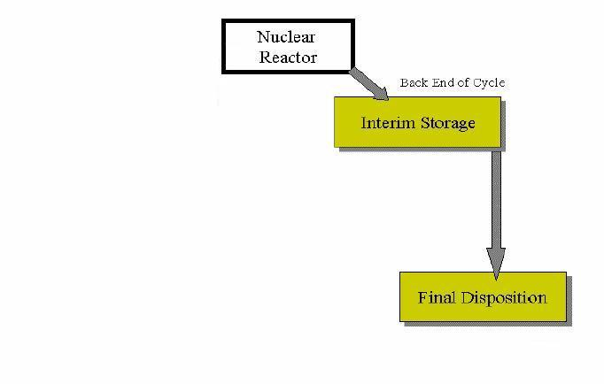
Interim Storage Risk
Risk during reactor operation is so large that federal liability protection is required.
Risk from irradiated fuel between these two high risk end points is also high.
Risk during final disposition is large because the hazardous material must be isolated from the environment for at least 10,000 years into the future.
Notes:
In a reactor, nuclear fuel is so hazardous that federal liability protection is required. And reactor cores are backed by multiple emergency cooling systems and housed inside robust containments to manage the hazard.
In a repository, spent fuel is so hazardous that it must be isolated from the environment for at least 10,000 years.
Spent fuel in interim storage between these two very hazardous endpoints is also hazardous. Yet spent fuel is currently being stored without appropriate and reasonable safety and security measures being taken.

Slide 4
Interim Storage Mess
Under the Nuclear Waste Policy Act of 1982 as amended in 1987, the federal government was tasked with operating a repository for spent fuel disposal.
The Department of Energy signed contracts with plant owners and collected funds in exchange for the federal government accepting spent fuel for disposal beginning in 1998.
The federal government has taken billions of dollars, but not an ounce of spent fuel.
Notes:
The interim storage step has become the de facto final step in the nuclear fuel cycle.
Under federal law passed more than 30 years ago, the Department of Energy was charged with opening a geological repository for spent fuel.
Since then, the federal government has taken billions of dollars from plant owners but not taken an ounce of their spent fuel.

Slide 5
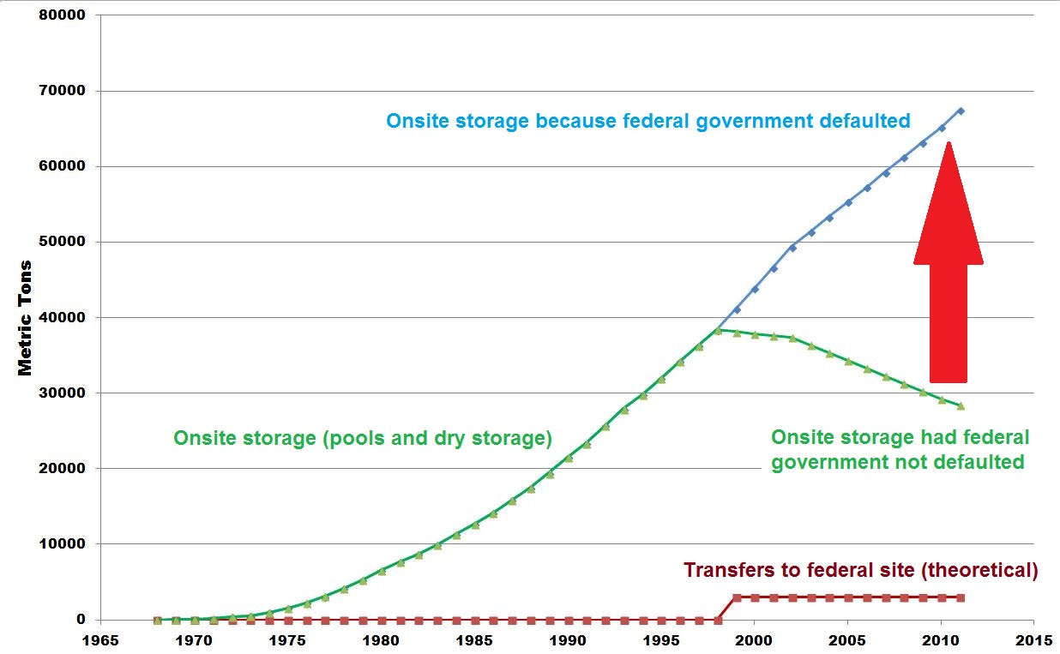
Interim Storage Mess
Image Source: UCS testimony to U.S. Senate, July 2013
Notes:
By federal law and legal contracts it signed with plant owners, the DOE was obligated to begin accepting spent fuel in January 1998.
Had DOE met its obligations, the amount of spent fuel in interim storage would have peaked at nearly 38,000 metric tons and then declined as spent fuel was shipped to the federal site.
Because the DOE failed, the amount of spent fuel in interim storage continues to increase.
The spent fuel pool at most nuclear power reactors is nearly full, holding about six times as much fuel as its reactor core. And excess spent fuel is placed in dry casks on a concrete pad out back.

Slide 6
What We Advocate
At operating reactors:
  expedite the transfer of spent fuel to dry storage to minimize the inventory of irradiated fuel assemblies stored in the pools
  protect the dry storage canisters against sabotage
At permanently shutdown reactors:
  complete the transfer of spent fuel to dry storage as soon as practical (closer to 6 years than the 60 years allowed by the Nuclear Regulatory Commission)
  protect the dry storage canisters against sabotage
Notes:
Our “asks” are simple. We seek the accelerated transfer of spent fuel from spent fuel pools into dry storage as well as better protection against sabotage of fuel in dry storage.

Slide 7
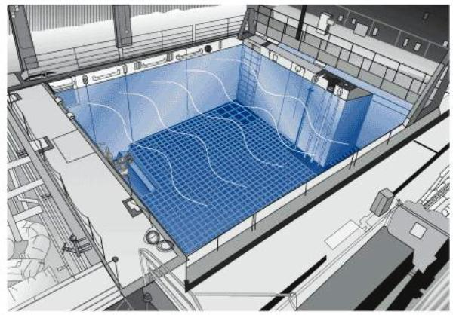
Interim Storage - Pools
Spent fuel assemblies are transferred underwater and placed in metal storage racks in the bottom of spent fuel pools.
The spent fuel pool’s water is continuously cooled to remove the decay heat emitted by the spent fuel assemblies. The water is continuously treated to remain as pure as possible to retard corrosion of the metal fuel rods. The water also attenuates the intense radiation emitted by the fuel so people can work safely in the area.
Notes:
About every 18 to 24 months, nuclear power reactors shut down for refueling. Some of the reactor core is discharged to the spent fuel pool and replaced with fresh fuel.
The spent fuel pool water is continuously cooled and cleaned. The water also serves as a radiation shield so that workers can perform tasks in the area without exposure to excessive radiation doses.

Slide 8
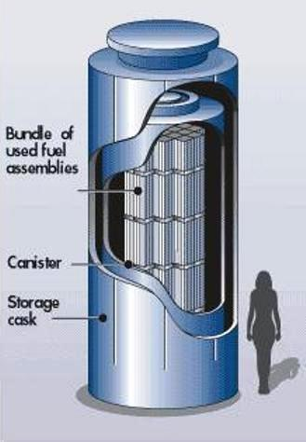
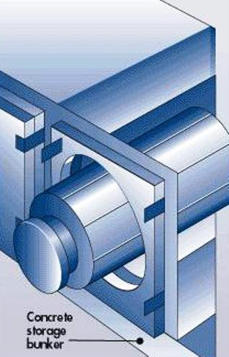
Interim Storage – Dry
After a few years, spent fuel assemblies can be transferred into canisters that are placed inside vertical casks or horizontal bunkers.
The cooling is passive – decay heat emitted by the spent fuel assemblies is conducted through the metal canister wall and carried away by convective air flow (i.e., the chimney effect).
Notes:
After a handful of years, spent fuel has cooled sufficiently to allow it to be transferred into dry storage.
Dry storage is somewhat like Russian dolls with spent fuel placed inside a canister that is in turn placed inside a concrete cask or bunker.
The spent fuel still emits decay heat. That heat passes through the canister’s metal wall and gets carried away by air flowing through the space between the canister and outer concrete.
It’s passive, low-tech safety.

Slide 9
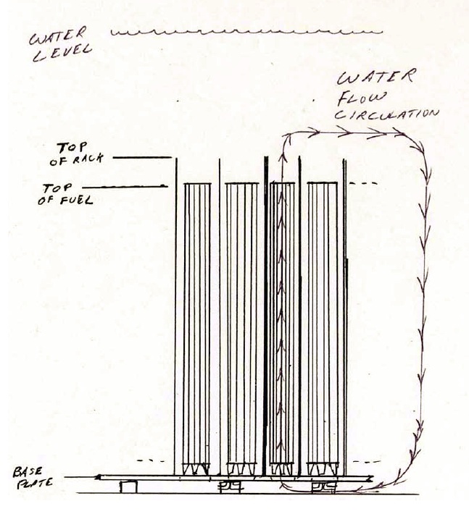
Risks - Pools
As shown in this cross-section view of a spent fuel pool, the storage racks have feet that provides a gap between the bottom of the racks and spent fuel pool’s floor. Decay heat emitted from the spent fuel assemblies warms water, causing it to rise out the top of the racks. In turn, cooler water is drawn under the racks and up past the spent fuel assemblies.
Image Source: www.iaea.org 2010 presentation by Argonne National Lab
Notes:
This shows a side view of the spent fuel assemblies in a storage rack in a spent fuel pool. Decay heat from the fuel warms water. The warmed water rises out the top of the racks. This upward movement draws in cooler water through the gap between the bottom of the racks and the floor.

Slide 10
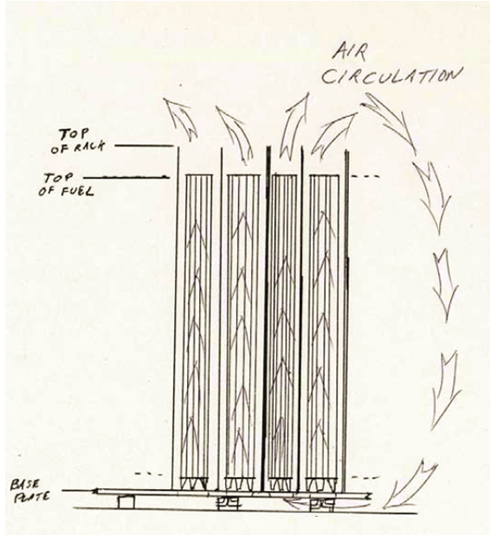
Risks - Pools
If all the spent fuel pool’s water boiled or drained away, air flow would be sufficient to cool the spent fuel assemblies with the possible exception of any assemblies discharged from the reactor core within the past 60 days.
But air does not provide shield against radiation like water, so workers would likely be unable to enter the area of the pool.
Image Source: www.iaea.org 2010 presentation by Argonne National Lab
Notes:
If all the water were removed from a pool, air flow through the fuel would be enough to prevent overheating damage except for the fuel recently discharged from the reactor core.
But air is not nearly as good a radiation shield as water, so workers would be unable to enter the area if needed to put more water into the pool.

Slide 11
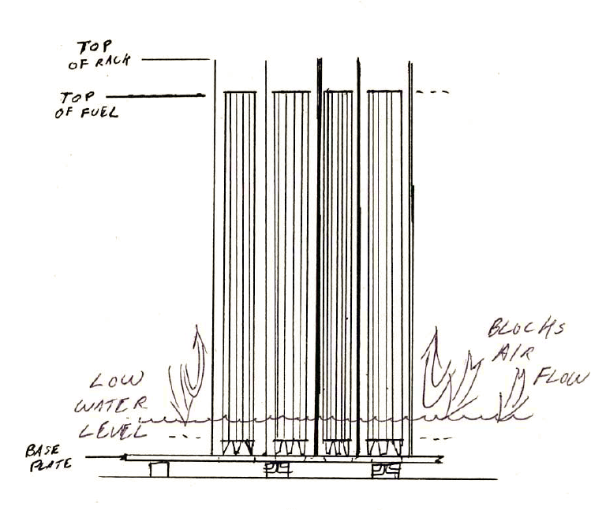
Risks - Pools
The primary hazard occurs when the water level drops below the top of the spent fuel assemblies but not all the way below the bottom. Partial draindown interrupts water cooling and blocks air cooling.
Image Source: www.iaea.org 2010 presentation by Argonne National Lab
Notes:
The primary hazard results from the spent fuel pool being partially drained. Partial drainage interrupts the water cooling process and blocks the air cooling process. The outcome can be spent fuel that overheats.
Because spent fuel pools are not housed inside robust containments, radioactivity released from damaged spent fuel is more likely to escape to the environment.

Slide 12
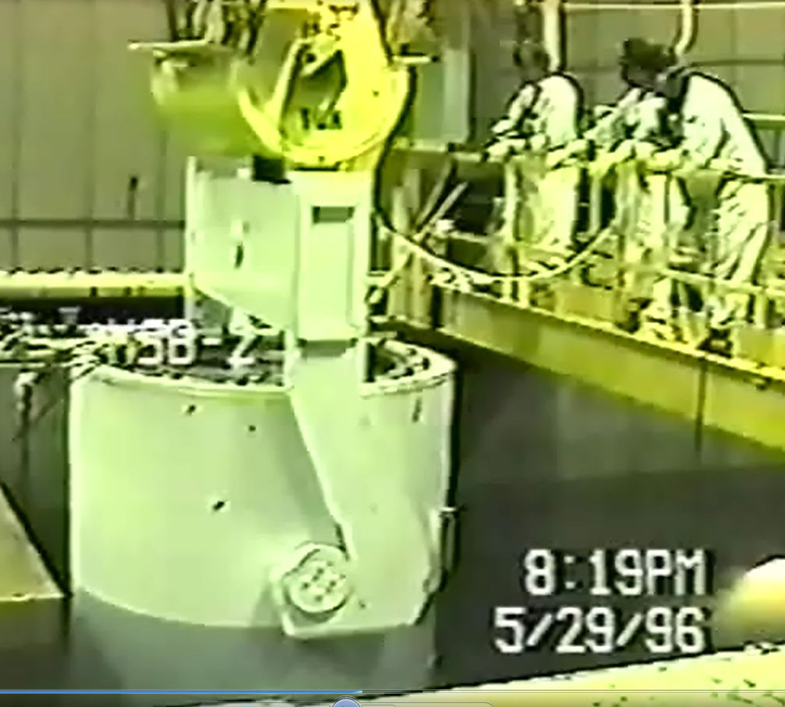
Risks – Dry
Loaded canisters weighing nearly 100 tons must be lifted out of the spent fuel pools.
The primary safety hazard is dropping a canister. A 100-ton canister striking the wall or floor of a spent fuel pool can easily create an opening that allows water to drain out.
Image Source: UCS freedom of information act request for video of Point Beach cask transfer
Notes:
The primary safety hazard from dry storage involves dropping a canister during movement over a spent fuel pool. Workers dropped a 350-pound bolt into the spent fuel pool at the Hatch nuclear plant in Georgia, poking a hole in its floor. A 100-ton canister dropped onto the spent fuel pool wall or floor could cause even more extensive damage.

Slide 13
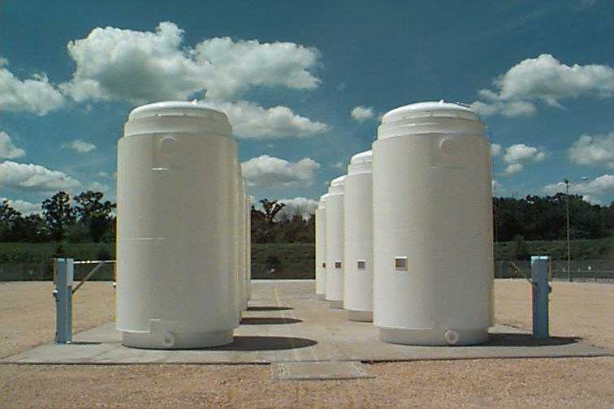
Risks – Dry
The primary security hazard involves sabotage. There are weapons that can breach the integrity of dry casks sitting on above-ground pads.
Image Source: NRC
Notes:
The primary security hazard is sabotage. There are weapons that can breach the integrity of the casks.

Slide 14
What We Advocate
At operating reactors:
  expedite the transfer of spent fuel to dry storage to minimize the inventory of spent fuel assemblies stored in the pools
  protect the dry storage canisters against sabotage
At permanently shutdown reactors:
  complete the transfer of spent fuel to dry storage as soon as practical (closer to 6 years than the 60 years allowed by the Nuclear Regulatory Commission)
  protect the dry storage canisters against sabotage
Notes:
Accelerating the transfer of spent fuel into dry storage lowers the risk by reducing the inventory in the spent fuel pool. Every fuel assembly transferred out of a pool lowers the decay heat level and fills that space with water. If something happens, these combine to give workers more time to intervene, increasing their chance for success. And if they fail, having less fuel in the pool means the radioactive cloud is smaller.
Protecting spent fuel in dry storage against sabotage makes more sense than taking our shoes off at airports.

Slide 15
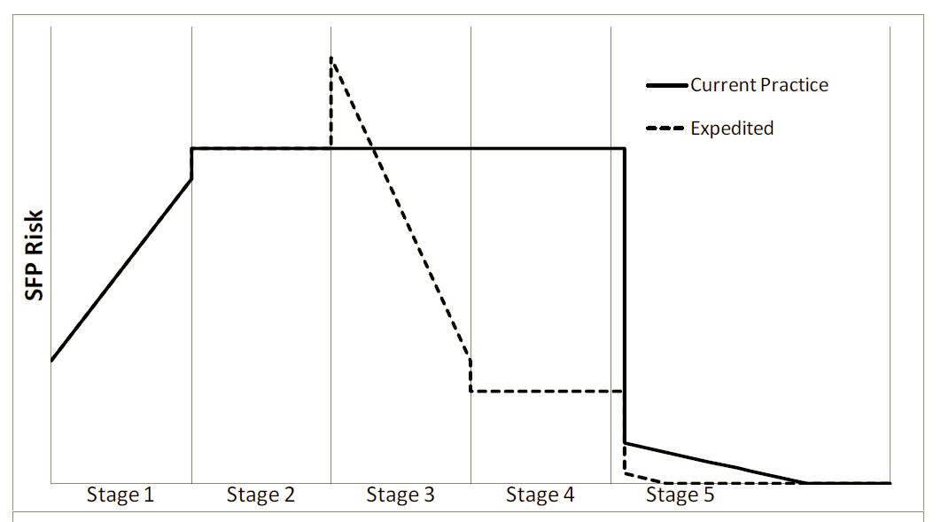
Managing Interim Risks
Risk deduction gained by expediting transfers to dry storage and reducing spent fuel pool inventory.
Spent Fuel Pool Risk
Stage 1 - Pool storage only
Stage 2 – Pool filled, dry storage begun
Stage 5 – Reactor permanently shut down, transfers to dry storage
Image Source: NRC Spent Fuel Consequence Study, October 2013
Notes:
This chart comes from the Nuclear Regulatory Commission’s spent fuel study issued in October 2013.
In stage one, risk rises as the spent fuel pool gets filled to capacity.
Beginning in stage two, fuel is transferred into dry storage matching the rate being discharged from the reactor. The risk jumps up to reflect the added risk from a cask drop.
That risk bump remains throughout stages two, three and four as fuel gets transferred to dry storage.
The spent fuel pool risk declines in stage five. The reactor has been permanently shut down and the pools empties as fuel gets fully transferred to dry storage.
With expedited transfers, the spent fuel risk is reduced dramatically by Stage 4 as shown by the green arrow. The risk bump at the beginning of Stage 3 reflects the cask drop risk. Because the same number of casks are loaded overall, the risk increase at the beginning of Stage 3 is matched by the risk reduction in Stage 5.

Slide 16
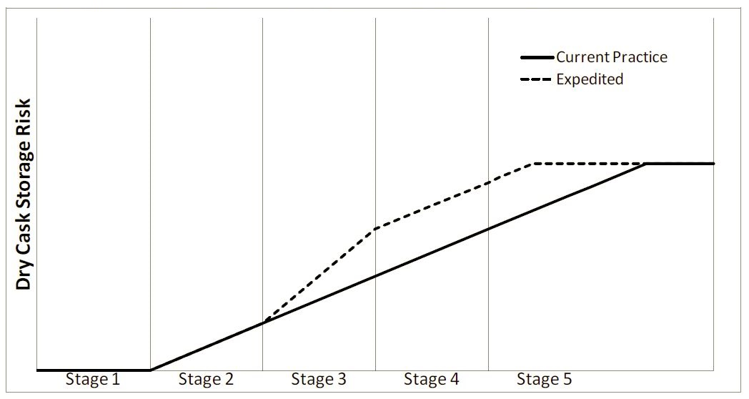
Managing Interim Risks
Because casks are loaded sooner, the expedited option increases the risk from more casks being onsite (i.e., more targets available).
The NRC ruled that the Stage 5 risk is acceptable for an infinite period after reactor closure. Even lower risks in Stages 3 and 4 for only a few years must also be acceptable to the NRC.
Image Source: NRC Spent Fuel Consequence Study, October 2013
Notes:
The NRC ruled last fall that spent fuel can be safely and securely remain in dry storage for an infinite period into the future – maybe even longer.
If the dry storage risk level in stage five for infinity is acceptable to the NRC, then even lower risk levels for a few years in stages three and four must also be acceptable.

Slide 17
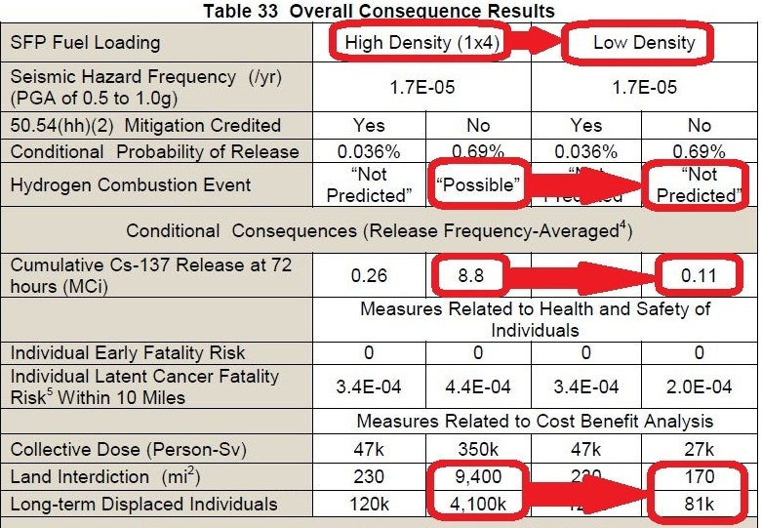
Managing Risks - Pools
High Density is Current Practice while Low Density is Expedited Transfer
About 0.5 MCi were released during the Fukushima meltdowns.
Image Source: NRC Spent Fuel Consequence Study, October 2013
Notes:
This table from the NRC’s spent fuel study puts some numbers on the curves presented in the previous charts.
High density is nukespeak for the current practice. Low density is a spent fuel pool with reduced inventory from expedited transfers.
The third row about Mitigation Credit merely means whether workers successfully add makeup water to the spent fuel pool or not.
The NRC concluded that a filled spent fuel pool could overheat and that process could generate sufficient hydrogen gas to cause detonation – something the world saw at Fukushima.
The NRC concluded that a filled spent fuel pool accident could release nearly 20 times the radioactive cesium released at Fukushima.
The NRC concluded that a filled spent fuel pool accident could cause the long-term displacement of 4.1 million persons.

Slide 18
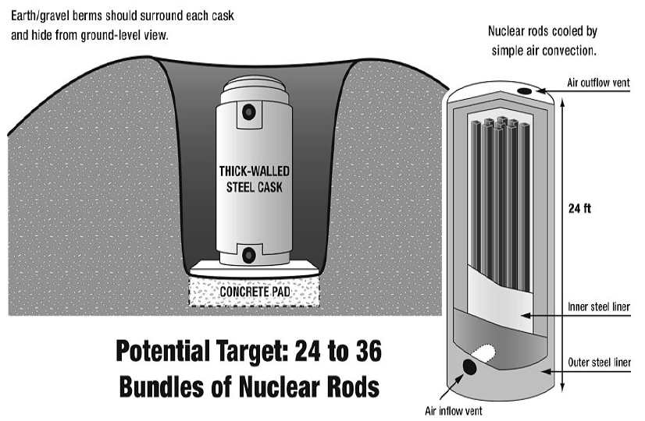
Managing Risks – Dry
UCS advocates literally dirt-cheap protection against sabotage for above-ground dry casks. Until the federal government figures out how to put spent fuel under the ground, the ground should be piled around the dry casks.
Image Source: North Carolina Waste Awareness and Reduction Network
Notes:
The DOE has not been able to figure out how to put spent fuel underground for an infinite period.
The NRC concluded that spent fuel can be safety and securely stored in dry casks on open concrete pads for an infinite period.
In the meantime, dirt or gravel berms should be installed around the casks to make it a little harder for bad guys to prove the NRC wrong.

Slide 19
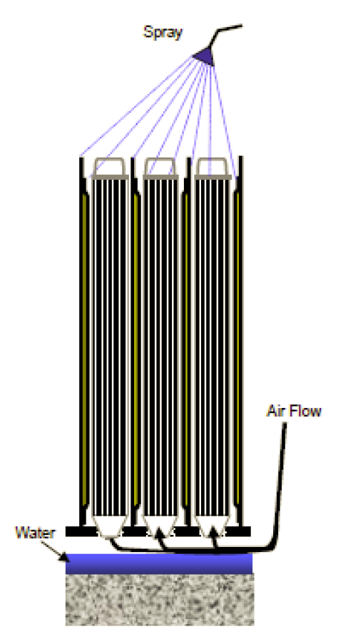
NRC’s Bad Decision
The NRC decided NOT to require expedited transfer to dry storage based on a flawed analysis. They assumed every spent fuel pool would fully drain and that workers would always establish cooling spray (despite intense radiation levels) at the “Goldilocks” rate – not too little to cause fuel meltdown and not too much to cause blockage of the inlet air flow.
The NRC’s assumption is simply wrong.
Image Source: NRC Spent Fuel Consequence Study, October 2013
Notes:
The NRC’s spent fuel study accepted the bad outcomes of hydrogen detonations, 20-fold larger cesium releases than Fukushima, and over four million persons losing their homes for a long time on science fiction, not science.
The NRC assumed that spent fuel pools would always fully drain and that workers, nay Super Workers, would defy intense radiation fields to always provide cooling spray at exactly the right rate – not too much to flood the bottom and block air flow and not too little to prevent overheating.
The NRC’s assumption is quite simply wrong.

Slide 20
Wrong Ain’t Right
Spent fuel pools are overcrowded today because DOE failed to open a repository.
Spent fuel pools are overcrowded today because NRC failed to properly evaluate the hazard.
Two wrongs still don’t make a right.
Notes:
Spent fuel pools are overcrowded today because the DOE failed to meet its legal obligations to open a repository.
Spent fuel pools are overcrowded today because the NRC failed to properly evaluate the hazard.
The people of California deserve better from their federal government.
You should demand that the NRC take two steps to better manage the risk from spent fuel during interim storage.

Slide 21
Links for More Info
Barto, Andrew and nine others. 2013. Consequence Study of a Beyond-Design-Basis Earthquake Affecting the Spent Fuel Pool for a U.S. Mark I Boiling Water Reactor, Nuclear Regulatory Commission. October. Online at http://pbadupws.nrc.gov/docs/ML1325/ML13256A342.pdf
Braun, Joseph C. 2010. Operational Safety of Spent Nuclear Fuel. Argonne National Laboratory. December 2. Online at http://www-ns.iaea.org/downloads/ni/embarking/argonne_workshop_2010/Braun/L.6.2%20Braun%20Operational%20Safety%20of%20Spent%20Nuclear%20Fuel.pdf
Lochbaum, David. 2013. Testimony to U.S. Senate on Spent Fuel. Union of Concerned Scientists. July 30. Online at http://allthingsnuclear.org/lochbaum-testimony-on-waste-bill-and-dry-casks/

