Slide 1
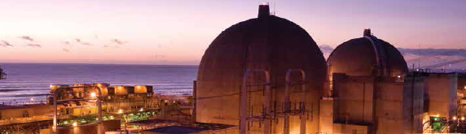
Nuclear Power Plant Issues: California Energy Commission
Sacramento (via WebEx), April 27, 2015
David G. Victor
Chairman, SONGS Community Engagement Panel
Spent Fuel Management at San Onofre: Beyond Yucca

Slide 2
What is the SONGS Community Engagement Panel?
18 members of the broader communities
  Elected officials; NGOs from many perspectives; experts
By design, no decision-making authority
Two-way conduit for information between co-owners and the communities

Slide 3
The Yucca Problem
CEP Agenda in 2014 and 2015 has focused heavily on waste storage issues
Permanent storage routes lead through Yucca, but Yucca itself is highly uncertain
Broad support for consolidated interim storage
  Consent based siting
  Focus on safety at every step

Slide 4
Making Consolidated Interim Storage Happen for California
CEP Memo from Victor, Brown and Stetson dated 14 April to the CEP
  Part of the public record
Memo reflects a sense of the communities but does not presume to speak for the communities
Critical role for CEC in articulating a state plan

Slide 5
Next Steps
At SONGS: articulate defense in depth for onsite storage systems
At CEC (we hope): articulate a strategy to accelerate consolidated interim storage for California
  Suggested details outlined in our memo
  Physical storage needn’t be IN California
  Consolidated storage won’t happen automatically
  Outcomes depend upon some regulatory and possible legislative reforms
  Outcomes depend upon important technical issues (transport standards, shipment sequencing, etc) that CEC can help address

Slide 6
Thank You

