Slide 1

NRC Decommissioning Activities for the San Onofre Nuclear Generating Station
Bruce A. Watson, CHP
Chief, Reactor Decommissioning Branch
Division of Decommissioning,
Uranium Recovery, and Waste Programs
United States Nuclear Regulatory Commission
California Energy Commission
Lead Commissioner Workshop on Nuclear Power Plant Issues
April 27, 2015

Slide 2
NRC’s Decommissioning Program
Appropriate statutory authority
Comprehensive regulations that include:
  radiological clean-up criteria
  public involvement opportunities
  financial assurance requirements
Effective decommissioning guidance
Appropriate oversight throughout decommissioning

Slide 3
Radiological Release Criteria
Unrestricted Release
    Total Effective Dose Equivalent (TEDE) ≤ 25 mrem/yr (0.25 mSv/a) and
    As Low As is Reasonably Achievable (ALARA)
    Average member of the critical group
    All pathways
    Period of performance – 1000 years
Restricted Release
    ≤ 25 mrem/yr (0.25 mSv/a) TEDE and ALARA, with institutional controls in effect
    Legally enforceable institutional controls
    If institutional controls fail, doses do not exceed 1 mSv/a, or 5 mSv/a, under
    specific circumstances
    Financial assurance via an independent third party
    Licensee and NRC public input and outreach requirements

Slide 4
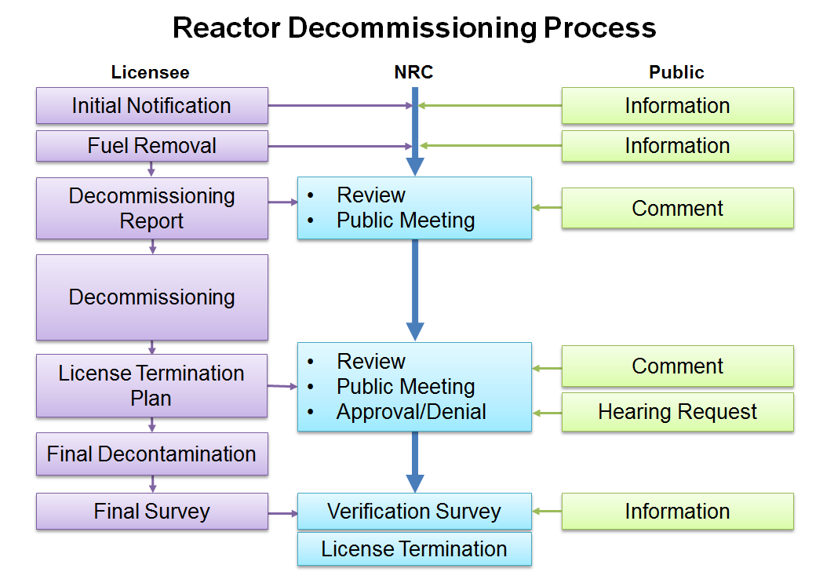

Slide 5
Reactor Operation to
Decommissioning Transition Activities
Notification of permanent cessation of operations and permanent removal of fuel from the reactor
Submittal of Post Shutdown Decommissioning Activities Report (PSDAR) and associated public meeting
Inspection oversight continues
Program oversight responsibility shifts
Licensing basis changes

Slide 6
PSDAR Contents
A description and schedule for the planned decommissioning activities
A site-specific decommissioning cost estimate, including the costs of managing irradiated fuel
A discussion that provides the means for concluding that the environmental impacts associated with the decommissioning activities will be bounded by appropriately issued Environmental Impact Statements (EIS)

Slide 7
License Termination Plan (LTP) Contents
Describe the site characteristics
Identify remaining site dismantlement activities
Discuss plans for site remediation
Provide plans for the final radiation survey for release of the site
Detail a method for demonstrating compliance with the radiological criteria for license termination
Update site-specific estimates of remaining decommissioning costs
Provide a supplement to the environmental report that describes any new information or significant environmental changes associated with the licensee’s proposed termination activities

Slide 8
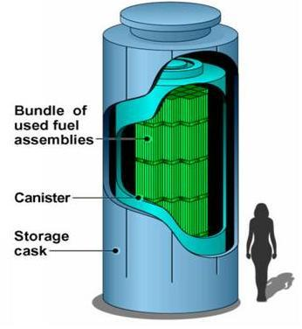
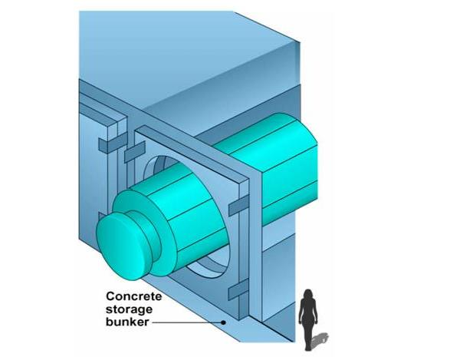
ISFSI Components:
Spent Fuel Storage Casks
Once the spent fuel has cooled, it is loaded into special canisters which are designed to hold Pressurized Water Reactor or Boiling Water Reactor assemblies. Canisters are filled with inert gas, welded, and rigorously tested for leaks. They may then be placed in casks for storage or transportation.
The canisters can also be stored in above-ground bunkers, each of which is about the size of a one-car garage. Eventually they may be transported elsewhere for storage.

Slide 9
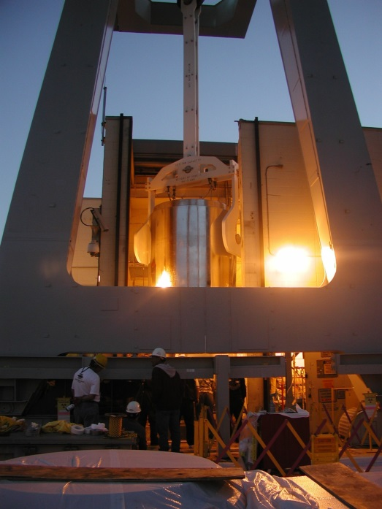
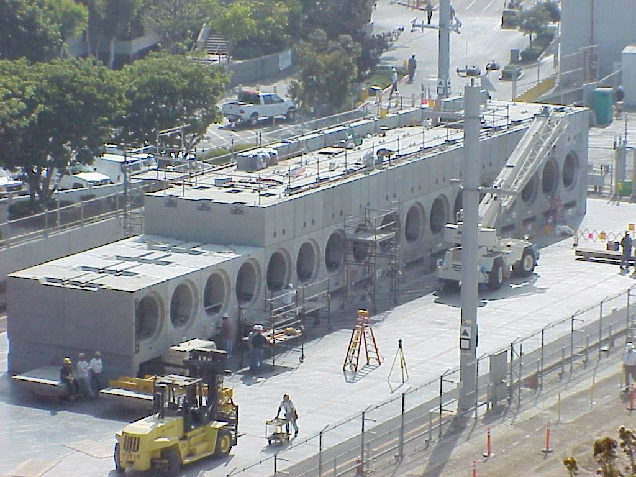
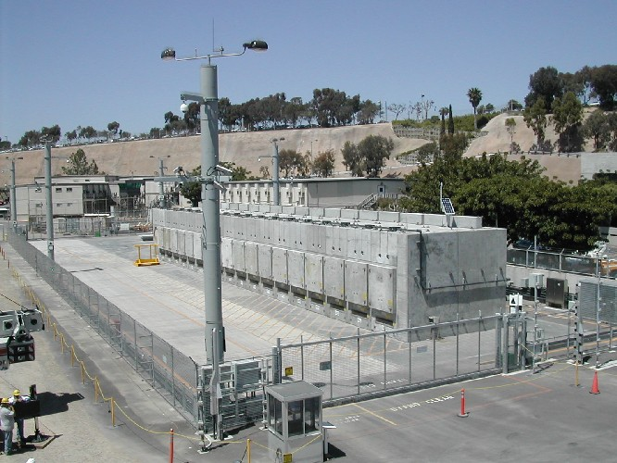
SONGS Current ISFSI Status
Transnuclear NUHOMS Horizontal Canister for Spent Nuclear Fuel

Slide 10
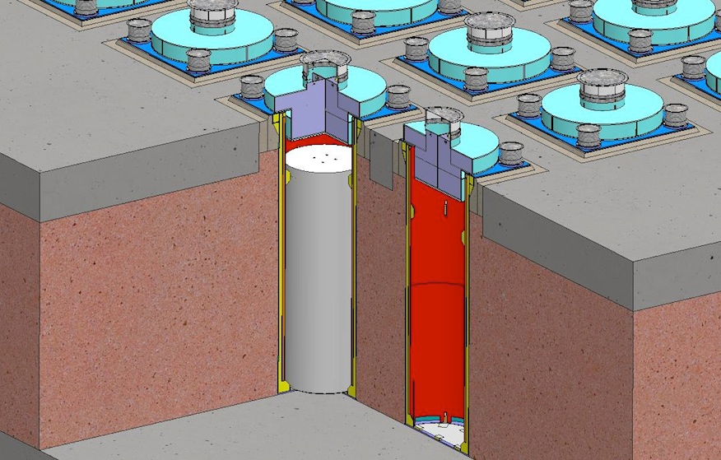
HOLTEC International Storage Module Underground MAXimum Capacity (UMAX) System Proposed for SONGS

Slide 11
Decommissioning Public Issues
Issues are Typically Locality Specific
Community Involvement – Advisory Groups or Panels
Emergency Planning Reductions
Physical Site Security Reductions
Post Shutdown Decommissioning Activities Report Comments
Review of the PSDAR by the NRC
Reactor Decommissioning Timeliness – 60 Years to Complete
Economic Losses to the Local Community
Decommissioning Trust Fund Adequacy
Government Funding of Decommissioning
Long-term HLW Storage Solution
Future Available Uses of the Site

Slide 12
Thank You!
Questions or Comments?

Slide 13
Backup Informational Slides

Slide 14
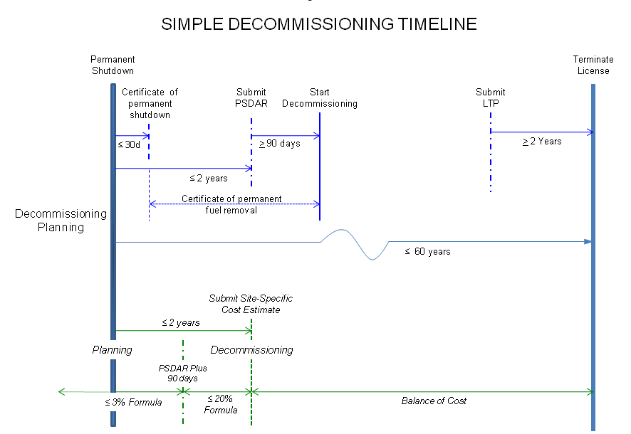

Slide 15
Objectives of the NRC Inspection Program
Objectively verify safe conduct of licensee’s decommissioning activities
Verify adequacy of licensee controls
Ensure safety problems and violations are promptly identified and corrected, and effective actions are taken to prevent recurrence
Examine trends in licensee safety performance

Slide 16
NRC Inspection Activities
Dedicated reactor inspection program for decommissioning (40+ inspection procedures)
Inspections of spent fuel pool and ISFSI safety
Inspections of decommissioning activities
  Scheduled during periods of higher risk activities and most procedures are conducted at least annually
  During and after remediation activities, NRC conducts independent radiological measurements to confirm licensee survey methodologies
Inspections of physical security and emergency planning

Slide 17
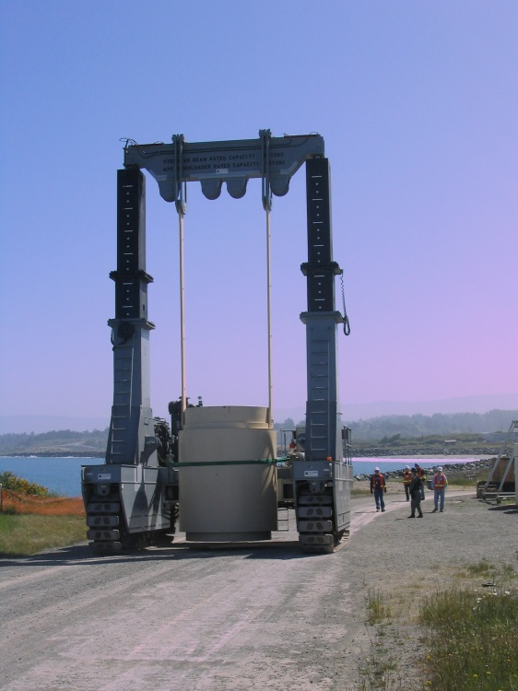
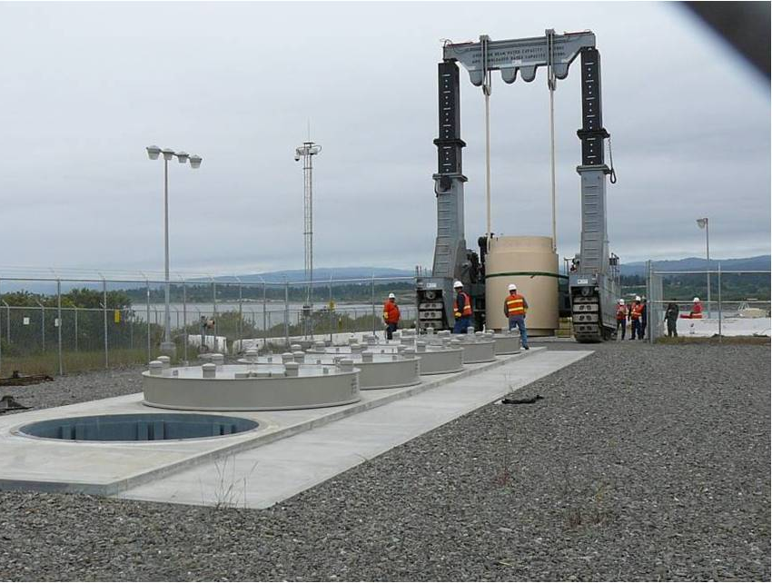
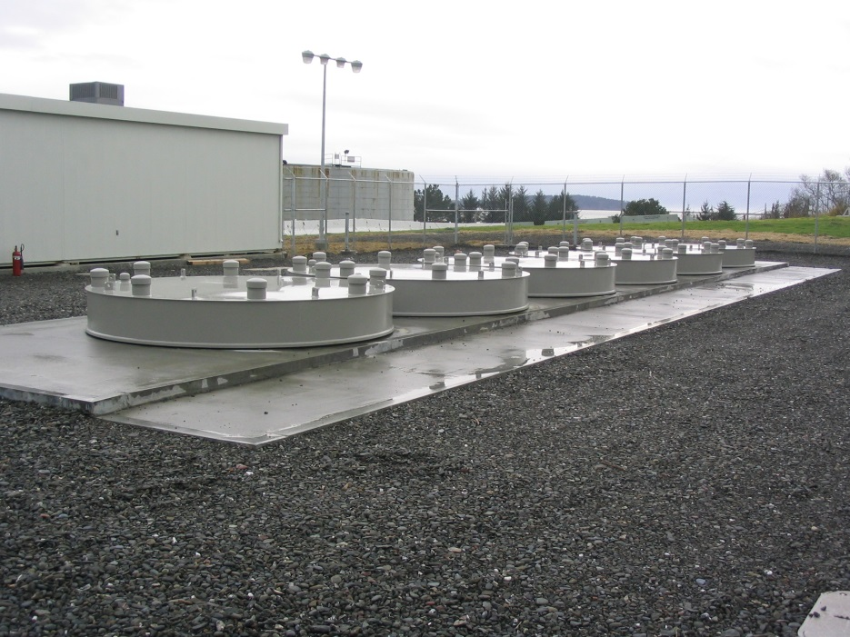
Humboldt Bay ISFSI Activities
HOLTEC HI-STAR Multi-Purpose Canister for Spent Nuclear Fuel

Slide 18
Regulatory Challenges
Optimizing regulations for transition from operation to decommissioning
Managing knowledge
Ensuring stakeholders and the public are appropriately involved in the process
  Decommissioning complex components and waste management issues

