Slide 1
California Energy Commission Workshop
Nuclear Power Plant Issues
Contingency Planning for Diablo Canyon
Jeff Billinton
Manager, Regional Transmission -North
April 27, 2015

Slide 2
2012-2013 Transmission Planning Process
Studied Grid Reliability Impact In the Absence of Nuclear Generation
  Study included assessment of the transmission system without the Diablo Canyon Power Plant
  Studies included the following evaluations:
    Potential transmission reliability concerns
    Potential mitigation options
  The results of the assessment and transmission impact are still valid

Slide 3
2012-2013 Transmission Planning Process
  These studies are not sufficient to base a decision to keep or retire the nuclear generating power plants
  Other studies would be needed to provide a more completed assessment:
    Asset valuations
    Environmental impacts of green-house gas emissions and compliance with AB 32
    Impacts on flexible generation requirements
    Least-cost best-fit replacement options
    Generation planning reserve margin
    Market price impacts
    Customer electricity rate impacts
    Impacts to natural gas systems for replacement generation

Slide 4
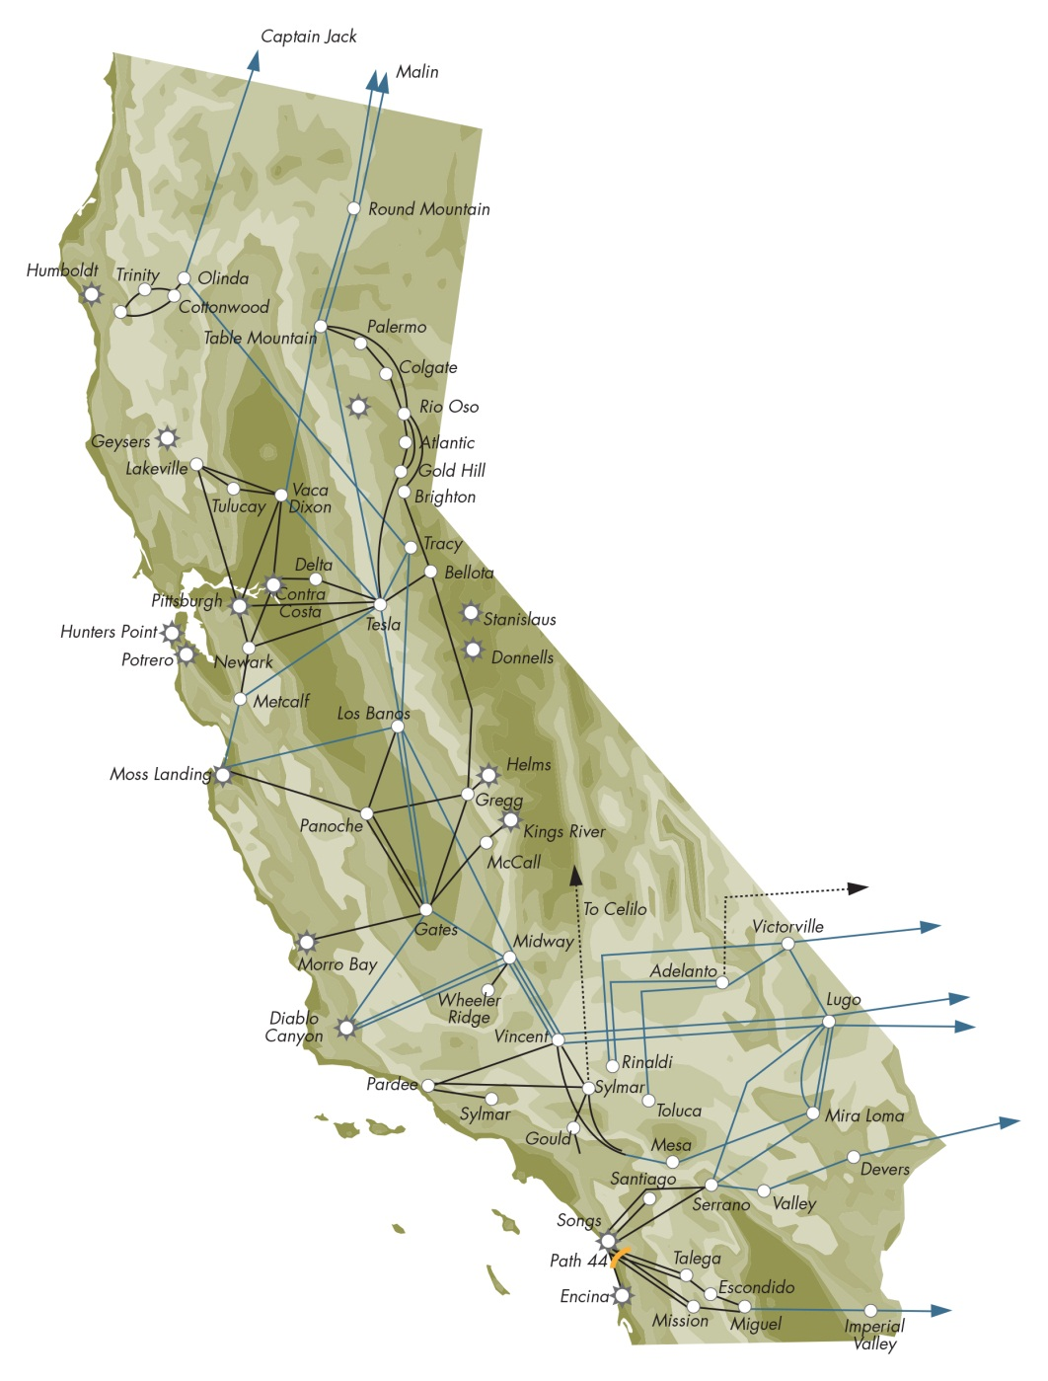
Studied the impact of absence of the Diablo Canyon and San Onofre nuclear power plants
Path 15
Path 26
Diablo Canyon
San Onofre

Slide 5
Study efforts completed in ISO 2012/2013 TPP
Summer
2012
(SONGS)
Summer
2013
(SONGS)
Contingency Planning for
Long-Term Outage
Relicensing Assessment
Summer 2012 and 2013 Preparedness
  Addendum to 2013 LCR studies (without SONGS) was posted
Mid Term Study – Contingency Planning (2018)
  Considers what elements of the long term plan should be initiated immediately to help mitigate future unplanned extended outages
Long Term Study – Relicensing Assessment (2022)
  Studies focus on transmission system implications of loss of SONGS and DCPP
Study results are documented in the ISO 2012/2013 Transmission

Slide 6
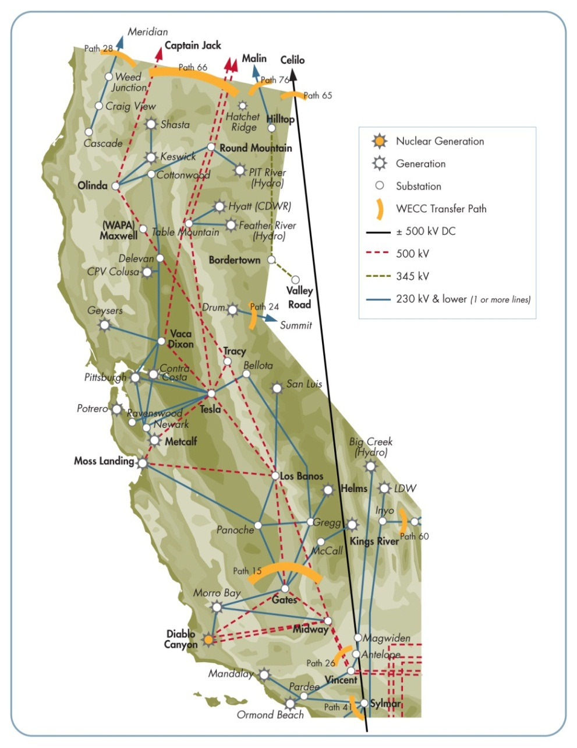
PG&E Bulk System Studies for the Diablo Canyon Power Plant Back-up
Post-transient and transient stability analysis for the cases with and without Diablo Power Plant
Peak and off-peak conditions
All single and double 500 kV outages studied, large generation outages, three-phase faults with normal clearing, single-phase-to-ground faults with delayed clearing
2012-2013 Transmission Plan Policy Driven Commercial Interest RPS case used as a starting case
DCPP generation was replaced by dispatching thermal generation and peakers in PG&E and hydro generation in Northwest

Slide 7
2012-2013 Transmission Planning Process
Study Conclusions for the Mid and Long Term Studies – Diablo Canyon Power Plant
  No material mid or long term transmission system impacts associated with DCPP absence in the assumption that renewable generation projects develop according to the CPUC RPS Portfolio
  Absence of DCPP allowed to avoid several overloads on the PG&E bulk system during off-peak load conditions (Westley-Los Banos 230 kV, Gates-Midway 230 kV)
  Category D contingencies will require more load tripping if DCPP is absent
  Additional studies are required to determine if the system has sufficient reactive margin with higher load
  Additional sensitivity studies with lower level of renewable generation may be required to confirm these conclusions

Slide 8
ISO Current Assessment of Potential Transmission Impacts
The ISO continues to monitor the system and assumptions related to the 2012-2013 Transmission Planning process assessment
  The results of the assessment and transmission impact are still valid
  There are no material transmission impacts without Diablo Canyon Power Plant
    May be some dynamic reactive requirements to address potential high and low voltage conditions under different operating conditions.

