Slide 2

HERO Product Standards:
Insights on Our Approach

Slide 3
Our Key Drivers
Clear, Concise, and Consistent Requirements
Streamlined Operations
Balanced Experience
Notes:
Clear, Concise, and Consistent Specifications - The first key to getting compliance with standards is making the standards so that contractors/customers can easily understand what they need to do.
Streamlined Operational Processes – Make the process of compliance simple and efficient for all parties involved.
Balanced Approach – CO must see that the benefits of complying with our standards are worth more than the transactional cost incurred through the process.

Slide 4
Our Product Standards
Eligible Product List:
Published list of prescriptive eligibility requirements for each eligible product type
Minimum performance specifications
Third-party certification requirements
Product Call-in Specifications:
Published list of product attributes and installation conditions that are required at the time of product call-in for each product type.
Funding Requirements Checklist:
Published list of final documentation submittal requirements for each product type
Permit requirements
Other required documentation

Slide 5
Our Process
Approval
Product Call-In
Complete Work
Funding
Notes:
Approval – This process stage covers the application eligibility review and approval (not detailed here).
Product Call-in - After approval, the next step in getting a HERO project started is for the CO to call in the specific products and installation specifications that will be included within the scope of their HERO Project. Once the CO has called in all product, they generate their financing documents and wait for notice to proceed (3-days).
Complete Work – Once a CO has received NTP, they have 110 – 135 days to complete installation of the specified products. If there are any scope of work changes during this period, COs can simply can the HERO Hotline to update their product information and regenerate their documents with the appropriate product information. Once installation has been fully completed, the CO and PO both sign a completion certificate stating that the specific products included in the scope of work have been installed to applicable standards and all local requirements have been complied with. COs submit this CC as well as any other required documentation (permits, NFRC labels, invoices, etc.) electronically through their HERO Pro account.
Funding – Once all documentation has been submitted, the HERO Funding department reviews all documentation and funds the product within 24-48 hours.

Slide 6

Technology Platform

Slide 7
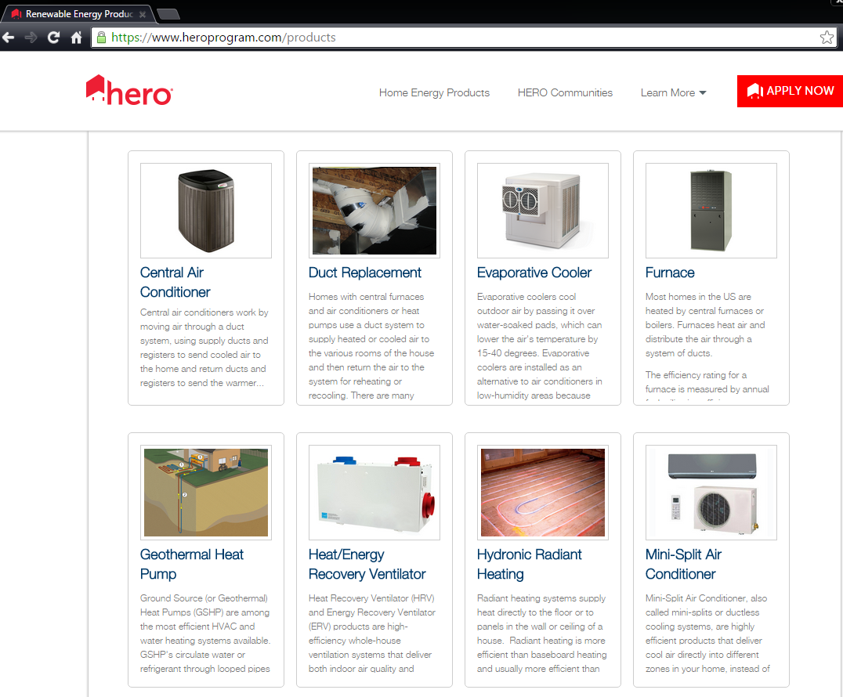
HERO Products
HERO offers over 60 eligible product types for customers to choose from when planning their energy efficiency, water efficiency, and renewable energy home improvement projects.
HERO Eligible Products Catalog:
11 Product Categories
62 Product Types
15 Third-Party Data Sources
1.3 Million Product Records
450 Data Attributes
Automatically Updated Daily

Slide 8
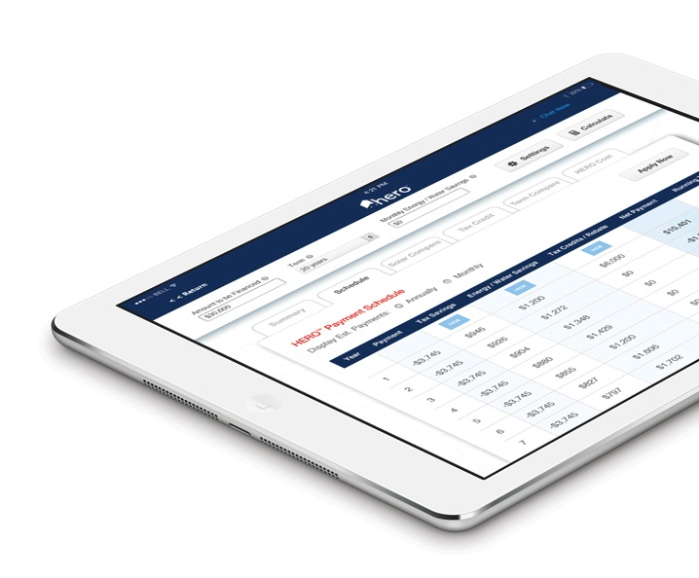
HERO Pro
        HERO Registered Contractors have access to HERO Pro, an integrated, secure platform designed to make the estimating, approval, documentation and funding process as easy as possible form homeowners and contractors.
  Features:
    Interactive Sales Tools
    Estimating Calculators
    Financing Document Generation
    Electronic Signature Capabilities
    Document Management & Submittal
    Information and Updates
    Web-based Training Curriculum
    Marketing Resource Center
    Company-specific webpage at heroprogram.com/companyname

Slide 9
Contact:
Jesse Fulton, Product Manager
jfulton@renovateamerica.com

