Slide 1

Improving the Implementation of Energy Efficiency Standards in CA
Wes Sullens
Green Building Policy & Advocacy, StopWaste of Alameda County
Technical Lead, BayREN Codes & Standards Program, ABAG
Chair, LEED Materials & Resources Technical Advisory Group, USGBC
Vice-Chair, ASHRAE 189.1 Standard for High-Performance Green Buildings
2015 CEC Integrated Energy Policy Report Workshop
July 27, 2015
Image © Chris Jordan

Slide 2

A public agency in Alameda County, California that promotes the wiser use of materials, energy, and water resources.
My role:
Support regional green building policy & programs
Advocacy on green building standards statewide & nationally
Participate on numerous technical committees
  LEED, ASHRAE, UL, CALGreen, GreenPoint Rated, etc.
www.stopwaste.org

Slide 3
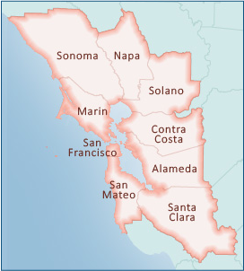
BayREN
(Bay Area Regional Energy Network)
BayREN is made up of public agencies representing all nine counties in the Bay Area
One of only two regional energy networks in California
Four program areas (Single Family retrofits, Multifamily Retrofits, Codes & Standards, and Financing)
Draws on the expertise, experience, and proven track record of local agencies and their staff
www.bayren.org/codes

Slide 4
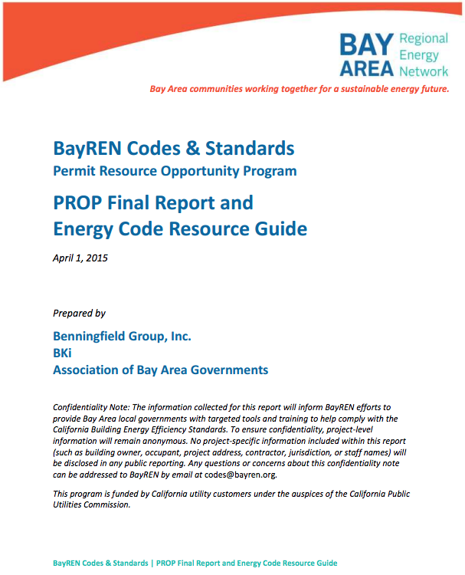
Permit Resource Opportunity Program (PROP)
Report released April 1, 2015 www.bayren.org/codes
Purpose
  Assess energy code enforcement activities in 15 Bay Area jurisdictions
  Results
  16% of projects reviewed were error-free throughout the permitting and inspection process
  Plan check phase resulted in greatest errors
  51% of projects overall performed worse than expected

Slide 5
PROP Report Findings
Discrepancy ‘Themes’
  Incomplete, inaccurate or conflicting energy information on plans/compliance documentation
  Installed measures that perform worse than what was specified at permitting stage
  Energy code documentation missing in the field

Slide 6
$
Safety/Risk
Skills &
Resources

Slide 7
$
Safety/Risk
12 Chapters of T24 updated every 3 yrs
Interim code cycles
Energy Code
Emergency Water Regs
Green Codes
Legislative actions
Skills &
Resources

Slide 8
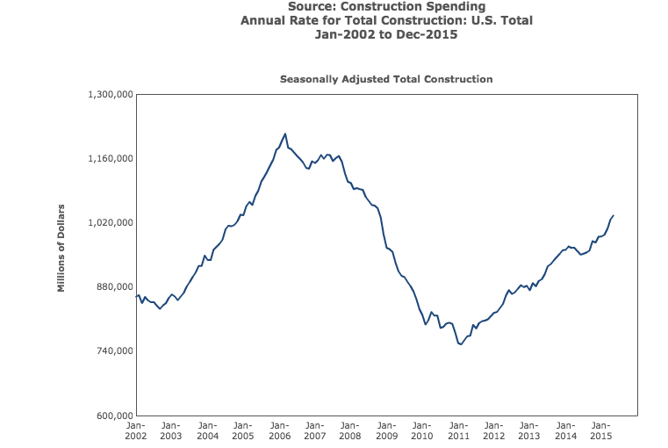
code changes
Source: US Census Bureau, Business & Economics Statistics

Slide 9
Competing Priorities Require Creative Solutions
Innovative ways to measure & assess compliance
  Smart phone-based compliance (photos/Skype)
  Electronic field inspection tools w/ prioritization
  Qualified contractors to self certify?
New models to address resource constraints
  Regional plan check center
  Third party inspections that build upon HERS
  Enhanced training
Streamlining processes and documentation
  Electronic permits and tracking
  TurboTax-like forms?
  Outcome based codes?

Slide 10
Regional Plan Check Program
Concept
Determine compliance with non-residential permits at Plan Check stage
Provide expert review and training to Plans Examiners
Report on compliance improvement metrics based on identified code errors
Conduct stakeholder engagement in Bay Area to assess opportunities for expanding program
Issue RFP (soon!) for enhanced compliance activities
  Electronic plan check online permitting software plug-in
  Tablet/iPad-based building inspection online application
  Feasibility study for a regional electronic/online permit service

Slide 11

Wes Sullens
1537 Webster Street
Oakland, CA 94523
510-891-6511
wsullens@stopwaste.org

