Slide 1

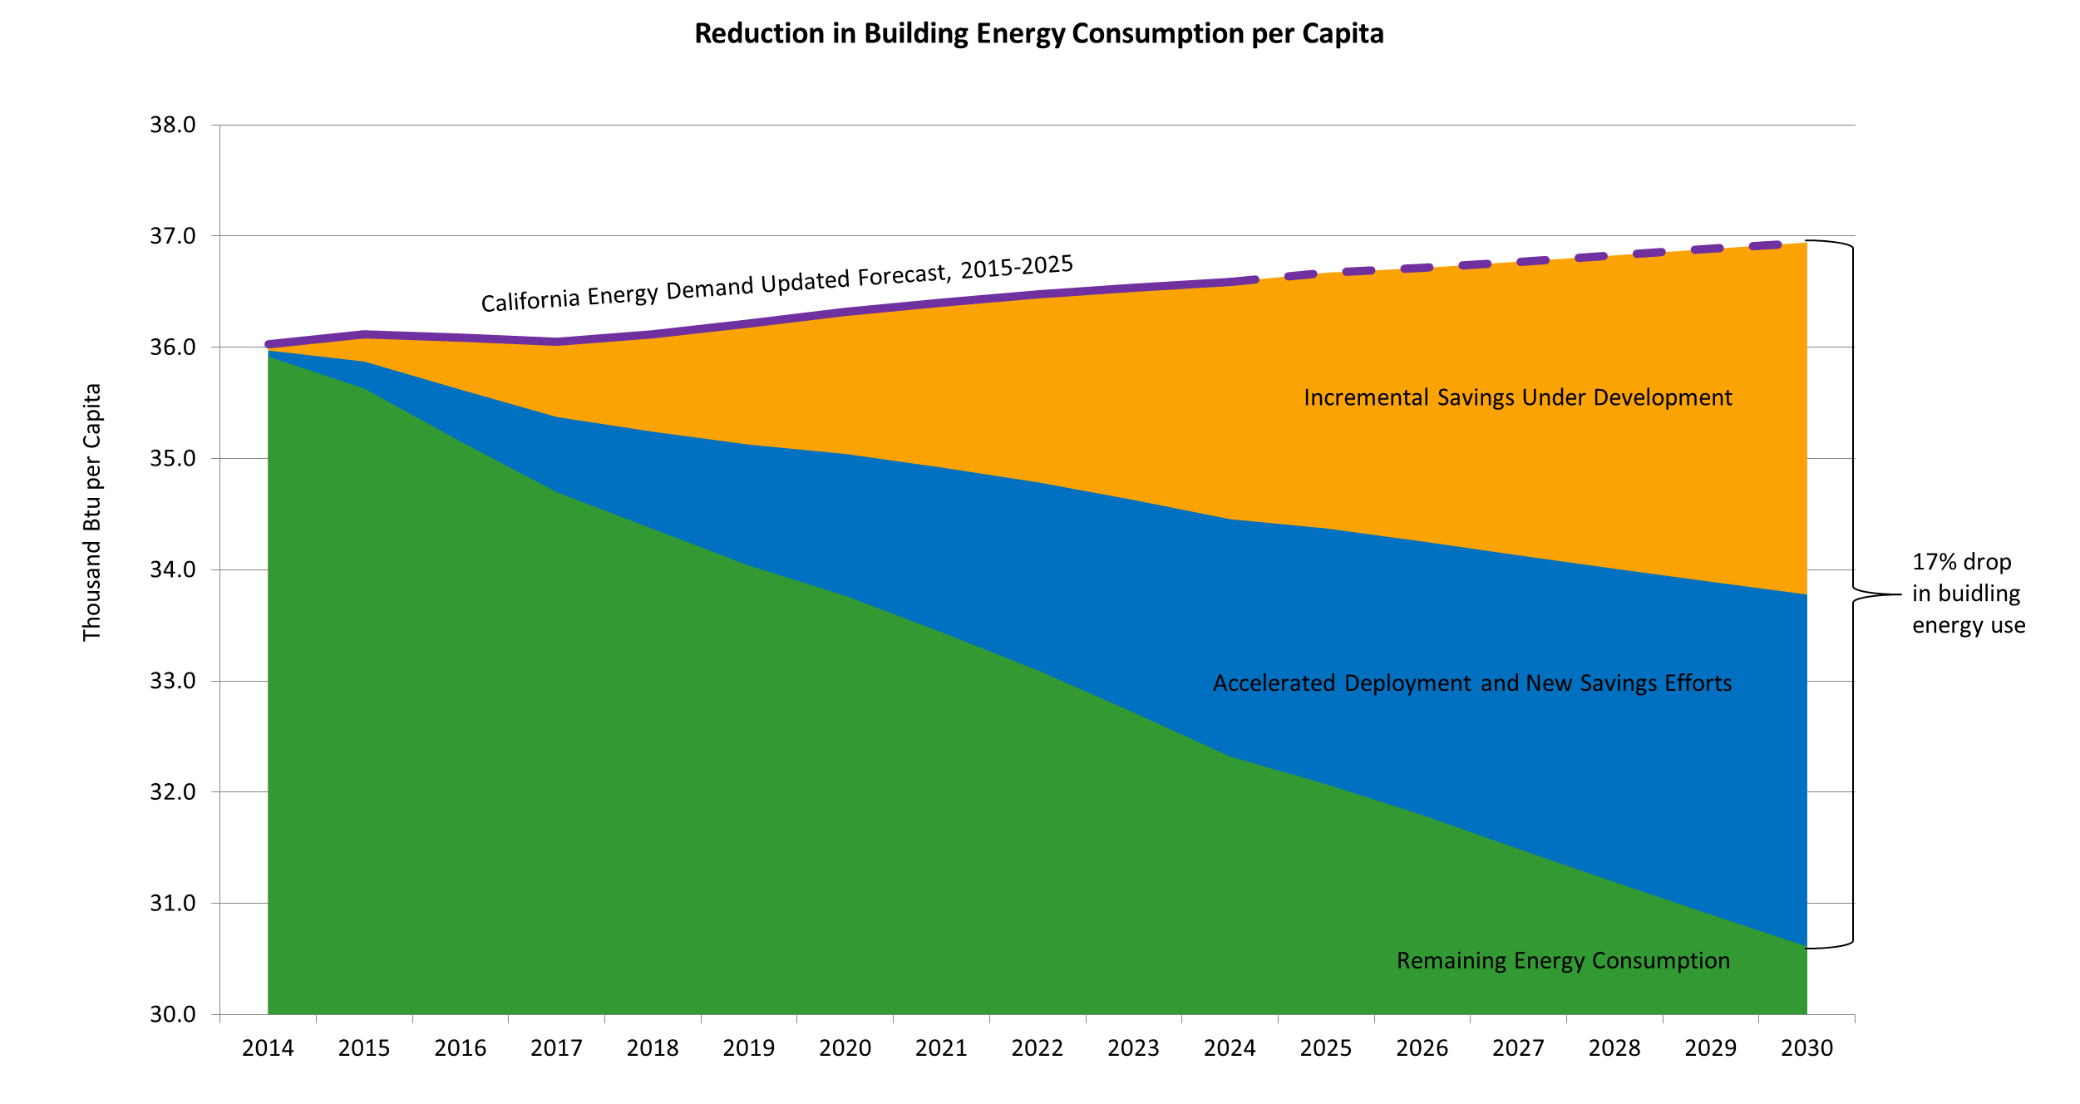
2030 EE Savings Goal
Source: CEC, Existing Buildings Energy Efficiency Action Plan, Draft March 6, 2015

