Slide 1
Achieving the Governor’s EE Goal: Unleashing Potential in Existing Buildings
Aaron Johnson
Vice President, Customer Energy Solutions
July 6, 2015

Slide 2
PG&E Enables California’s EE Community
PG&E’s 2015 DSM Budget: $650M
  $437M Energy Efficiency
  $162M Energy Savings Assistance Program
  $50M Demand Response
We partner with over 400 entities and 700 trade professionals to implement programs across our service territory
PG&E’s 2010-2014 EE programs helped customers avoid release of over 2 million metric tons of CO₂

Slide 3
Achieving Governor’s EE Goal Requires New Policy Framework
Capture to- and above-code savings in existing buildings
  Leverage SmartMeter investment by measuring savings at the meter
Evolve the cost-effectiveness test for EE
Notes:
Will require rebalancing of incentives budget; not major budget increases

Slide 4
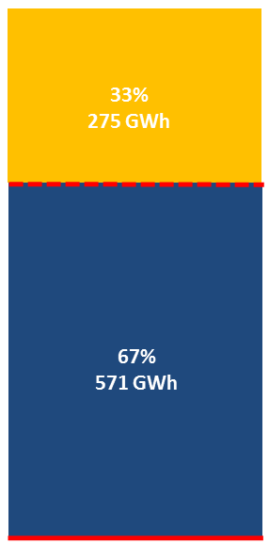
Majority of Energy Savings Potential In Existing Buildings Is In Bringing Them Up To Modern Code
  Aggregate Potential Energy Savings
1/3 of potential savings were above current code
Above-code savings
Title 24
2/3 of potential savings were in bringing buildings up to current code levels
To-code savings
Existing Conditions
  Study examined 3 dominant end-uses (heating, cooling, and lighting) in 66,850 commercial buildings in PG&E territory
Source: Preliminary results from EnerNOC study, May 2015

Slide 5
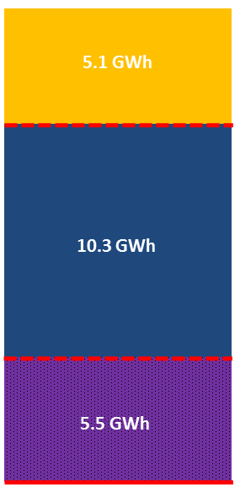
Current Policy Does Not Address Largest Areas of Potential Savings
  Aggregate Potential Energy Savings
24.4% of potential savings were above current code
Above-code savings
49.2% of potential savings were in bringing buildings up to current code levels
To-code savings
More than 75% of potential savings
26.4% of potential savings were in operational improvements
Operational savings
  Study examined 22 building energy end-uses making up the majority of consumption in 164 office, retail, grocery, and school buildings in the Central Valley
Source: Preliminary results from FirstFuel study, May 2015

Slide 6
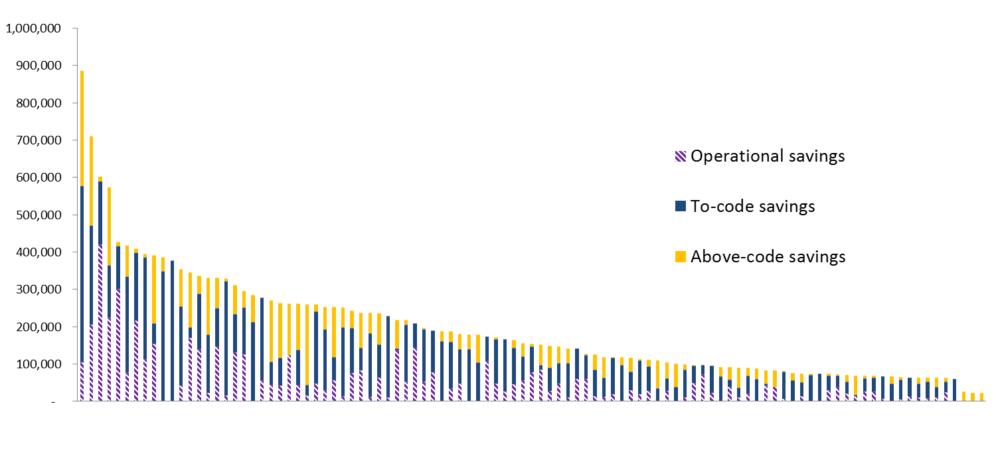
Current Policy Does Not Target Least Efficient Buildings
  kWh Savings Potential by Building (Retrofit + Operational)
20 buildings with the largest energy savings potential
The 100 buildings with largest energy savings potential (out of the 164 examined)
10 buildings that are the best targets under current incentive rules
Source: Preliminary results from FirstFuel study, May 2015

Slide 7
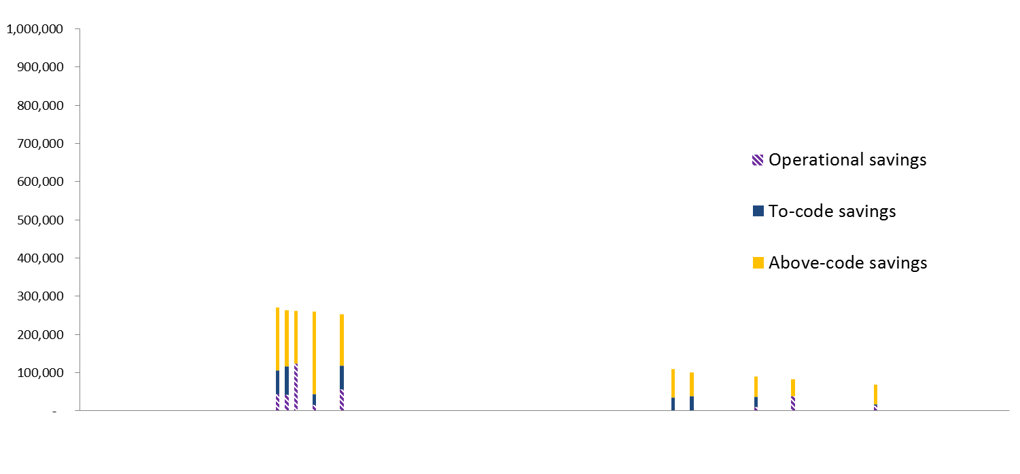
Current Policy Does Not Target Least Efficient Buildings
  kWh Savings Potential by Building (Retrofit + Operational)
None of the 20 buildings with the largest energy savings potential remain in this set
The 10 buildings that are best targets under current incentive rules
(i.e., more than 50% of potential savings are above-code)
Source: Preliminary results from FirstFuel study, May 2015

Slide 8
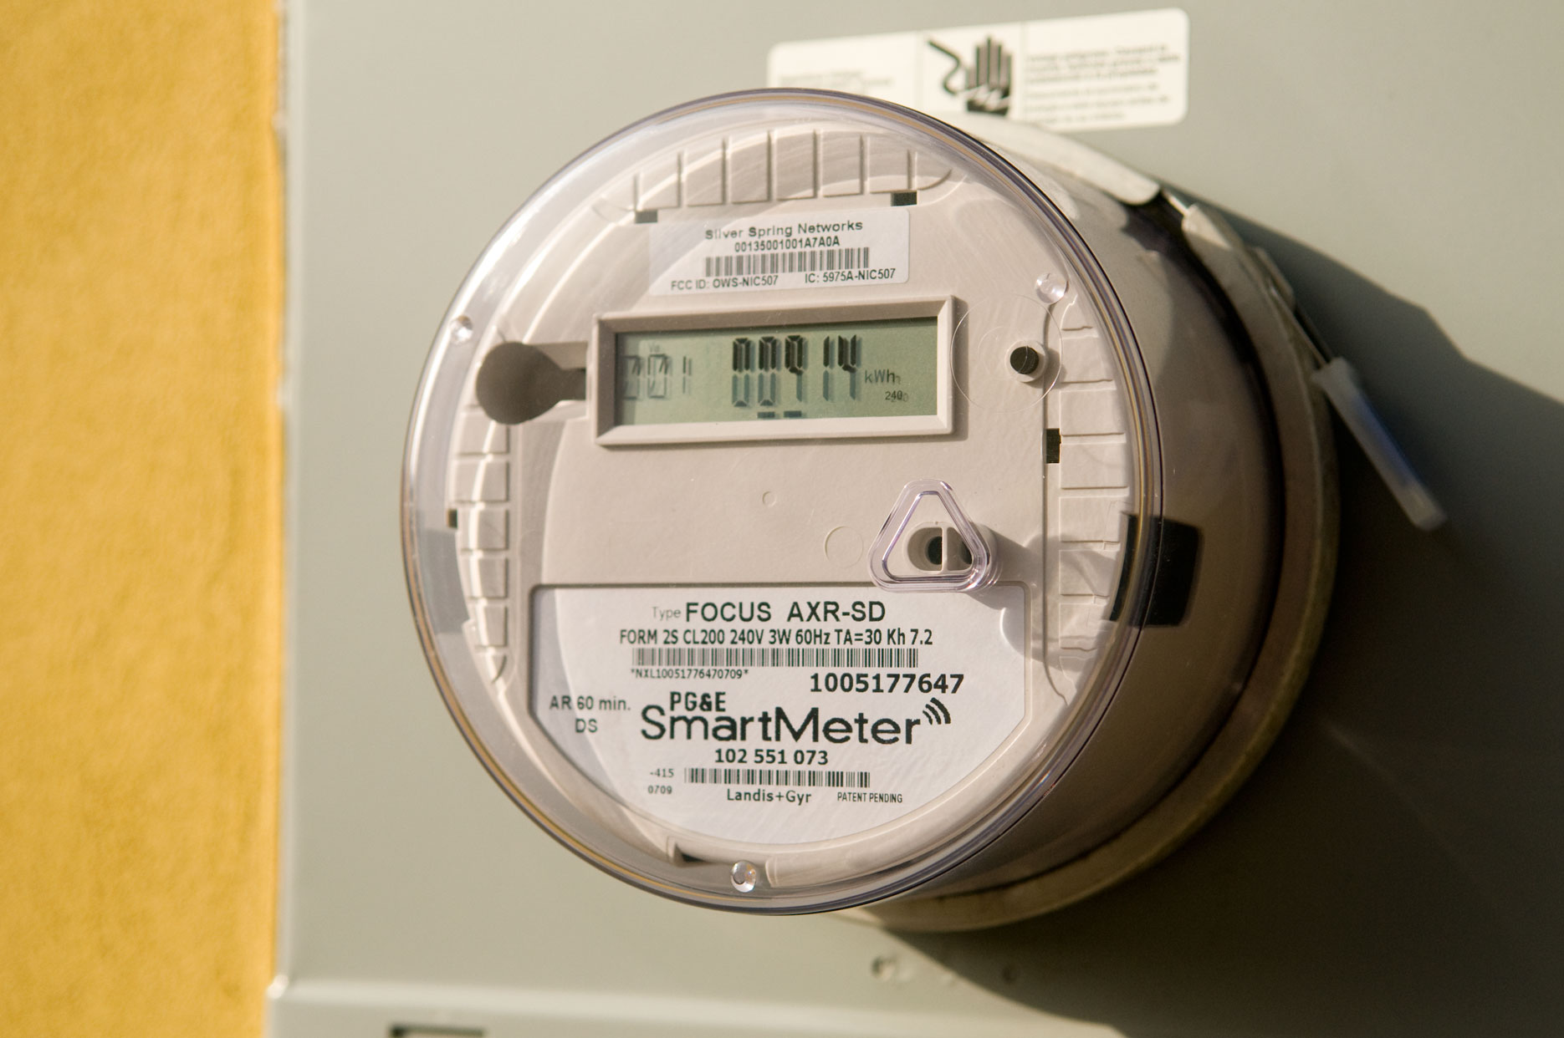
Maximize Savings By Leveraging SmartMeters

Slide 9
Participants’ Willingness To Pay For Technology Should Be An Asset, Not A Disadvantage
Source: Recorded results, 2013 – March 1, 2015; market penetration data from CA Lighting and Appliance Saturation Survey, 2014

Slide 10
Achieving the Governor’s EE Goal Requires Additional Energy Savings
Capture to- and above-code savings in existing buildings
  Enable targeting of the state’s least efficient buildings
  Increase the adoption curve for building upgrades and new efficient equipment
  Leverage SmartMeter investment by measuring savings at the meter
  Encourage deeper whole building upgrades and behavioral and operational energy savings
Evolve the state’s cost-effectiveness test for EE
  Support innovative program approaches and EE technologies

