Slide 1
Northwest Market Transformation
Susan E. Stratton, Executive Director
Presented to: California Energy Commission
July 6, 2015

Slide 2

Original Organizational Hurdles: 1996
Funds for NEEA had to be allowable expenses
Alliance had to operate in markets that cross state and utility service territory boundaries
Voluntarily funded
Regularly evaluated
Success could not be judged on a single project or short period
Had to prove that market transformation could be replicated and result in sustained, measurable market change
Notes:
To be successful, the alliance had to overcome some initial obstacles:
Utility regulators would have to agree that funds for the effort would be allowable utility expenses and would not become stranded assets.
The effort would need to operate in markets that crossed state and utility service territory boundaries, requiring uniform participation and equitable funding from all of the utilities in the four-state area.
With more than half the region served by self-governing utilities, the effort would have to be voluntarily funded by all the region’s utilities.
The work needed to be regularly evaluated.
The organization’s success should not be judged based on a single project.
Lastly, the effort would need to prove that market transformation could be replicated and result in sustained, measurable market change.
NEXT SLIDE

Slide 3
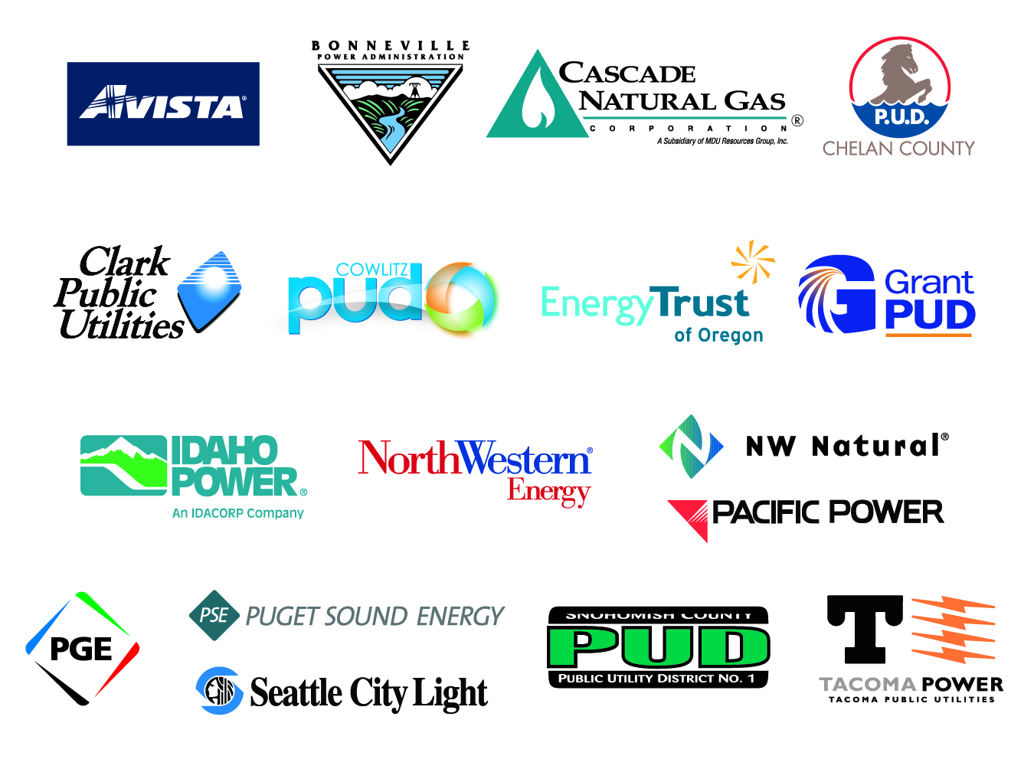

Northwest Energy Efficiency Alliance
Notes:
NEEA is an alliance of Northwest utilities and energy efficiency organizations that is voluntarily funded
Born out of necessity in the era of deregulation, the alliance was the brainchild of regional energy efficiency organizations who believed that the region had see far too much value from regional EE efforts to let them become stranded assets.
NEEA was incorporated in 1996 as a regional collaborative tasked with pursuing the highest value activities to secure energy efficiency for the region
NEEA is a catalyst for Market Transformation in the Northwest, but it’s the funding organizations and their staff, who are as dedicated and passionate about EE as we are, who make it all possible.
NEXT SLIDE

Slide 4
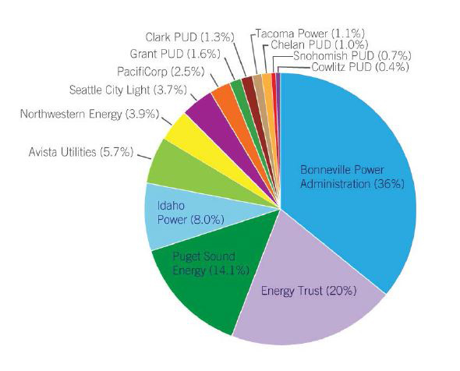
NEEA Funding Shares

Slide 5
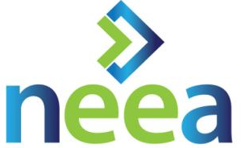
About NEEA
Funders
  $169 M for 2015-2019 (electric)
  $18 M for 2015-2019 (natural gas)
  Bonneville Power Administration, on
  behalf of more than 140 utilities
  Energy Trust of Oregon
  Seven public and eight investor-owned utilities
Board Governance
  14 Funding utilities
  1 Indirect funder representative(s)
  4 State representative(s)
  1 Public interest representative(s)
Team Breadth
  85 staff with deep expertise
  Strong market partner & contractor base
  Advisory committees, regional
  work groups
Notes:
Note that regional utility investment in EE is approximately $400 million.
NEEA represents about 10% of regional utility investment and about 20% of the measured savings.

Slide 6
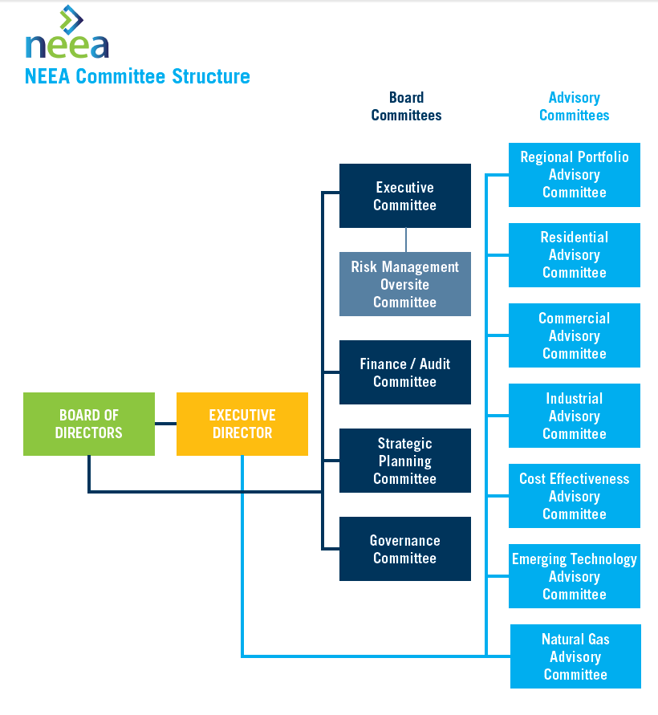
NEEA Governance Structure
Notes:
NEEA Board is a policy board
NEEA advisory committees advise the staff

Slide 7
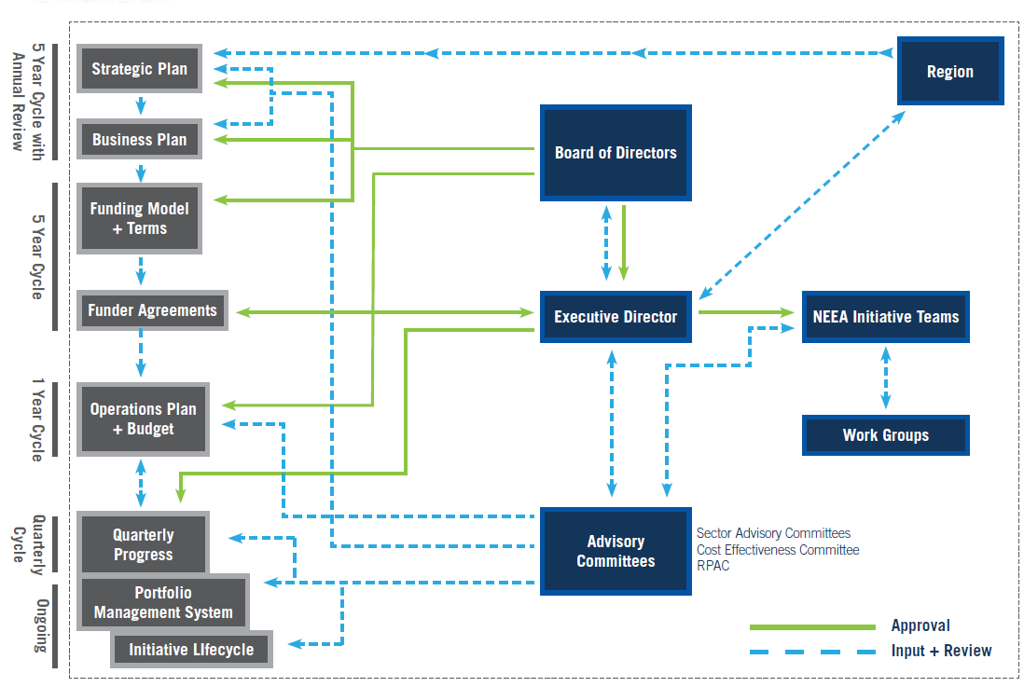
NEEA Core Business Process
Notes:
NEEA collaborates with regional entities, advisory committees and utilities on 5 year and annual business plans.
Individual utilities report to their regulatory authorities on investment and savings realized from NEEA. NEEA is not directly governed by the regulatory community.

Slide 8
What is Market Transformation?
NEEA’s Definition:
“The strategic process of
intervening in a market
to create lasting change.”
Notes:
What is Market Transformation?
This is an abbreviated version, but I’ll read you the full version that we have on our website:
“Market Transformation is the strategic process of intervening in a market to create lasting change in market behavior by removing identified barriers or exploiting opportunities to accelerate the adoption of all cost-effective energy efficiency as a matter of standard practice.”
That’s a mouthful, so I want to try to deconstruct that and hopefully de-mystify it a bit… [next slide]
NEXT SLIDE

Slide 9
Market Adoption Curve
Dollars Invested
Codes & Standards
Natural Baseline
Market
Market Share
Transformation
Early Adopters
Early Majority
Late Majority
Laggards
Time
Notes:
This “S-Curve” represents market share over time.
As we remove market barriers, we shift the curve up and to the left – accelerating AND increasing market share. That is Market Transformation.
As market share increases, the region’s market transformation investment declines. As a result, market transformation programs are very cost effective. Our levelized cost over the last business cycle was $1.5 cents/ kWh.
NEXT SLIDE
9

Slide 10
How NEEA Works
IDENTIFY BARRIER
MARKET INTERVENTION
MARKET TRANSFORMED
NEEA identifies barriers that impede market adoption of energy-efficient products, services and practices.
NEEA strategically intervenes to remove market barriers in collaboration with our partners.
The market is transformed and continues to accelerate without further intervention.
Notes:
So, how do we shift that curve?
Instead of thinking about individual customers and how to influence an individual, NEEA focuses on whole markets. We start by thinking about why an exciting energy efficiency opportunity isn’t just taking off on its own, what the barriers are.
Once the specific barriers to market adoption are identified, we look for leverage points in the market that will help us intervene to remove those barriers and develop intervention strategies
We test whether those market interventions are working, and make changes if necessary until we find the barriers are removed and the market is accelerating on its own.
A market is considered transformed when it continues to change without our help.
NEXT SLIDE

Slide 11

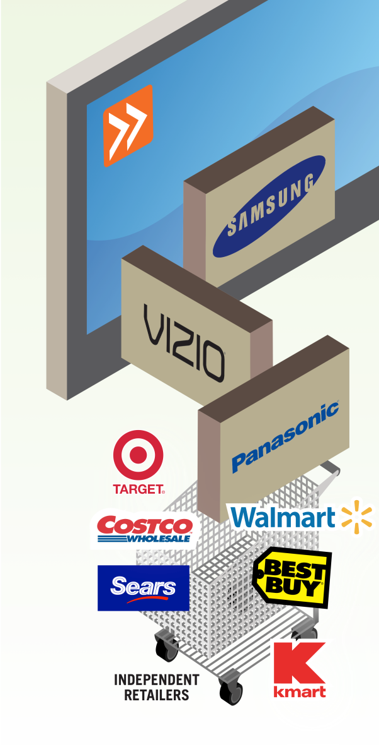





Tuning into Energy Efficient TVs
IDENTIFY BARRIER
MARKET INTERVENTION
MARKET TRANSFORMED
Average television uses
60%
the energy of an incandescent light bulb
Market share of ENERGY STAR v. 5.3 is
95%
at the end of 2014.
CONFUSION
CONFUSION
CLARITY
SUCCESS
Total Regional
Savings
142 aMW
Notes:
Here’s a specific example of how this works:
NEEA started its Television initiative in 2009. At the time, consumers were on the verge of changing from tube-based to digital TVs and energy efficiency wasn’t a factor for most buyers. Because consumers didn’t value EE, manufacturers and retailers did not value energy efficiency. Manufacturers and industry associations were resistant to increased EE specs fearing they would increase costs. [BUILD]
Interventions:
On behalf of Northwest utilities and ratepayers, NEEA joined forces with California utilities to offer retailers cash incentives for selling the most efficient televisions. Representing 19% of the U.S. population and speaking with a unified voice, we made it easy and attractive for retailers to participate. By offering incentives to retailers to stock the most-efficient televisions, we influenced retailers to change the product mix on their shelves.
To keep pace with rapidly changing technology, NEEA changed the efficiency level eligible for incentives every year. NEEA met with buyers from retailers such as Walmart, Best Buy and Costco before their annual buying trips, helping them align purchasing decisions with upcoming specifications. In turn, retailers influenced what manufacturers produced.
Outcomes:
Today, the average television uses 60% the energy of an incandescent light bulb. The ENERGY STAR specification is exponentially more stringent than 2009, and every TV on the market is more efficient than NEEA’s first incentive tier. Market share of ENERGY STAR version 5.3 hit 95% in 2014 and Total Regional Savings from 2009-2014 are 142 aMW!! (NOTE FOR SUSAN: NME = 44 aMW)
NEXT SLIDE

Slide 12
TVs Market Transformation
Market
% Market Share of TVs
Transformation
Notes:
The area between the dotted line and the solid line is Market Transformation
NEXT SLIDE

Slide 13
Milestone Progress – Portfolio Overview
Cycle 4 Investment Portfolio of Savings in RED . Lifecycle Status as of December 2014.
  Combined Space & Water Heating
  Windows 2.0
  Home Energy Management
  Manufactured Homes
  Advanced Water Heating Systems
  -----------------------
  Advanced RTU
  Business IT
  Net Zero New Construction
  Secondary Glazing Systems
  Occupancy Building Mgmt
  -----------------------
  Extended Pump Products
  Efficient Power Supplies
  Super Efficient Dryers
  Retail Product Portfolio
  Luminaire
  Level Lighting Controls
  Comm.Lighting Top Tier Trade Ally
  Commercial Real Estate
  Next Step Home
  RETA CRES Refrigeration Operator Cert
  Existing Bldg Renewal (disc)
  Reduced Wattage Lamp Repl.
  Heat Pump Water Htrs
  Homes
  Building Operator Cert- Expan.
  Ductless Heat Pump
  Healthcare
  Codes &
  Standards*
  TVs
  Dishwashers
  Clothes washers
  Refrigerators
  Residential CFLs
  ----------------------
  80 Plus
  Building Operator Certification
  Commissioning
  ----------------------
  Food Processors
  Drive Power, MagnaDrive,
  AM400, BacGen
  Variable Freq Drives
Programs
C4 Discontinuations:
Irrigation
Solid State Street Lighting
Small/Med Industrial
Existing Building Renewal
*Refers to codes and standards that are not included as part of a voluntary initiative
Notes:
We invested in others in early stages in 2013/2014, but those that are already contributing savings are noted in red
Those in bold are what we built our c/e metrics for Cycle 4 on. The final portfolio of market development work – those in full scale MD are those which we use in portfolio c/e

Slide 14
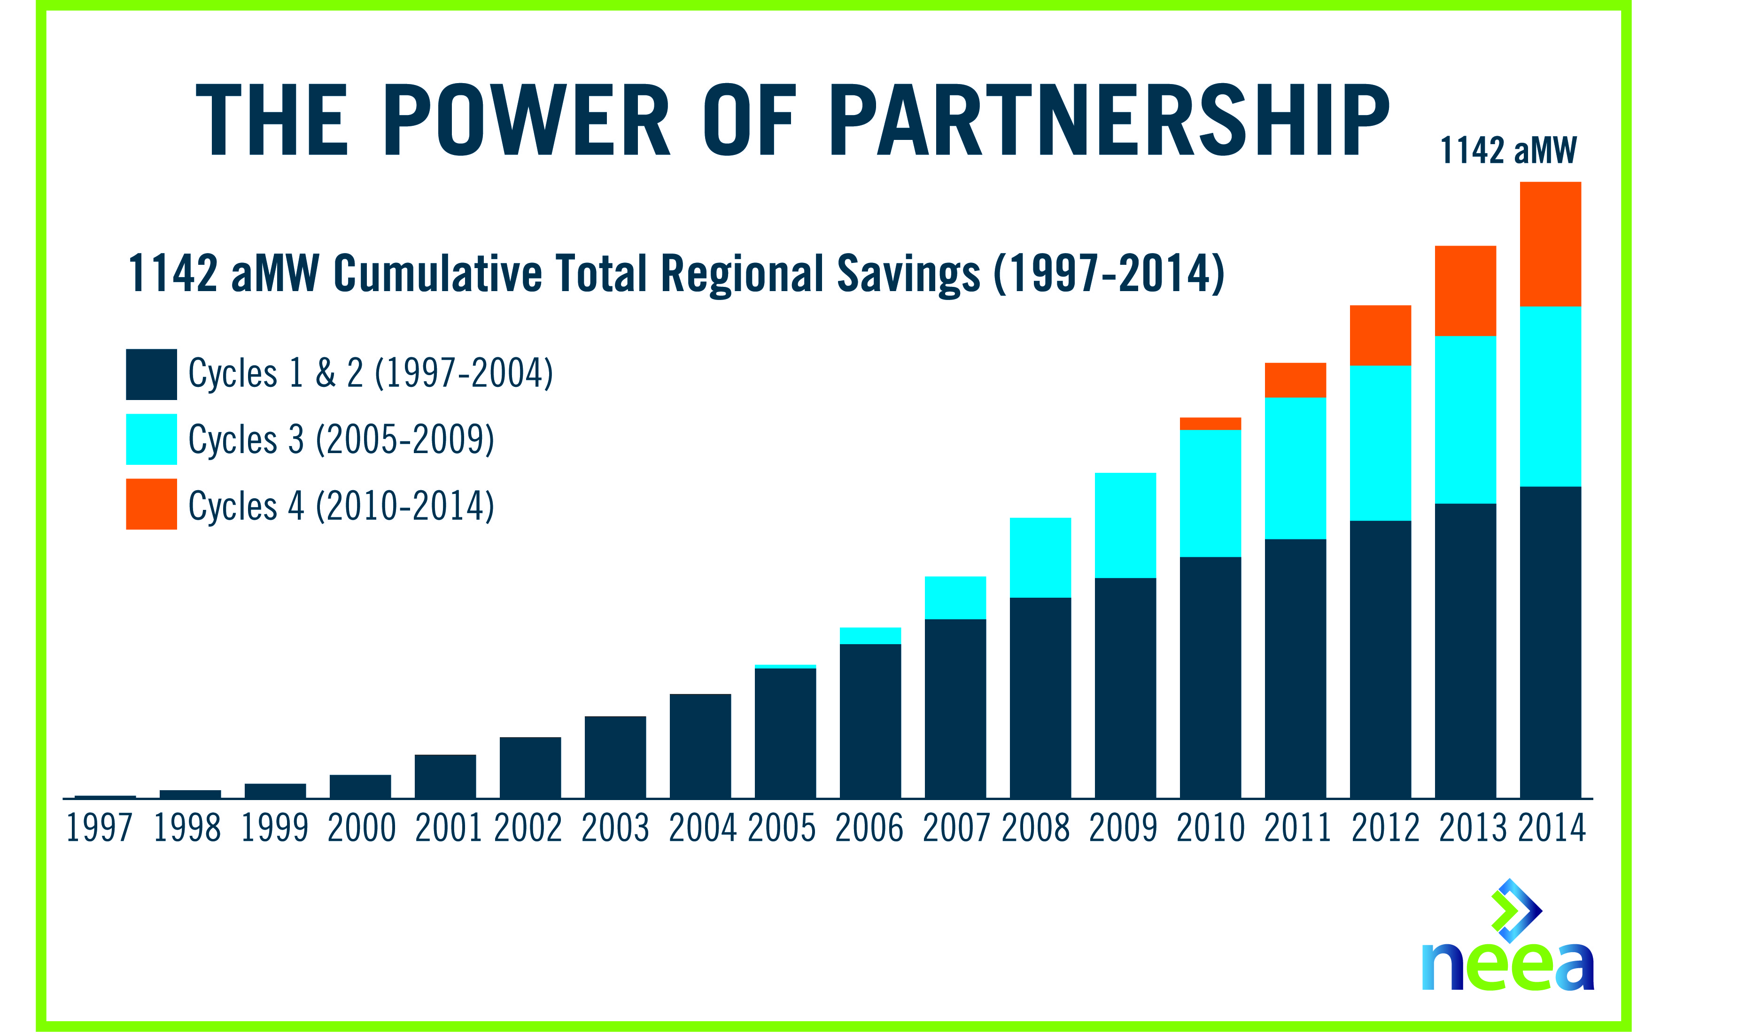
NEEA Cumulative Savings

Slide 15

Questions & Comments
Filling the Energy Efficiency Pipeline
Accelerating Market Adoption
Leveraging Regional Advantage
Thank You!
neea.org
Notes:
15

