Slide 1

Plug Load Projects
Energy Council- CEC Plug Load Meeting
June 18, 2015

Slide 2
Plug Load Projects
StopWaste’s “Product Decisions” team supports a number of appliance/plug load related projects
  Quantity Quotes purchasing platform
  Home Energy Analyzer energy end use dis-aggregator
    948 Households enrolled
  Office Occupant plug load use monitoring
    NBI/PIER study in 2012
    LEED EBOM Platinum Certification
  Multifamily Appliances
    Bay Area Multifamily Building Enhancements (BAMBE) Rebates
      Energy Pro Lite
    Multifamily Green Property Management Training
      Appliance upgrades at time of unit turn-over
Notes:
At the January Joint Boards meeting, Gary presented an overview of the Agency – providing global context for our work, some agency history; going over our core objectives and financials.
This is a continuation of that presentation, giving you a more detailed description of major projects in our program areas. These series of presentations are for information only; however, these presentations are designed to give you a comprehensive overview of our agency’s work and will help provide context during budget discussion. I would urge your attendance at these meetings.

Slide 3



www.quantityquotes.net
An online tool created with funding from the U.S. Department of Energy to connect large quantity buyers with suppliers of energy-efficient products
Notes:
Welcome
Thanks for joining us
Thrilled to be relaunching the QQ platform
I’m Stephanie Stern… happy to have Energetics; they’ve been great supporting QQ for DOE

Slide 4
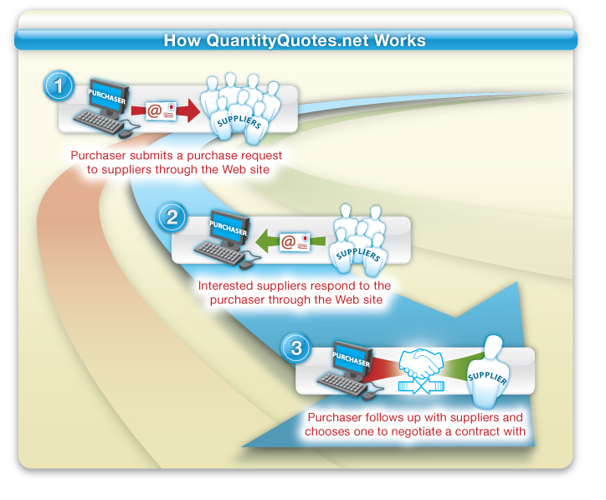
Basic Quantity Quotes Concept

Slide 5
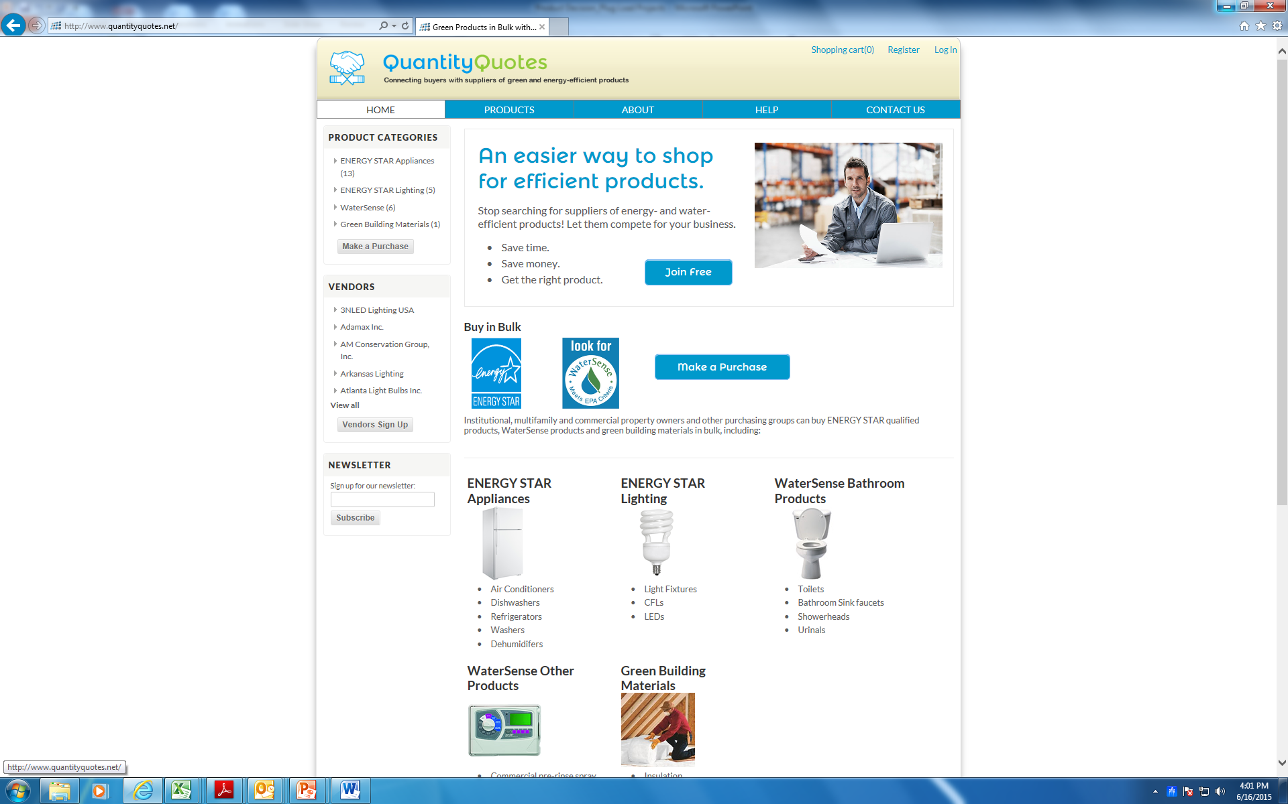
Products & Vendors- See www.quantityquotes.net
Save time
  Get multiple bids in one step
Free for purchasers & vendors

Slide 6
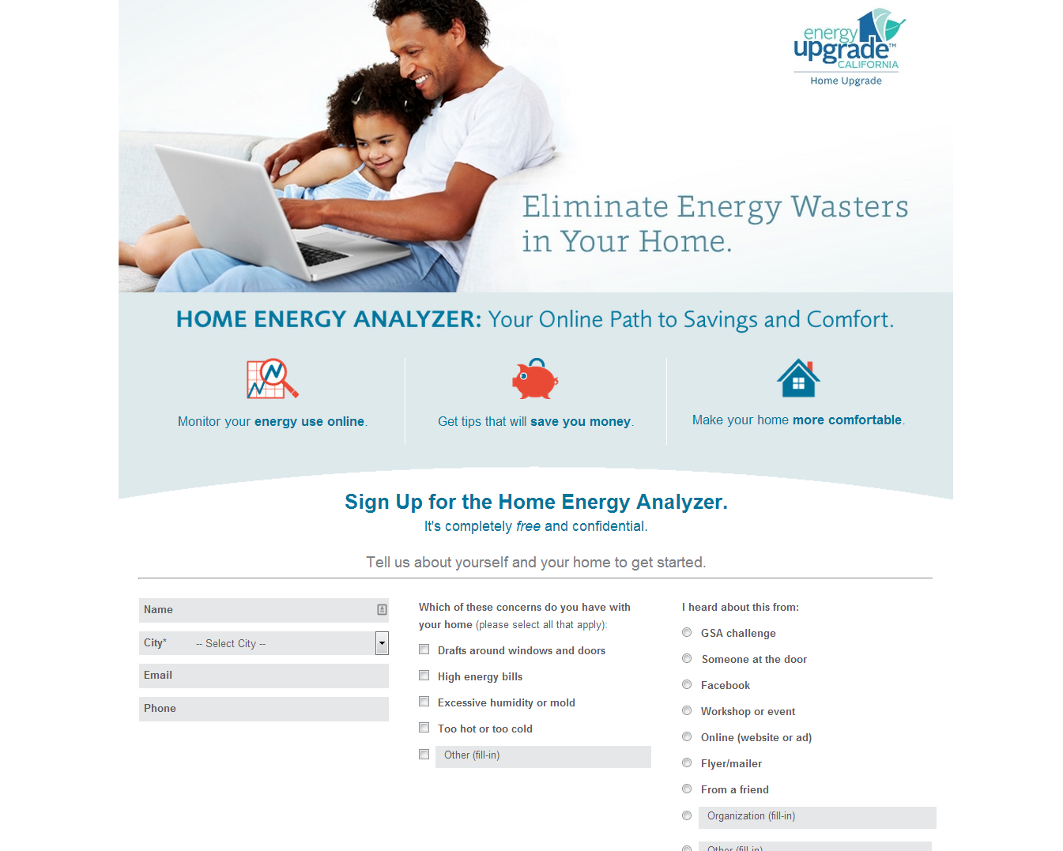
Home Energy Analyzer (HEA)

Slide 7
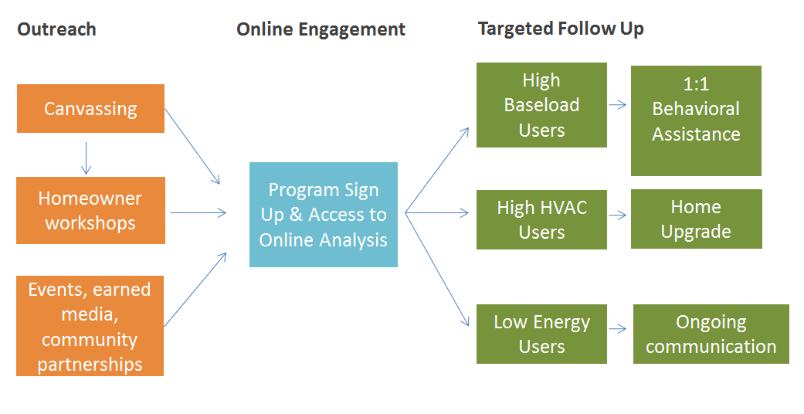
HEA Program Model
Notes:
High plug: >4000 kWh non HVAC use annually
HVAC: 8btf/sf/heating degree day and more than $1,500 in bills
Low: less than $800 annually

Slide 8
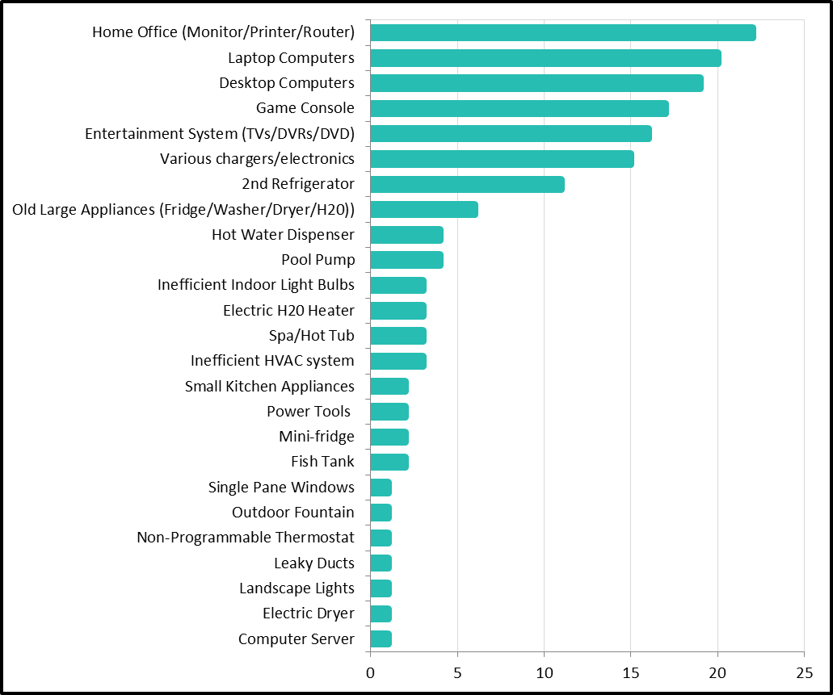
(HEA) High Plug Load Actions

Slide 9
Multifamily: Appliances as Plug-Load
Plug-Load
Owner-Supplied
Hard-Installed
Tenant-Supplied
Envelope
HVAC
DHW
Lighting
Appliances
Consumer Electronics
Multifamily / Renter-Occupied
Notes:
On top of the hard-installed vs. plug-load categories, there is an overlay of who supplies the equipment, who makes the purchasing decision. In most cases, the property owner buys the appliances while the tenant still brings their own consumer electronics. This changes the best audience and point of intervention for appliance rebates. In this sector, appliances may be best targeted through the property owner, through a whole building type of program, rather than individual residents through retail or other consumer-oriented campaigns.

Slide 10


Multifamily: Appliances as Plug-Load
  Bay Area Multifamily Building Enhancements (BAMBE)
  $750/ dweling unit flat rebate
  Average 16% (min 10%) whole building energy savings in 8,500 units installed to date
  Appliances bundled with more permanent building improvements as part of % improvement package for flat (non-escalating) incentives
  Clothes washers
  Dish washers
  Refrigerators
  Appliances modelled in “Energy Pro Lite” pilot software
    Does not use HERS II engine, uses DOE 2 and has ability to insert custom calculations to the model

Slide 11
Thank You!
Questions?
Heather Larson
Green Building Program Manager
hlarson@stopwaste.org

