Slide 1
IEPR CEC Staff Workshop
Plug Load Efficiency strategies
Pierre Delforge
June 18, 2015
Notes:
Thanks, appreciate the opportunity…
Want to give you a brief overview of:
NRDC’s findings on challenges and opportunities for EE in plug loads
Why this is a critical strategy to meet the states energy goals in both new and existing buildings
Why we need a comprehensive strategy to achieve this savings potential.

Slide 2
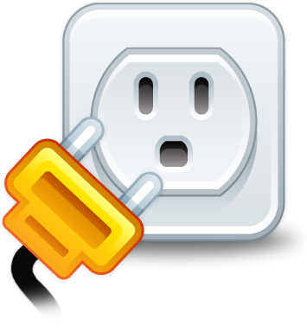
What are plug loads?
In this presentation:
  Plug Load = Plug-in Equipment
  All electrical devices brought into the building by the occupants
  (i.e., not builder-installed)
  Include:
    White good appliances
    Consumer and office electronics
    Data center IT equipment
    Miscellaneous electric loads (MELs)
Notes:
No clear definition of plug loads:
Historical: AC to low-power DC conversion, mostly electronics
Miscellaneous = Not individually identified in studies? Depends on the study
All plug-in equipment <= NRDC
Why:
Plug loads not covered by code. No permit required. No way to control through T24 mechanism.
“Misc” is large and growing, but other plug-ins still have large EE potential
Also MELs not clearly defined, don’t want things to fall thru cracks

Slide 3
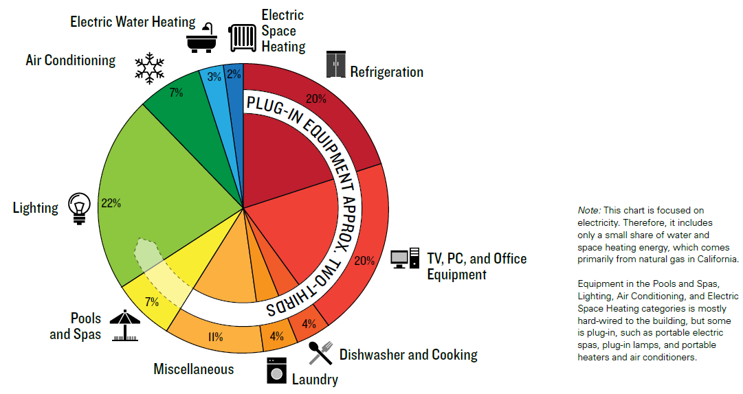
Plug-ins and MELs responsible for two-thirds of CA residential electricity use…
Source: 2009 Residential Appliance Saturation Survey
Notes:
PIE+MELs responsible for two thirds of CA residential electricity use
Just electricity, does not include natural gas and other fuels
HVAC+WH responsible for significant share of home energy use
Residential, not commercial

Slide 4
and 70 percent of projected demand growth to 2024…
Two thirds of residential electricity use.
Miscellaneous/other:
  29% of use
  70% of demand growth by 2024
Source: CEC 2014 Demand Forecast Data: http://energyalmanac.ca.gov/electricity/electricity_stats/index.html
Notes:
Chart 1: and growing faster than other uses
Chart 2: What’s behind PIE+MELs?
Most of the growth comes from MELs, rest is pretty much flat => “fix the MELs, fix the growth”
Matters for both existing and new buildings => critical strategy for ZNE and existing buildings (758)

Slide 5
… but account for less than 20 percent of utility energy efficiency savings
Clear gap between current plug load savings and the opportunity from the demand forecast
Large untapped energy efficiency opportunity
Assuming half of codes and standards savings (22% net savings expected):
CPUC 2010-2011 Energy Efficiency , Annual Progress Evaluation Report
CPUC 2014 Annual Progress Evaluation Report, table 4
Notes:
Two-thirds of use, only 18% of savings from utility EE programs and C&S.
Not because of lack of cost-effective savings: large opportunities for saving both in programs and standards:
Standby load
Energy data analytics: HEA, Opower…
T20 appliances standards are some of the most cost-effective savings available anywhere, 1.3c/kWh for BCS.
Current processes and resources not aligned for the oppty on PLs.
How do we change this?
First take a closer look at what plug loads we’re talking about.

Slide 6

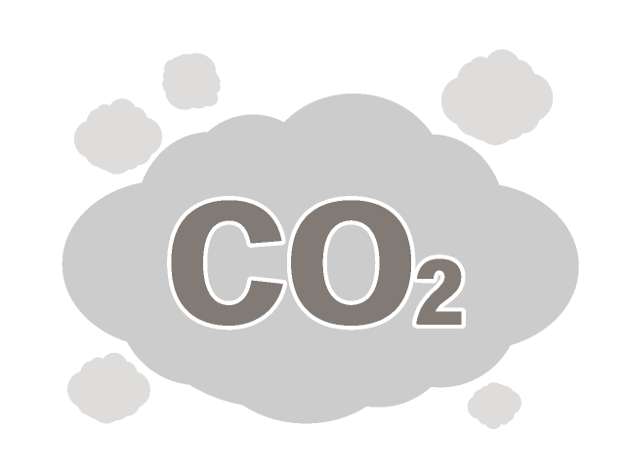
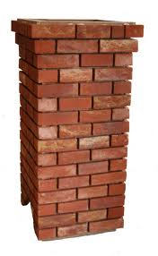
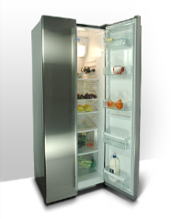


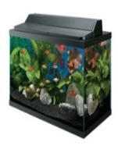

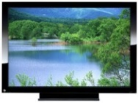


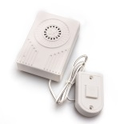

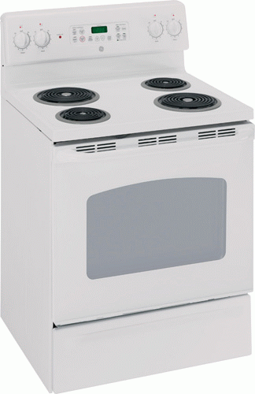



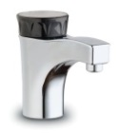
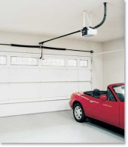
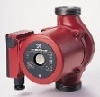
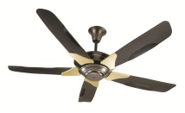
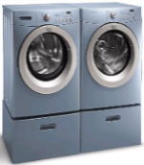
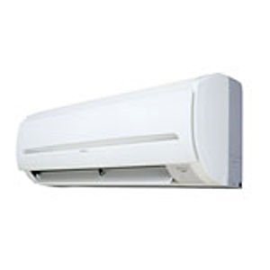


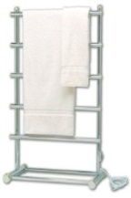
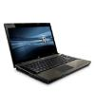
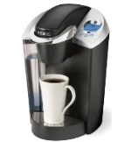
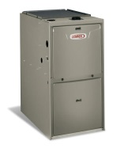
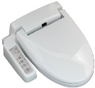



What are these plug loads? - Residential
Home Electrical Equipment
Plug-in
Hard-wired
Appliances
Electronics
Miscellaneous
Notes:
Start with Residential: 3 main buckets of plug loads
Not just electronics!
Appliances
MELs: everything not identified specifically, and non-electronic
Hard-wired: builder installed: not plug loads, but can be addressed with same policies

Slide 7
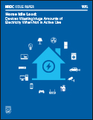
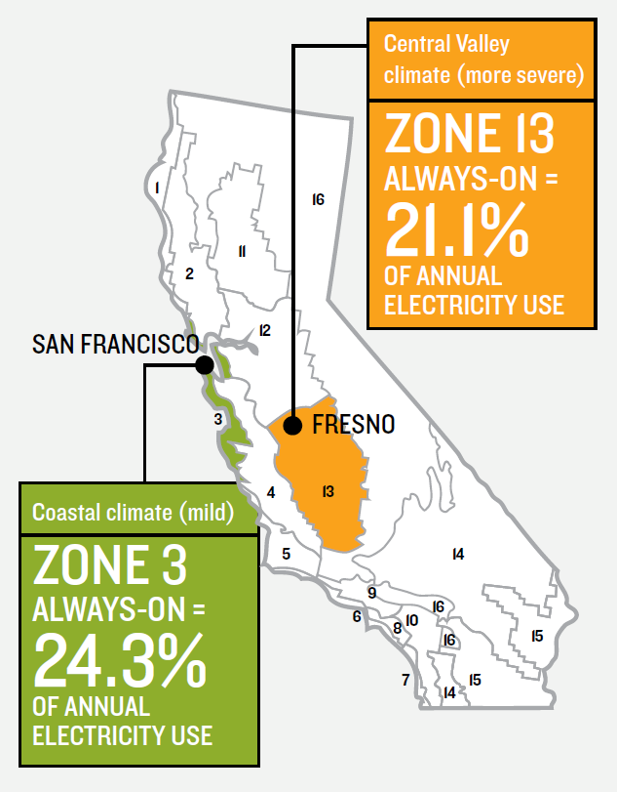
NRDC Home Idle Load study: 23 percent of CA residential electricity used by always-on but inactive devices
65 electrical devices per home, two thirds drawing more than
1 watt 24/7
Even when occupants may be asleep or away from home: little or no benefit to consumers
But costing California households more than $200 annually in wasted electricity bills, $3 billion statewide
Climate impact: 6 million tons CO2 annually
Notes:
With spread of displays and digital controls on appliances, always-on connected appliances
Wanted to find out how much of electricity is vampire load
Smart meter data: new tool
Study / HEA and Stanford: 70,000 meters, field audit of 10 homes
Findings:
Takeaway: one of the reasons for the rise of plug load electricity consumption.

Slide 8
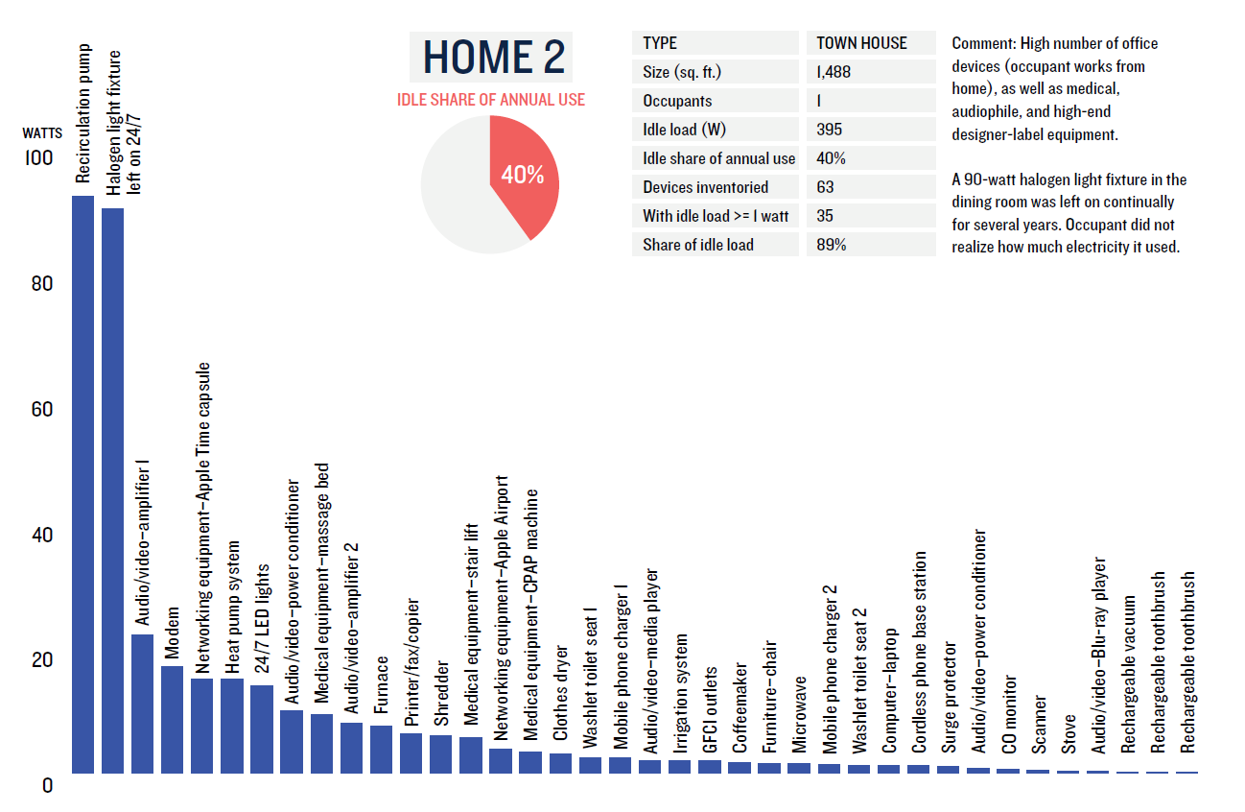
The “long tail” of idle loads: “Top offender” approach not sufficient, need cross-cutting policies
Notes:
Example of 1 home audit results
“Long tail”: majority of energy used by a large number of small uses.
Top offender approach not sufficient
Need horizontal/cross-cutting standards

Slide 9
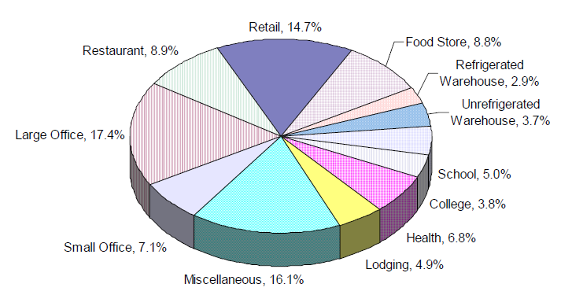
Even broader plug-load diversity in commercial sector
Broader diversity of commercial building end-uses,
results in an even larger variety of plug loads
CALIFORNIA COMMERCIAL END-USE SURVEY
Figure E-1: Commercial Electricity Use by Building Type
Notes:
Even larger variety of plug loads on commercial side
Lots of subsectors, different buildings uses => different plug-in devices
Across entire sector, plug-ins a smaller share (16%, EIA)
But large share in some subsectors: office, health, lodging, education, electronic retail…

Slide 10
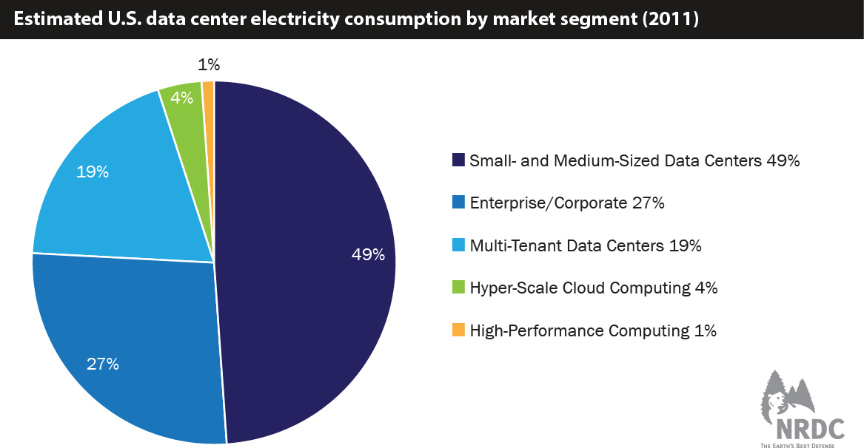
Server rooms and closets: one of the largest commercial plug loads
US: 3 million data centers, 12 million servers, 140 billion kWh by 2020
One of largest and fastest growing plug load in the commercial sector
Majority of energy used in small and medium server rooms and closets
NRDC, Data Center Efficiency assessment, 2014
www.nrdc.org/energy/data-center-efficiency-assessment.asp
Notes:
One notable example: Data centers
While not entirely a plug load (facility), all IT equipment is.
Common misconception about data centers == large vs. small
30% servers zombies, average utilization level of 6-12%
Large share of the energy efficiency opportunity is operational: utilization => EE programs

Slide 11
Technology solutions exist
Home Electrical Equipment
Plug-in
Hard-wired
Appliances
Electronics
Miscellaneous
Notes:
(Flashing this slide again just to set the scene for the next one…)
Coming back to our home for a minute…
What can be done about plug load energy use?
GOOD NEWS: technology solutions exist

Slide 12
Technology solutions exist
Home Electrical Equipment
Plug-in
Hard-wired
Appliances
Electronics
Miscellaneous
Advanced efficiency in appliances, e.g.,
Refrigerators: brushless DC motors, variable speed compressors,
LED lighting, thermo-acoustic cooling…
Dryers: heat pump
etc…
“Mobile efficiency” - Applying efficiency techniques of mobile phones and tablets to all plug-in electronic devices
Low standby load
Power management
Controls
Energy data analytics
Energy reporting
Active mode efficiency
User behavior (unplug, timer, power strip, settings…)
Low standby load
Power management
Controls
Energy data analytics
Energy reporting
Active mode efficiency
Building codes
12
Notes:
Appliances:
Many advanced technology opportunities remain, even in fridges that have been regulated for 40 years
Heat pump dryers
Electronics: mobile efficiency (battery-powered devices)
Miscellaneous: standby, controls, energy

Slide 13

Plug load efficiency requires a comprehensive approach using all the tools in the policy toolkit
RD&D, Emerging Tech
Energy Efficiency Programs
Codes and Standards
Mobile efficiency
Consumer rebates
Mid-stream and upstream incentives
Behavior / operational
Energy reporting
…
Horizontal standards: Standby
Product-specific standards
Building codes: builder-installed loads, controls…
MARKET TRANSFORMATION
Plug load targets to set trajectory aligned with state energy goals
Regulatory reform to unleash utilities to achieve market transformation
Additional resources to scale up plug load programs and standards
Notes:
Plug loads are challenging:
Lots of miscellaneous devices, broad variety
Many “small” loads, some big loads but in few homes
Rapid market evolution: new products, short lifecycles
Can be addressed with existing EE toolkit, but must be brought to full market transformation to achieve major energy savings.
RD&D, Emerging Tech (2% of savings achieved)
Incentives and utility programs (20% of savings achieved)
Standards (95% of savings achieved)
Recommendations: Innovate to make this work better for plug loads
Long-term market transformation opportunities need to be in the R&D pipeline
New technologies help with EM&V: Energy data analytics
Regulatory reform to incent utilities to achieve market transformation, align incentives: value long-term savings, attribution of savings.
Resources to be able to scale up standards (new standards, update existing, work with DOE on preempted appliances)

Slide 14
THANK YOU!

