Slide 1


More than Smart in
Consumer Electronics
California Energy Commission
June 18, 2015

Slide 2
Key Points
Energy efficiency gains seen in mobile computing space can and should be replicated in other consumer electronic devices. Policy push could help move these efforts
More connected devices = more energy efficiency opportunities
Energy Efficiency discussions, such as for Title 20, need to develop a pathway for linking with state’s upgrade of its electricity distribution grid. Energy efficiency needs to be seen as a service that can meet specific grid needs, and promote greater use of efficiency (and other Distributed Energy Resources) over time.

Slide 3
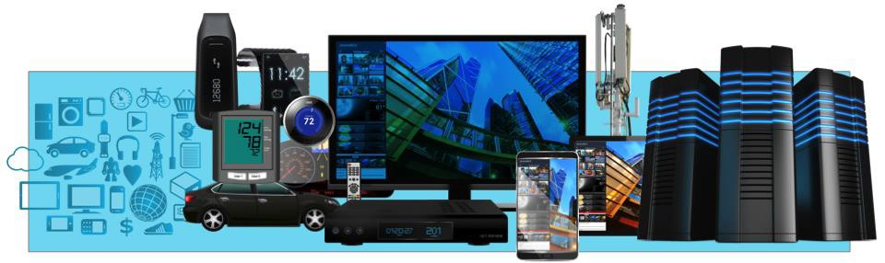
ARM Example
ARM ecosystem meets needs of vertical markets – from sensors to servers
  Addressing automotive, consumer, industrial, mobile, medical, metering and beyond
  12bn ARM chips shipped in 2014 alone – increasingly becoming connected as part of IoT
ARM’s market share at 37% overall
  Ongoing high share of chips into mobile devices, and increased penetration into key growth markets such as enterprise infrastructure and embedded intelligence
Year | Market Share
2007 | 17%
2008 | 20%
2009 | 22%
2010 | 25%
2011 | 29%
2012 | 32%
2013 | 35%
2014 | 37%
Source: ARM

Slide 4
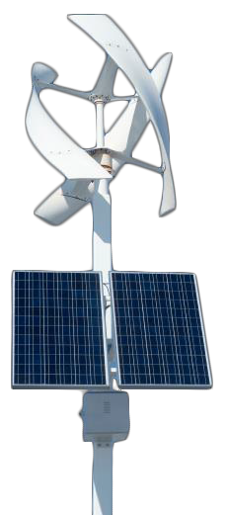

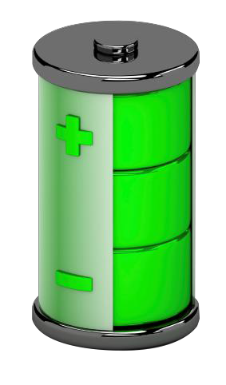
Energy Efficiency Underlies All Markets
Power efficiency is important for all
applications
  Thinner and lighter
  Lower cost – minimal thermals
  Lower energy use – reduced operating
costs and carbon footprint
  New product categories – wireless sensors with 15 year battery life
The ARM Architecture has low-power
design in its DNA
  Instruction set architecture
  Processor micro-architecture
  System design
  Implementation
  Operating systems and software
  Partnership and ecosystem

Slide 5











ARM efficiency for 64-bit server compute Platforms
1.8X
10.4X
7X
Acquisition cost
Power Consumption Per Year
Node Density/Rack
Traditional Data Center Equipment
ARM 64-bit based m400 HP Moonshot
Game changing $/Watt/Cu FT benefit over traditional infrastructure delivering traditional data center services like Firewall,VPN, LDAP, Kerberos,Virtualized, etc.
Source: PayPal

Slide 6
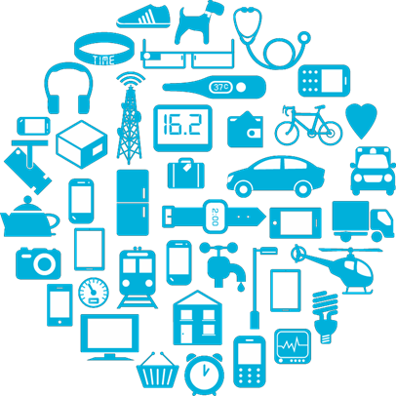
More connected devices = more opportunities

Slide 7
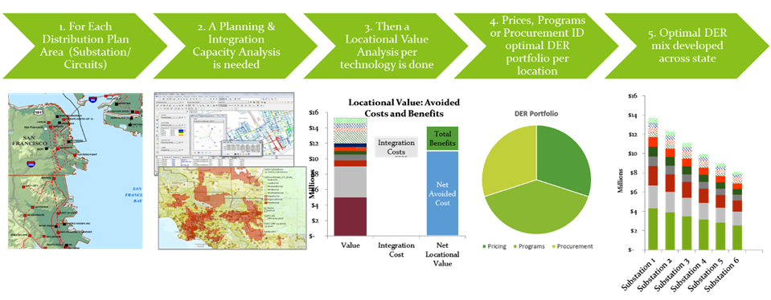
More than Smart Framework: Integrated Distribution Grid Planning in action

