Slide 1

CEC Plug-load Standards Development
- Residential EE Programs -
Peter Franzese
June 18, 2015

Slide 2
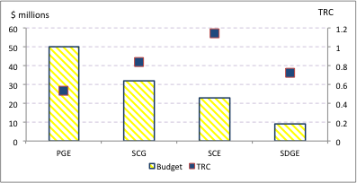
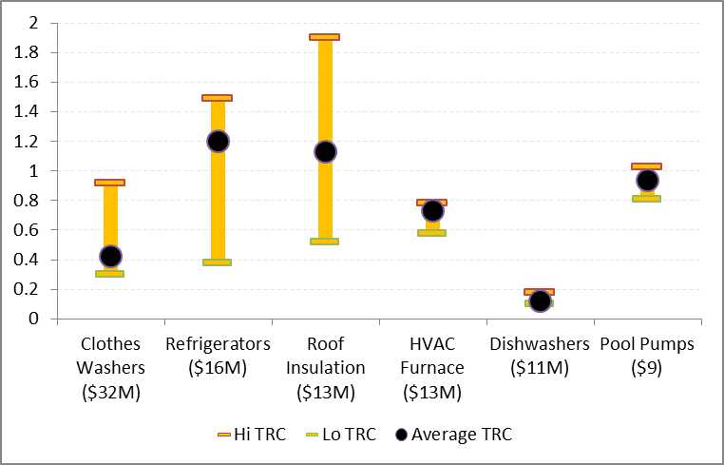
2010-2012 Residential Programs
Home Energy Efficiency Rebates
Total: $115 million
TRC: .69
$91 million (80%) not cost-effective
HEER Measures (of 21 total)
$65 million (57% of expenditures) on non-cost-effective measures

Slide 3

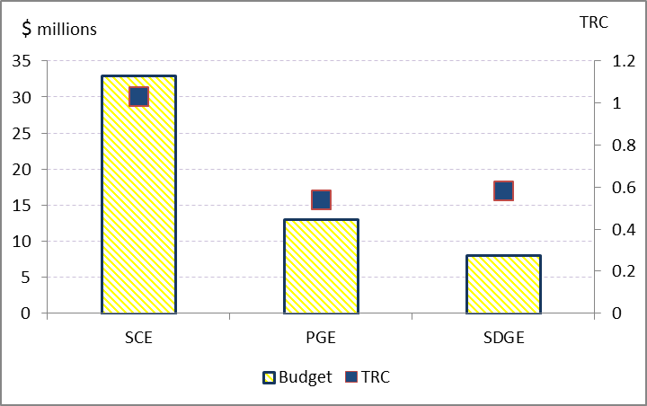
2010-2012 Residential Programs
Appliance Recycling
Total: $54 million
TRC: .82
Refrigerators:
92% of expenditures
TRC of .79

Slide 4
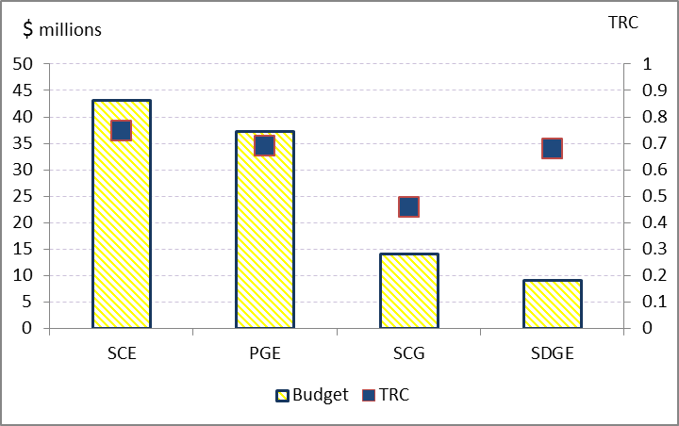
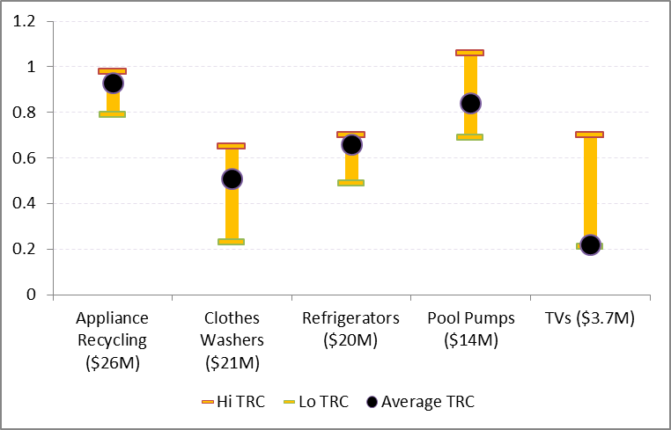
2013-2014 Residential Programs
Plug Load and Appliances
Total: $102 million
TRC: .66
Top PLA Measures TRC (of 23 in total)
$84 million (81% of expenditures) on non-cost-effective measures

Slide 5
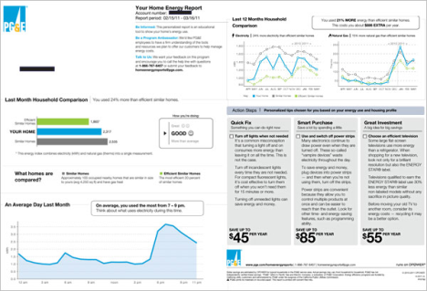
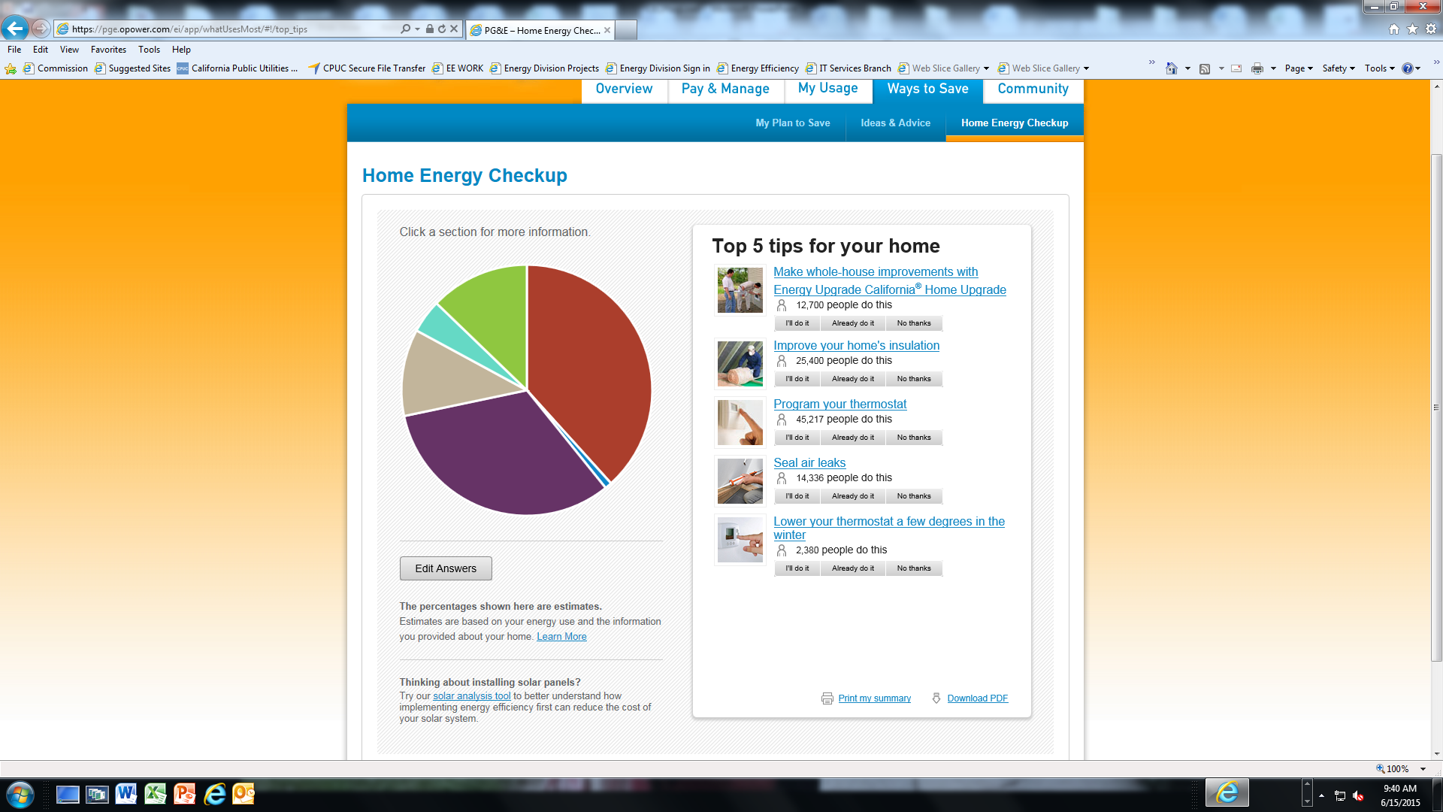
Plug-load marketing
Home Energy Efficiency Survey/Energy Advisor
customer fills out a survey (online/mail) and receives recommendations on low-cost/no-cost actions to save energy
Home Energy Reports (OPower)
comparative usage
tips on how to save energy
Broader EE marketing
includes email, direct mail, bill inserts, etc.
no distinct and uniform plug load messaging – predominantly “white goods” based

Slide 6
Future efforts
IOU Pilots in 2013-2014:
Set-top Box (downstream)
RPP (mid-stream)
Game Consoles (upstream)
Significant challenges with each approach.
Legislation? – AB793 and AB1094

Slide 7
Support for Standards
Major need for advocacy support: DATA
  Load shapes, equipment saturations, average existing equipment age, equipment testing, sales data, metering analysis, etc.
  What happens when things change?
    How customers react when prices drop? Do they buy more equipment?
Opportunity for leveraging incentive programs
  Limited potential because of the specific data needs for advocacy and incentive program design
  Close coordination with C&S Advocacy is key to align design to meet data collection needs
  Still, may not be feasible in many cases

Slide 8
Thank you.
Peter Franzese
peter.franzese@cpuc.ca.gov
Paula Gruendling
paula.gruendling@cpuc.ca.gov

