Slide 1
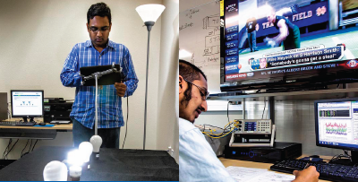


Incorporating User Behavior into
Standards for Plug Load Efficiency
Dr. Joy Pixley
Project Manager, Social Sciences
California Plug Load Research Center
California Institute for Telecommunications and Information Technology
University of California, Irvine
California Energy Commission
IEPR Lead Commissioner Workshop on Plug Load Efficiency
June 18, 2015
www.calplug.org

Slide 2
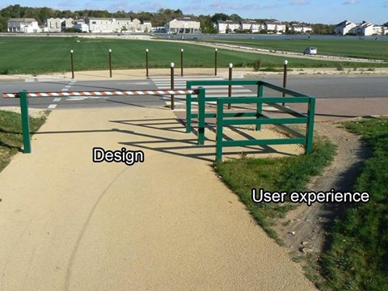
Focus on User Behavior
Most efforts toward greater plug load device energy efficiency have focused on how devices perform in standardized lab conditions.
Little attention is given to how people use the devices in real-life situations.
Effective set up/installation
Enabling of energy-efficient features
Persistence
Notes:
Opportunity to improve the realized energy efficiency

Slide 3
The Mythical Average User
Estimate energy savings based on the real range of user behaviors, rather than assuming all users fit the average.
Requires more research into how different types of people use devices.

Slide 4

Learn from Users
Study real-life use of features to:
  Verify predicted energy savings
    Relative efficiency may differ in actual use versus lab setting
  Improve design
    Rethink devices based on why users are avoiding or misusing energy-efficiency features
Example: Computer power management
  Changed PM settings because computer needs to be on for automatic updates and backups or for remote access: 33% office desktops, 18% home desktops, 14% laptops
Example: Set-top box restart too slow
  Frustration threshold study: 5 seconds acceptable

Slide 5

User Interface, I
Is the user interface easy to use?
Does it effectively communicate efficiency options to users?
Does it give users options they want?
Examples: Computer power management
  For office desktops compared across survey and monitoring:
    Users reported that sleep was enabled: 86%
    Actually had sleep enabled: 26% (30% of those who said they did)
    Conclusion: many users confused about whether sleep was enabled

Slide 6
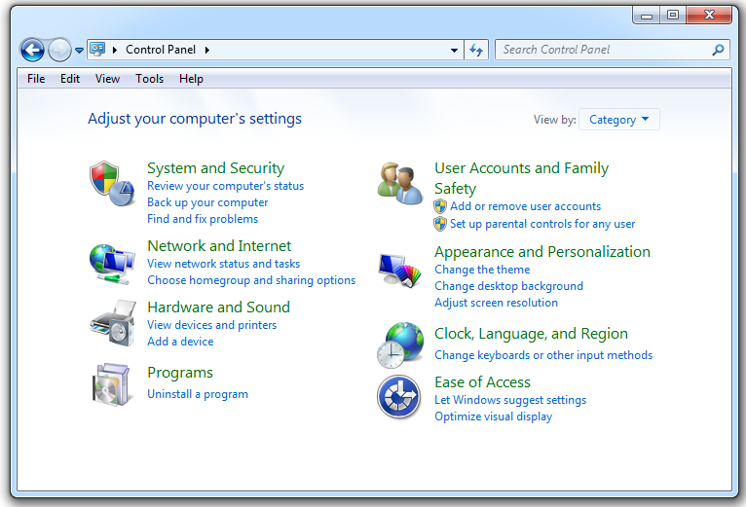
User Interface: Windows PM

Slide 7
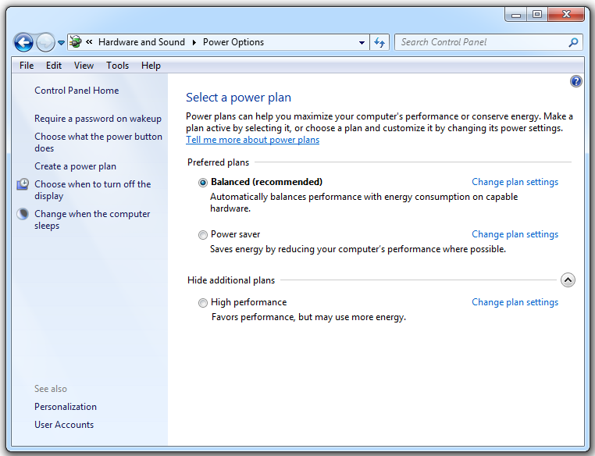
User Interface: Windows PM

Slide 8
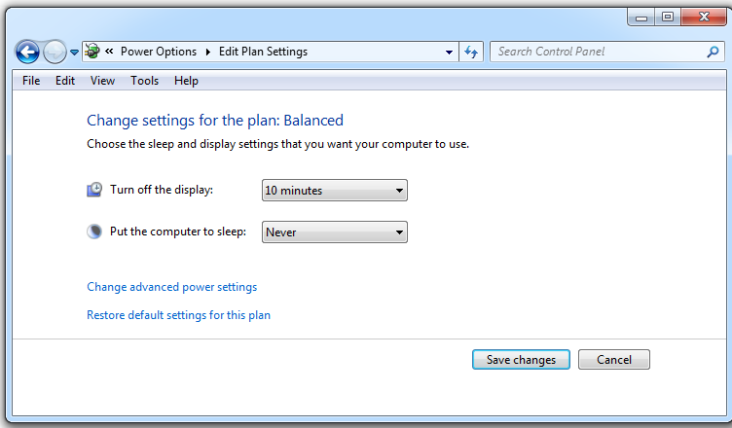
User Interface: Windows PM
Default sleep delay: 30 minutes
# with “Balanced” plan: 48
# of those changed to “never”: 43

Slide 9
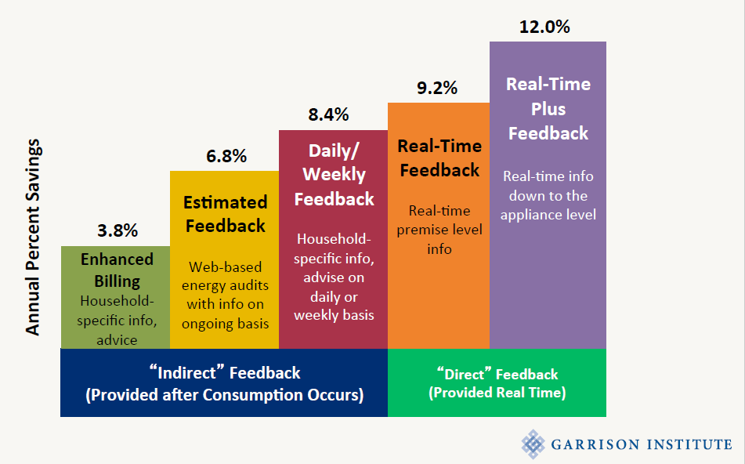
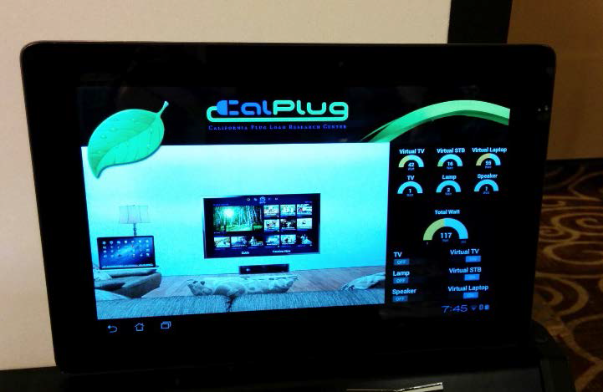
User Interface, II
Does it effectively communicate the current power state of the device?
Can the device directly communicate its energy usage?
Average Household Electricity Savings by Feedback Type
CalPlug’s Wall of Power Interface
(Karen Ehrhardt-Martinez, 2012)

Slide 10
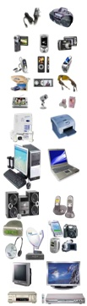
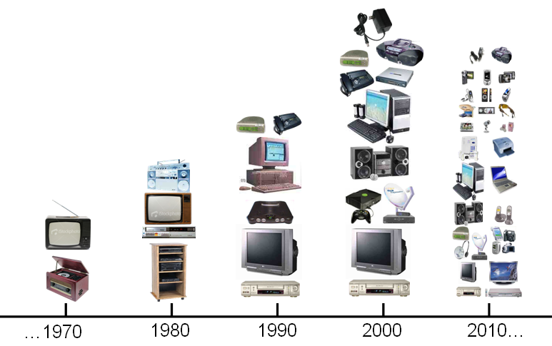
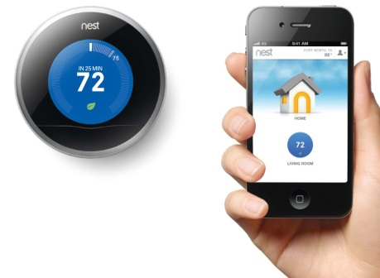
Responding to User Behavior
Devices can learn user behavior and automatically adjust
Estimates of savings should involve field tests in realistic situations
  How many users exhibit behavior so variable that it can’t be predicted?
  How do users experience the device?
Can networking devices save energy?

Slide 11
Recommendations
Improve device energy efficiency by informing design –especially of user interface – with research on users’ real-life behavior toward plug load devices.
Improve evaluative tests for plug load device energy efficiency by incorporating how devices are used and experienced in real-life environments, rather than relying solely on standard laboratory tests.
Improve user behavior by designing useful feedback mechanisms to communicate devices’ energy consumption, empowering users to make informed decisions.

Slide 12
Thank you!
Dr. Joy Pixley
jpixley@uci.edu
Project Manager, Social Sciences
California Plug Load Research Center
California Institute for Telecommunications and Information Technology
University of California, Irvine

