Slide 1
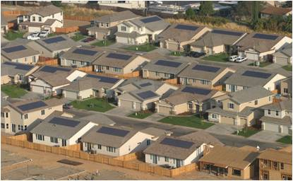
Pathways to ZNE: SMUD Perspectives, Grid Impacts, Shared Solar
Obadiah Bartholomy
Rebecca Rundle
Stephen Frantz
Presented at CEC IEPR Workshop 5/18/2015

Slide 2
If these are the questions...
How can we use new buildings to help attain the State’s 2030 and 2050 carbon reduction goals?
How can we most rapidly decarbonize the State’s electricity generation mix?
How can we drive down the energy intensity of new buildings?
How can we ensure that occupants of new buildings will have the lowest possible utility bills?
How can we minimize grid impacts of significant new additions to load?

Slide 3
...ZNE buildings may not be the best answer.
Requiring on-site generation equivalent to annual consumption may allow overinvestment in supply and underinvestment in efficiency and increased electrification.
Utility investment in required back-up infrastructure and generation capacity will never be recovered by the ratepayers who must pay for it.
Zeroing out at the building rather than at the network level will lower carbon reduction per dollar invested.
How do we think beyond ZNE to a preferred endpoint that maximizes value to both the buidling occupant and the distribution system?

Slide 4
Alternative approaches are possible
Redefine ZNE
  From zero energy on annual basis with TDV consideration
  To
    Zero peak (or peak resource)
    Zero carbon
    Demand responsive (including more controllable loads)
    ZEV ready
Consider using shared rather than on-site PV
Have builders pay for net costs of serving new construction loads with zero-carbon resources

Slide 5
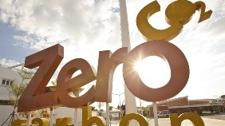
SMUD New Construction Program: Major Program Drivers
Integrated DSM (market segment focus)
Peak reduction
Ease of participation
Moving toward ZNE readiness
Ultimately Moving towards Zero Carbon
Notes:
Zero Carbon (not just ZNE):
-super-efficient construction
-electric vehicles
-100% renewable energy (either onsite or contracted)
-no fossil fuels (all-electric)

Slide 6
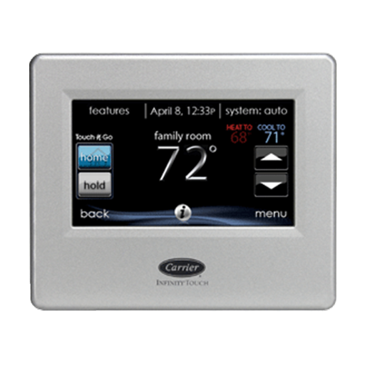
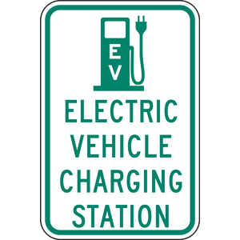

Program Structure: SMUD Smart Homes 2015
Program Entry
$400
+
Performance Points
$25 per point – HERS between 84 - 75
+
Bonuses
$250 - peak reduction*
$50 per point – HERS below 75
$250 – W/SW- facing PV
$150 - 100% LED
84
ready
*<1kW average peak demand from 4-7PM not counting solar PV
Notes:
Program Entry:
HERS Score of 84
75% LED lighting
Demand response capable thermostat
Electric vehicle readiness
Energy Star appliances

Slide 7
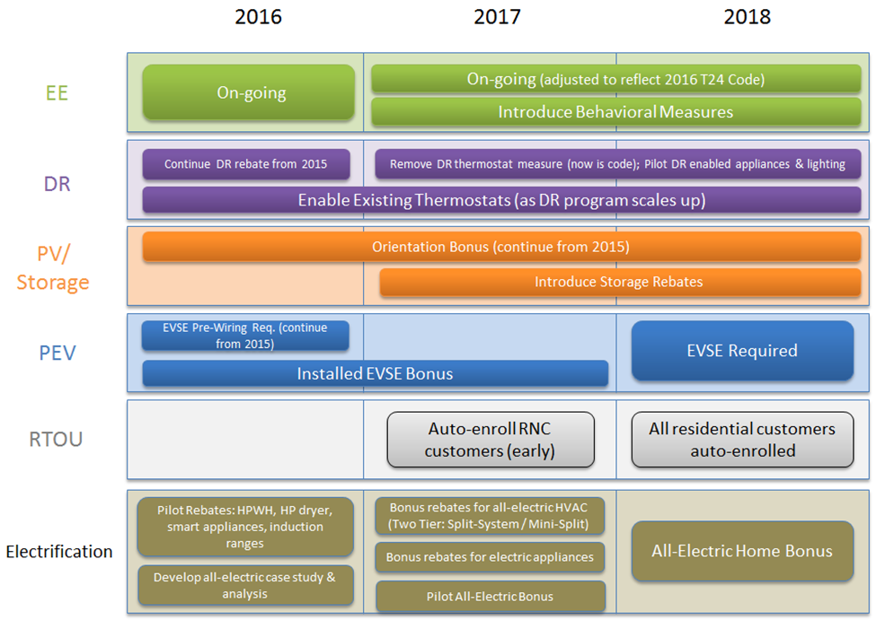
SMUD RNC: Three-Year Road Map
Notes:
End goal: an zero-carbon home that benefits the utility & the homeowner

Slide 8
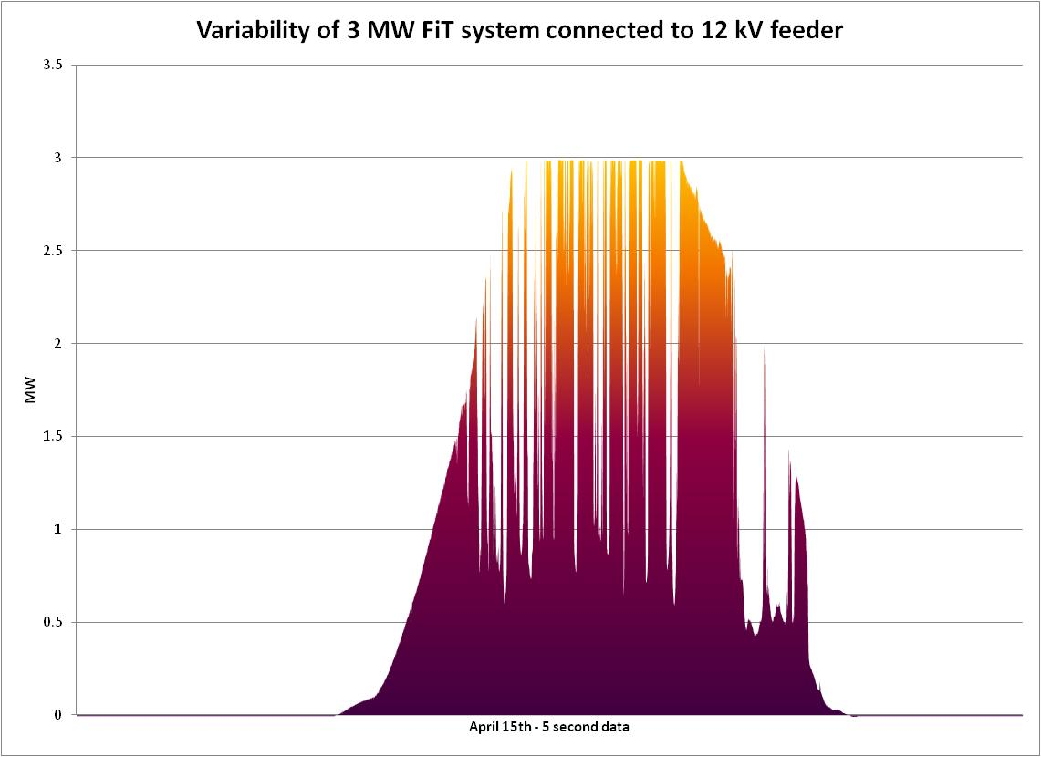
How might ZNE impact grid
Significant geographic concentrations of solar can impact voltage faster than system currently regulates it
This may create:
  short-term excursions outside of voltage standards
  increased losses if average voltage must be kept higher due to passing cloud impacts to voltage
  Increased wear and tear on substation
  voltage regulators
  Increased investment in distributed voltage
  controls
PV output ramping between 0.5 and 3 MW within 30 seconds multiple times during the day

Slide 9
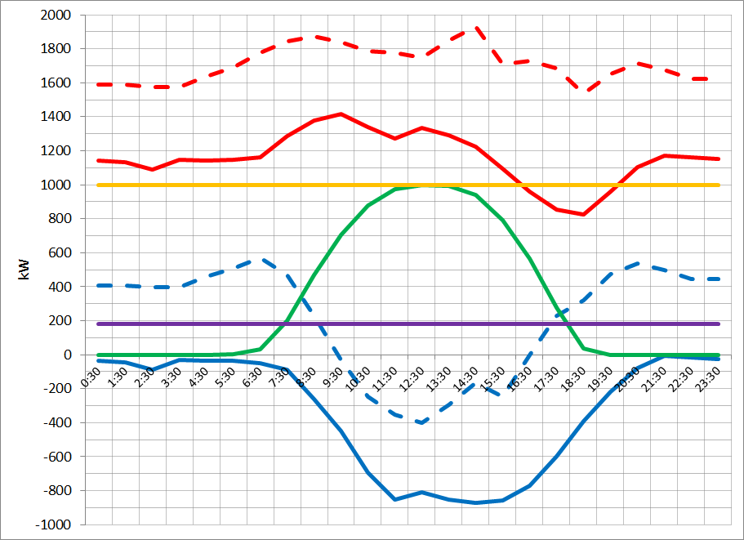
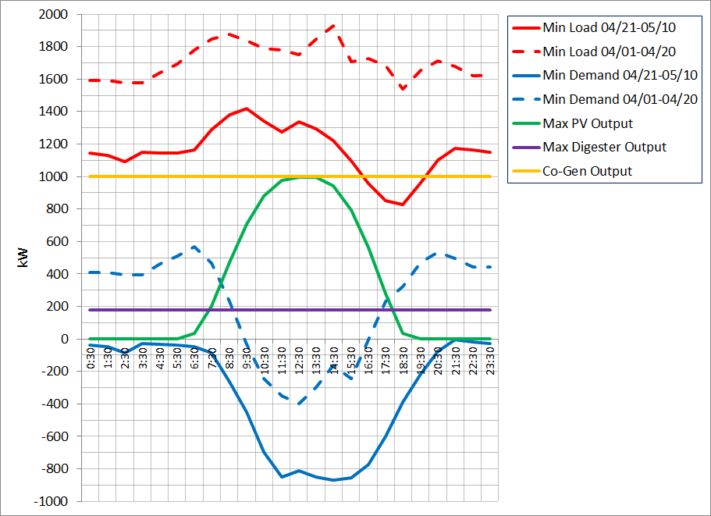
How might ZNE impact grid cont’d
Overgeneration and control of distributed PV Systems
  Sizing systems to meet annual load, in Sacramento, will likely mean ~3 - 4kW system for efficient home, 6kW including EV
  Daytime loads during spring for a typical New Construction home will be on the order of 300 Watts
  Exports of 90% of output during spring days may conflict with high hydro / high wind conditions
  Curtailment of many distributed systems may present challenges with communication and compensation
  Value of Solar PV may drop, and cost to non-participants may offset value of ZNE to participants
backfeed

Slide 10
Here are some possible advantages of a shared approach, but more analysis is required:
Lower cost per kWh of solar energy produced
More control over siting for optimal performance and economic benefit
Easier for utility to price, balance, and dispatch.
Increasing system benefits by using DSM and DR measures to improve the match between load profiles and solar generation curve.
Increased latitude for building design and orientation.
No competition with trees.
Increased assurance that the monetary value of generation will equal the value of energy consumed.

Slide 11
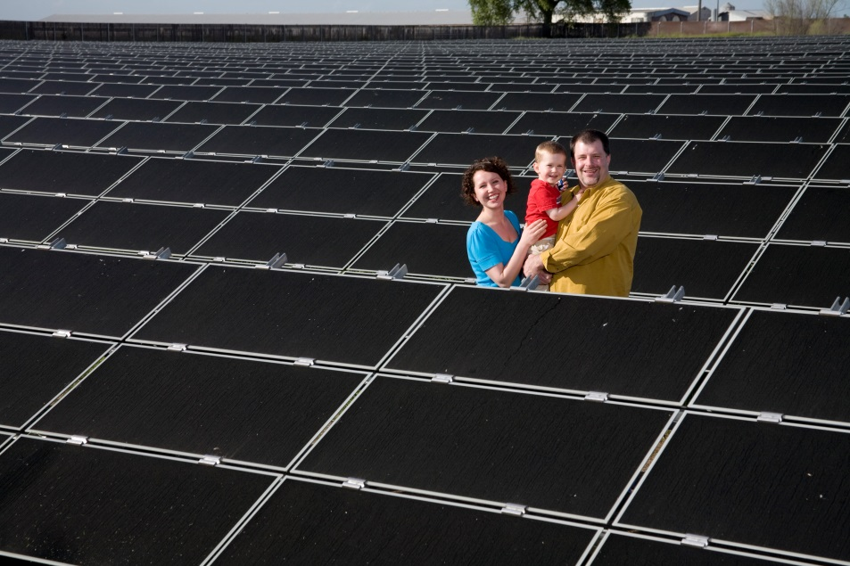
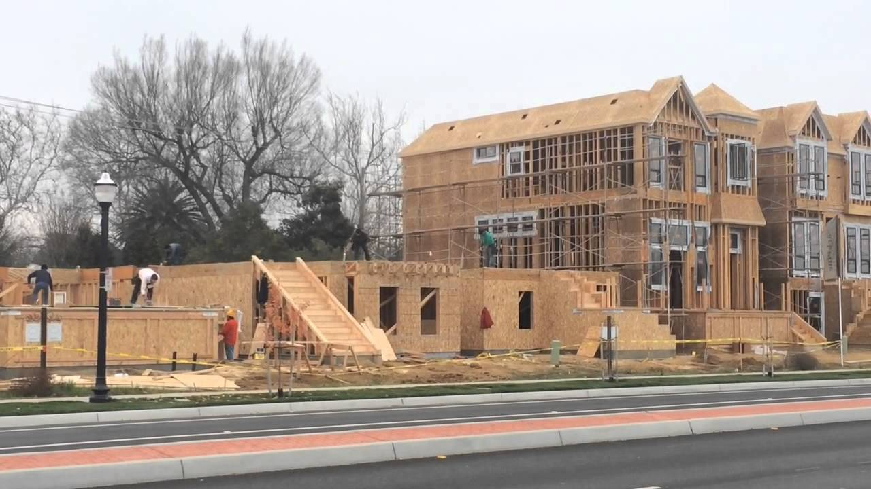
SMUD’s High-Value Integrated Community Solar Project
Goal: To demonstrate the customer and system value of shared, distributed PV when combined with demand-side measures that improved the match between customer load shape and generation curve.
Notes:
Objective #1: To demonstrate the resource potential of 1MW-5MW PV projects when accompanied by DSM that improves the match between load shape and solar generation curve and mitigates reliability issues.
Objective #2: Streamline the siting process for small, in-fill solar projects by adding value to otherwise underutilized property and by modeling new financial partnerships with SMUD customers.
Objective #3: To demonstrate that a significant segment of SMUD customers will be willing to make investments and take actions that accelerate solar deployment and increase the energy efficiency and load responsiveness of existing buildings.

Slide 12
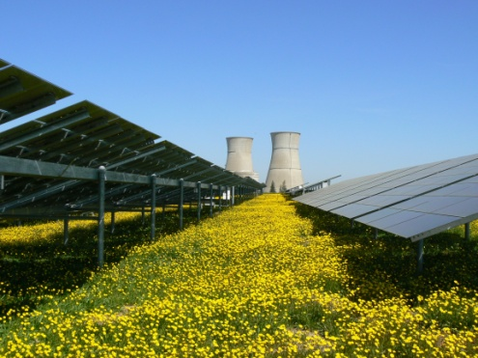


Thank You!
Obadiah Bartholomy
Obadiah.Bartholomy@smud.org

