Slide 1
Energy Benchmarking and Transparency
^{Cliff Majersik,}
^{Executive Director}
^{cliff@imt.org;@IMTCliff.}
^{May 7, 2011}

Slide 2
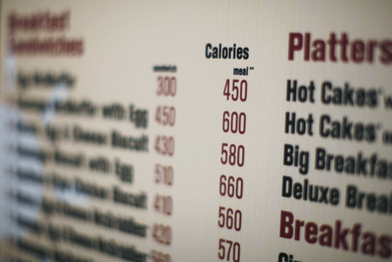
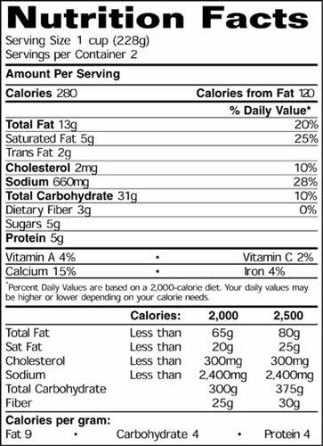
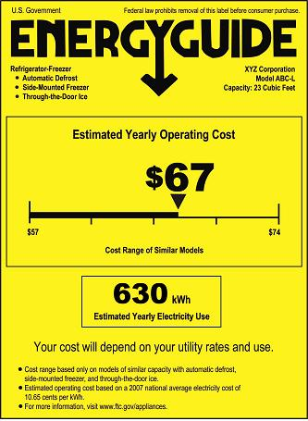
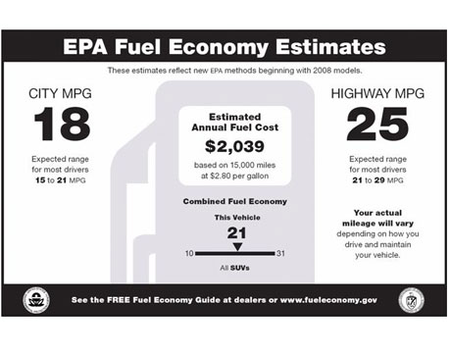
You Can’t Manage What You Don’t Measure
Notes:
Can’t manage what you don’t measure. Mechanisms in other industries that are built on this old adage and allow for transparency. Imagine managing your weight without calorie counts, nutrition facts and a scale. Foundation of a successful energy management strategy.

Slide 3
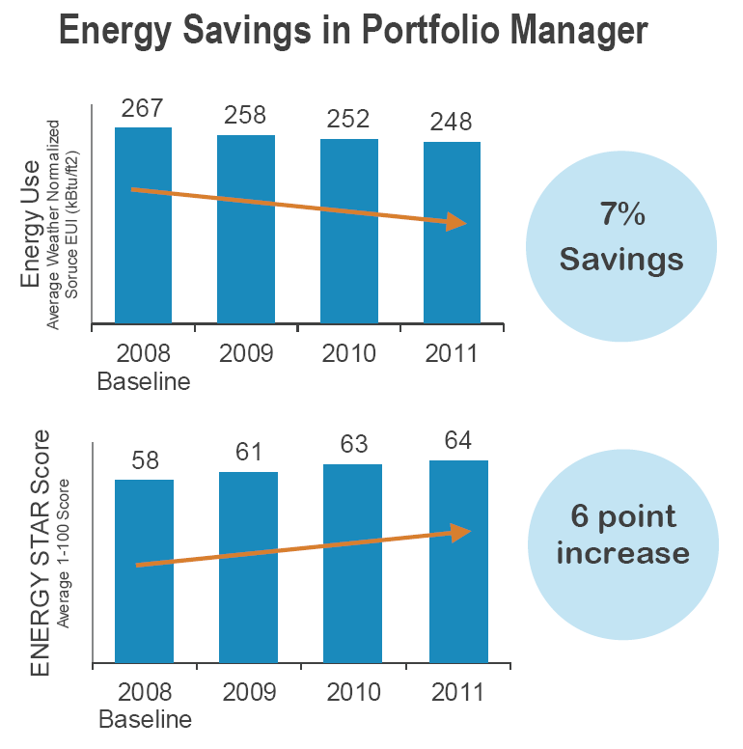
Benchmarking and Energy Savings
Consistent benchmarking in buildings results in energy savings and improved performance
www.energystar.gov/datatrends
Notes:
An recent EPA analysis of more than 30,000 buildings that consistently tracked energy consumption in Portfolio Manager over a three year span showed 7% average energy savings and a 6 point ENERGY STAR score increase from 2008-2011.
For more information, see www.energystar.gov/datatrends.

Slide 4
Features of a Benchmarking and Transparency Policy
Component
Audience
Outcomes
Benchmarking
Building Owners
Owners compare their properties to peers and become aware of opportunities for improving building performance
Reporting
Policy makers
Utility program administrators
Researchers
Target incentives toward low performers
ID and support low performing buildings and market sectors
Track progress toward goals
Policy Framework
Transparency
Buyers and tenants
Brokers
Financing and investment firms
Market considers building energy performance when making purchasing and leasing decisions.
High performing buildings achieve higher valuations and lower vacancy rates

Slide 5

Energy Benchmarking and Transparency
Notes:
EPA Energy Star is not involved in advocating for or designing benchmarking and disclosure mandates, but does provide technical assistance to jurisdictions with mandatory benchmarking requirements in place.
More than 15 billion square feet of commercial space has been voluntarily benchmarked in the past decade
Top performing buildings are eligible for Energy Star “label” recognizing the top 25% of energy-efficient buildings nationwide
Washington, DC is requiring Energy Star Target Finder scores for new buildings
Compare the 200k+ buildings already using Portfolio Manger to the 5,200 within a 10 year old version of CBECS!

Slide 6
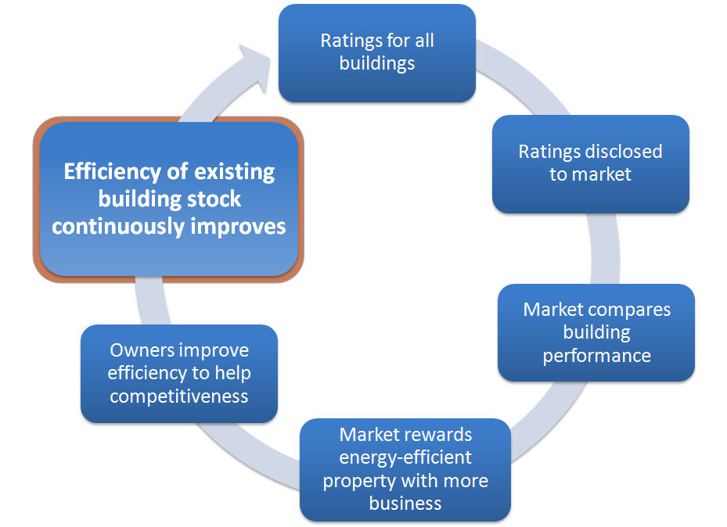
Transparency Drives Cycle of Improvement
Notes:
EPA Energy Star is not involved in advocating for or designing benchmarking and disclosure mandates, but does provide technical assistance to jurisdictions with mandatory benchmarking requirements in place.
More than 15 billion square feet of commercial space has been voluntarily benchmarked in the past decade
Top performing buildings are eligible for Energy Star “label” recognizing the top 25% of energy-efficient buildings nationwide
Washington, DC is requiring Energy Star Target Finder scores for new buildings

Slide 7
Added Value of ENERGY STAR-Certified
Commercial Buildings in the U.S. Market

Slide 8
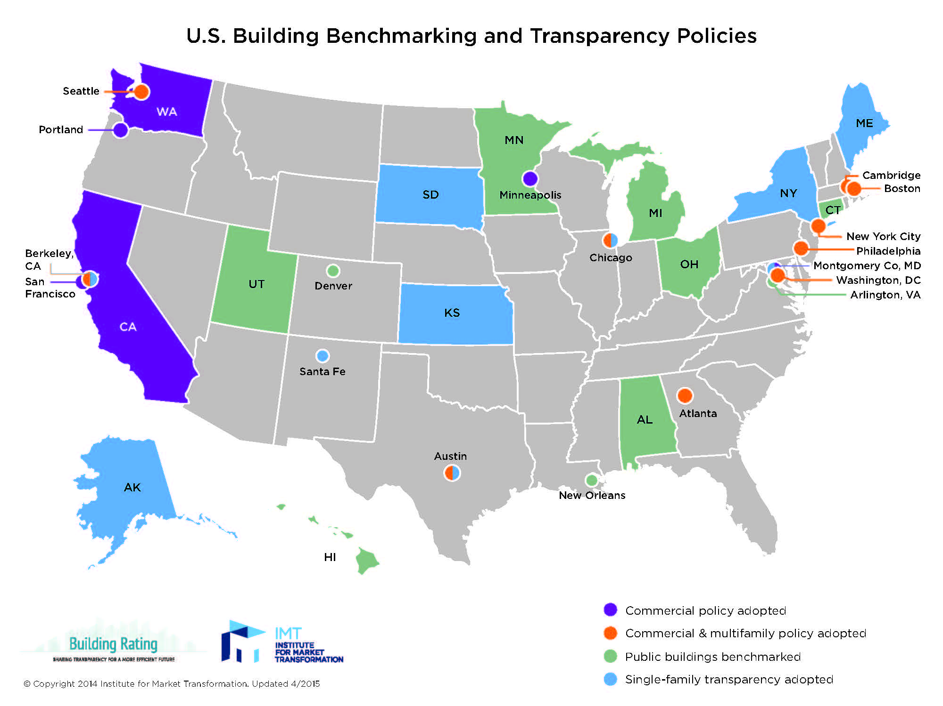
U.S. Benchmarking Policy Landscape
Notes:
Recognizing these benefits, benchmarking policies are now on the books in 9 cities and 2 states. They target large commercial buildings, some also include multifamily buildings (like DC, Seattle, and NYC). These policies aim to catalyze the market by making energy usage transparent. By being able to see and understand the energy performance of a building, owners/manager/tenants/investors/etc. can act and make decisions incorporating that information.

Slide 9

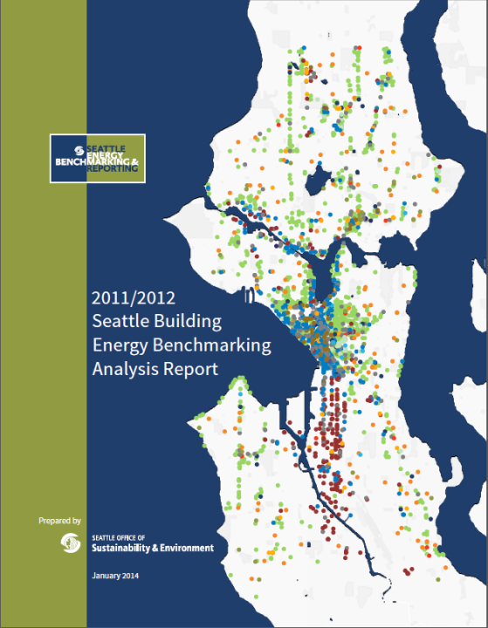

Presenting Benchmarking Information

Slide 10
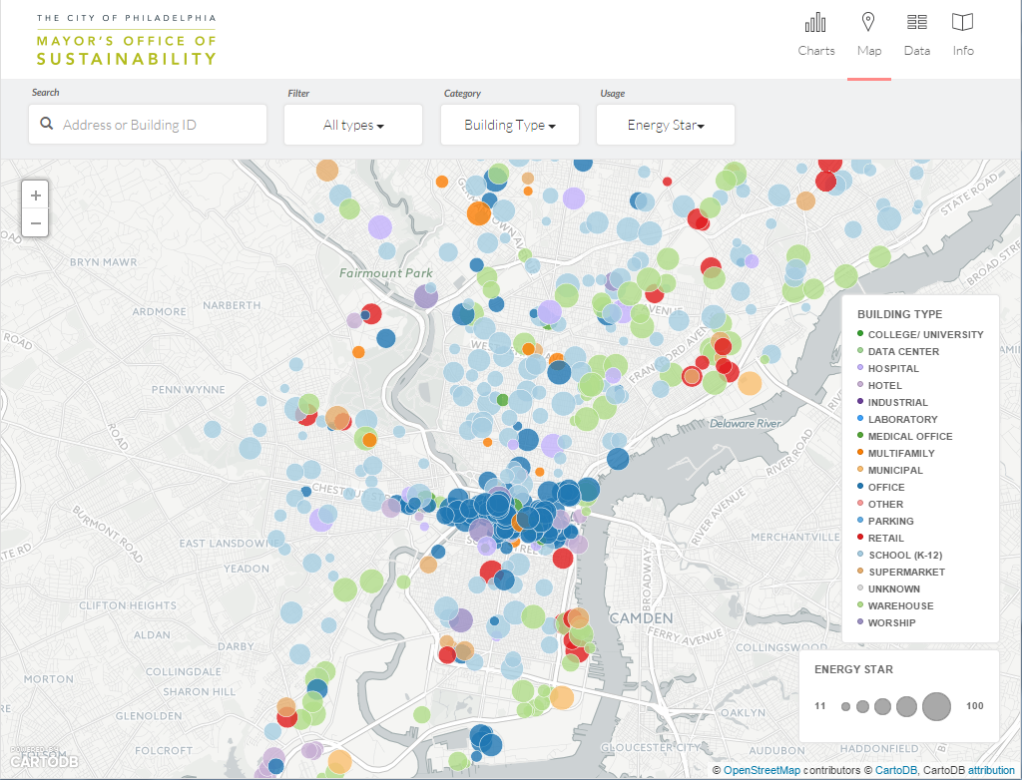
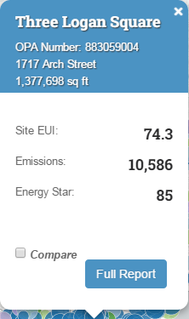
Presenting Benchmarking Information

Slide 11
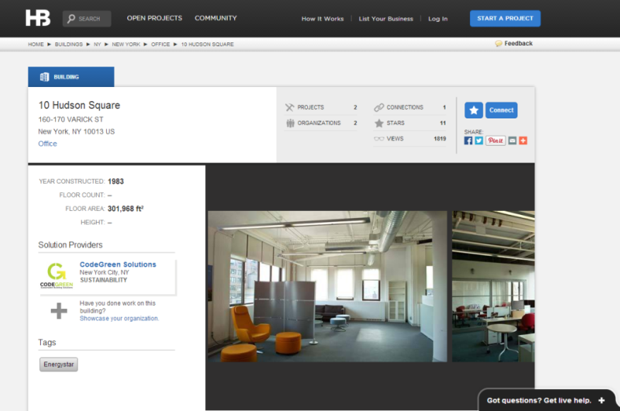
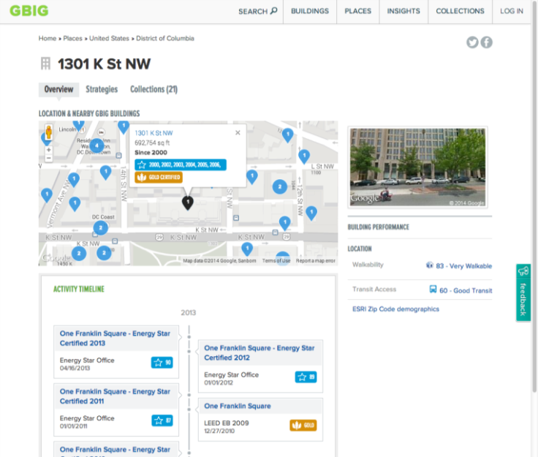
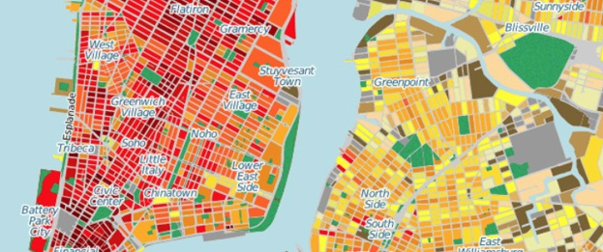
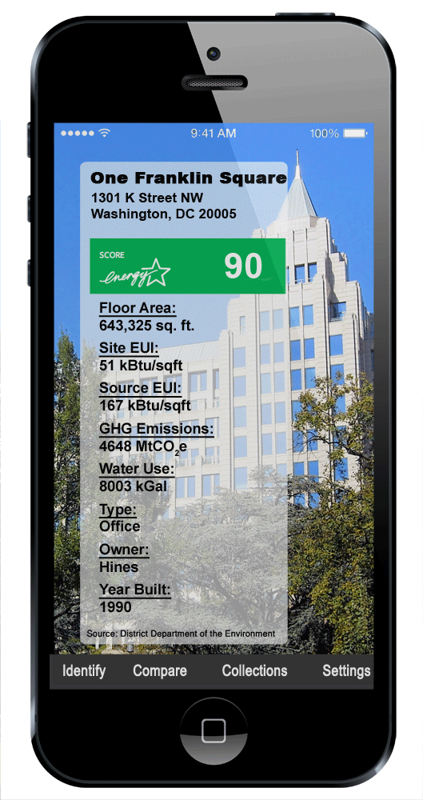
Presenting Benchmarking Information

Slide 12
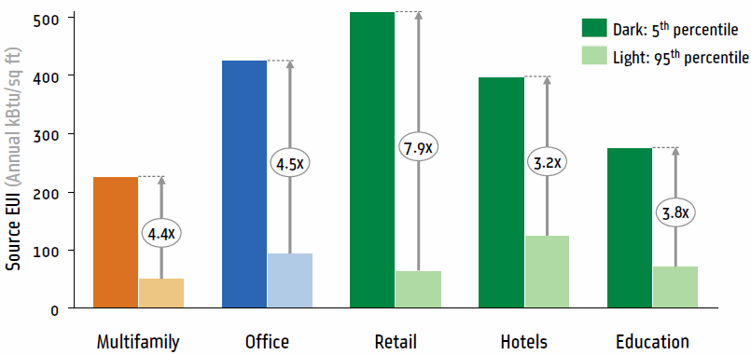
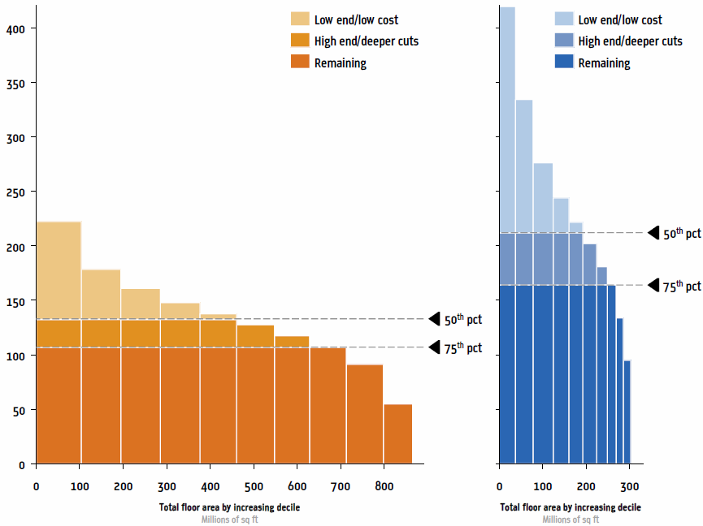
Energy Intensity Findings in New York City
The poorest performing buildings use 3x to 7x the energy of the best performing buildings.
Credit: New York City Local Law 84 Benchmarking Report, August 2012
By improving the poor performers
citywide energy reductions of 18% to 31% could be achieved.

Slide 13
Collecting Utility Data

Slide 14
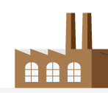
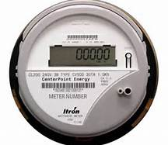



Collecting Utility Data
Bill Payer(s)

Slide 15





Collecting Utility Data
Building Owner
Building Physical
and Operating Characteristics
Energy Consumption
Tenants
Bill Payer(s)

Slide 16

Collecting Utility Data
Building Owner
Building Physical
and Operating Characteristics
Energy Consumption
Tenants
Bill Payer(s)

Slide 17
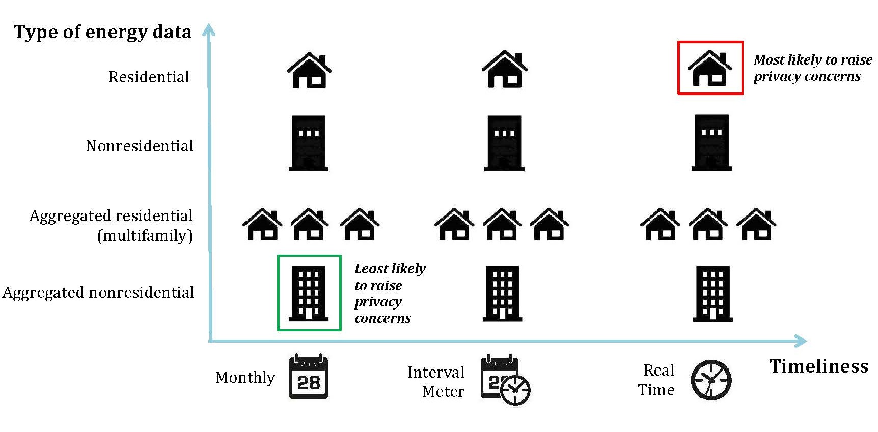
Sensitivity of Energy Data
Sensitivity of Energy Data
Notes:
CK – FORMAT TITLE

Slide 18







Energy Data Access
The Data Access and Transparency Alliance (DATA) is a collaborative effort led by the commercial real estate industry and energy efficiency organizations to provide building operators with energy consumption data to advance energy-efficiency and energy cost savings in buildings.
More information can be found: http://www.energydataalliance.org/

Slide 19
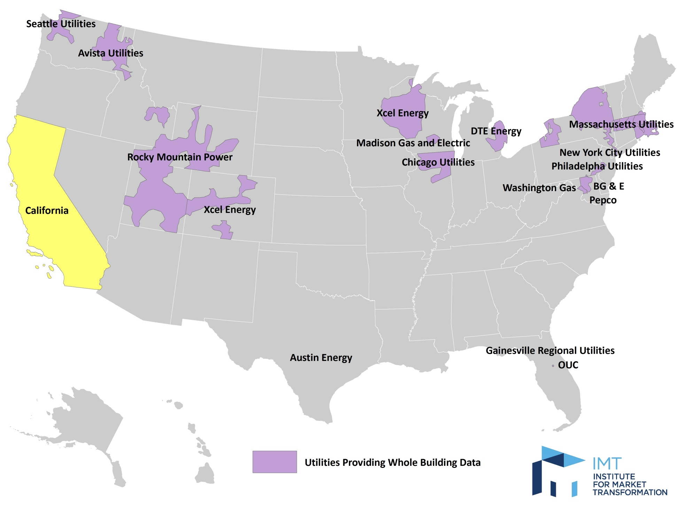
Utilities Providing Whole-Building Data

Slide 20

Thank you!
  Cliff Majersik
  Executive Director,
  Institute for Market Transformation
  Washington, DC
  cliff@imt.org, @IMTCliff

Slide 21
Utilities Providing Whole-Building Data
Utility Company (State) | Aggregation Threshold | Automated Upload to Portfolio Manager
Austin Energy (Texas) | 4/80* | -
Avista (Washington) | 2/-- | ✓
California IOUs | - | ✓
Commonwealth Edison (Illinois) | 4/-- | ✓
Consolidated Edison (New York) | 2/-- | -
National Grid (Massachusetts) | 3/50 | -
Eversource (Massachusetts) | 3/50 | TBD
PECO (Pennsylvania) | 5/-- | ✓
Pepco (District of Columbia) | 5/-- | ✓
Puget Sound Energy (Washington) | 5/-- | ✓
Seattle City Light (Washington) | 2/-- | ✓
* Does not apply to multifamily buildings
Updated April 2015

