Slide 1
Existing Buildings Energy Efficiency Action Plan Vision for Benchmarking
      Erik Jensen
      Benchmarking Program Manager
      California Energy Commission

Slide 2
Goal 1: Proactive and informed government leadership in energy efficiency

Slide 3
1.2 Nonresidential Benchmarking & Disclosure
Update AB 1103 Regulations 1.2.1
Simplify data access and reporting
Simplify compliance
Benchmarking and Disclosure Rulemaking 1.2.2
Establish meter data reporting protocols
Develop phase-in schedule
Benchmarking Infrastructure Development 1.2.3
Match utility data to physical properties
Encourage seamless integration of Portfolio Manager and SEED
Implement Statewide Program 1.2.4
Establish metrics to evaluate effectiveness and compliance
Potential Mandatory Program 1.2.5
Consider requirements for efficiency improvements
Notes:
Establish an energy benchmarking program with eventual public disclosure for commercial, public and multifamily buildings above 50,000 sf gross floor area.
As of now 1103 is a transaction-based disclosure and will not reach that many commercial buildings in a given year. The larger statewide program will complement 1103 in terms of reporting requirements will be complementary
Resolve data access; establish aggregation protocols .
Utilities will be required to map meters to buildings
Working with local jurisdictions to share reporting and disclosure infrastructure (leverage national efforts like SEED- strategy x.x)

Slide 4
Distinctions Between 1103 and AP
Program Elements | AB 1103 | ACTION PLAN
Audience for Disclosure | Energy Commission and Buyer, Lessee, or Lender | First cycle: Energy Commission Second cycle: Energy Commission and public
Building Size Thresholds | Currently 10,000 sf | 50,000 sf
Building Types | No multifamily | Includes multifamily
Time of Disclosure | Time of transaction | Time certain

Slide 5
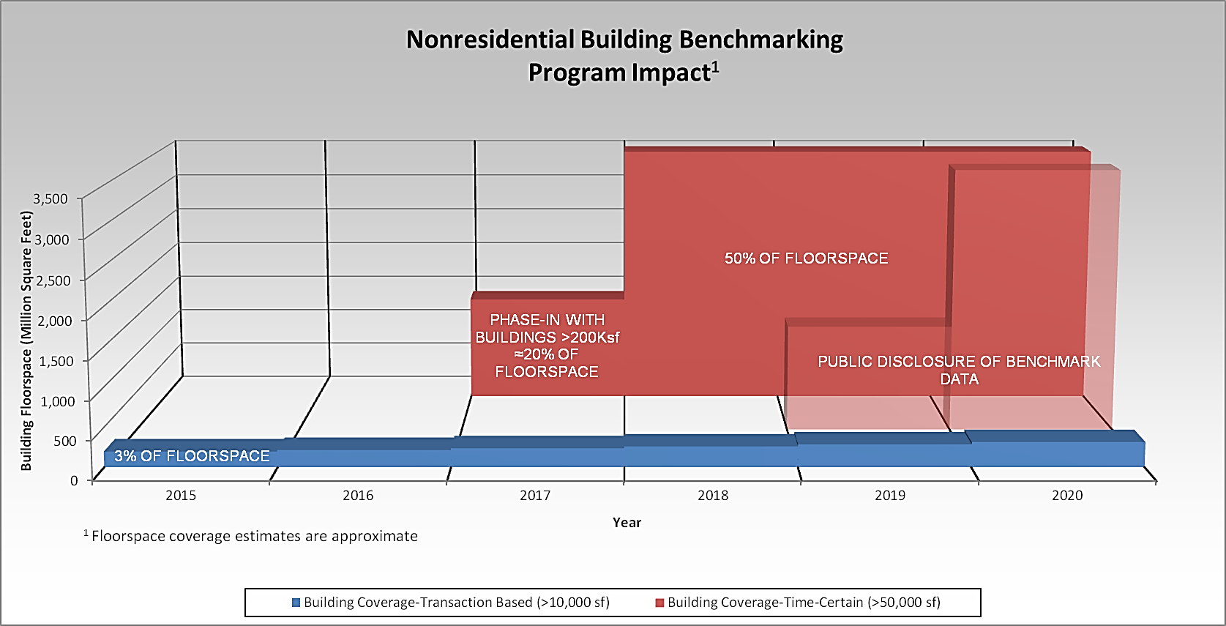
Comparison of Floor Space Covered by 1103 and Benchmarking strategies in Action Plan

Slide 6
Implementation Schedule
Pre-Rulemaking
Q3 2015
Rulemaking
Throughout 2016
Regulations Become Effective
Phase 1: 2018
Phase 2: 2019

Slide 7
Infrastructure Development
Explore and possibly implement SEED platform
Launch and facilitate CA SEED Working Group to explore synergies across local jurisdictions; inform DOE on necessary improvements
Partner with local governments
Employ a SEED-compatible database infrastructure for eventual public disclosure of benchmark data
Improve Portfolio Manager
Work with the U.S. EPA to support the program; encourage seamless integration of benchmark data in Portfolio Manager with SEED

Slide 8
Potential Program Modifications
Review program effectiveness.
Determine whether the program has motivated improvements resulting in sufficient savings.
Consider mandatory improvements.
Make recommendations regarding whether mandatory retrofits or retrocommissioning are necessary to increase energy savings.
Consider program expansion.
Determine whether the program should be extended to buildings smaller than 50,000 sf.

Slide 9
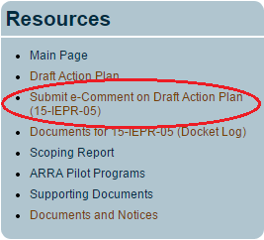
Submit Comments by 5 p.m. on May 21
eComments
http://www.energy.ca.gov/ab758/
Paper Comments
      Dockets Office, MS-4
      RE: Docket No. 15-IEPR-05
      California Energy Commission, 1516 Ninth Street
      Sacramento, CA 95814-5512

Slide 10
Contact Information
      Energy Commission Benchmarking
      Program Manager
      Erik Jensen
      916-654-4166
      Erik.Jensen@energy.ca.gov
      Energy Commission Staff Contact for
      Action Plan and Workshops
      David Ismailyan
      916-654-4045
      David.Ismailyan@energy.ca.gov

