Slide 1

Successes & Challenges in Southern California Municipal Facilities
CEC IEPR Lead Commissioner Workshop Benchmarking and Local Government Challenge
May 7, 2015
Laurel Rothschild, The Energy Coalition

Slide 2

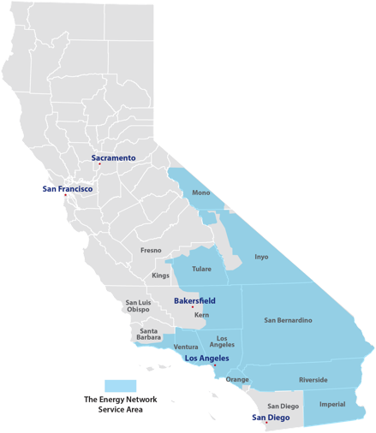






Background
The Energy Coalition
Founded in 1975
501(c)3 Social Change Organization
Leader in policy, education and
engagement and smart energy solutions
Community Energy
Partnership
Very First Local Government Partnership
8 cities
Southern California
Regional Energy Network
(The Energy Network)
Administered by Los Angeles County
Public Agency Program
Over 700 eligible agencies
Notes:
SoCalREN
12 Counties

Slide 3

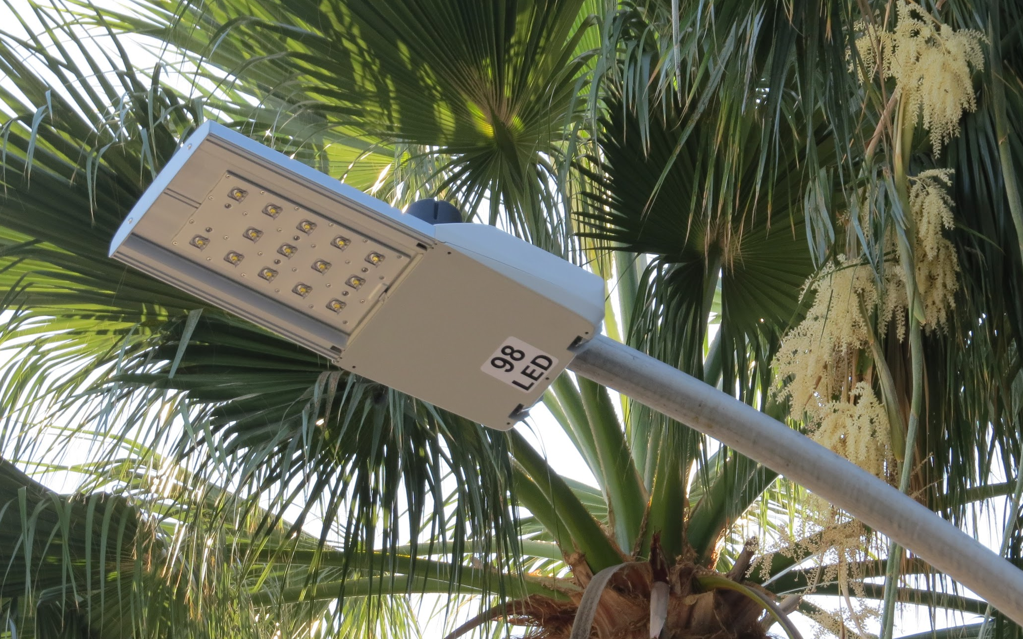

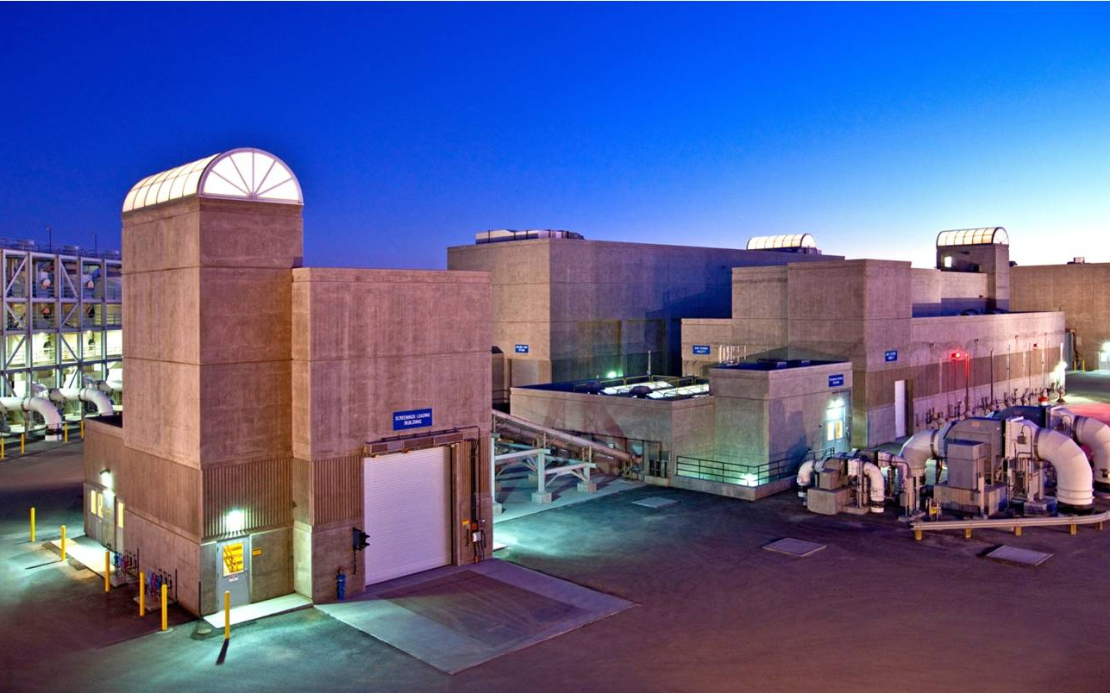
Municipal Energy Efficiency Upgrades
Notes:
many are universal challenges faced by many or all market sectors
Ties to Local Government Challenge program: Aggressive efficiency for public buildings

Slide 4
Challenges
Public Agency
Programs
Policy

Slide 5
Public Agency Challenges
1
Limited staff time and expertise
Limited understanding of project financials
Limited understanding of procurement and construction
EE competing with other projects
Deferred maintenance is the priority
Renewables are visible with stronger appeal
Investing in deeper & whole building retrofits
Requires more stakeholders to buy into project
Requires bundling measures to invest in capital intensive projects
2
3
Notes:
From the agency perspective

Slide 6
Energy Efficiency Program Challenges
1
Numerous Programs
Multiple customer touch points
Confusing and at time cross-purpose offerings
Navigating IOU Incentive Process
Complex and time consuming due to extensive documentation requirements
Length of time to process application
Measuring Success
Depends on participation in IOU EE program
Above code vs existing condition baseline -- Not measuring actual impacts
Lack of Access to Data
Privacy concerns and required disclosure forms
Time to collect data and level of accuracy
2
3
4
Notes:
FROM THE AGENCY PERSPECTIVE

Slide 7

Policy Challenges
Siloed energy policies and proceedings → no true integrated and cohesive solution for the customer
Disconnected programs and industry practices → competing outcomes
Weak linkage between program designs and State’s goals → lack of clear market transformation strategies and target outcomes
Lack of uniform metrics → should be avoided costs of GHG
Over emphasis on administrative efficiency → loosing focus on customer needs
1
2
3

Slide 8
Successes
Local Government Partnership
The Energy Network
Looking Ahead

Slide 9



Local Government Partnership Successes
Agencies assist to identify opportunities in community for program promotion
Popular: No-cost one-time opportunities with minimal effort and large return
Greater communication between utilities and agencies
Increased agency awareness of energy efficiency programs and benefits received

Slide 10
The Energy Network Successes
The Energy Network highly successful in addressing challenges
Focus on actual impacts, overcoming barriers to action and building capacity within agencies
Engage market actors to implement whole building retrofits & aggressive EE including contractors, engineers, financing, IOU, agency and trade associations
Standardized tools for engineering, procurement, energy management and permitting
One-stop service from full turn-key to a-la-carte
Remove hurdles where projects typically stall
Project Management services from project identification to construction
High customer satisfaction

Slide 11
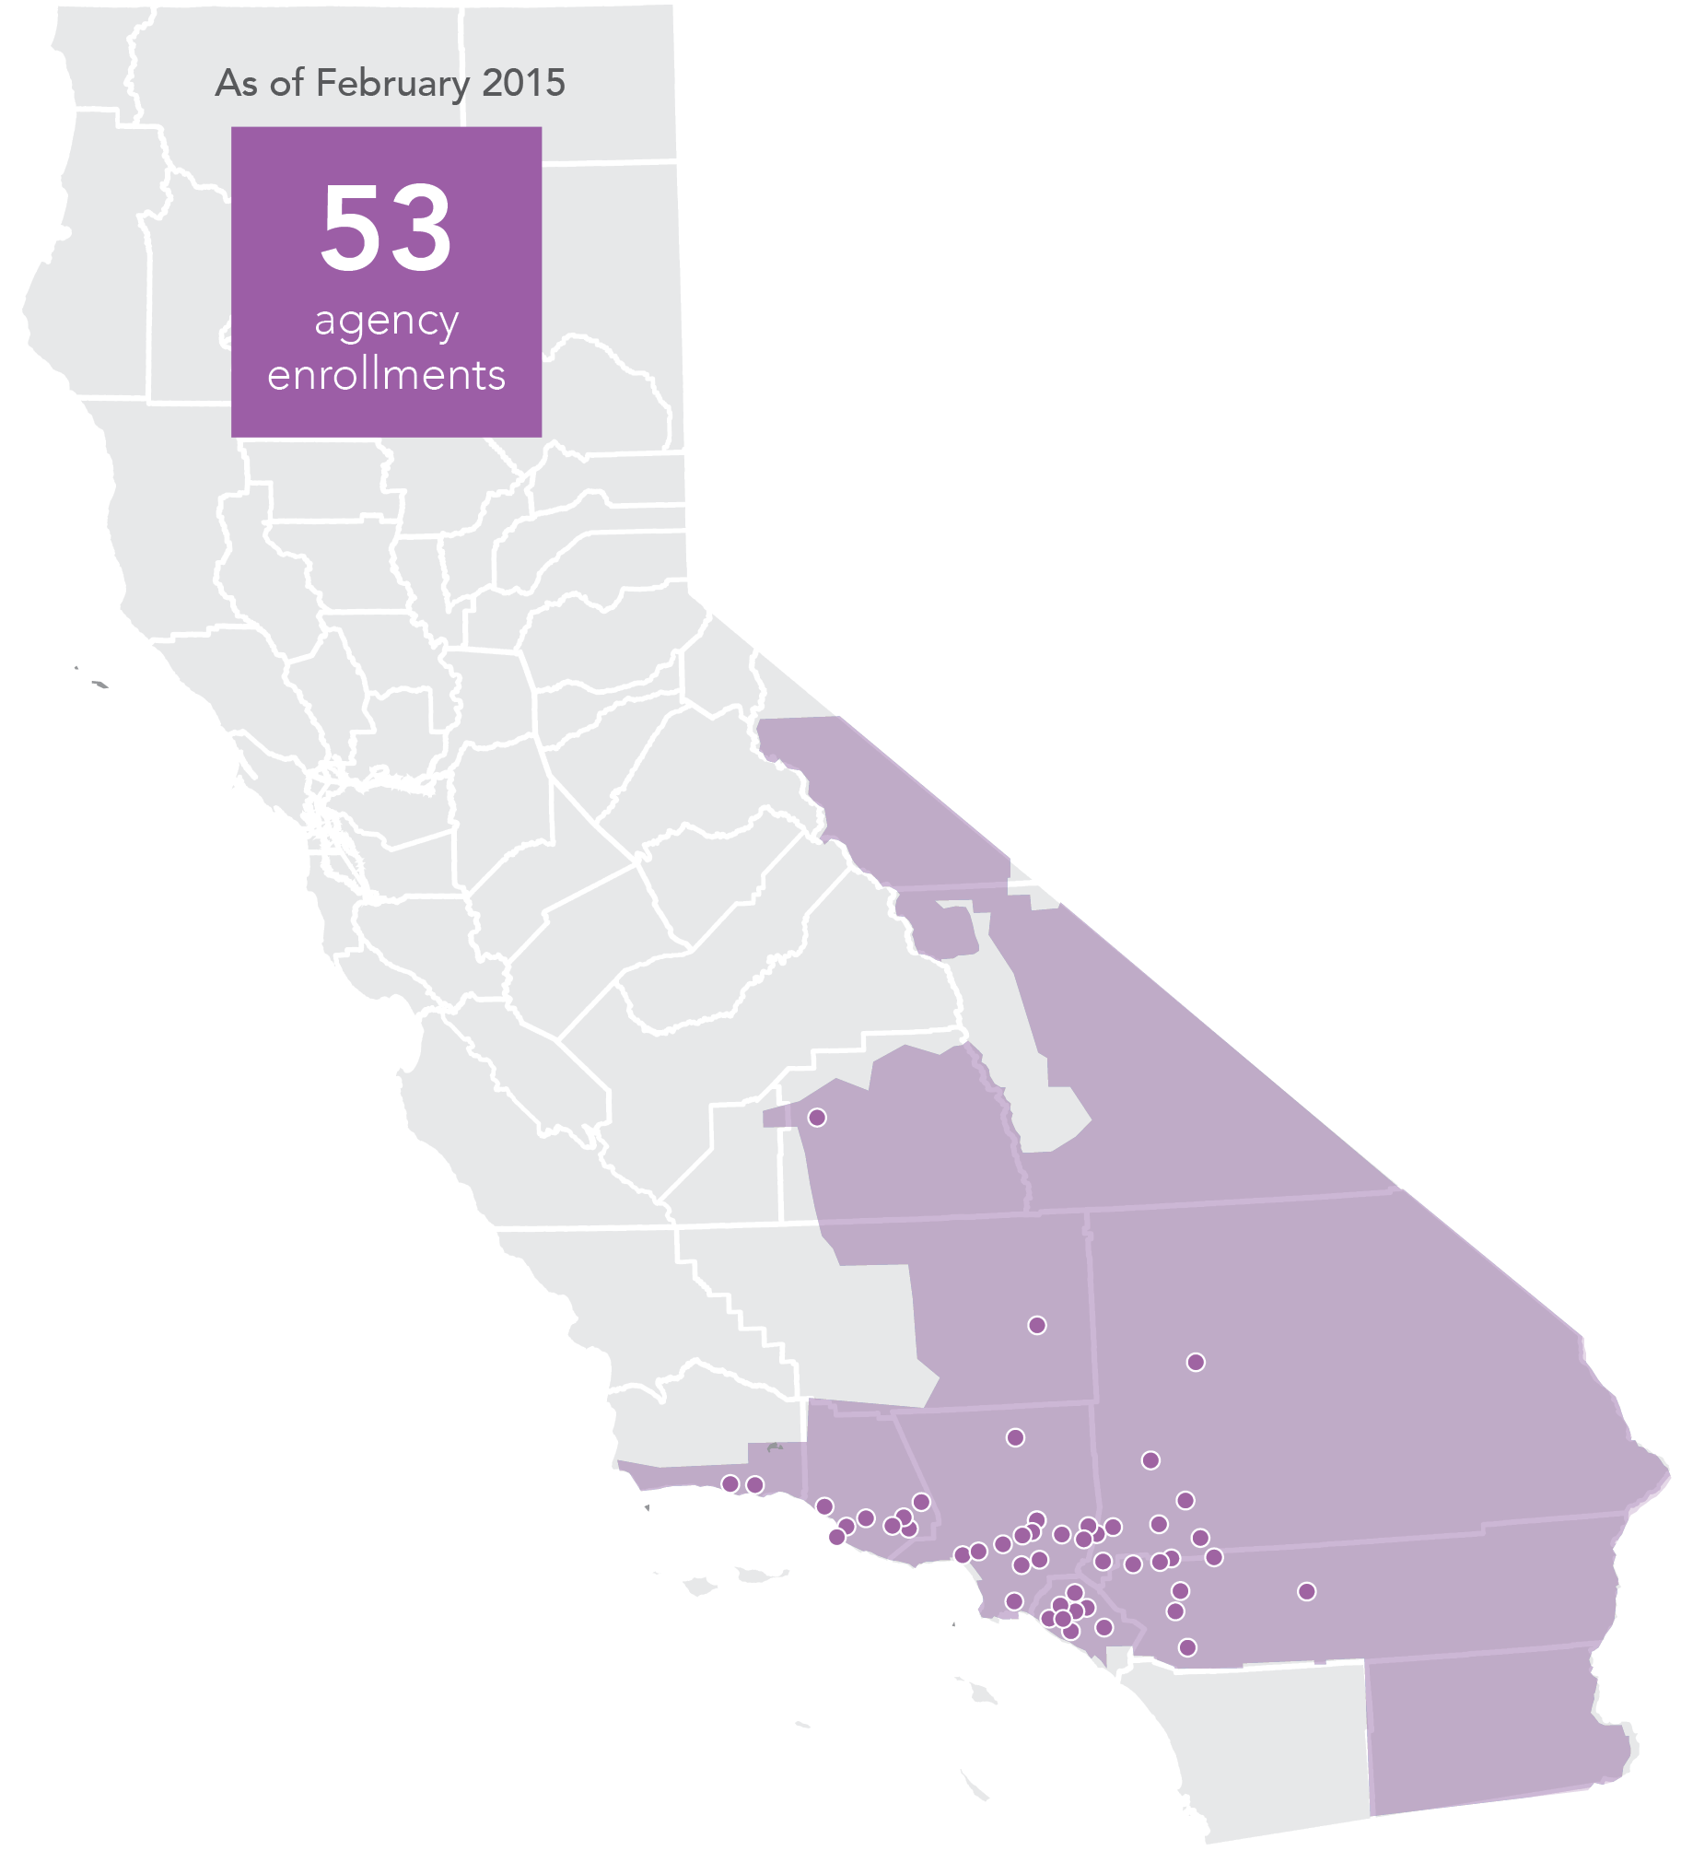
Who Is in The Energy Network?
56
Agency Enrollments
2
Counties
As of April 2015
12
Water Agencies
38
Cities
56
Agencies
2
School Districts
2
Special Districts

Slide 12
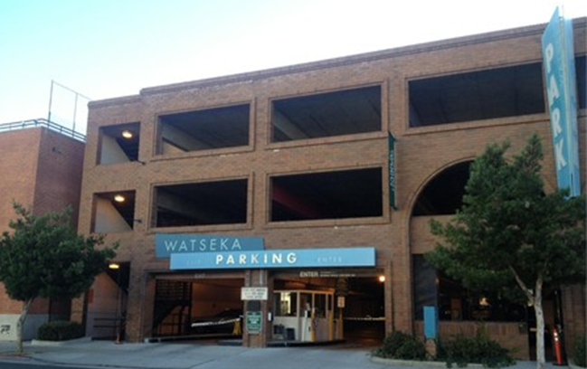
Case Study
City of Culver City
Watseka parking garage lighting project
Needed to move fast → Audit kick-off through construction completed in 7.5 weeks
Benefits - 243% ROI, $19k savings annually, 18.63 tons of CO2e avoided.
Comparison of Energy Network turnkey project delivery and standard design-bid-build process:
Audit
Design
(1.5 weeks )
Review, Approve
& Award
(2 weeks )
Construction
Audit
Design ( 1-2 months)
Bid/Award (2 to 3 months)
Construction
Notes:
This project would not have happened without NJPA, first one to use turnkey services
126,000 kWh savings
151 x 150 W HP Sodium lights → new 80W Induction fixtures

Slide 13
Needed Action for Future Success
Policy -- Integrate energy policy framework across State’s energy agencies
CEC, CPUC, CARB, CAISO aligned on Governor’s 2030 Goals and State’s energy objectives
Standardized program goals while providing program flexibility for regional needs
Program Design -- Program guiding principles
Focus on the customer’s needs
Integrated customer energy solution
Pilot Implementation -- Testing innovative approaches on-the-ground
Smart energy districts with integrated demand-side resources → local governments uniquely suited to lead
Pilot newly effective program design then scale-up → The Energy Network’s Public Agency Program

Slide 14
Contact Information
Laurel Rothschild
Assistant Director, Engagement & Education
The Energy Coalition
lrothschild@energycoalition.org
(949) 732-1071

