Slide 1
EBEE Draft Action Plan Workshop
- Strategies Related to Data –
Jonathan Changus
Member Services Manager & Regulatory Affairs
jonathan.changus@ncpa.com – (916) 781-4293

Slide 2
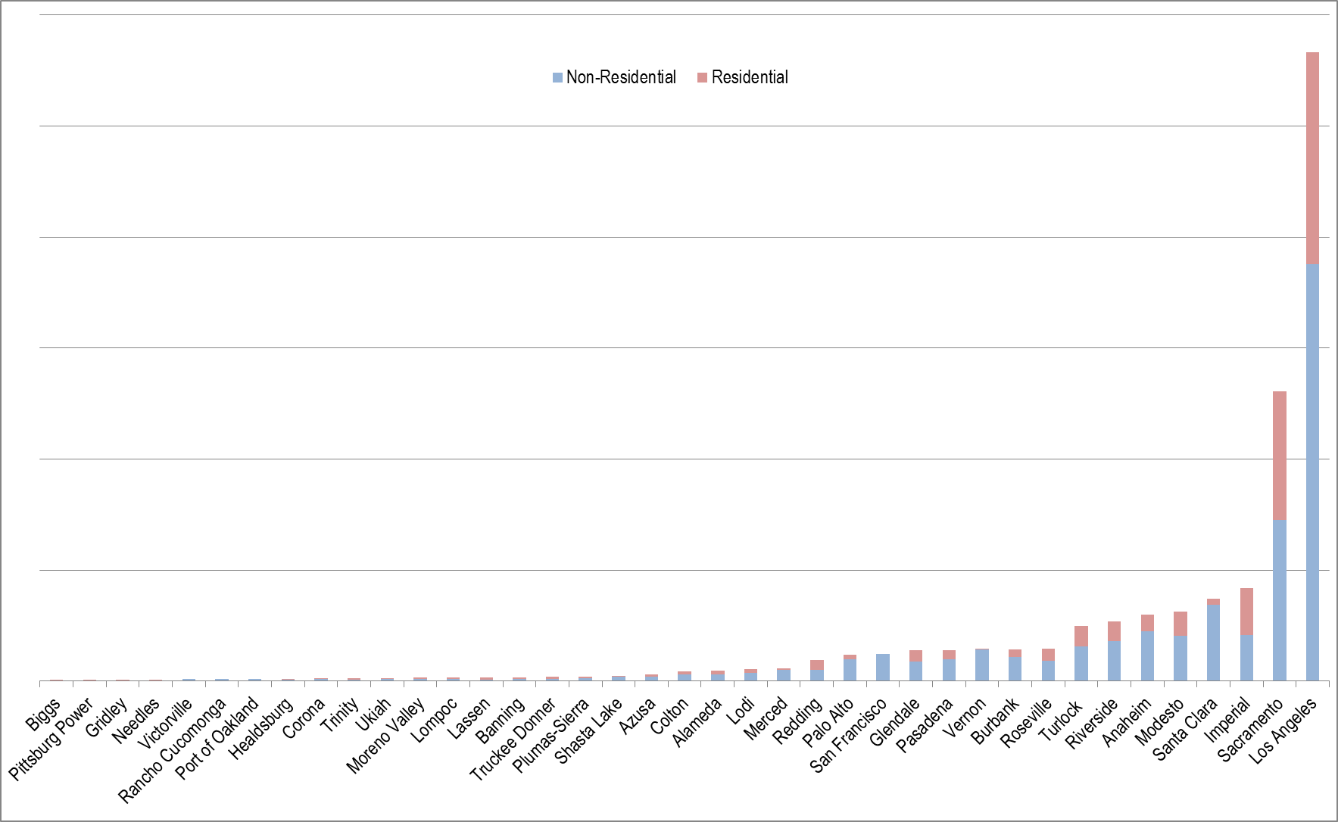
Diversity of Public Power – Retail Sales (MWh)

Slide 3
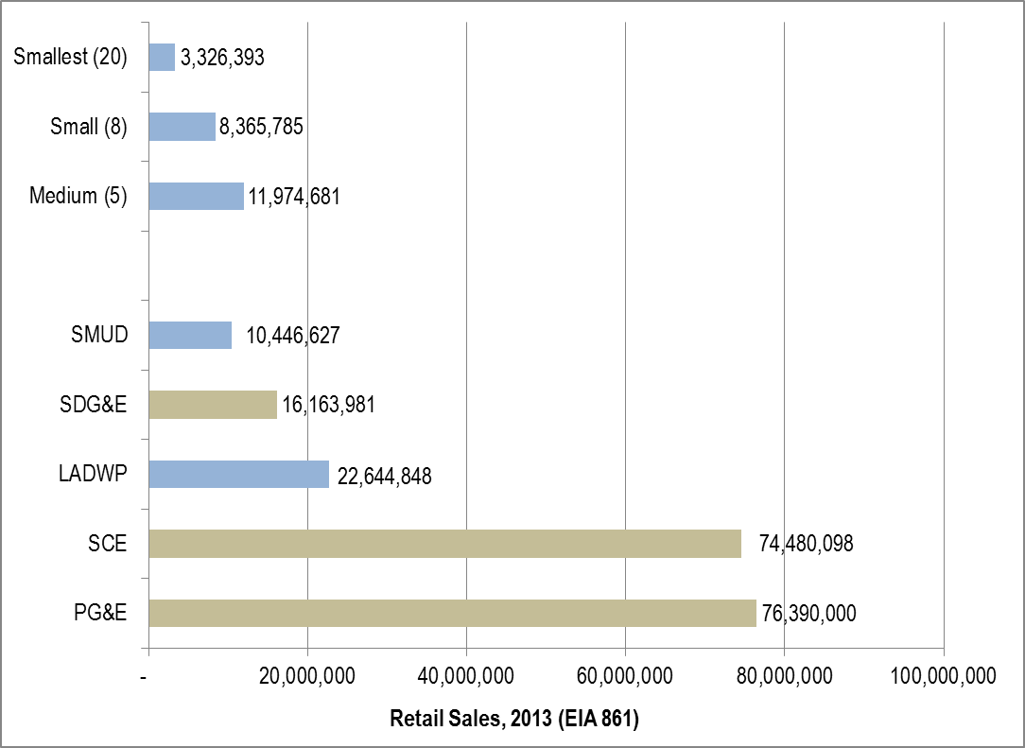
IOU and POU Retail Sales

Slide 4
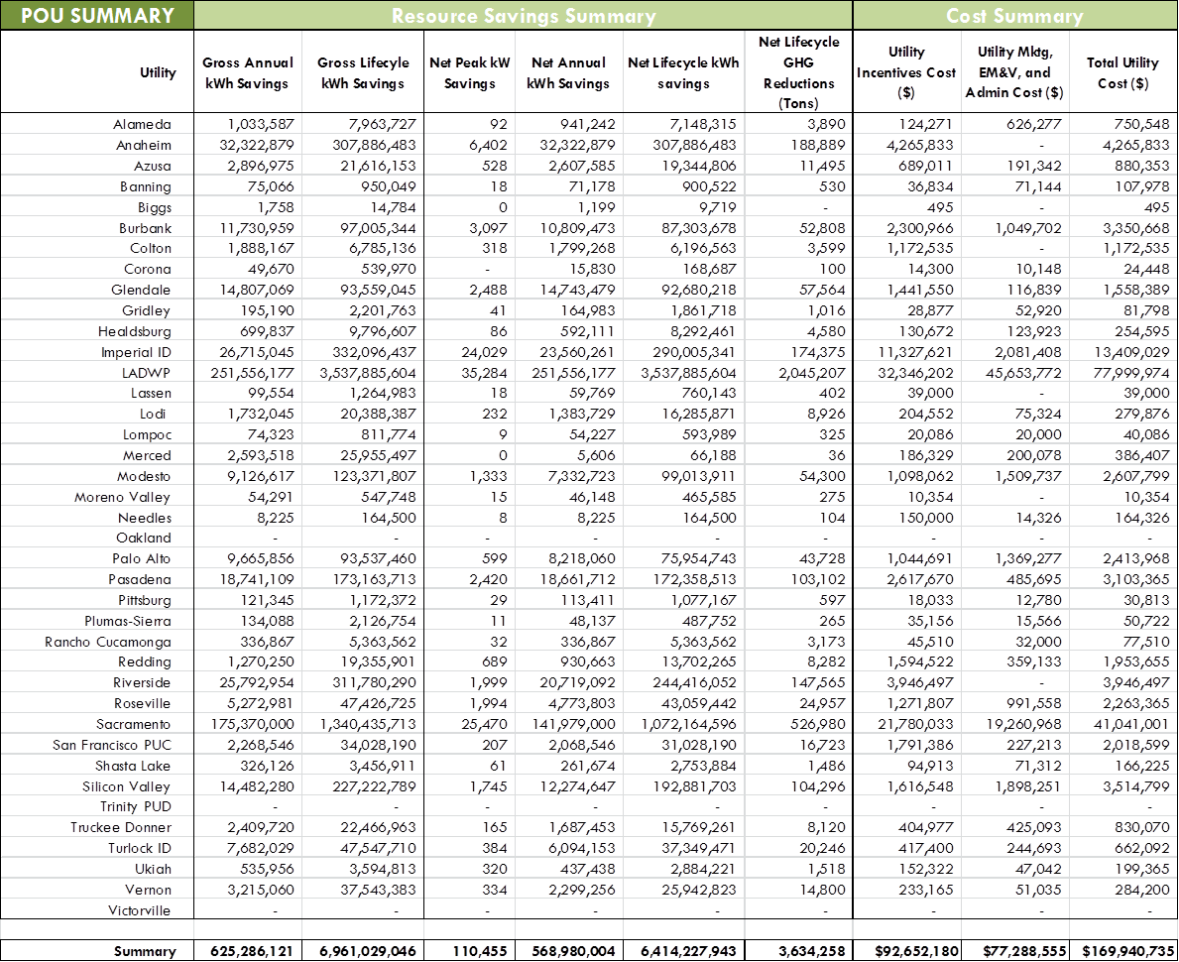
Annual Energy Efficiency Report

Slide 5
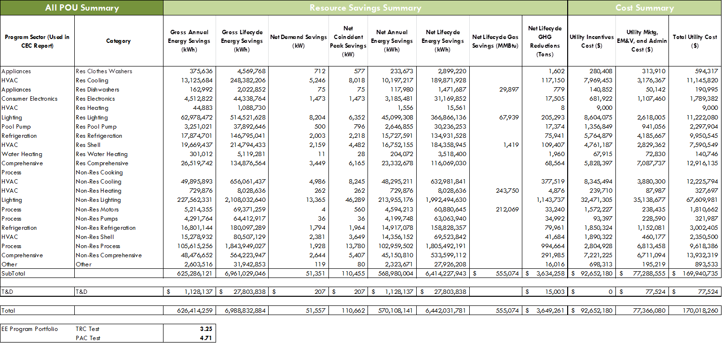
Annual Energy Efficiency Report
Download the full report at:
http://cmua.org/wpcmua/wp-content/uploads/2015/03/2015-FINAL-SB-1037-Report.pdf

