Slide 1
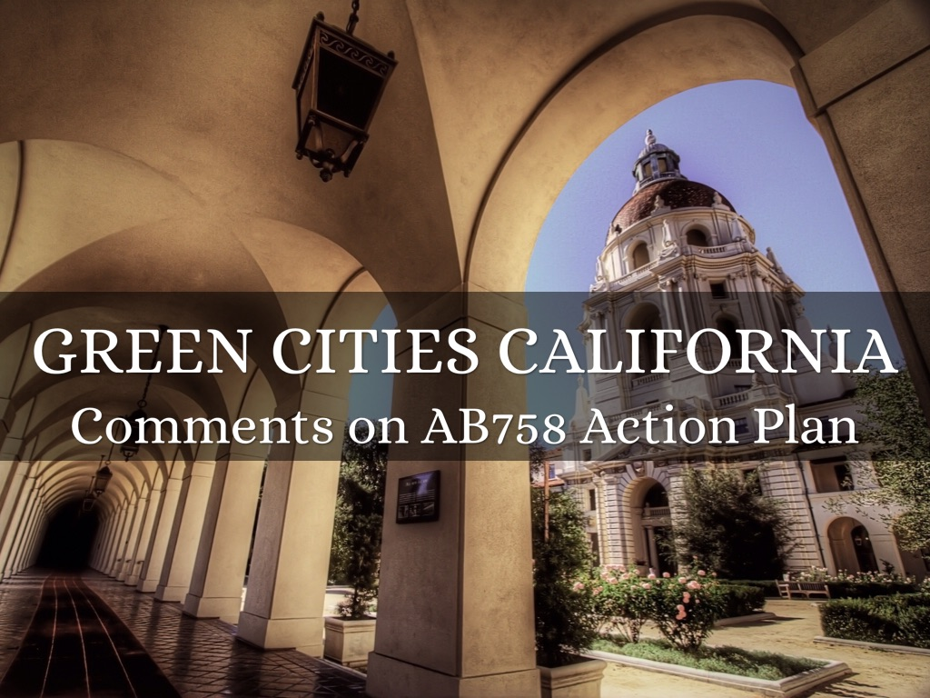
Photo by gtall1 - Creative Commons Attribution License http://www.flickr.com/photos/44461337@N06
Created with Haiku Deck

Slide 2
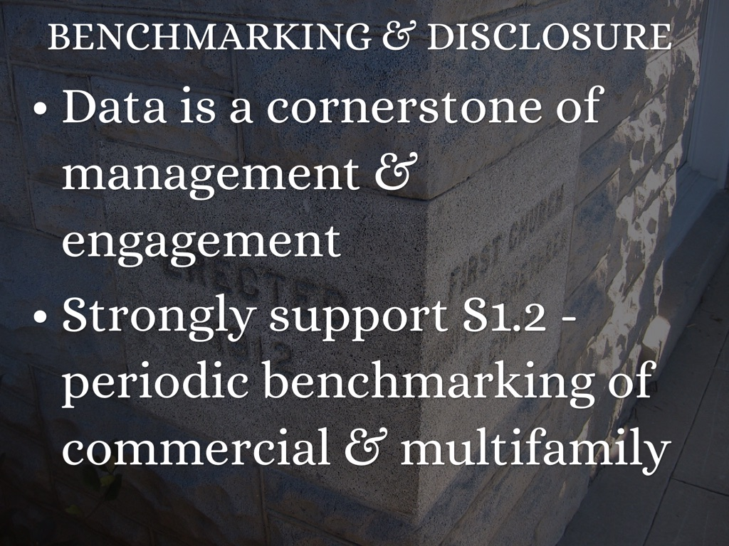
Photo by eli.pousson - Creative Commons Attribution-ShareAlike License http://www.flickr.com/photos/59179756@N00
Created with Haiku Deck

Slide 3
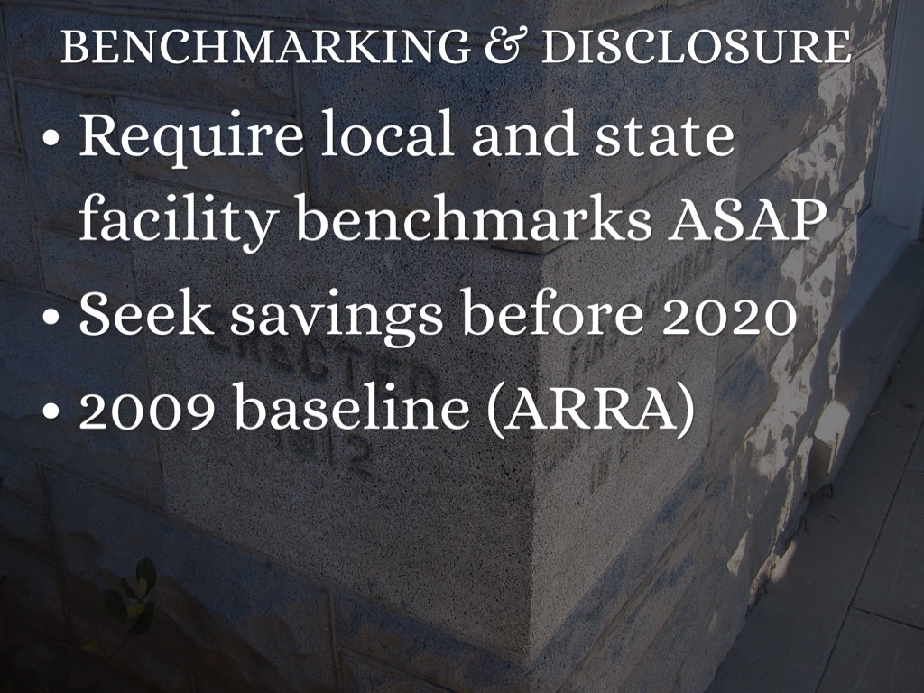
Photo by eli.pousson - Creative Commons Attribution-ShareAlike License http://www.flickr.com/photos/59179756@N00
Created with Haiku Deck

Slide 4
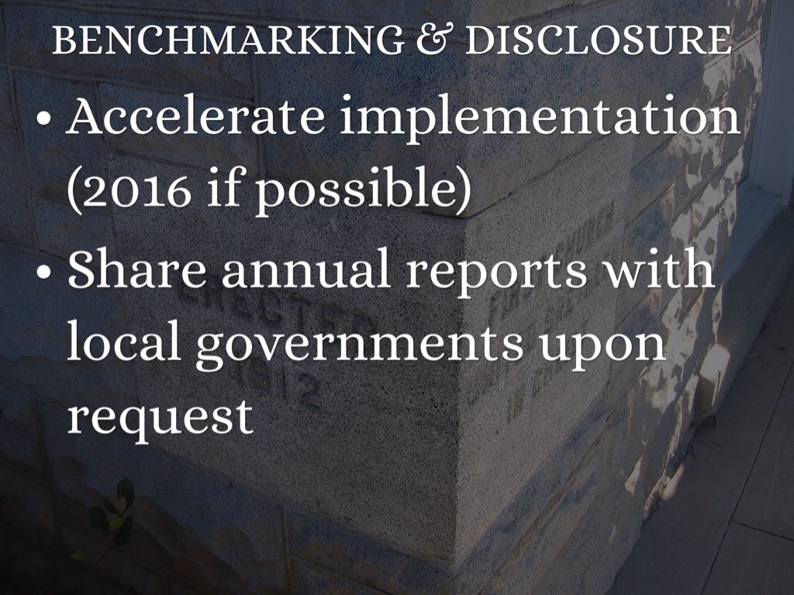
Photo by eli.pousson - Creative Commons Attribution-ShareAlike License http://www.flickr.com/photos/59179756@N00
Created with Haiku Deck

Slide 5

Photo by MarkMoz12 - Creative Commons Attribution License http://www.flickr.com/photos/106574022@N04
Created with Haiku Deck

Slide 6

Photo by familymwr - Creative Commons Attribution License http://www.flickr.com/photos/36196762@N04
Created with Haiku Deck

Slide 7
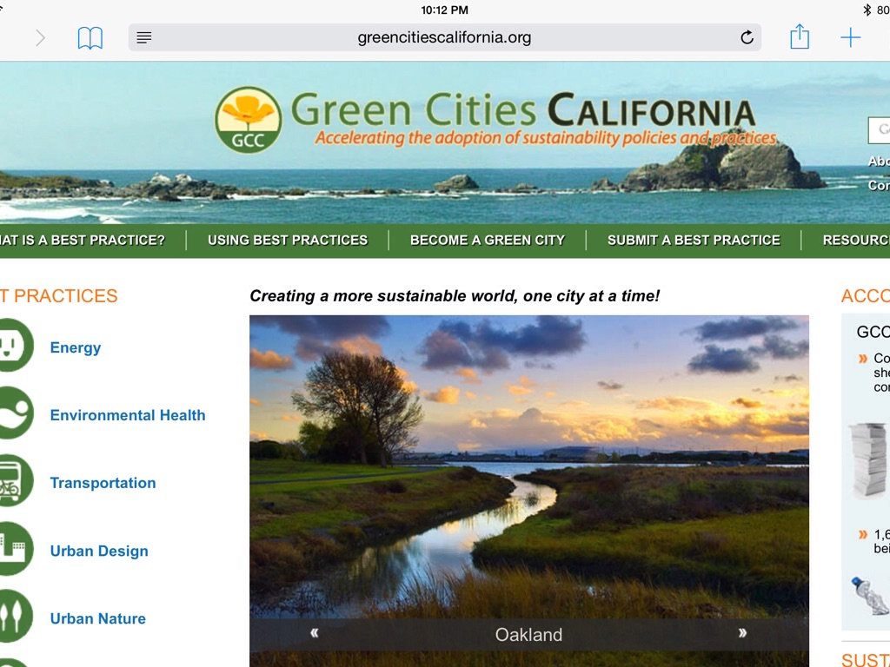

Slide 8
The Following Slides Are Borrowed with Minor Edits
Author:
Elena Alschuler
US Dept of Energy
Office of Energy Efficiency & Renewable Energy
Building Technologies Program

Slide 9



Federal Tools Support Markets
Data Sources
Tools
Databases
Basic Building Info
Energy Consumption (Green Button)
SEED Platform
Audits
Asset Score
Commissioning studies
Operating characteristics
Equipment & asset info
Other Tools & Databases
Public records
Other Platforms
Key: Public Tools | Private Tools

Slide 10
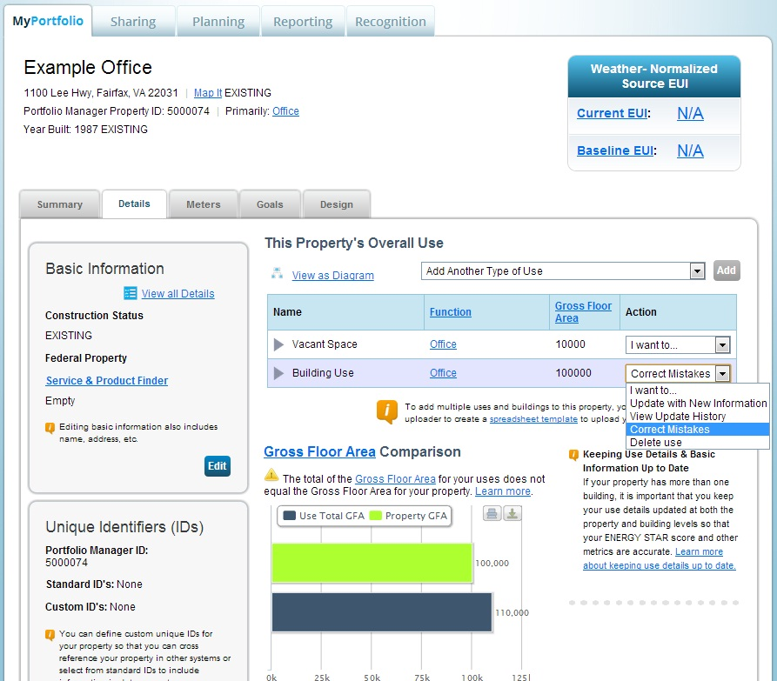
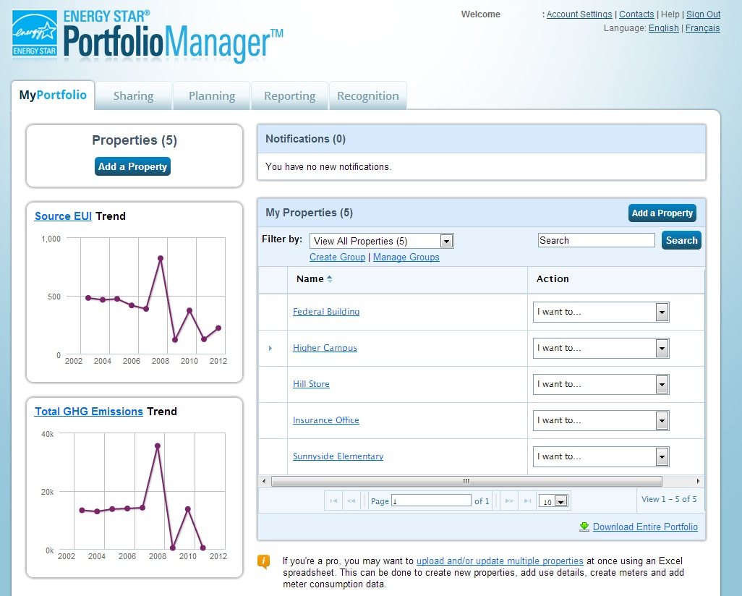
ENERGY STAR Portfolio Manager
Assesses Operations. Tracks energy and water consumption, and provides weather normalized Energy Use Intensity and a 1-100 score.
Notes:
Reiterate a couple points that KH makes in her remarks

Slide 11
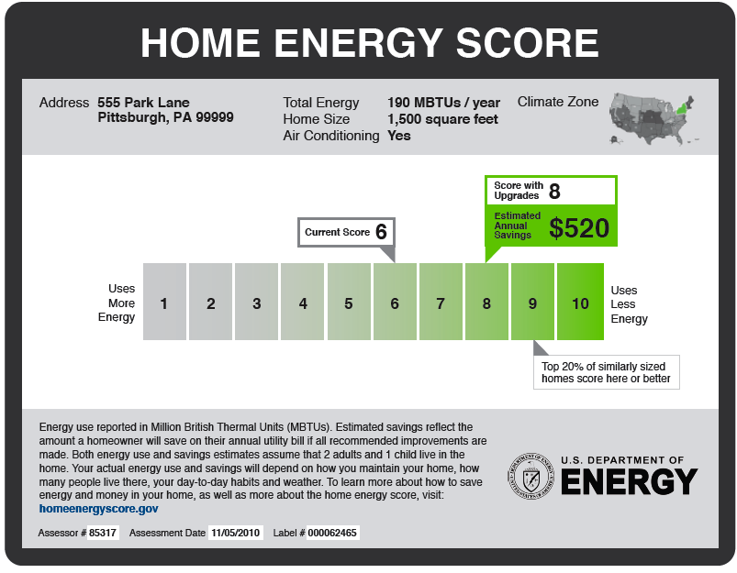
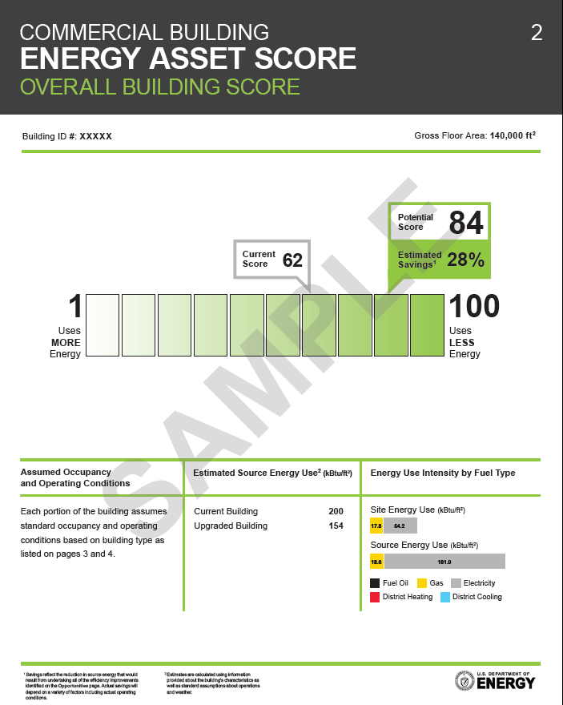

Commercial Asset Score & Home Energy Score
Assesses Physical Conditions. Provides a score and identifies opportunities for improvements.
Notes:
Reiterate a couple points that KH makes in her remarks

Slide 12
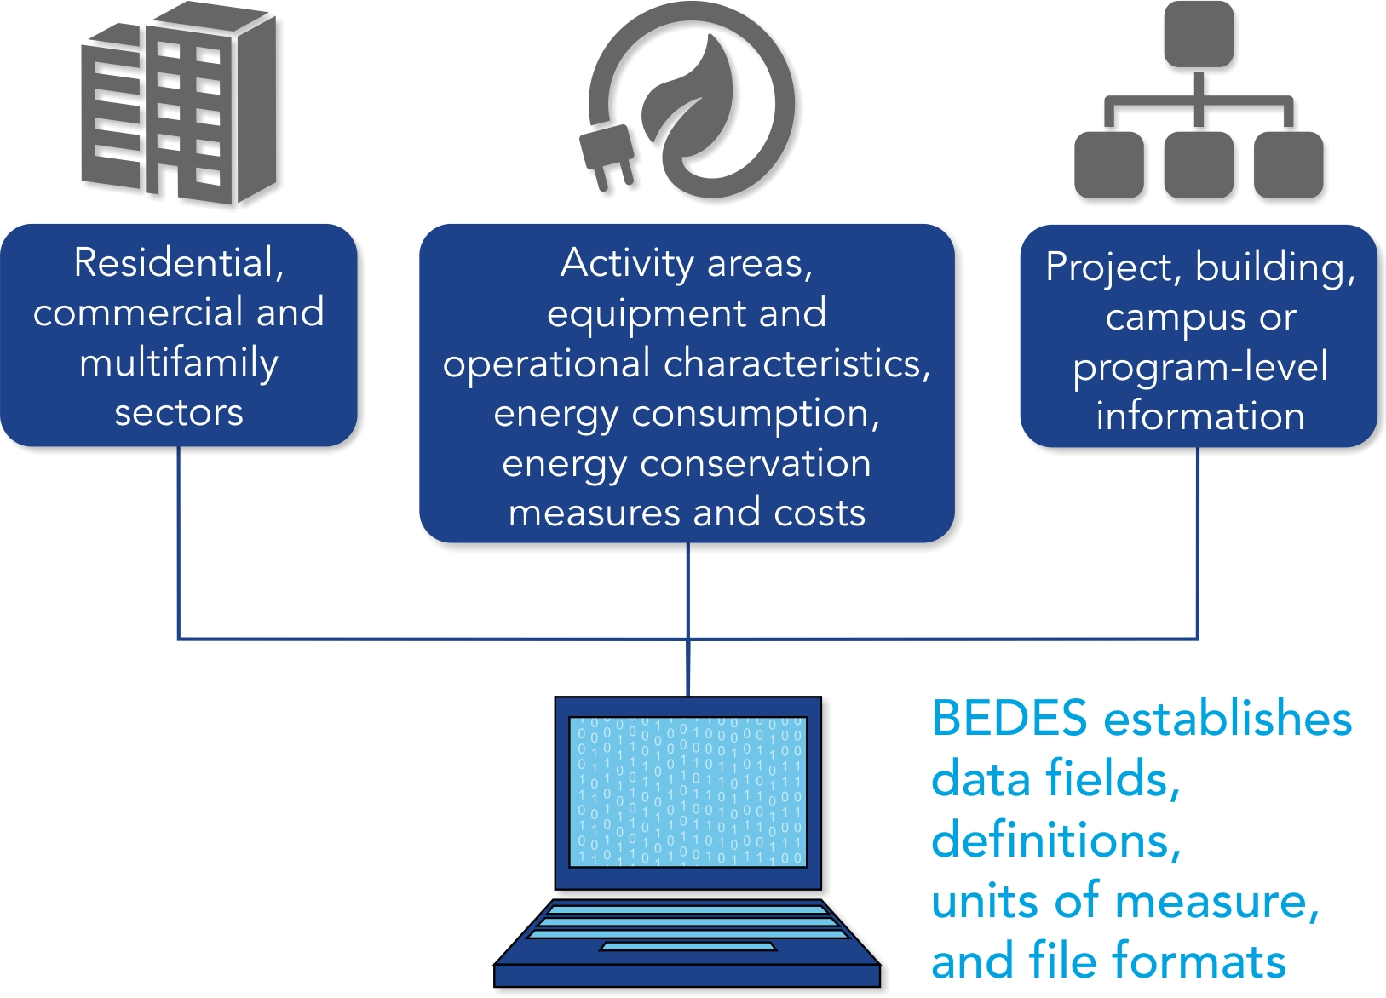
Building Energy Data Exchange Specification
Notes:
Reiterate a couple points that KH makes in her remarks

Slide 13

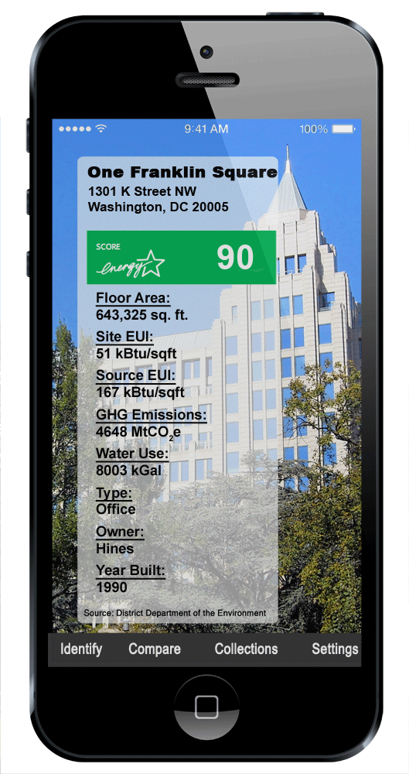
Standard Energy Efficiency Data Platform
Open source database and user interface
Initially designed to help cities manage building transparency programs, but has many other potential uses
Inputs
Database
Outputs
Asset Score
City A’s SEED
Utility Data
Public Records

Slide 14
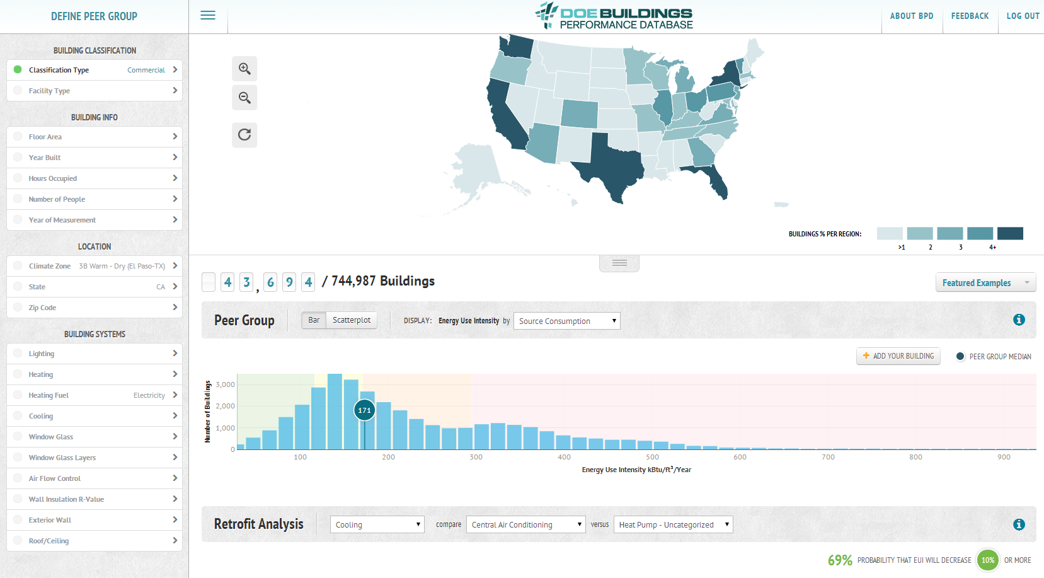
Buildings Performance Database (BPD)
Enables users to statistically analyze trends in the energy performance and physical & operational characteristics of real commercial and residential buildings.
A public data resource that protects confidentiality
Notes:
Reiterate a couple points that KH makes in her remarks

Slide 15
Early Adopters
Benchmarking Cities: Portfolio Manager, SEED, BPD, Asset Score
Reporting for DOE programs: Home Performance with Energy Star, State Energy Program, Federal building ESPCs
Private companies using BEDES data format to efficiently link audit software, efficiency project performance, etc.

Slide 16

San Francisco Experience
April 13, 2014
Barry Hooper, Green Building Coordinator
San Francisco Department of the Environment

Slide 17
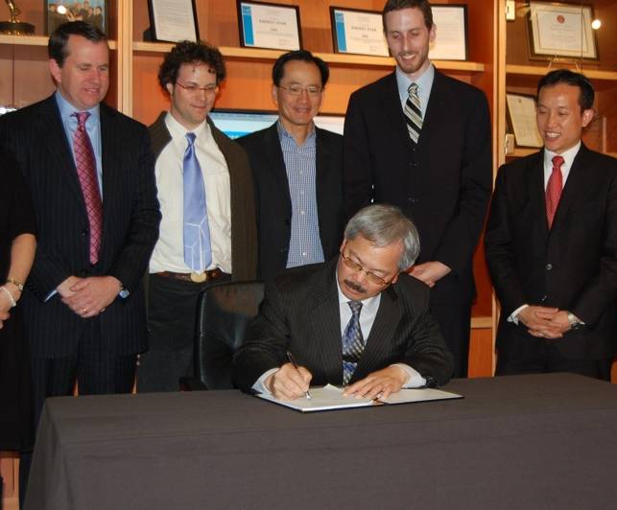
San Francisco
Existing Commercial Buildings Ordinance
3 year phase-in: 2011-2014
Mandatory:
    Annual benchmarking
    Energy audits or retrocommissioning every 5 years
Voluntary:
    Capital improvements
    Operational action
    Engaging tenants
    Financing & incentives

Slide 18
Affected Building Stock

Slide 19
San Francisco Experience with Tools
Local Objectives
  Consistency over time and across markets
  Sharing development resources
  Ability to apply best practices, innovations from other cities
  Structured data, standard format: interoperable
US DOE & LBNL have
  Exemplified these values
  Been client focused and strongly supportive
  Learned tough lessons too
Notes:
19

Slide 20
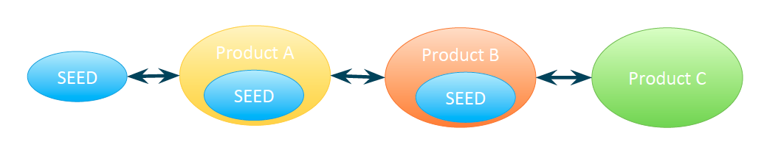
San Francisco Experience with Tools
Participating in development since 2012
SEED v1.1 is a success
The ecosystem will be
  Flexible
  Interoperable
Needs time, users, & developers to mature
Trademark is specific to code base:
Notes:
20

Slide 21
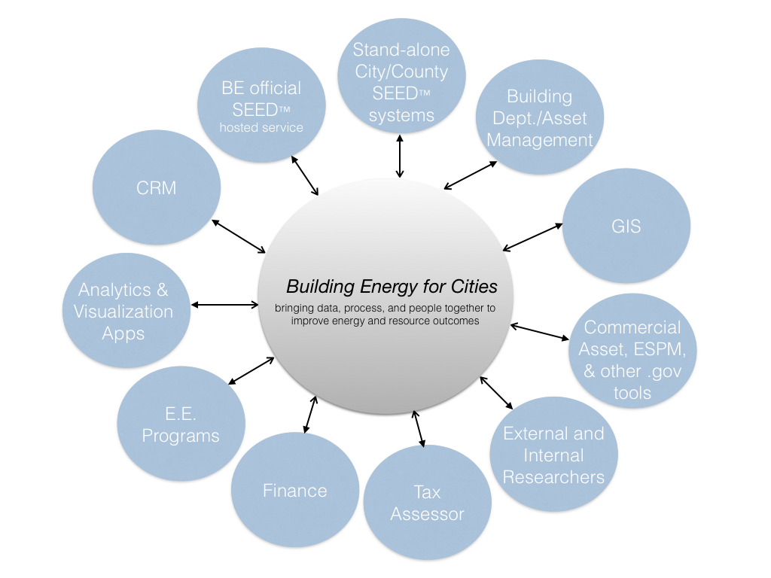
Current Tool in Application in San Francisco
Shared development
Open source
Interoperable
  SEED API
  Incorporates BEDES
Ongoing BEDES commitment
Developed SEED v1.1
‘Fork’ met San Francisco needs

Slide 22
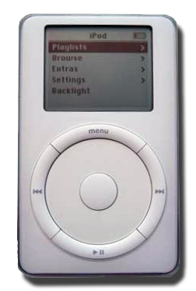

Recommendation: Patience
≠
Give SEED, related tools, and SEED trademark process time to mature
Images under Creative Commons license

Slide 23
Recommendations
Prioritize interoperability - BEDES
Set clear values with stakeholders. E.g.:
  Consistency over time and across markets
  Sharing development and innovations
  Collaborate with local governments
Start by testing the most mature use case: Benchmark compliance for AB1103 & AB758

Slide 24
Learn more
Barry Hooper
barry.hooper@sfgov.org
San Francisco Dept of Environment
Existing Commercial Buildings Energy Ordinance
www.sfenvironment.org/ecb

