Slide 1
California Solar Initiative
Public Reporting
How timely information and data access helped transform California’s solar industry
April 14, 2015
California Energy Commission
IEPR Lead Commissioner Workshop
Chris Burmester, PhD
Vice President
Energy Solutions

Slide 2
What can Data Driven Policy Do?

Slide 3
CSI Reporting Features and Functionality

Slide 4
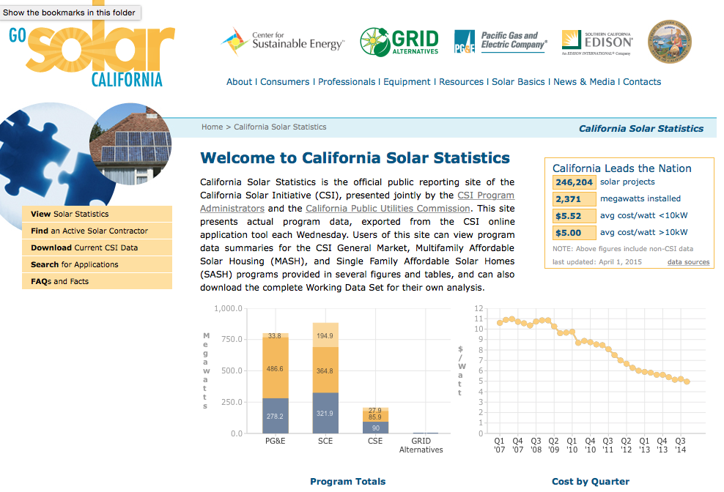
California Solar Statistics (CSS)
Features
Complete CSI Public Data Set
Weekly Data Updates
Interactive Charts and Reports
Downloadable Data Sets
  Filtered Data Set
  Working Data Set
  Raw Data Set
  Archival Data
Contractor sourcing
Find Projects
Metrics and Budgets
Explanatory Details
Notes:
Archival Data back to January 2009

Slide 5
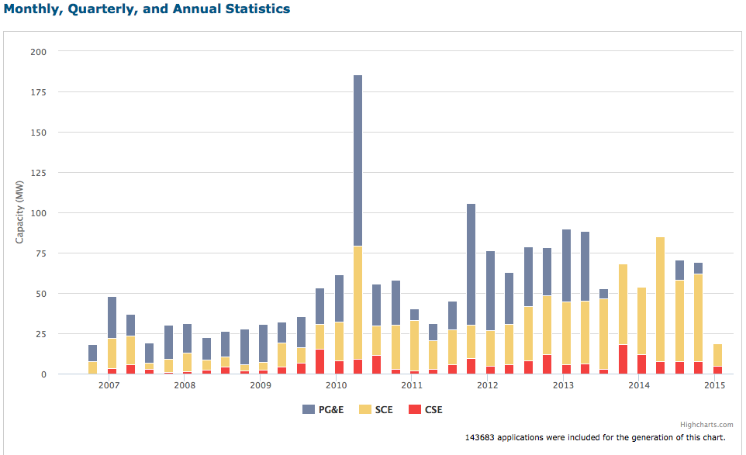
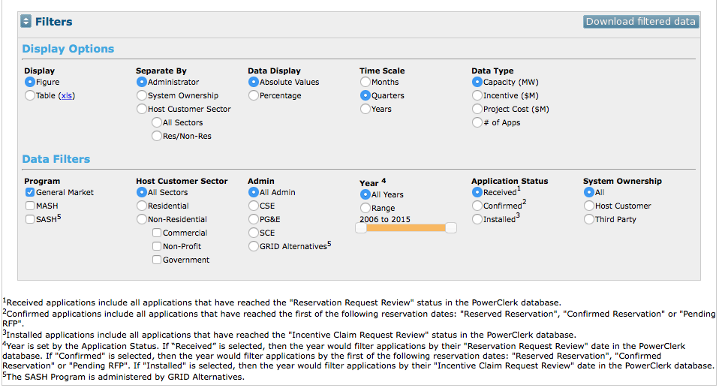
CSS: Standard Report Features
Interactive figures and charts enable users to quickly understand program metrics.

Slide 6
CSS: Standard Report Features
Record count and public dataset download options promotes reuse of data in independent reports.

Slide 7
CSS: Standard Report Features
Standard display options allow the user to select different data types, time scales, and other high level program attributes.

Slide 8
CSS: Standard Report Features
Standard data filters allow the user to narrow and refine their queries, and visualize the differences across multiple program components.

Slide 9
CSS: Standard Report Features
The “fine print” – explanatory details to help promote comprehension and transparency

Slide 10
Success factors and Lessons Learned

Slide 11
Key Success Factors
Data Integrity ensures data quality and allows for automated public reporting
Frequent updates and feedback loops provide insight into market drivers and continuously enhances data quality
Downloadable data provides un-fettered access to data and “crowd-sourced” quality assurance
Data visualizations give policy makers the tools necessary to present real program performance
User friendly interface (UI/UX) grants the public the ability to view data multi-dimensionally
Notes:
Stakeholder engagement
Regular, frequent updates
Iterative data integrity validation
Data integrity feedback loops
Documented data schema
Open, downloadable data
Inclusive data set
Automated reports
Automated metrics

Slide 12
Public Data Reporting Outcomes
Iterative data integrity loops yield high quality data
Data availability, transparency, and quality create trusted data sets
EM&V cost minimized by availability of trusted data set
In-situ program modifications enabled by current data trends
Reduced administrative costs through automation, standardization, and self-serve reporting
Stakeholders enabled to make data driven decisions
Cumulative effect is to yield more reliable and greater program impacts

Slide 13
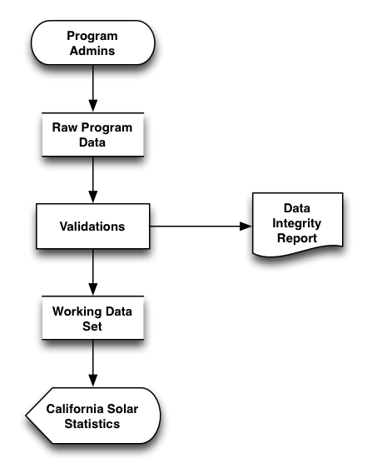
Data Integrity: Automated Validation
Field Level Validation
  “Has Value”
  “Is Integer”
  “Valid Value Range”
Multi-field Validation
  “If this field, then that field”
Record Validation
  “If this record, then that record”
Program Logic Validations
Data Set Validations

Slide 14
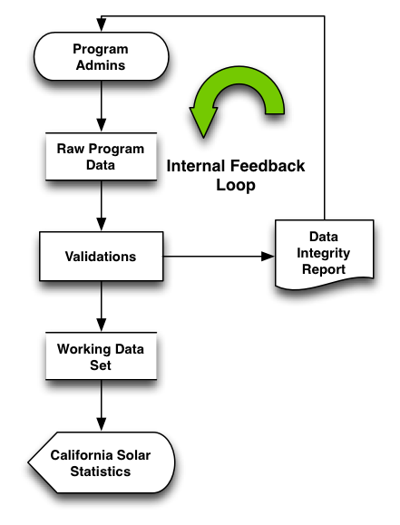
Data Integrity: Internal Feedback
Failed records excluded from Public Export
  Excluded records reported on CSS
Data Integrity Failure report provided weekly to Program Administrators
Program Administrators address Data Integrity Failures
Fixed records included in next Public Export

Slide 15
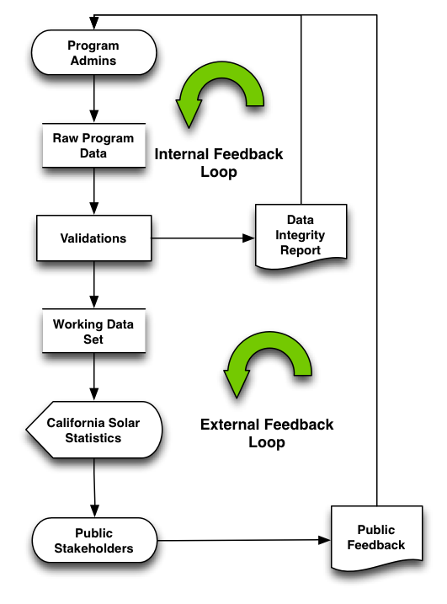
Data Integrity: External Feedback
External stakeholders report data issues via
Data Integrity Failure report provided weekly to Program Administrators
Program Administrators address Data Integrity Failures
Fixed records included in next Public Export

Slide 16




Data Serves Diverse Needs
"Rather than having a single purpose, we hold that publishing these data serves multiple goals. First, it provides market suppliers (manufacturers, contractor, and investors) with information about what equipment is being installed where and for how much. Second, it provides distributed generation (DG) host customers with information about which contractors are active in their area and at what price. Third, it provides academic researchers and journalists with vital information about the progress of the industry. Fourth, it helps utilities to understand the nature of their DG fleet and its impact on the grid and on needed resources. And fifth, it informs the Commission and state government policy-makers about new technologies and market models, enabling them to intelligently modify existing programs and design future programs."
Citation needed
Policy Makers: Data informs timely program refinements
Customers/Vendors: Data facilitates a competitive market
Investors: Data provides transparency on investment value and market potential
Academia: Data indicates the state of the market
This introduces the idea of multiple users
Notes:
Customers: Informed purchase decisions
Solar Vendors: Competitive pricing and Market Research
Investors: Transparency on investment value and market potential
Policy makers: Real-time program refinements
Consumers
Solar Industry
Financial Industry
Administrators
Utilities
CPUC, CEC, Governor’s office
Policy makers
Academia
"Rather than having a single purpose, we hold that publishing these data serves multiple goals. First, it provides market suppliers (manufacturers, contractor, and investors) with information about what equipment is being installed where and for how much. Second, it provides distributed generation (DG) host customers with information about which contractors are active in their area and at what price. Third, it provides academic researchers and journalists with vital information about the progress of the industry. Fourth, it helps utilities to understand the nature of their DG fleet and its impact on the grid and on needed resources. And fifth, it informs the Commission and state government policy-makers about new technologies and market models, enabling them to intelligently modify existing programs and design future programs."

Slide 17
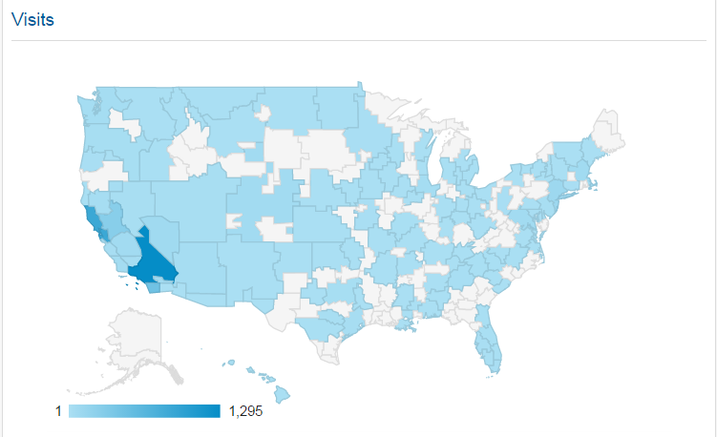
Data Serves Diverse Needs
Out of State Users: The largest solar data set in the world serves users across the nation
Academia: Data indicates the state of the market
Notes:
Customers: Informed purchase decisions
Solar Vendors: Competitive pricing and Market Research
Investors: Transparency on investment value and market potential
Policy makers: Real-time program refinements
Consumers
Solar Industry
Financial Industry
Administrators
Utilities
CPUC, CEC, Governor’s office
Policy makers
Academia
"Rather than having a single purpose, we hold that publishing these data serves multiple goals. First, it provides market suppliers (manufacturers, contractor, and investors) with information about what equipment is being installed where and for how much. Second, it provides distributed generation (DG) host customers with information about which contractors are active in their area and at what price. Third, it provides academic researchers and journalists with vital information about the progress of the industry. Fourth, it helps utilities to understand the nature of their DG fleet and its impact on the grid and on needed resources. And fifth, it informs the Commission and state government policy-makers about new technologies and market models, enabling them to intelligently modify existing programs and design future programs."

Slide 18
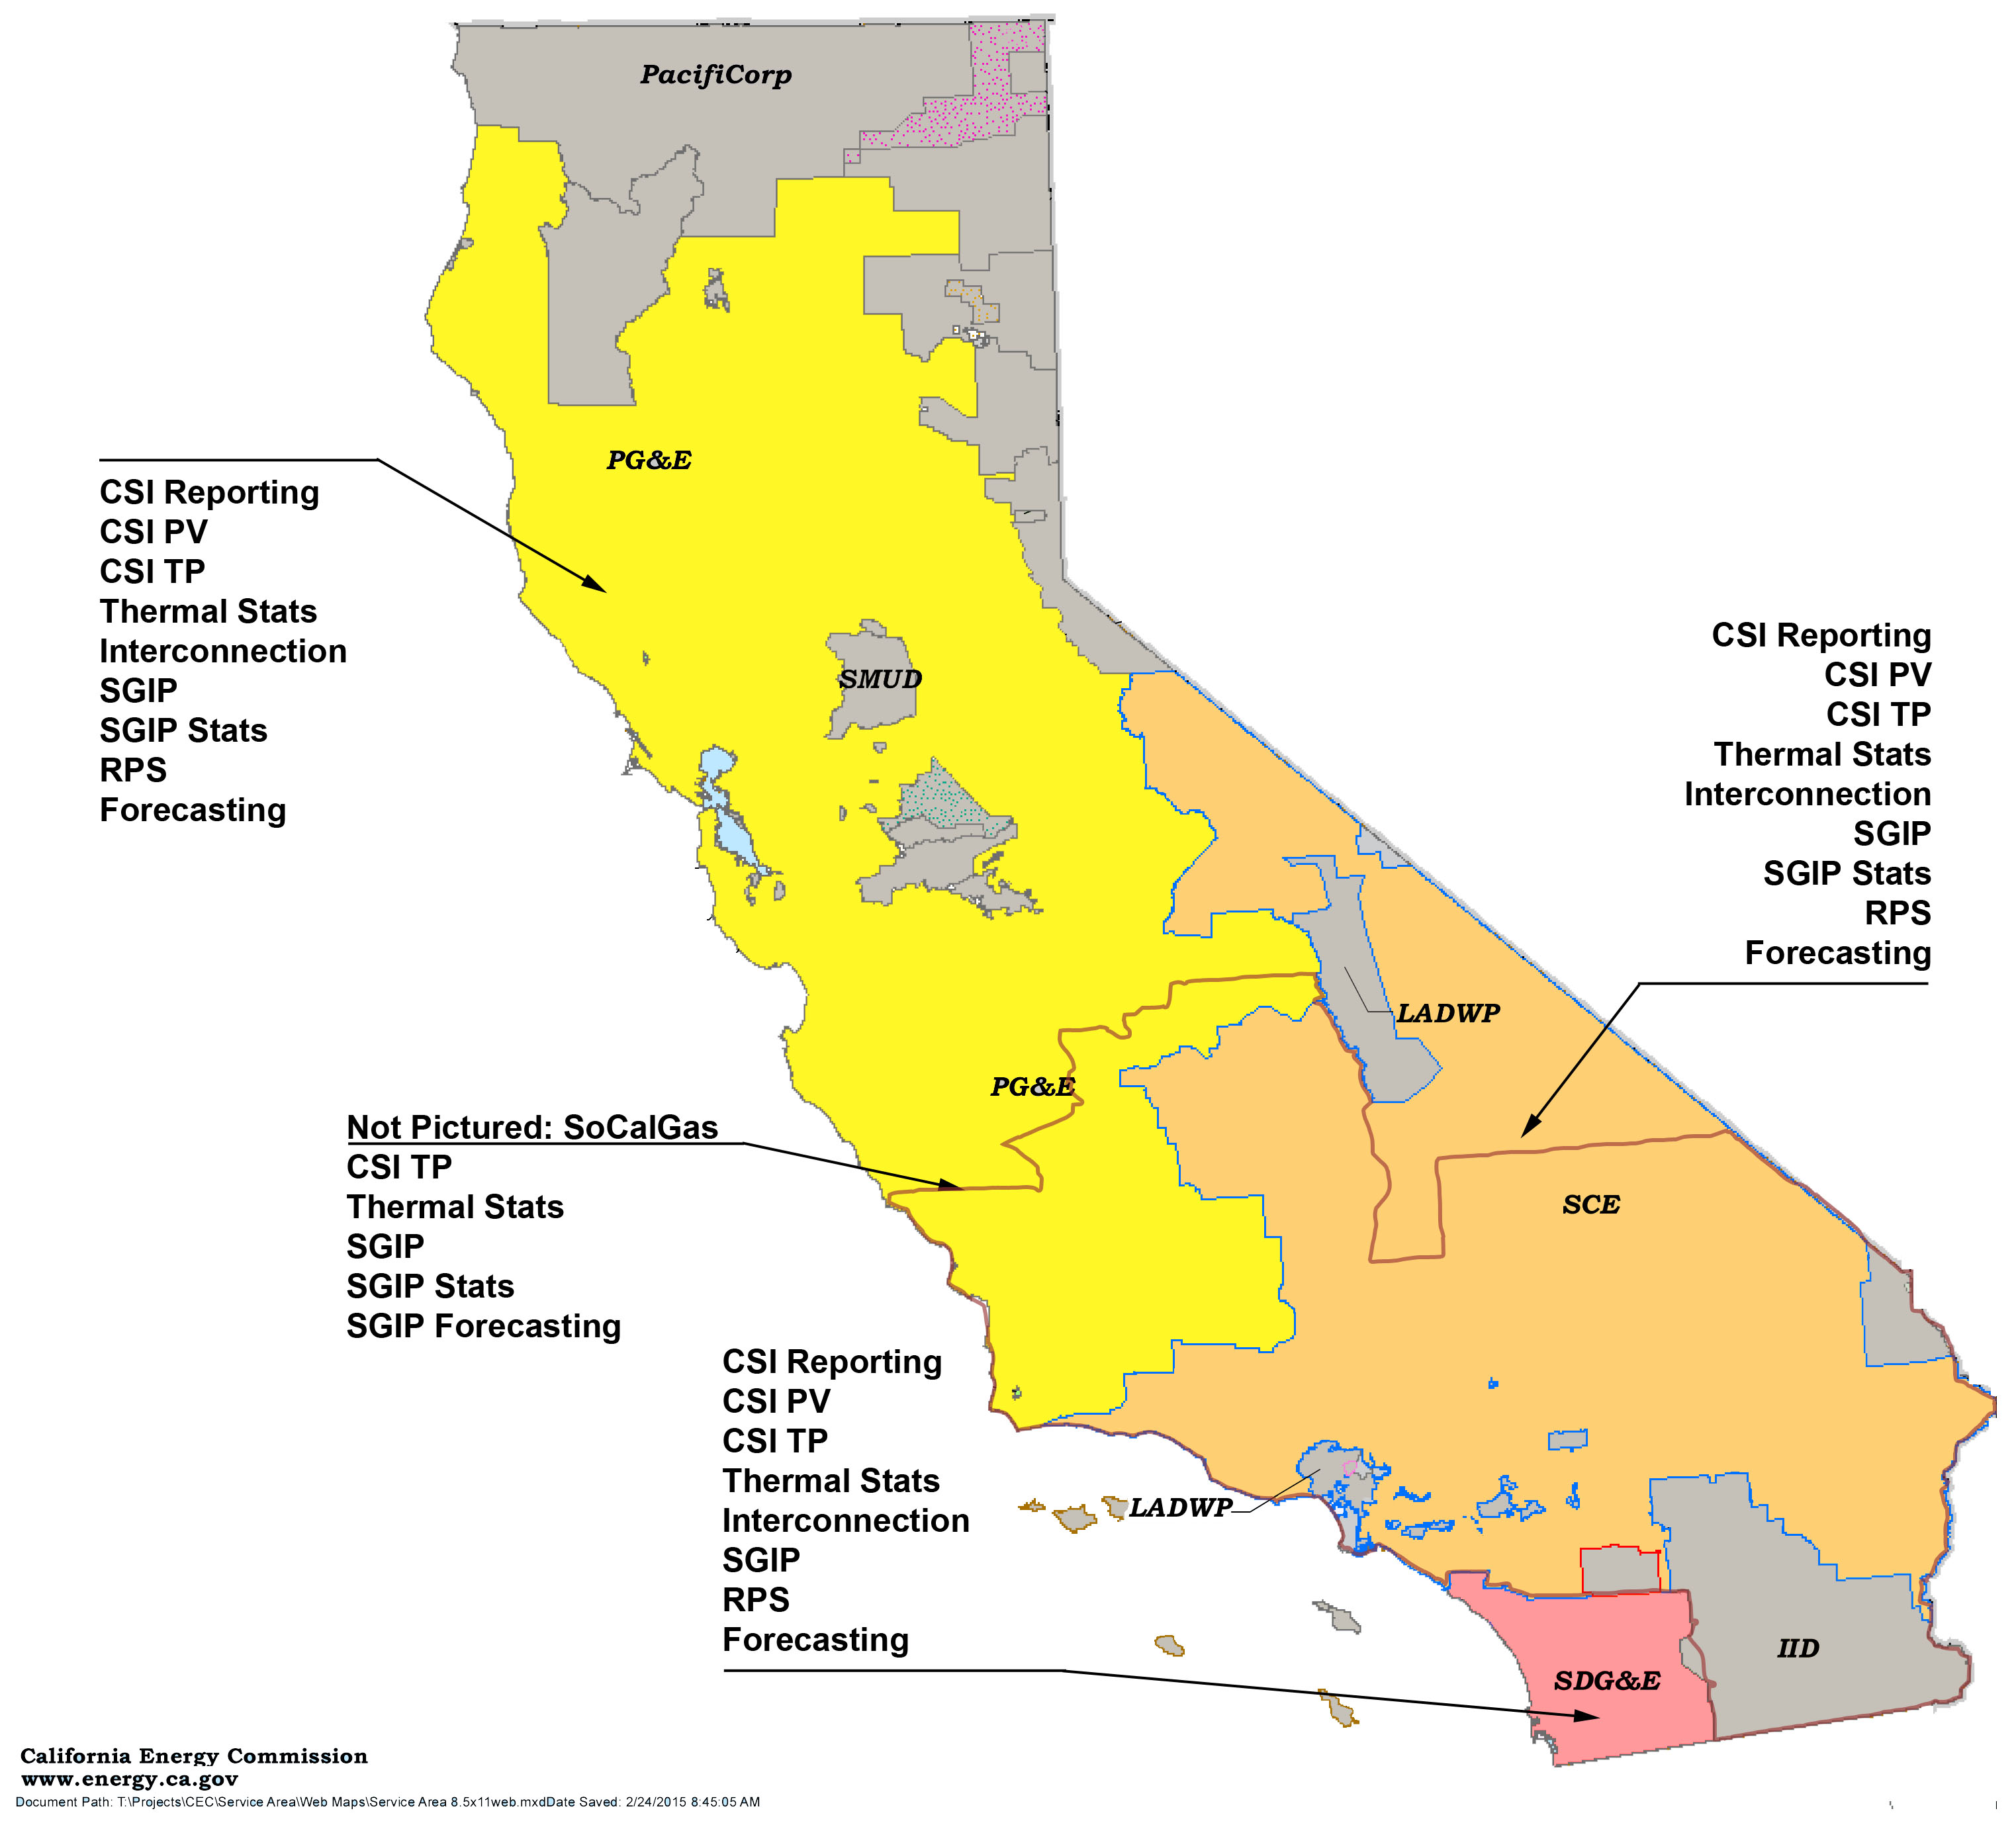
Reporting: Near-term Opportunities
Capture the data we have
Standardize data schema and format
Update regularly
Establish feedback channels
Support common use cases
Notes:
Create uniform data schemas for IDSM projects
Provide locational data
Provide summary demand and consumption data
Bonus! Allow request of detail data funneled to customers
Create data integrity feedback loops
Create reports and features around major stakeholder use cases

Slide 19
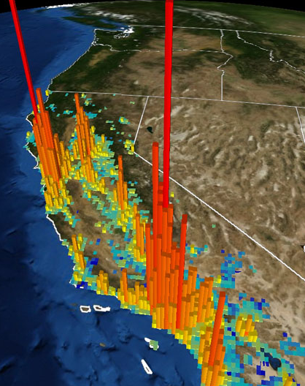

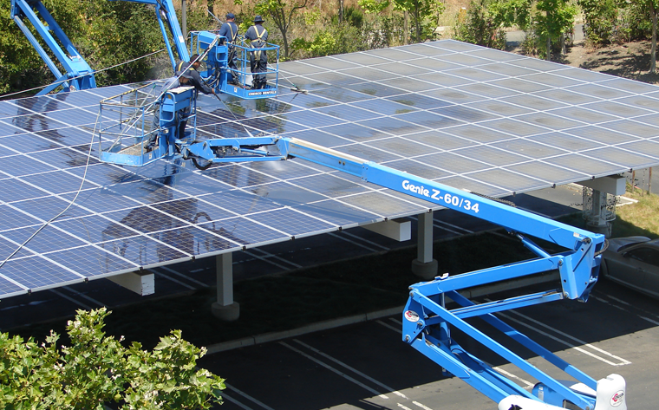
Reporting: Future
Integrated project data
Building models
Cross-referenced data sets
Integration with Energy Data Center, and climate and marketplace indicators
Notes:
Integrated Project Performance Data
Building Models
Cross-reference future data sets
Integration with Energy Data Center, Climate, Marketplace indicators

Slide 20
"Rather than having a single purpose, we hold that publishing these data serves multiple goals. First, it provides market suppliers (manufacturers, contractor, and investors) with information about what equipment is being installed where and for how much. Second, it provides distributed generation (DG) host customers with information about which contractors are active in their area and at what price. Third, it provides academic researchers and journalists with vital information about the progress of the industry. Fourth, it helps utilities to understand the nature of their DG fleet and its impact on the grid and on needed resources. And fifth, it informs the Commission and state government policy-makers about new technologies and market models, enabling them to intelligently modify existing programs and design future programs.“
Decision 14-11-001, November 6, 2014

Slide 21
Thank You
Chris Burmester, PhD
Vice President
cburmester@energy-solution.com
510-482-4420 ext. 253

