Slide 1
Existing Buildings Energy Efficiency Draft Action Plan Data Workshop
California Energy Commission
Efficiency Division, Existing Buildings Unit
Lead Commissioner, Andrew McAllister

Slide 2
Goal 2: Data drives informed decisions.

Slide 3
2.1 Data for Improved Decisions
Data Exchange Protocols 2.1.1
Adopt consistent statewide data exchange protocols in line with national efforts (SEED, BEDES, Green Button)
Benchmarking Data Infrastructure 2.1.2
Map meters to physical buildings to develop benchmarking infrastructure.
Easy-to-Access Data and Analytics 2.1.3
Improve access to energy use data and analytics
Data for Local Governments 2.1.4
Standardize process for local governments to access data.

Slide 4
2.1 Data for Improved Decisions cont.
Standardized Utility Rate Information 2.1.5
Maintain utility tariffs in a consistent format on a public website.
Project-specific measured savings 2.1.6 - 2.1.7
Provide public access to project-level, locale-specific, anonymized information for program participants.
Data Access for Policy Planning & Research 2.1.8 - 2.1.10
Establish secure energy data centers with utility data.
Establish energy use baselines.
Develop data collection protocols and forecasting methods.

Slide 5
Data-related strategies
Consumers
DATA INFRASTRUCTURE
Industry
SEED, BEDES
S 1.2
Benchmarking
S 3.1
Shared program data drives innovation
GREEN BUTTON
S 1.3
Reliable assmnt tools
S 3.2
Utility rate data
Performance-driven industry
ENERGY DATA CENTERS
Granular, baseline data
STD UTILITY TARIFFS
Demographic data
S 1.4
Reliable asset tools
Project-specific program data
G 5
S 4.1
Investor Confidence Project
EE value embedded in real estate
OPEN EE METER
CALTRACK , CALTEST
Policy makers
TO BUILDINGS
METERS MATCHED
Notes:
Consumer-focused driving data

Slide 6
2.2 Consumer-Focused Energy Efficiency
Enhanced Program Design and ME&O 2.2.1
Include all end uses of energy and water.
Target consumers at key transaction points.
Establish behavior and operations as central elements.
Connect consumers across programs.
Expand Behavior Program 2.2.2
Leverage innovations; plan for expanded scope and market reach.
Targeted Programs 2.2.3
Use data-driven market segmentation to target customers.

Slide 7
2.2 Consumer-Focused Energy Efficiency cont.
Building/Portfolio Cohorts 2.2.4
Encourage engagement, awareness, value, and implementation of improvements.
Work with corporations to address entire portfolios.
Strategic Energy Planning 2.2.5
Establish sector-specific support centers for plan development.
Create directories of qualified building professionals.
Provide ongoing technical assistance.

Slide 8
Statewide Energy Efficiency Policy Planning and Tracking
DATA NEEDS
“Granular Baseline Data” is Building Energy Use by:
Fuel type
Building/business type
Building size
Building age
Building location
For the entire existing building stock, updated routinely
Also need demographic data to understand natural trends
Notes:
Data will need to be weather normalized, but CEC can do that
Much if not all of the same data is needed for long term demand forecasting
Level of detail (aka “granularity”) depends on specific planning & tracking needs
Need time series data to track trends (aka “progress”)
Need demographic data to establish counter factuals

Slide 9
Submit Comments
Comments due by April 28, 2015
Submit eComment
Fill in required fields at: https://efiling.energy.ca.gov/Ecomment/Ecomment.aspx?docketnumber=15-IEPR-05
Submit paper comments to Docket 15-IEPR-05
      Energy Commission
      Dockets Office, MS-4
      RE: Docket No. 15-IEPR-05
      1516 Ninth Street
      Sacramento, CA 95814-5512
      Staff Contact
      David Ismailyan: 916-654-4045 / David.Ismailyan@energy.ca.gov

Slide 10
Next Steps: Future Action Plan Workshops
Benchmarking and Local Government Challenge Workshop
  Occur on the same day but half day workshop for each strategy
  May 7, 2015
Future TBD Workshops
  Topics: ZNE, Plug Loads, Title 24

Slide 11
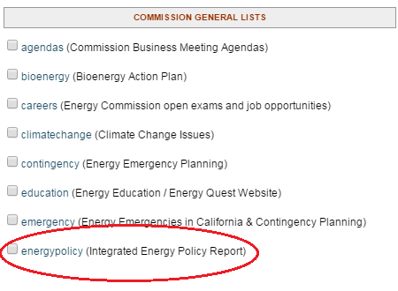
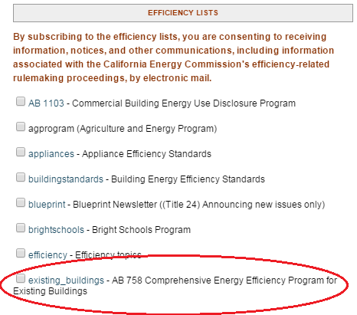
Stay involved
Attend Workshops
Submit Comments
Join the Existing Buildings
and Energy Policy Listservs
at: http://energy.ca.gov/listservers/

Slide 12
Submit Comments
Comments due by April 28, 2015
Submit eComment
Fill in required fields at: https://efiling.energy.ca.gov/Ecomment/Ecomment.aspx?docketnumber=15-IEPR-05
Submit paper comments to Docket 15-IEPR-05
      Energy Commission
      Dockets Office, MS-4
      RE: Docket No. 15-IEPR-05
      1516 Ninth Street
      Sacramento, CA 95814-5512
      Staff Contact
      David Ismailyan: 916-654-4045 / David.Ismailyan@energy.ca.gov

