Slide 1

Building Energy Saving Ordinance (BESO):
Using Information to Accelerate Savings
California Energy Commission
April 7, 2015
Notes:
Thank you for the opportunity to present additional information about the proposed Building Energy Saving Ordinance
Billi Romain. Al Murray…

Slide 2
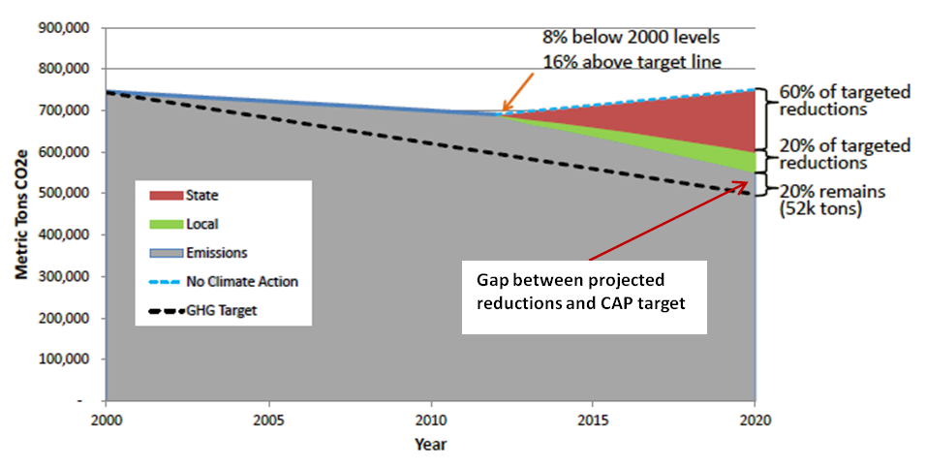
Climate Action Plan (CAP) Target:
Additional GHG Reductions Needed
Notes:
Increasing energy efficiency across all building types is a key component of achieving the CAP goals
As you know, the CAP goals (REPRESENTED BY DOTTED LINE) are ambitious, and the current RECO and CECO are not consistent with the scale of reductions required
Community-wide emissions are not on track to achieve the 2020 target (BLUE LINE)
Additional action is needed to fill the gap

Slide 3
Building Energy Information
Efficiency Action Plan
Incentives
& Assistance
Energy Upgrades
Reduced Emissions
Energy Bill Savings

Slide 4
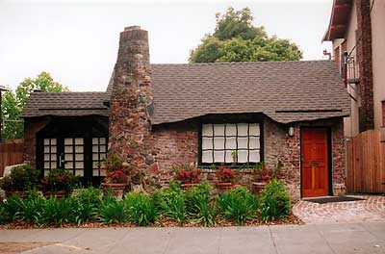

BESO for Berkeley Homes
Energy Assessment prior to sale
Exemption for High Performance Homes
Deferrals to Buyers
Rebates for early compliance
Rebates and financing
for upgrades

Slide 5
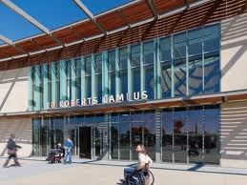
BESO for Commercial &
Multifamily Buildings
Energy Assessments every 5 - 10 years based on building size
Report Energy Star Performance Score
Access to free & low cost energy assessment services
Rebates and financing for upgrades
The Ed Roberts Campus
Energy Star Certified Score of 96

Slide 6
Benefits of Energy Assessment Reporting
Shows property owners how to reduce energy costs & increase property values.
Provides building-specific recommendations to maximize efficiency, health, safety & comfort.
Teaches owners how to access valuable financing & incentive opportunities.
Motivates property owners to invest in energy saving improvements.

Slide 7
For More information
Contact
Billi Romain, Sustainability Program Manager
City of Berkeley
510-981-7432
BRomain@CityofBerkeley.info
www.cityofberkeley.info/BESO

