Slide 1
Existing Buildings Energy Efficiency Draft Action Plan Kickoff Workshop
California Energy Commission
Efficiency Division, Existing Buildings Unit
Lead Commissioner, Andrew McAllister

Slide 2
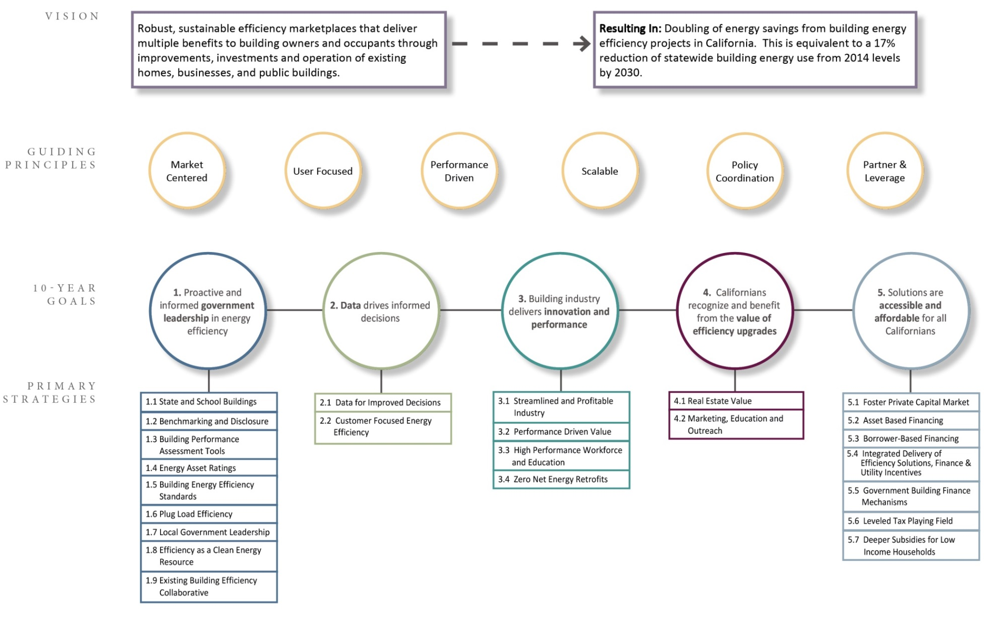
Vision and Goals Framework
Notes:
Bulk of socument is ch 3. If you read only one chapter, read this one..
# of strategies doesn’t necessarily mean more scope there,
Vision---Guiding principles

Slide 3
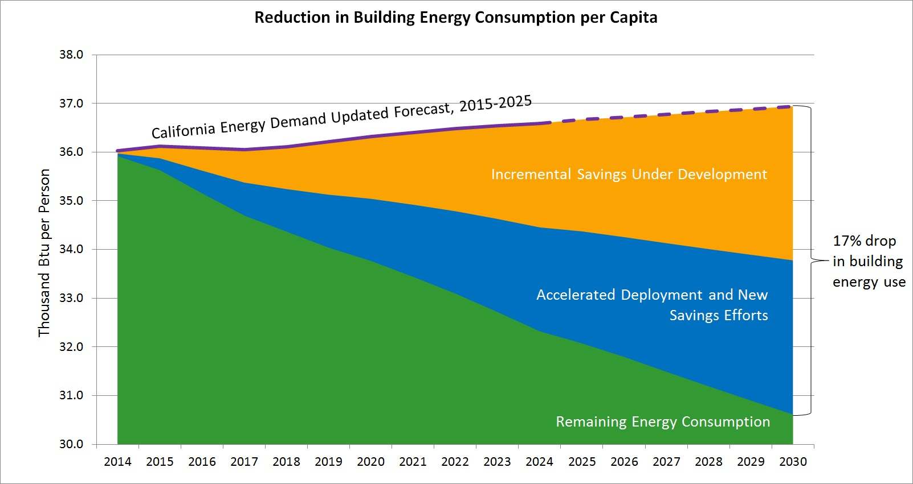
Quantitative Savings
Notes:
Martha- We doubled the AAEE from the IEPR demand forecast, and calculated what that meant in terms of reduction in building energy use- which came to 17%. Then for dramatic effect- aka in order to insert a sense of urgency to the public, we divided that by capita, which then shows the drastic drop you see above.

Slide 4
Goal 1: Proactive and informed government leadership in energy efficiency

Slide 5
1.1 State and School Buildings
State Buildings 1.1.1
Increase DGS capacity to accelerate improvement of state buildings.
Provide investment decision support to DOF and Treasurer.
Increase capital for state building energy efficiency projects.
Track energy performance metrics consistent with Executive Order.
Clean Energy Jobs Act 1.1.2
Implement school building energy upgrades.
Encourage spillover effects to other building sectors.
Notes:
Erik: Lead by example. Innovate where other programs are more constrained. Have the governance and oversight of the implementation of this plan (collaborative- whose point is to have real ownership of the plan, accountability thru the IEPR process))
Biggest thing is we have to increase capacity we are not getting improvements as fast as we need to. Not enough projects are getting funded.
Clean Energy Jobs act is a work in progress- we have a big grant program (prop 39)- we are going to use it as an example of getting our data act together. Actuarial data analysis from the schools project. Providing energy project and savings to the public
Division of State Architects- are looking to start a program where they come up with retrofit design ‘templates’ that can be scaled to other projects. Use these exemplars to show the road to other school districts

Slide 6
1.1 State and School Buildings cont.
DSA Deep Retrofit Exemplars 1.1.3
Plan deep energy retrofits of selected school buildings.
Distribute case studies describing opportunities to school districts.

Slide 7
1.2 Non-Residential Benchmarking & Disclosure
Update AB 1103 Regulations 1.2.1
Simplify data access and reporting.
Simplify compliance.
Benchmarking and Disclosure Rulemaking 1.2.2
Establish meter data reporting protocols.
Determine benchmarking metrics to be disclosed.
Develop phase-in schedule.
Benchmarking Infrastructure Development 1.2.3
Match utility data to physical properties.
Partner with local governments.
Encourage seamless integration of Portfolio Manager and SEED.
Notes:
Establish an energy benchmarking program with eventual public disclosure for commercial, public and multifamily buildings above 50,000 sf gross floor area.
As of now 1103 is a transaction-based disclosure and will not reach that many commercial buildings in a given year. The larger statewide program will complement 1103 in terms of reporting requirements will be complementary
Resolve data access; establish aggregation protocols .
Utilities will be required to map meters to buildings
Working with local jurisdictions to share reporting and disclosure infrastructure (leverage national efforts like SEED- strategy x.x)

Slide 8
1.2 Non-Residential Benchmarking & Disclosure
Implement Statewide Program 1.2.4
Establish metrics to evaluate effectiveness and compliance.
Potential Mandatory Program 1.2.5
Consider requirements for efficiency improvements.
Notes:
Establish clear metrics to evaluate effectiveness. # of buildings that reported, square footage covered, scores of reported buildings, improvements made (ties to strategy 1.2.1-.3)
Infrastructure would be stood up and available for beta testing before implementation date.
Ratings/ data will be disclosed after the second time you have benchmarked. Intent being you have the ability to improve your score after the first benchmark before it is made public. (large buildings might need 2 years to see substantial change in their scores)

Slide 9
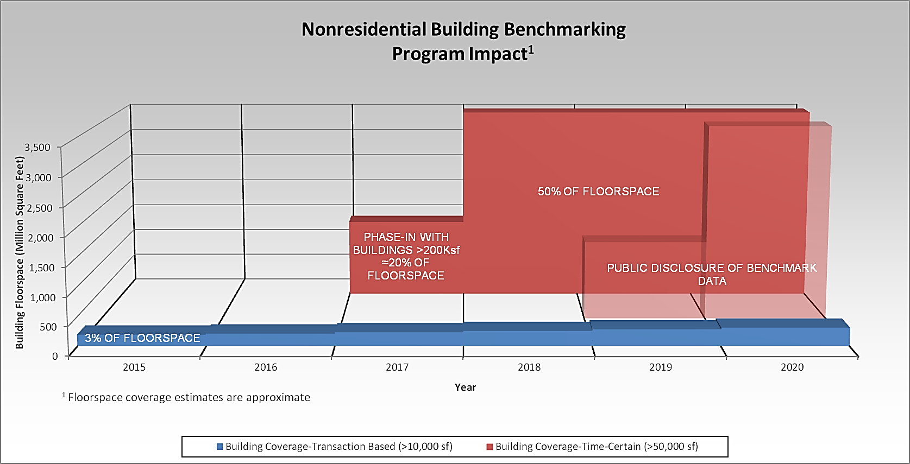
1.2 Nonresidential Benchmarking & Disclosure

Slide 10
1.3 Minimum Standards for Assessment Tools
Home Energy Rating System (HERS) II 1.3.1
Align with current home upgrade practices and other relevant industry protocols.
Standards for Smart Meter Data Analytics 1.3.2
Establish minimum standards and protocols for tools.
Notes:
Move from only allowing CEC-approved tools; let industry use most appropriate tools; Energy Commission may establish minimum threshold.
1.3. Minimum Standards for Assessment Tools
1.3.1 Home Energy Rating System (HERS) II:
Utilizing the HERS II Rulemaking process, modify the HERS II whole house assessment protocols to align with current home upgrade program practices and other relevant industry protocols
1.3.2 Minimum Standards for Smart Meter Data Analytics:
Establish minimum qualification standards and evaluation protocols for eligible low and no-touch home energy assessment tools.
Mixed bag of smart meter data analysis tools listed by utilities; would like consistency. Utilities should provide access to every tool meeting Energy Commission approval, and not pick winners and losers.

Slide 11
1.4 Uniform Energy Asset Ratings
Standardize Asset Ratings 1.4.1 & 1.4.2
Review current asset rating methods.
Develop California specification for asset rating calculations.
Develop or adopt rating methods for existing buildings.
Notes:
Primary use of asset rating is for property valuation; use may change between occupants. KBB assesses the car only, not the car and driver.
Trying to distinguish between assessment tools (for improving asset, behavior, and maintenance) and asset ratings tools (to inform property valuation); recommending different treatment for each in updated HERS II regulations.
Contractors should have full discretion for choice of assessment tools, needs to be consistency among asset rating tools.

Slide 12
1.5 Building Efficiency Standards Development and Compliance
Improve Clarity and Ease of Use 1.5.1 - 1.5.4
Assess cost effectiveness for existing buildings.
Improve water efficiency.
Improve Compliance 1.5.5 - 1.5.8
Assess compliance gap and the needs of building departments.
Evaluate local online permitting pilots.
Determine need for a statewide serial number tracking system.
Develop compliance strategic plan.
Notes:
Existing building regulations get insufficient scrutiny. More focused EB outreach and evaluation necessary. Figure right balance between cost effectiveness and compliance.
Have to re-think compliance processes. Move to performance-based? Build mechanisms that encourage contractors to always meet code as part of business practice.

Slide 13
1.6 Efficiency of Plug-in Loads
Technical Advancements & Market Transformation 1.6.1 - 1.6.7
Increase scope of appliance efficiency regulations.
Pursue advanced appliance efficiency technologies.
Finalize and apply the Commission’s enforcement regulations under SB 454.
Support enhanced federal regulations.
Partner with other states to leverage resources.
Notes:
Expand Energy Commission resources to accelerate adoption of appliance efficiency regulations. Cooperate with feds to improve efficiency of federally regulated appliances.
Partner with R&D and emerging technology programs; incorporate new technologies into regulated appliances. Partner with other states to incorporate other research.
454: Potential to get full compliance with proper enforcement; recently granted authority allows this.
Specification development allows for efficiency and quality requirements above federal standards. Ex. Energy Star [Ask Ken if this is a good example.] LED quality spec. example.
[Can mention purchase agreements here on in state buildings.]

Slide 14
1.7 Local Government Leadership
Local Government Challenge Program 1.7.1
Create repository of best practices and lessons learned.
Encourage data-driven policy and actions.
Local Government Partnerships 1.7.2
Coordinate utility data sharing with local government partnerships.
Other Efforts 1.7.3
Leverage local climate action, land use, water conservation, and other plans to improve energy efficiency and reduce greenhouse gas emissions.
Ensure access to energy use data by planners.
Notes:
Refer to flier. Mention that there will be a workshop on this on May 7.

Slide 15
Guest Speaker
Billi Romain
Sustainability Program Manager
Department of Planning & Development
City of Berkeley

Slide 16
Guest Speaker
Gina Goodhill Rosen
Senior Policy and Legislative Affairs Associate
Global Green USA

Slide 17
1.8 Energy Efficiency as a Clean Distributed Energy Resource
Utility Procurement 1.8.1
Further develop the utility procurement model for energy efficiency, building on the SCE Preferred Resources Pilot.
Market Transformation Program Portfolios 1.8.2
Understand code shortfalls; minimize in future projects.
Consider alternate approaches to administering statewide market transformation efforts.
Long-Term Energy Supply Planning 1.8.3
Incorporate all expected energy savings in existing buildings in long-term demand forecast.
Notes:
Keep general: Meter savings-based efficiency improvements; utilities starting to open process for buying efficiency.
Build actuarial database with every project to create probability distribution. Allows providers to bid with confidence on
Think about utilities buying efficiency rather than deliver efficiency. The marketplace will bid into the process.
Base success on measured performance.
Relax cost effectiveness criteria to allow innovative programs that can become part of a future procurement process.
1.8.2: Future projects. (Code baseline issue.)
Pros and cons to different administrative models; need to find most effective.
1.8.3: (Check for this in data strategy): Make long-term forecast more localized to understand peak demand. Distribution constraints are local, especially with increased EE and renewables.

Slide 18
1.9 Leadership: Existing Building Efficiency Collaborative
Statewide Agency Leadership
Form the Existing Building Efficiency Collaborative (EBEC) to lead and coordinate progress toward energy efficiency across the energy agencies.
Governance Structure 1.9.1
Staff the EBEC with senior Energy Commission and CPUC staff, who will report to lead commissioners.
Coordination and Stakeholder Engagement 1.9.2
Coordinate analysis, identify promising strategy options, monitor and report on strategy effectiveness, and provide public briefings.
Notes:
How we are going to manage the plan, raise issues to the Governor, assess collaboration with state and local governments.
Raise importance: Strong connection with Governor’s office, so they are kept apprised of progress and don’t get any surprises.
Report on progress in IEPR.
Sounding board for industry. Be able to respond to industry concerns.

Slide 19
Lunch Break

Slide 20
Goal 2: Data drives informed decisions.

Slide 21
2.1 Data for Improved Decisions
Data Exchange Protocols 2.1.1
Adopt consistent statewide data exchange protocols in line with national efforts (SEED, BEDES, Green Button)
Benchmarking Data Infrastructure 2.1.2
Map meters to physical buildings to develop benchmarking infrastructure.
Easy-to-Access Data and Analytics 2.1.3
Improve access to energy use data and analytics
Data for Local Governments 2.1.4
Standardize process for local governments to access data.

Slide 22
2.1 Data for Improved Decisions cont.
Standardized Utility Rate Information 2.1.5
Maintain utility tariffs in a consistent format on a public website.
Project-specific measured savings 2.1.6 - 2.1.7
Provide public access to project-level, locale-specific, anonymized information for program participants.
Data Access for Policy Planning & Research 2.1.8 - 2.1.10
Establish secure energy data centers with utility data.
Establish energy use baselines.
Develop data collection protocols and forecasting methods.

Slide 23
2.2 Consumer-Focused Energy Efficiency
Enhanced Program Design and ME&O 2.2.1
Include all end uses of energy and water.
Target consumers at key transaction points.
Establish behavior and operations as central elements.
Connect consumers across programs.
Expand Behavior Program 2.2.2
Leverage innovations; plan for expanded scope and market reach.
Targeted Programs 2.2.3
Use data-driven market segmentation to target customers.

Slide 24
2.2 Consumer-Focused Energy Efficiency cont.
Building/Portfolio Cohorts 2.2.4
Encourage engagement, awareness, value, and implementation of improvements.
Work with corporations to address entire portfolios.
Strategic Energy Planning 2.2.5
Establish sector-specific support centers for plan development.
Create directories of qualified building professionals.
Provide ongoing technical assistance.

Slide 25
Guest Speaker
Elliot Hoffman
CEO
REV

Slide 26
Goal 3: Building industry delivers innovation and performance.

Slide 27
3.1 Streamlined and Profitable Industry
Sustainable and Effective Program Delivery 3.1.1
Streamline program requirements to reduce transaction costs.
Improve and expand direct install programs.
Align long-term funding commitments with business investment decisions.
Industry Partners Program 3.1.2
Encourage partnerships among trade organizations and industry agents to address key market barriers, facilitate innovation, and share best practices.
Notes:
Overwhelming process to apply for incentives; keeps contractors out of market. Projects miss energy savings as a result.
Don’t limit to low-hanging fruit. Ceiling insulation example.
Longer portfolio cycle would allow upgrades with longer payback. Same programs (and incentives) would need to be available year after year. Program design needs to align with business plans.

Slide 28
3.2 Performance-Driven Value
Performance Assurance 3.2.1
Develop verification tools to substantiate predicted savings.
Facilitate widespread use of tools.
Enable easy access to energy use data.
Incentives Tied to Performance 3.2.2
Make incentives contingent on performance improvements.
Notes:
Contractors can advertise realization rate (percentage of projects that meet predicted performance improvements).
3.2.2: Most incentive programs based on assumed improvement, not measured improvement. Establishing easy ways to take measurements, makes performance-based more compelling. Currently, same payment regardless of work quality. Performance would create incentive to increase work quality and disincentive to do poor quality work.
Introduce speaker at end of this slide.

Slide 29
Guest Speaker
Joanne O’Neill
Supervisor, Residential Buildings Programs
Pacific Gas and Electric Company

Slide 30
3.3 High Performance Workforce and Education
Priority Sectors, Systems, and Workforce Categories 3.3.1
Select buildings sectors and trades that will need to scale up soon or need most improvement.
Knowledge, Skills, and Abilities Specifications 3.3.2-3.3.3
Strengthen curricula for performance-oriented efficiency jobs.
Efficiency Marketing Included in Workforce Training 3.3.4
Train contractors and other market actors to sell energy efficiency, including financing options.
Notes:
Current, centralized training opportunities not ideal for trades requiring on-the-job training; takes time away from work.
Make sure KSAs that are already specified for trades include EE aspects. Tie to 3.3.5
Soft skills: Know how to explain the advantages of proper installation, a higher efficiency unit; generally, the whole-house picture of EE.
Currently, upgrades may require visits from utility installation verifiers as well as building department inspectors.

Slide 31
3.3 High Performance Workforce and Education cont.
Industry Delivered Quality Assurance 3.3.5
Contractors, construction firms, and other businesses deploy QA as standard practice.
Special Skills Training 3.3.6
Incorporate training in retrocommissioning and building operations.

Slide 32
3.4 Zero Net Energy Retrofits
Focus on Key Building Types 3.4.1
Identify building sectors with significant potential for ZNE retrofits and financing.
Develop and/or Enhance ZNE Retrofit Tool Kits 3.4.2
Provide design and financing guidance for building sectors with limited guidance for ZNE retrofits.
Provide Incentives and Other Financing Mechanisms 3.4.3
Make incentives and other financing mechanisms widely available for ZNE retrofits.
Notes:
3.4.2: Make templates and case studies from completed ZNE projects available.

Slide 33
15 Minute Break

Slide 34
Goal 4: Californians recognize and benefit from the value of efficiency upgrades.
Notes:
Add content regarding overall goal.
Can only go so far without all consumers demanding energy efficiency.
Smart phone analogy: People don’t need to know how a smart phone work, they just need it to work.

Slide 35
4.1 Real Estate Value
Pilot Real Estate Industry Energy Asset Ratings 4.1.1
Partner with appraisers, leasing agents, local governments, and rating tool providers to pilot building energy asset rating methods.
Modify based on industry feedback.
Energy and Water Cost Savings 4.1.2
Compile information on building life-cycle and building occupant tenure cost reductions.
Develop cost savings estimates by building type and region.
Notes:
4.1 Real Estate Value:
Work collaboratively with real estate industry, underwriters, and financial agents to adopt property asset-related energy characteristics in building valuation and to integrate energy efficiency into all transactions.
4.1.1 Pilot Energy Asset Ratings with the Real Estate Industry:
Distinct pilots for residential and nonresidential; tools, actors, approaches will be different.
Allow decision maker to tailor rating for intended use of building.
Introduce the uniform property valuation approaches established in Strategy 1.4 to appraisers, commercial leasing agents and other real estate actors.
Partner with California appraisers, leasing agents, local governments, and rating tool providers to pilot the building energy asset rating methods adopted in Strategy 1.4.
Modify the final specifications for the uniform building energy asset rating methods based on industry feedback gathered in the above pilots.
4.1.2 Energy and Water Cost Savings:
Develop and compile information on building life-cycle and/or building occupant tenure cost reductions for energy and water efficiency measures.
Develop separate cost savings estimates as needed for each unique commercial business category and building type, as well as unique residential dwelling type.
Incorporate regional (e.g. climate) differences in expected cost savings information when appropriate.

Slide 36
4.1 Real Estate Value cont.
Energy Efficiency Appraisals 4.1.3
Evaluate the Green Addendum and other tools.
Incorporate energy asset ratings and cost savings into property appraisals.
Property Listings 4.1.4
Incorporate energy efficiency into property and lease listings; include asset ratings as available.
Green Leases 4.1.5
Collaborate with real estate industry to develop and distribute educational materials.
Offer technical and financial assistance to implement Green Leases.
Notes:
4.1.3 Energy Efficiency Appraisals:
Work with industry agents to advocate and expand the inclusion of the value of energy in appraisals.
Evaluate the Green Addendum and other relevant tools for applicability in valuing California properties for energy efficiency.
Incorporate energy asset ratings (4.1.1) and cumulative cost savings (4.1.2) into residential and nonresidential property appraisal processes.
4.1.4 Property Listings:
Incorporate energy efficiency into property and lease listings. Include energy asset ratings as soon as is practical.
4.1.5 Green Leases:
Deploy Green Leases (or green lease clauses) to align the costs and benefits of energy efficiency investments between building owners and tenants.
Collaborate with real estate industry to develop and to disseminate Green Lease templates, education, and information to owners and tenants.
Offer technical and/or financial assistance to implement Green Leases as appropriate for specific market sectors.

Slide 37
4.2 Targeted, Data- and Research-Driven ME&O
Decision Maker-Focused ME&O 4.2.1
Determine best practices by building sector and end use.
Extend outreach efforts completed in CaLEAP and other local efforts.
Leverage and develop partnerships with community leaders, manufacturers, and distributors.
Energy Upgrade California 4.2.2
Secure business and civic leader commitments to stimulate local action.
Assign EBEC oversight of Energy Upgrade California.
Encourage behavior and operational marketing messages in line with Plan goals.
Notes:
4.2 Targeted, data and research driven ME&O:
Educate, motivate, and activate consumers to take action on energy efficiency as part of their demand-side energy management with a comprehensive and complementary suite of targeted ME&O.
4.2.1 Decision-Maker Focused Marketing and Outreach:
Develop an influencer strategy that focuses on communicating the value proposition for decision-makers and leaders in California for the key strategies in the Action Plan.
Develop and disseminate case studies and best practices with leaders based on sector and/or end use. Complete ongoing implementation and feedback processes to ensure effectiveness of activities.
Leverage and extend outreach efforts completed in CaLEAP and other local energy and climate planning efforts.
CaLEAP (California Local Energy Assurance Planning) is a California Energy Commission sponsored project to assist local governments throughout the state in preparing plans to ensure that key assets are resilient to disaster events that impact energy.
Leverage existing channels of community leaders in real estate, financing, manufacturing, construction, and architecture trades. Engage and activate partnerships with manufacturers and distributors.
4.2.2 Energy Upgrade California:
Align energy efficiency elements of Energy Upgrade California ME&O with EBEE Action Plan and determine relationship to programs
Use business and civic leader commitments and competition to stimulate local action.
Assign Existing Building Efficiency Collaborative oversight of Energy Upgrade California brand activities
Determine the extent of alignment and coordination of EBEE Action Plan programs with use of the Energy Upgrade California brand
Encourage behavior and operational marketing messages by Energy Upgrade California in line with Plan goals

Slide 38
4.2 Targeted, Data and Research Driven ME&O
Notes:
Breaking through background noise to achieve actual engagement and resulting action is difficult .
To achieve Strategies 2.2 and 4.2, ME&O and program designers must work together to align objectives and messages to provide programs that work for the targeted consumer.
Campaign materials, channels, and reach methods must provide a compelling call to action.

Slide 39
Guest Speaker (via WebEx)
Sara Neff
Vice President, Sustainability
Kilroy Realty Corporation

Slide 40
Goal 5: Solutions are accessible and affordable for all Californians.

Slide 41
5.1 Foster Private Capital Market
State Finance Council 5.1.1
Establish council to shepherd offerings and identify priority initiatives. (I-Bank, CAEATFA)
Database 5.1.2
Ensure database of finance payment and project performance informs capital markets for risks & returns (CAEATFA).
Pilots 5.1.3
Assess IOU financing pilots, PACE, & other financing products. (CPUC, CAEATFA)

Slide 42
5.1 Foster Private Capital Market cont.
Evaluation of Priorities 5.1.4
Review priorities for new/modified finance products. (Council)
Trigger Point Financing 5.1.5
Ensure availability of financing matched to trigger points. (Council)

Slide 43
5.2 Asset-Based Financing
Mortgages that Value Efficiency 5.2.1
Incorporate energy efficiency into the mortgage valuation and underwriting process. (Mortgage and appraisal industry)
PACE 5.2.2
Increase uptake of PACE finance transactions. (Local governments, real estate industry, energy service providers, contractors)
Split Incentives 5.2.3
Encourage new investment cost recovery mechanisms to combat split incentive problem (e.g. tenant meter-based, green leases). (CPUC, POUs, multi-family and commercial real estate industries)

Slide 44
5.3 Borrower-Based Financing
Loans
Facilitate broader eligibility for unsecured loans.
Test alternative credit criteria, where helpful.
Target credit support, where needed.
Enable bundled loan securitization on secondary market.
(CAEATFA, Council)

Slide 45
5.4 Integrated and Streamlined Delivery of Efficiency Solutions, Finance and Utility Incentives
Streamlined Timing 5.4.1
Coordinate EE delivery timing through standardized project and performance data platforms and automation that enable prompt processing of loans and incentives. (EE program implementers, EE industry, lenders, utilities)
Targeted Incentives 5.4.2
Transition incentives to fill gaps for selected technologies, markets, depth, and/or trigger points to scale EE transactions with sustainable levels of ratepayer or public funding. (CPUC, CEC, POUs)

Slide 46
5.4 Integrated and Streamlined Delivery of Efficiency Solutions, Finance and Utility Incentives
Alternative Models 5.4.3
Explore alternative capital sources and turnkey efficiency services (e.g. energy performance contracts, Measured EE Transaction Structure, Investor Confidence Project). (Council, CPUC, POUs)

Slide 47
5.5 Government Building Finance Mechanisms
Expand funding options for local and state governments, and schools. Determine needs and best options (I-Bank, CA Dept. of Finance, Public finance organizations)
Revolving Funds 5.5.1
Expand funding resources for revolving funds (I-Bank, CA Dept. of Finance, Legislature and local governments)
Energy Service Agreements 5.5.2
Promote expanded use of energy service agreements. (Public finance organizations, ESCOs)

Slide 48
5.6 Leveled Tax Playing Field
Align tax treatments of efficiency and renewable energy
Align federal and state tax treatments (credits and depreciation) for energy efficiency improvements with those for renewable energy. (EE industry, National Association of State Energy Offices, US Department of Energy, Congress)

Slide 49
5.7 Establish deeper subsidies for full participation by low-income households
Balanced Assistance Options 5.7.1
Work with stakeholders to assess optimal balance of EE investment assistance options (loans, grants, direct installations) to maximize EE savings and lower energy costs for low income households. (CPUC, POUs, Legislature)
Cap and Trade Funds 5.7.2
Assess relative blend of utility and Cap and Trade fund allocations to support EE for low-income households. (CARB, Legislature, CPUC, POUs)
Multifamily Buildings 5.7.3
Determine blend of owner/tenant services and assistance for EE in multifamily buildings that house low-income occupants. (CPUC, POUs)
Notes:
5.7.1 Balanced Assistance Options: Work with stakeholders to assess optimal balance of assistance options across financing, on-bill repayment tied to meter, and grants or direct-installation to maximize water and energy efficiency levels, using ratepayer, occupant, or other funds.
5.7.2 Cap and Trade Funds: Assess changes to or coordination between utility and Cap and Trade fund allocations to low-income households for energy improvements.
5.7.3 Multifamily buildings: Integrate low-income household services with building owner eligibility for regular energy efficiency programs to increase efficiency levels in multifamily buildings with low-income occupants.

Slide 50
Guest Speaker
Brad Copithorne
Vice President of Commercial PACE Programs
Renewable Funding

Slide 51
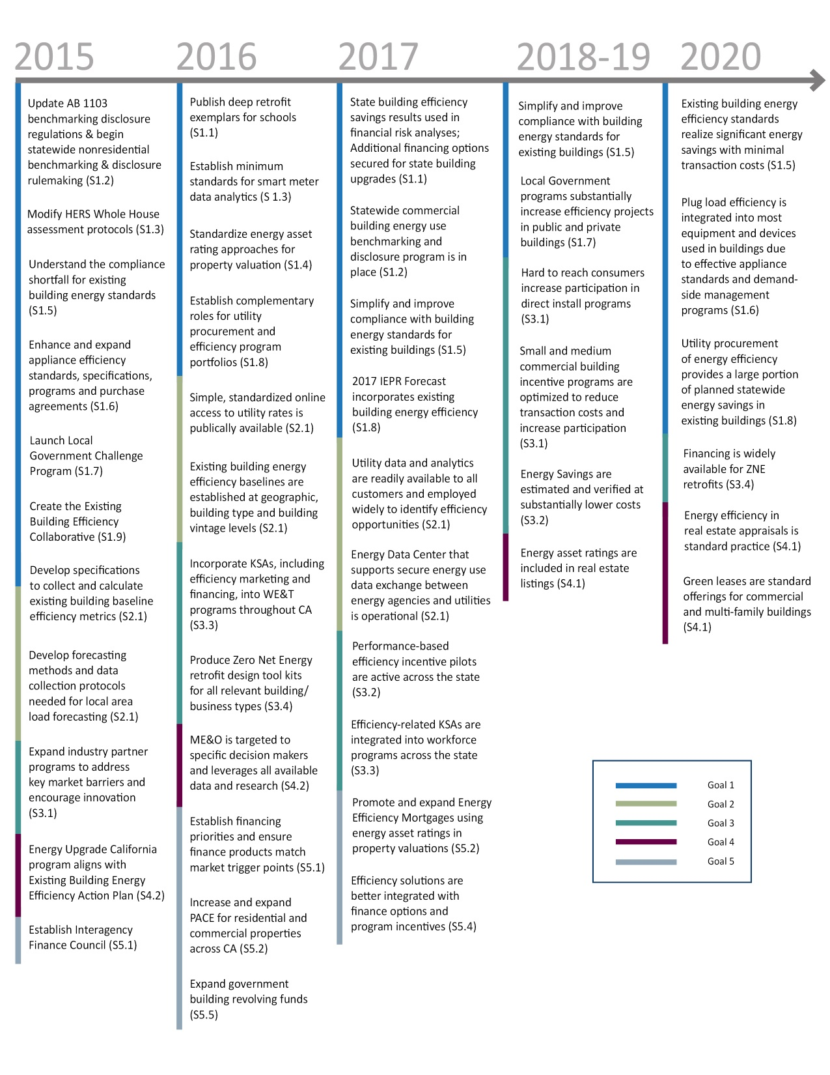
Milestones/Schedule

Slide 52
Next Steps: Future Action Plan Workshops
Data for Improved Decisions Workshop
  Full day workshop
  April 14, 2015
Benchmarking and Local Government Challenge Workshop
  Occur on the same day but half day workshop for each strategy
  May 7, 2015
Future TBD Workshops
  Topics: ZNE, Plug Loads, Title 24

Slide 53
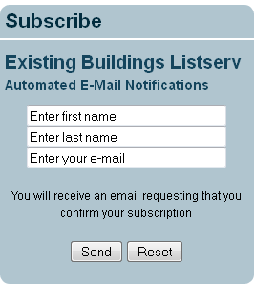
Stay involved
Attend Workshops
Submit Comments
Join the Existing Buildings Listserv
Fill in fields of subscription box at:
http://www.energy.ca.gov/ab758/

Slide 54
Submit Comments
Comments due by April 21, 2015
Submit eComment
Fill in required fields at: https://efiling.energy.ca.gov/Ecomment/Ecomment.aspx?docketnumber=15-IEPR-05
Submit paper comments to Docket 15-IEPR-05
      Energy Commission
      Dockets Office, MS-4
      RE: Docket No. 15-IEPR-05
      1516 Ninth Street
      Sacramento, CA 95814-5512
      Staff Contact
      David Ismailyan: 916-654-4045 / David.Ismailyan@energy.ca.gov

