Slide 1

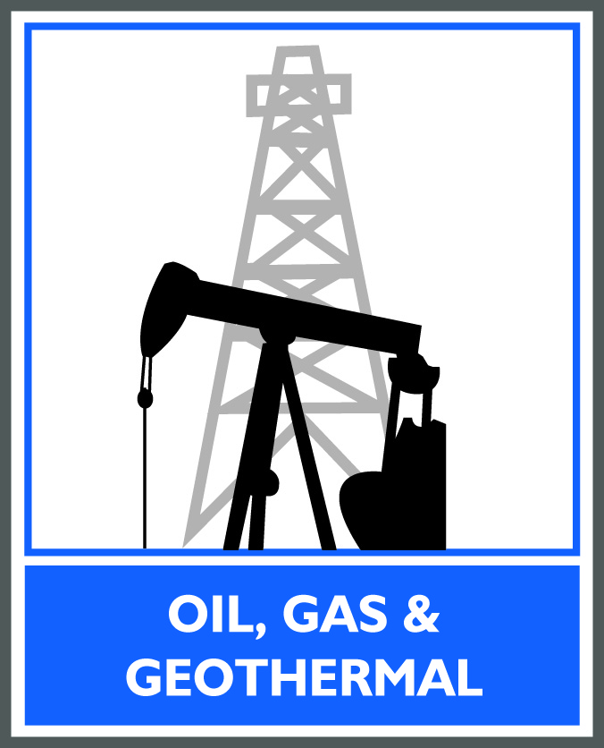
Fugitive Methane Emissions: Natural Gas in CA and the Role of Hydraulic Fracturing
CA Energy Commission, June 1, 2015
Steve Bohlen, State Oil and Gas Supervisor, California Division of Oil, Gas, and Geothermal Resources

Slide 2
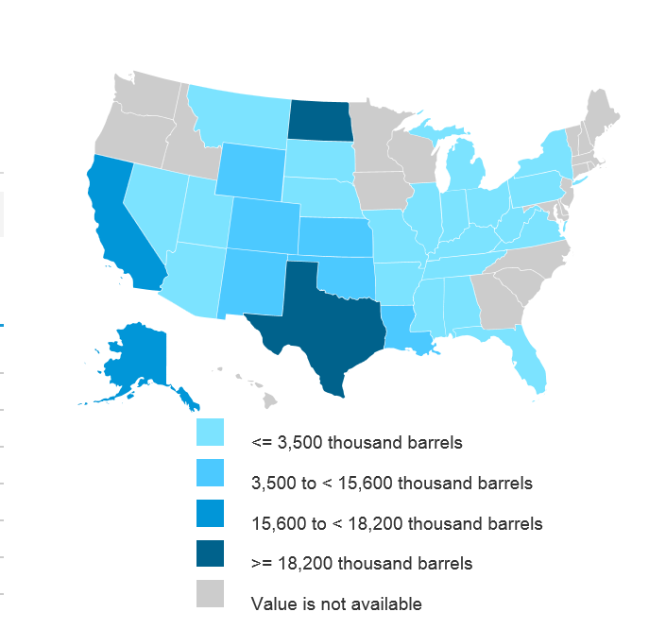
Top Ten Oil Producing States in the US, 2014
Texas
North Dakota
California
Alaska
New Mexico
Oklahoma
Colorado
Wyoming
Louisiana
Kansas
eia.gov

Slide 3
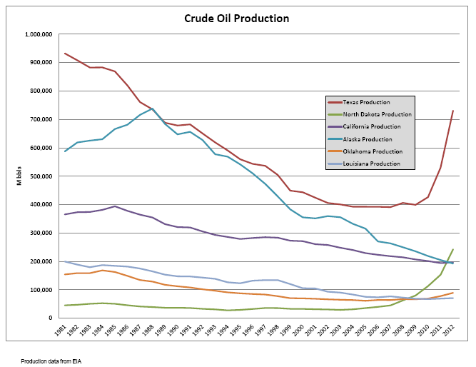
Notes:
California looks to be in 3rd place behind Texas and North Dakota. Alaska is dropping fast.

Slide 4
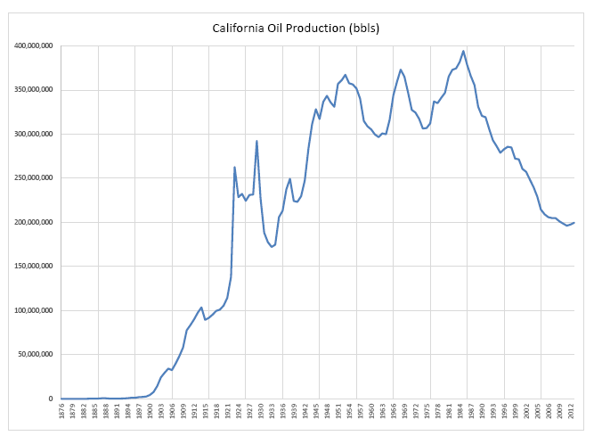
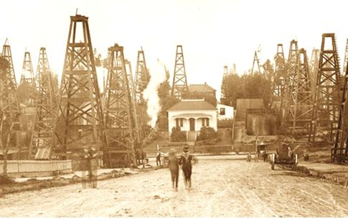
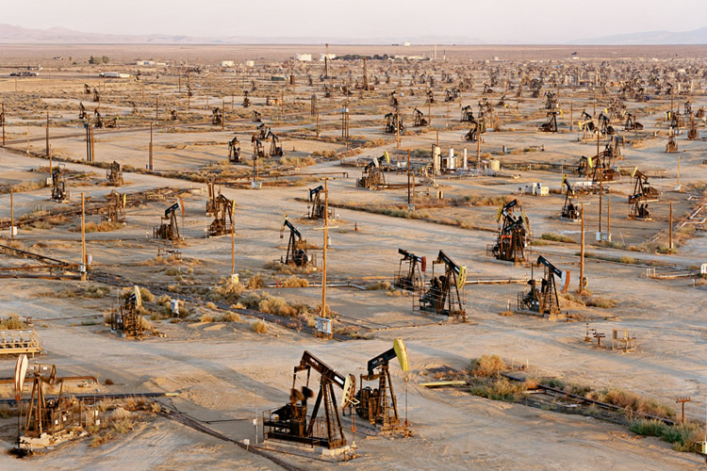
Notes:
Production peaked in 1986 and continues to decline.
The past decline was between 2-4%
Recent decline is around 1% (2011-2012)

Slide 5
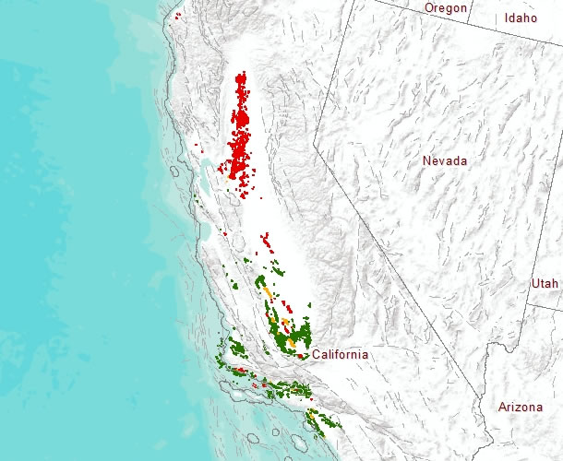
California’s Oil and Gas Fields

Slide 6
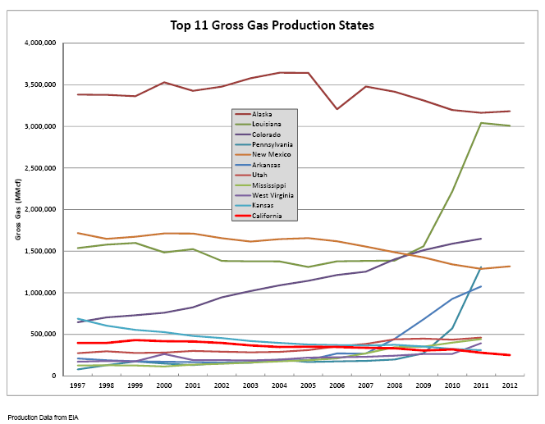
Notes:
You can see the impact that hydraulic fracturing has made in the nation’s gas production.
Notice California, no real change.

Slide 7
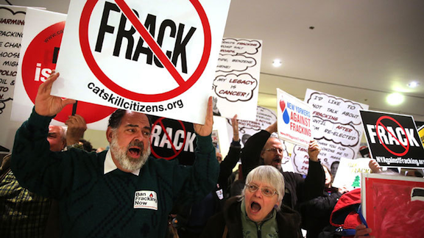
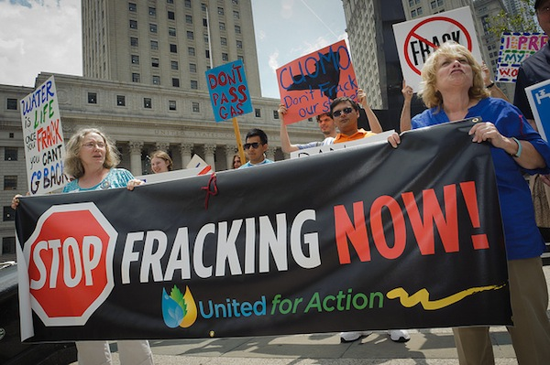
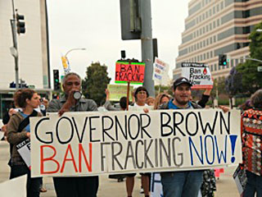
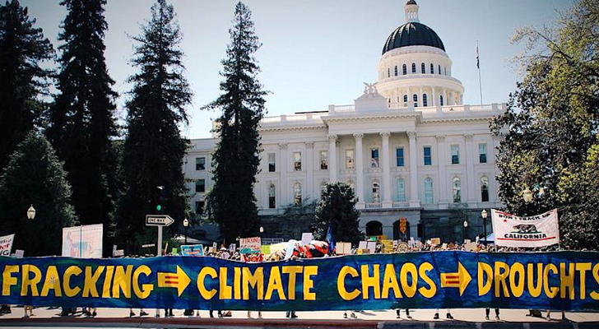

Slide 8

Notices and Disclosures 2014-15

Slide 9
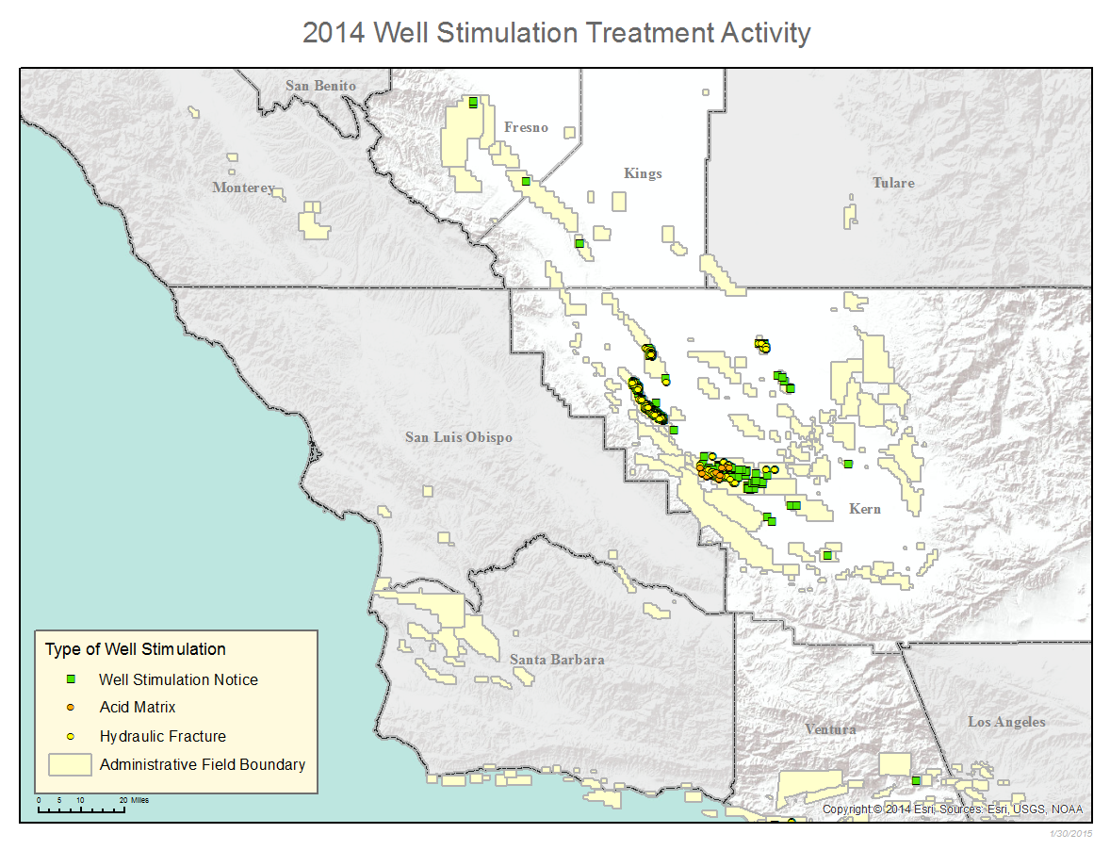

Slide 10
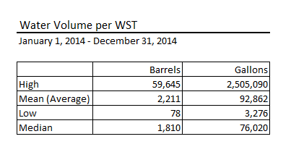
HOW MUCH WATER IS USED?

Slide 11
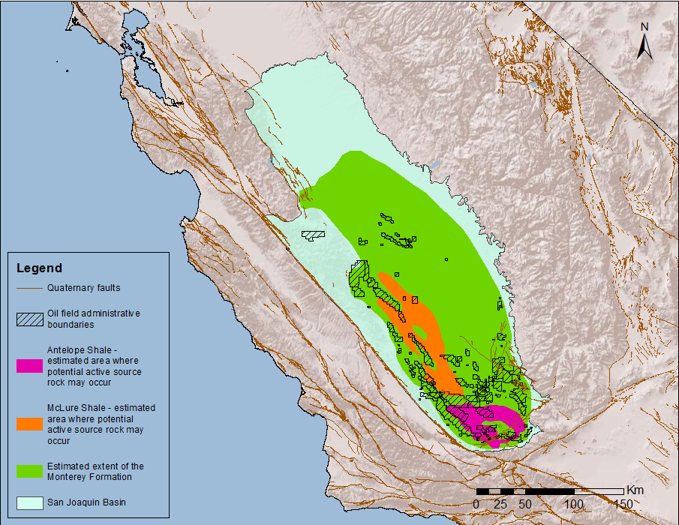
Could WST allow production of unconventional resources?
Unconventional oil in deeper, low permeability source rocks
  Monterey Formation
  Soda Lake Shale, Vaqueros Formation
  Tumey Formation
  Kreyenhagen Formation
  Moreno Formation
San Joaquin Basin – Monterey data from Magoon et al., 2009

Slide 12
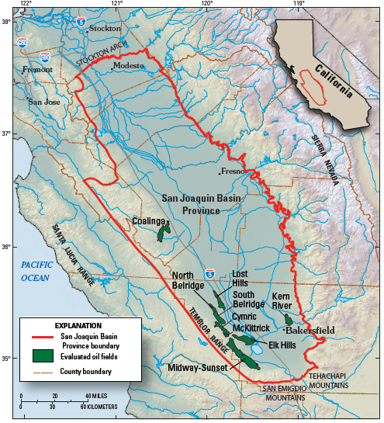
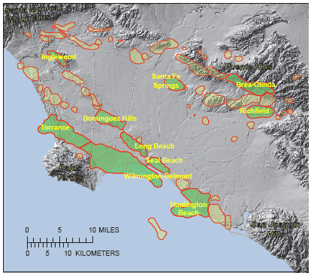
Current technology could add 4.9 to 15.6 billion barrels from just 19 giant San Joaquin and L.A. basin fields, with WST use much as it is today, i.e., mostly in SJV
USGS Fact Sheet 2012–3120;
USGS Fact Sheet 2012–3050

Slide 13
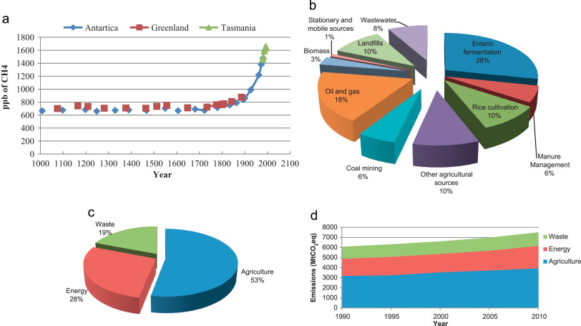
Context

Slide 14
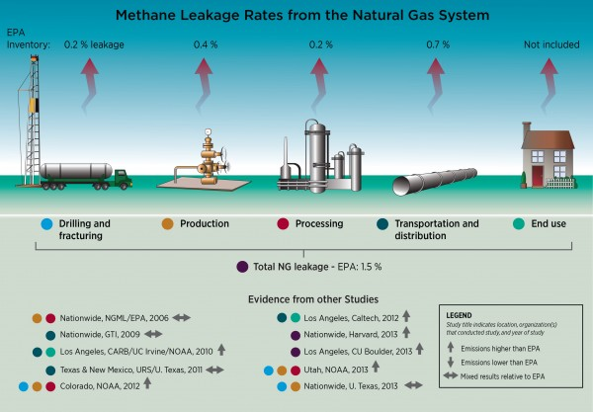
Bottom Up vs. Top Down

Slide 15
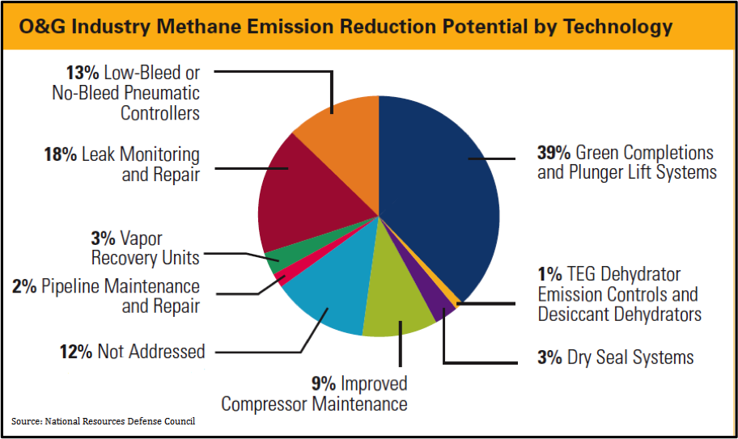
Areas for Improvement?

Slide 16
Fugitive Methane Emissions: Natural Gas in CA and the Role of Hydraulic Fracturing
CA Energy Commission, June 1, 2015
Steve Bohlen, State Oil and Gas Supervisor, California Division of Oil, Gas, and Geothermal Resources

