Slide 1
Natural Gas Supply and Production:
Brief Outlook
AB 1257 STAFF WORKSHOP
California’s Natural Gas Infrastructure, Storage, and Supply
November 18, 2014
Leon D. Brathwaite
Supply Analysis Office
Energy Assessments Division
California Energy Commission

Slide 2
Integrated Energy Policy Report 2013_____
Integrated Energy Policy Report (IEPR) 2013:
  Three Common Cases
Reference Case:
Low Demand/High Price Case
High Demand/Low Price Case

Slide 3
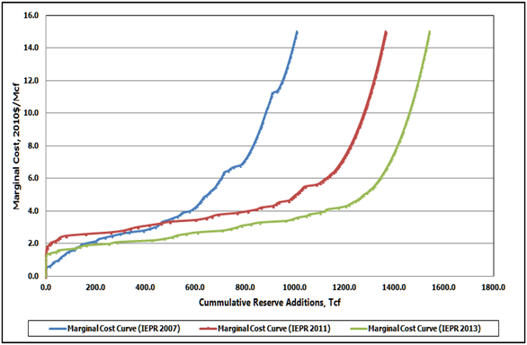
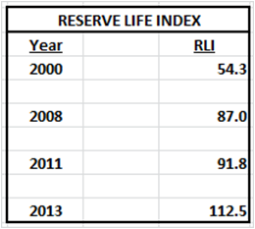
Lower 48: More resources at lower cost__
  Supply cost shifting to the right
  More natural gas available at low cost

Slide 4
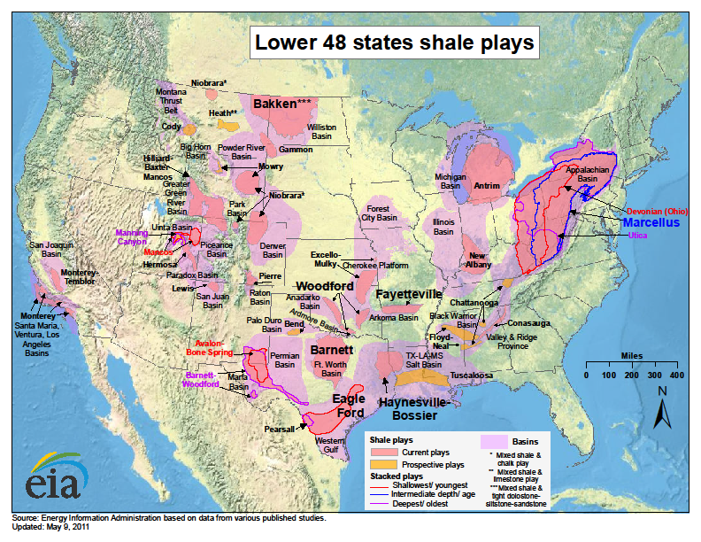
Development of Shale Formations_________
Deposits now stretch through
  at least 31 states in the Lower 48
  at least five provinces in Canada

Slide 5
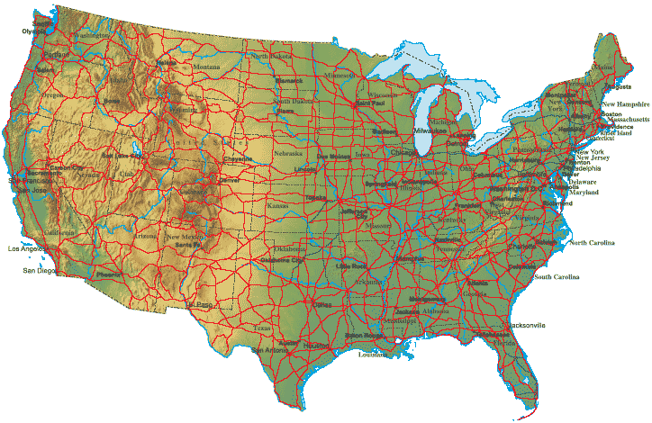
Supply Portfolio: Lower 48 (2025)_________
Canadian
Imports: 12.7 Bcf/d
Reference Case
Two main demands: End-use and Exports
Demand satisfied by:
  Canadian Imports
L48 Production
LNG Imports
Lower 48
Production: 72.3 Bcf/d
Demand: 73.6 Bcf/d
Exports:
8.4 Bcf/d
LNG Imports:
0.21 Bcf/d

Slide 6
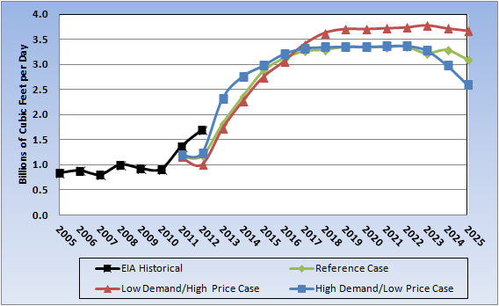
Lower 48 Pipeline Exports to Mexico_____
Growing demand in the power generation sector
Significant underdeveloped natural gas resources
Several pipeline projects proposed to export natural gas from L48

Slide 7
Potential for LNG Exports_________
At least fourteen proposals:
  US Gulf Coast
  East Coast
  Pacific Northwest
Four LNG export projects have received approval:
  Sabine Pass Liquefaction, Louisiana (under construction)
  Cove Point LNG, Maryland
  Cameron Liquefaction, Louisiana
  Freeport Liquefaction and Export Project, Texas

Slide 8
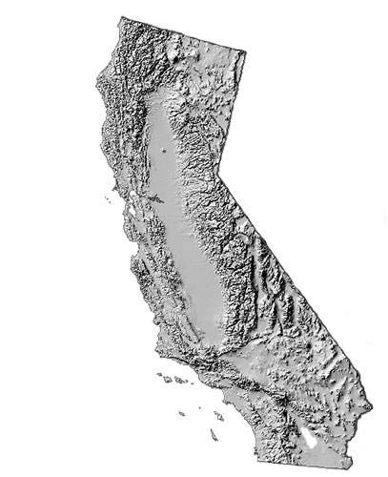
Supply Portfolio: California (2025)_________
Calif. Imports (Malin):
2.68 Bcf/d
Reference Case
California Demand: End-use
Demand satisfied by:
  Imports (Malin)
Rocky Mountain Supplies
Southwest Supplies
Local Production
Rocky Mountain:
1.25 Bcf/d
Southwest:
2.32 Bcf/d
California
Production: 0.20 Bcf/d
Demand: 6.38 Bcf/d
( ) Percent change from reference case

Slide 9
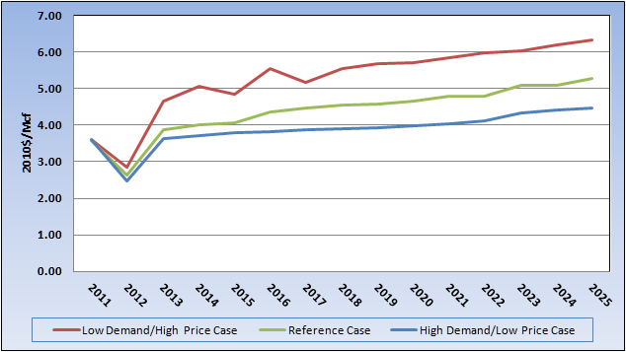
Price Performance of Cases (Topock Hub)______
In general, prices behave as expected:
  High Price case produced highest prices
  Low price case produced lowest prices
The three cases creates a “zone of uncertainty” for California prices

Slide 10
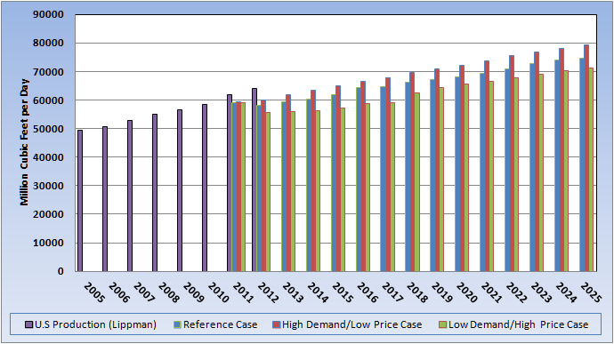
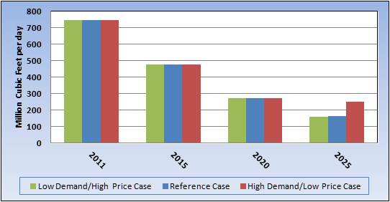
Natural Gas Production:
Lower 48 vs California__________________
Lower 48
California
Production in Lower 48 is rising
Production in California is falling

Slide 11
Questions and Issues___________________
Panel Discussion

