Slide 1
Natural Gas and Electricity
Steve Hance
Senior Division Manager, Resources
Silicon Valley Power
Nov 17, 2014
Notes:
This is a voluminous package and I have submitted it to you as a reference. Tonight, I will go through it very quickly and hit some of the highlights that have occurred since the last update in November.

Slide 2
Silicon Valley Power
POU serving the City of Santa Clara
~ 52,000 electric customers
~ 490 MW of peak demand
~ 3,125 GWh/year of demand
73% Load Factor Utility
~ 90% of retail sales go to commercial and industrial customers.
Load Following Metered Subsystem

Slide 3
Supply Side
900 plus MW of name plate capacity
  300 plus MW of Large Hydro
  200 MW of wind
  20 MW of solar
  300 MW of gas fired gen
  Geothermal, Small Hydro, Coal, and LFG as well

Slide 4
Natural Gas Fired Generation
DVR – Combined Cycle Plant 147 MWs, 2 LM6000 Turbines, 1 Steam Turbine ~ 122 MW with DUCT firing for an additional 25 MWs. Heat Rate at 122 MW is about 7,800 (DUCT burners Heat Rate 10,000)
Gianera Units 1 and 2 – 1980’s era simple cycle peakers, 25 MW each with about a 15,000 Heat Rate.
LEC – 72 MW Participant in the Lodi Energy Center project operated by NCPA 6,800 Heat Rate
CSC Cogen – 7 MW cogen facility that provides steam to neighboring paper manufacture
Lodi and Alameda - simple cycle CTs operated by NCPA 15,000 Heat Rate Peakers (75 MW total, SVP share 31.5MW)

Slide 5
Simple Cycle Operation
The Gianera, Alameda, and Lodi CTs rarely run.
Capacity is typically bid into the CAISO market as Non-Spin.
Energy is available to the CAISO in emergencies through terms in the Metered Subsystem Agreement, or through energy bids where the high heat-rate makes them uneconomical in almost all hours.
Gianera Units last significant run was during the Metcalf Substation event for voltage support for the south bay area.
Gas for these units is only procured after a market award is received.

Slide 6
CSC Cogen Operation
Typically is base loaded near full output to meet the steam demand of the neighboring paper mill.
Gas Demand is about 2,400 MMBTU’s/day with little variation.
Self-Scheduled with the CAISO (price taker)

Slide 7
Lodi Energy Center
Operates as a Merchant Plant bid into the CAISO markets.
Provides Energy, Spin, Regulation Up, and Regulation Down
Commercial in late 2012 and typically cycles off and on daily.
NCPA (Northern California Power Agency) operates the project for the participants.
Gas is purchased on a daily basis by 0700, and incremental purchases or sales are made once the market awards are published by the CAISO.
Third party agreement to manage the monthly/daily gas balancing.

Slide 8
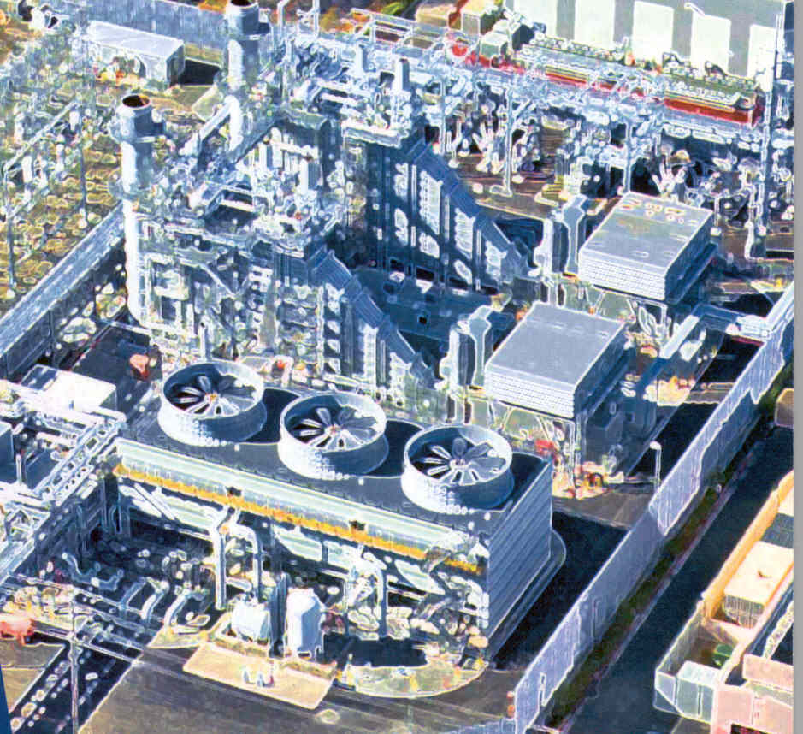
SVP Major Projects:
Donald Von Raesfeld Power Plant
  Local reliability
  Voltage support
  Control over electric and fuel resources
  Reduces transmission charges
147 MW peak /122 MW base load output
September 9, 2003 - License Received
March 24, 2005 - Commercial Operation
Total cost of construction - $175 M
  $150 M Revenue Bonds

Slide 9
DVR power plant
Operated by SVP
Gas is typically procured at the PG&E City Gate under annual, monthly, and daily contracts.
Third Party Agreement provides daily/monthly gas balancing.
Plant Operates based on daily economics of the generator’s specific nodal LMP and its marginal cost to generate based on the daily PG&E Citygate price plus O&M plus gas transport costs.
During average to wet hydro conditions in California DVR typically operates as a peaker, and during dry hydro conditions will typically run as a base loaded unit.
Also provides load following services for the MSS

Slide 10
DVR continued
Gas demand is currently easy to forecast since the project is self-scheduled vs. bid into the CAISO market.
Load Following for the MSS provides some error in forecasted demand.
Gas burn about 23,000 MMBTUs/day when in base load mode.
PG&E 2015 gas rate case may cause a drastic shift in DVR’s current operation. The proposed rate for BB connected and LT connected generation is nearly 90 cents/MMBTU of difference equating to $6 - $8 of difference in the marginal cost to generate power for equivalent heat-rate units depending on how they are connected to the gas system.

Slide 11
Gas Balancing Agreement
SVP has entered into a Gas Balancing Agreement for a variety of reasons.
Frequent OFO’s would make it nearly impossible for SVP’s “existing staff” to stay within the daily balancing requirements.
Being part of a larger pool allows SVP to have some flexibility in our power production.
Requires SVP to provide balancing agent with Month ahead forecasts, and daily forecasts of our expected daily burns.
Requires notification to Balancing Agent of any significant deviations to our forecast, (forced outages or significant forecast errors caused by load following)

Slide 12
Gas Balancing Agreement
Allows SVP to have Third Party gas delivered directly to Balancing Agent.
Differences between Third Party deliveries and forecasted daily burn are cashed out at the midpoint of the Citygate Index.
Significant differences between forecasted gas burn and actual gas burn identified after 0700 on the gas scheduling day almost always work against a generator and cause a loss in revenue.

Slide 13
Gas scheduling vs. Electric Scheduling
Gas scheduling, Energy scheduling, and CAISO markets are not aligned.
Purchasing gas does not use the same calendar or observe the same holidays. Veterans day was observed by the WECC prescheduling calendar but not by gas.
CAISO markets observe neither calendar and run 365 days per year.
On weekends since gas trades as a Saturday – Monday block this usually results in purchasing a three day block of gas and once generation awards are known, gas on Saturday and Sunday is typically sold back to the balancing agent at a slight loss.

Slide 14
Gas Procurement
Procured under long term agreements with PG&E Citygate as the Delivery Point.
Procured as “Firm” under a NAESB standard agreement.
Under NAESB diversion of procured gas is not considered Force Majeure unless there is interruption and/or curtailment of Firm transport.
Gas delivery performance, in the event of curtailments, must be prorated amongst other Firm customers, and only after all non-firm or interruptible customers have been curtailed.
Currently about 32,500 MMBTU/day under physical contract, (mix of fixed and index contracts).

Slide 15
September 2010 vs. September 2014 Actual Daily Gas Burn

Slide 16
Gas Procurement Concerns
Gas burn forecasts are generally due to balancing agent by 7:00 am on the day before flow day of natural gas. (at least 6 hours prior to knowing what your CAISO DA awards are)
Gas trades on ICE Monday – Friday and CAISO Energy Market runs 7 days a week. In the 2010 scenario this made it difficult to forecast weekend gas burns. Around some holidays a generator is typically scheduling gas supply 3 to 4 days prior ahead of knowing their CAISO energy awards.
Generally this isn’t a concern unless there is an OFO, or if your generation is operating in a peaking mode where generation profile can vary greatly.
When an OFO is issued gas prices used to create a bid into the CAISO market may not be close to what a generator ultimately pays for gas if the market award is substantially different from what was expected.

Slide 17
Potential Solutions
Improve alignment between Energy and Gas scheduling calendars. (observe the same holidays, potentially scheduling gas and energy 7 days a week with no observed holidays)
Owning storage rights – Expensive and mostly needed by units that operate as peakers with little or no opportunity to recover the cost.

Slide 18
Reliability Concerns
Non Core Electric Generation gas can be diverted to Core Customers.
  Possible outcomes – Gas intended to supply a 7000 heat-rate combined cycle plant is diverted. CAISO calls on 15000 heat-rate simple cycle units providing non-spinning reserves potentially making the problem worse.
PG&E’s Diversion procedure calls for pro-rata diversions vs. looking at generator heat-rates, locations, electric transmission concerns, or coordination with the CAISO and other CA Balancing Authorities.
Credit received for diverted gas and OFO/EFO charges are not aligned with potential energy prices in the CAISO. A 7000 heat rate generator may only be charged $100 plus the daily Citygate index as a noncompliance charge, but may face much higher costs if they fail to generate in accordance with their DA awards.

Slide 19
Reliability Continued
Units claimed for Resource Adequacy have a must offer obligation and are required to bid into the CAISO market, but still face diversion, and may not have gas.
Gas fired units offering Operating Reserves (Non-Spin) have no obligation to have physical gas under contract available should they need to run during a time frame when the gas system is stressed.

Slide 20
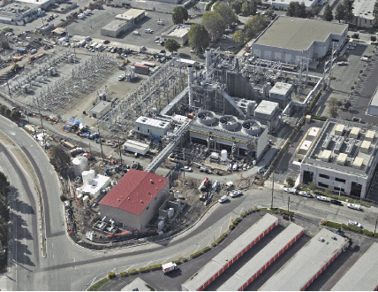
Thank You

