Slide 1
Pacific Gas and Electric Company
Natural Gas Operations
Roger Graham
Presentation to the California Energy Commission
Sacramento, California
November 18, 2014

Slide 2
Summary
PG&E’s backbone gas transmission system is adequate
There is sufficient gas storage capacity in Northern California to:
  Meet peak day demands
  Balance intraday and day-to-day supply and demand changes
  Optimize supply purchases
Regardless of limited overall demand growth, certain local transmission systems require additional capacity

Slide 3
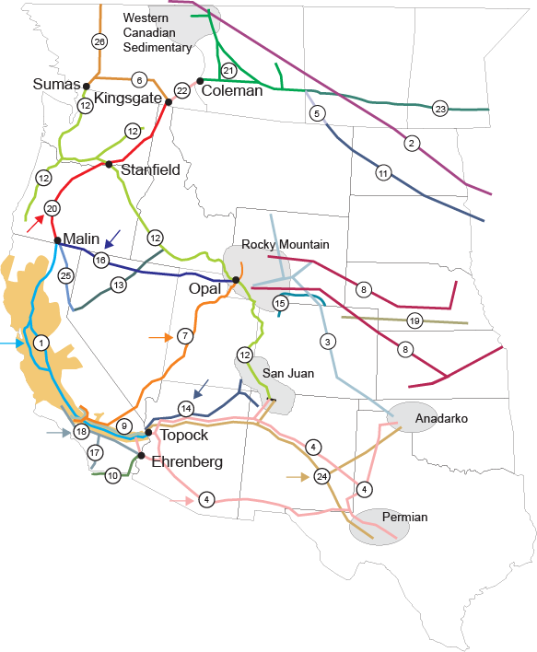
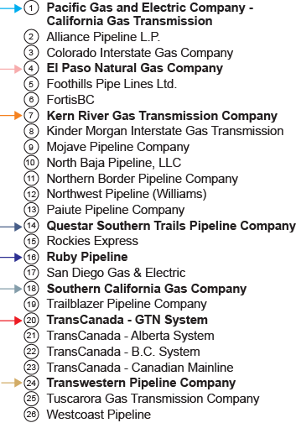
Western Natural Gas Pipeline Network
Pipelines delivering to the PG&E system

Slide 4
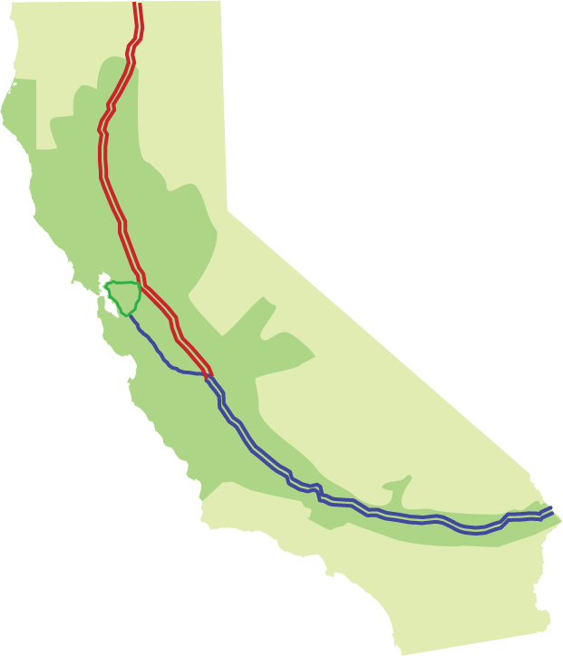
PG&E Backbone Pipeline System
Malin
Redwood Path- Lines 400 & 401
From Malin, OR to Panoche
Connects to TransCanada’s GTN & Ruby
Canadian and Rocky Mountain source gas
2.2 Bcf/d capacity
36” & 42” parallel pipes
5 compressor stations
Tionesta
Baja Path – Line 300
From Topock, AZ to Milpitas
Connects to El Paso, Transwestern, Kern River & Questar
Southwest and Rocky Mountain source gas
1.2 Bcf/d capacity
Two 34” parallel pipes
Three compressor stations
Burney
Gerber
Delevan
Silverado Path
Numerous interconnects
California source gas - Sacramento & San Joaquin Valleys
Antioch
Brentwood
Irvington
Milpitas
Bethany
Panoche
System Inventory
3.9 to 4.3 Bcf
400 MMcf swing
Kettleman
Hinkley
Topock

Slide 5
PG&E Backbone Capacity is Adequate
CEC should look to the Utilities Capacity Adequacy filings – PG&E’s Advice Letter 3490-G
Demand forecast represents weather conditions with a 1-in-10 year occurrence that account for both dry hydro years and cold winters
Short-term off-system sales were not included in the forecast
Forecast capacity utilization is about 76% on an annual basis
Near 100% utilization during some spring and summer months

Slide 6
Historical Backbone Utilization

Slide 7
Northern California Gas Storage Facilities
Malin
Wild Goose Storage
950 MMcf/d withdrawal
525 MMcf/d injection
75.0 Bcf working Gas
PG&E Storage
McDonald Island, Los Medanos & Pleasant Creek Fields
2010 MMcf/d withdrawal
450 MMcf/d injection
103 Bcf working gas
Lodi Storage
750 MMcf/d withdrawal
550 MMcf/d injection
29 Bcf working gas
Wild Goose
Pleasant Creek
Central Valley GS
Los Medanos
Lodi
Central Valley NGS
300 MMcf/d withdrawal
300 MMcf/d injection
11 bcf working gas
McDonald Island
Gill Ranch
Gill Ranch
650 MMcf/d withdrawal
450 MMcf/d injection
20 bcf working gas
Topock

Slide 8
Peak Day Supply and Demand
  Available Supply
    Supplies via interstate pipelines, 67% of firm capacity - 2,000 MMcf/d
    Supplies from gas storage, 80% of maximum capacity - 3,750 MMcf/d
  System Demand
    Average winter demand (Jan 2013) - 3,412 MMcf/d
    Historical Peak Day (Dec 9, 2013) - 4,958 MMcf/d
    Abnormal Peak Demand - 5,530 MMcf/d

Slide 9
Local Transmission Capacity
Demand growth in Sacramento area and Santa Clara County
  Sacramento, new housing and commercial growth
  Santa Clara County, mostly commercial some residential growth
Other systems near there capacity limits – North Bay, Fresno
  PG&E maximizes capacity during cold weather through manual operations and CNG/LNG augmentation

