Slide 1
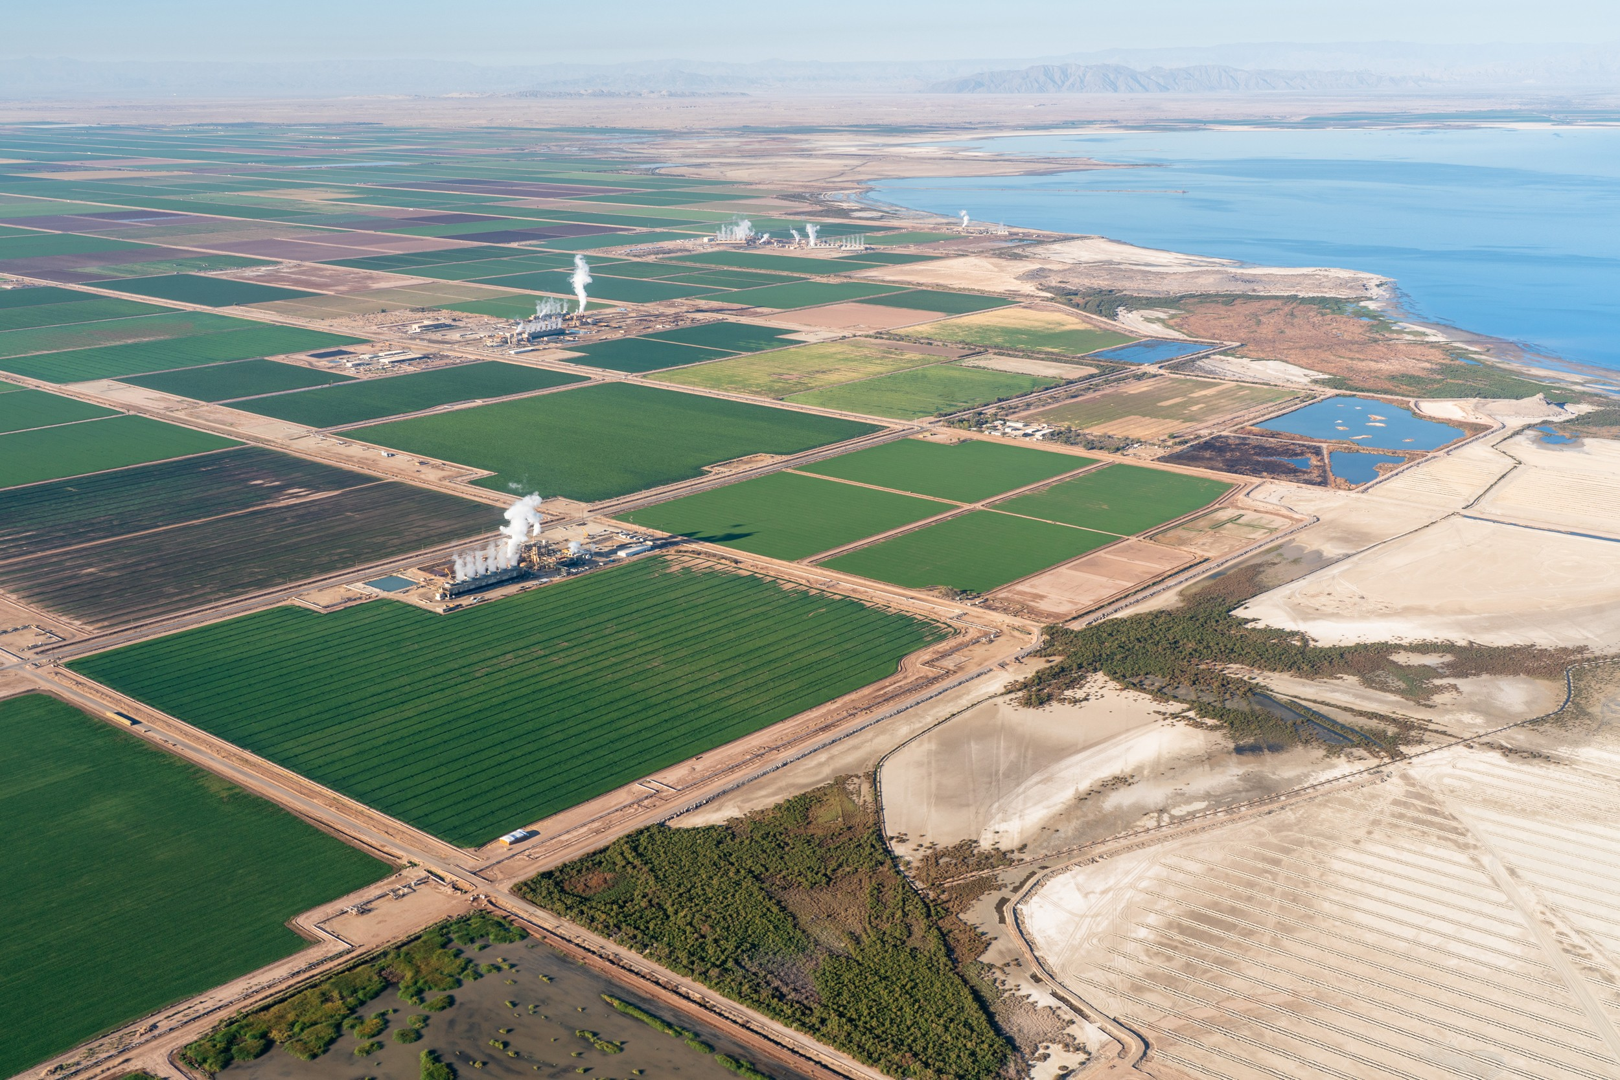
Competitive Advantages of Recovering Metals
from Salton Sea Geothermal Brines
Michael McKibben, PhD,
Research Professor, Earth & Planetary Sciences, U. C. Riverside
mckibben@ucr.edu
EcoFlight

Slide 2
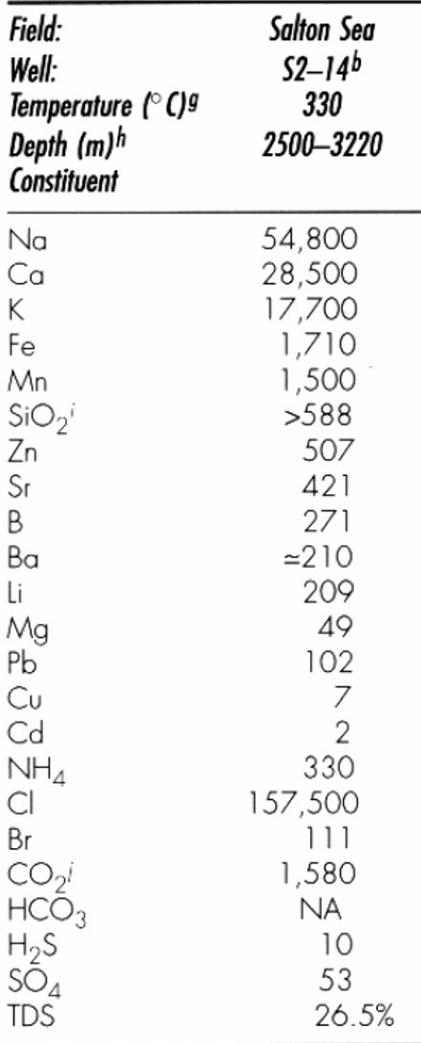

Lithium is only one of many metals in the Salton Sea geothermal brines that are strategic (critical)
Commodity | Main use | Import reliance | Import sources
Li 200 ppm | Batteries | >90% | Argentina, Chile, China
Mn 1500 ppm | Steel-making | 100% | S. Africa, Australia, Gabon, Georgia
Zn 500 ppm | Galvanizing | 76% (refined) | China, Peru, Australia
K 18000 ppm | Fertilizer | 93% | Canada, Russia, Belarus
Sr 400 ppm | Magnets | 100% | Mexico, Germany, China
Rb 90 ppm | Quantum computers | 100% | Canada, China
McKibben & Hardie 1997

Slide 3
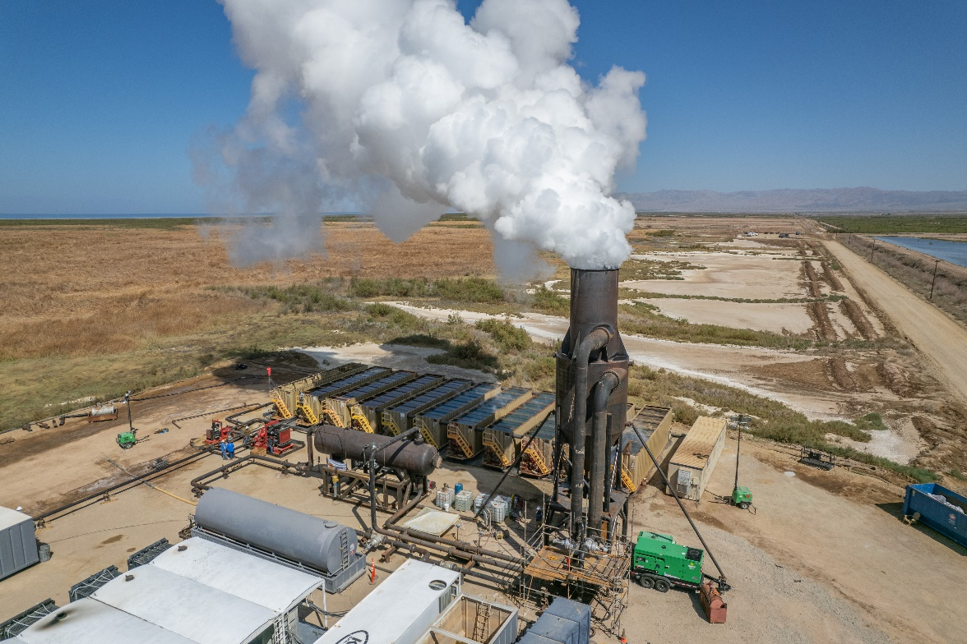
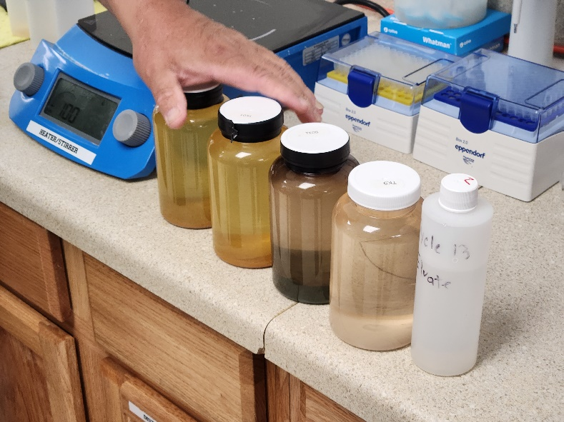
Revenue potential from additional brine minerals (10 power plants)
Potential metric tons of metals per year at 90% recovery efficiency:
Metal ppm Rate % of 2023 US Consumption
Mn 1500 162,000 tpy 24
Li 198 21,384 tpy ~67
Zn 500 54,000 tpy 6
Sr 421 45,468 tpy 967
K 17,700 1,911,600 tpy 45
CTR

Slide 4
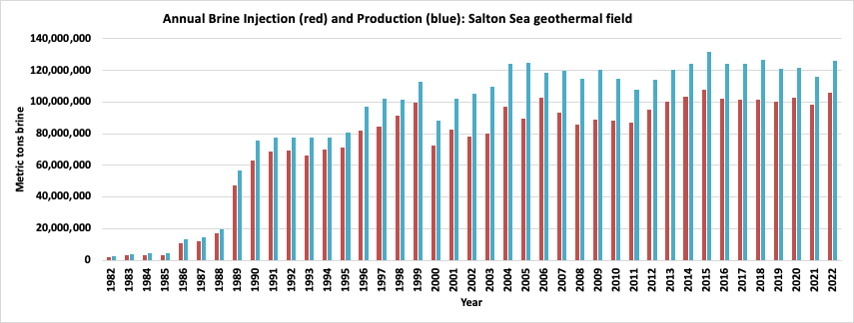
Long-term consistency in brine (and Li) production (10 power plants)
Annual Li production = mass of brine × Li conc. × recovery efficiency for the current 400 MWe capacity
Using 20-year avg. of brine production (120,000,000 metric t/y), 200 ppm Li, and a recovery factor of 90%, 21,600 metric tons/y Li metal (115,000 metric tons/y LCE) could be recovered now (3.6 M EVs/y)
If field expands from 400 to max of ~3000 MWe, production could reach ~863,000 mt/y LCE (27 M EVs/y)
For comparison, global Li production in 2024 was 1,276,000 mt/y LCE (USGS MCS 2025).
Salton Sea Geothermal Field production and injection data from CA Dept. of Conservation
Dobson et al., 2023

Slide 5
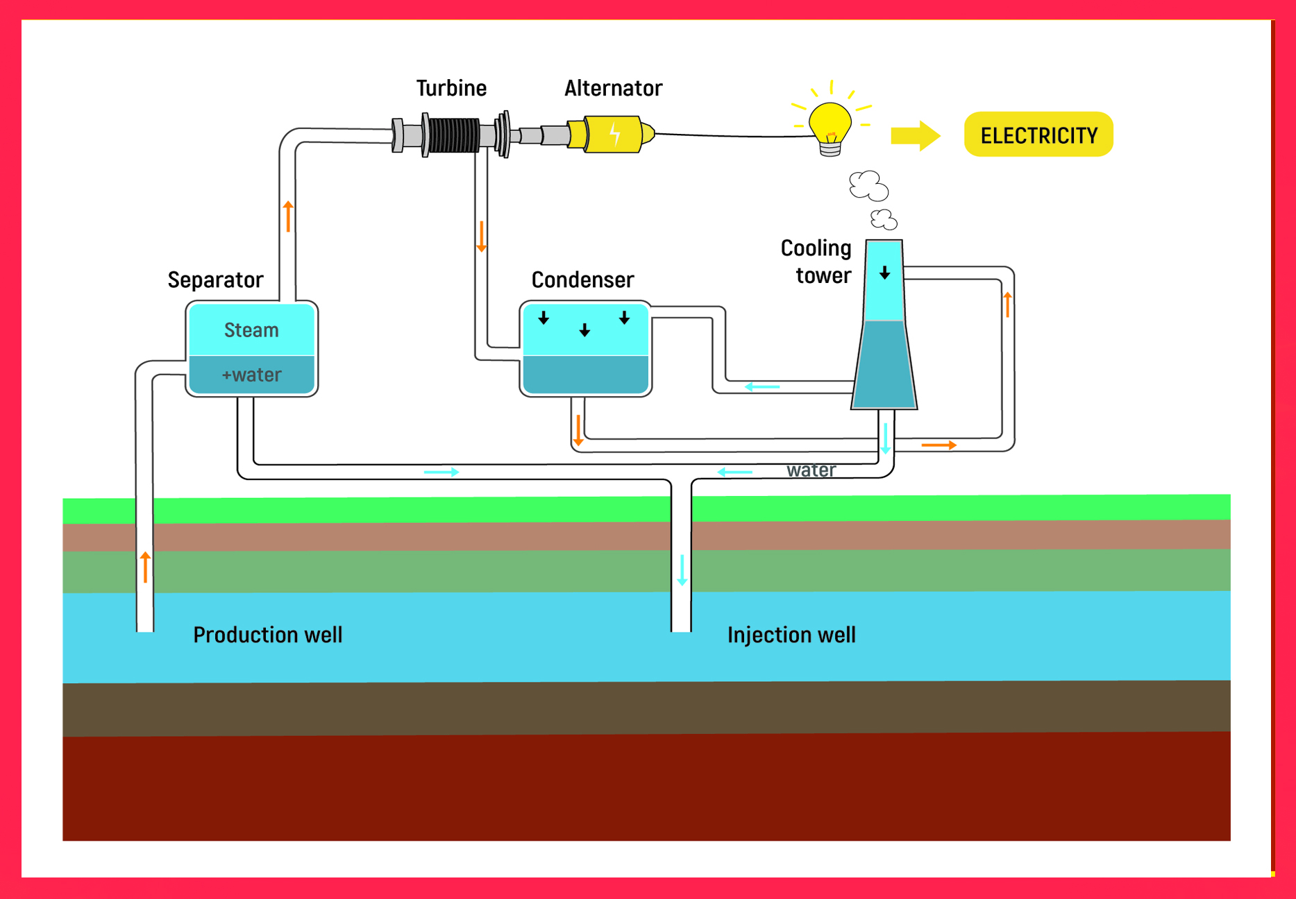
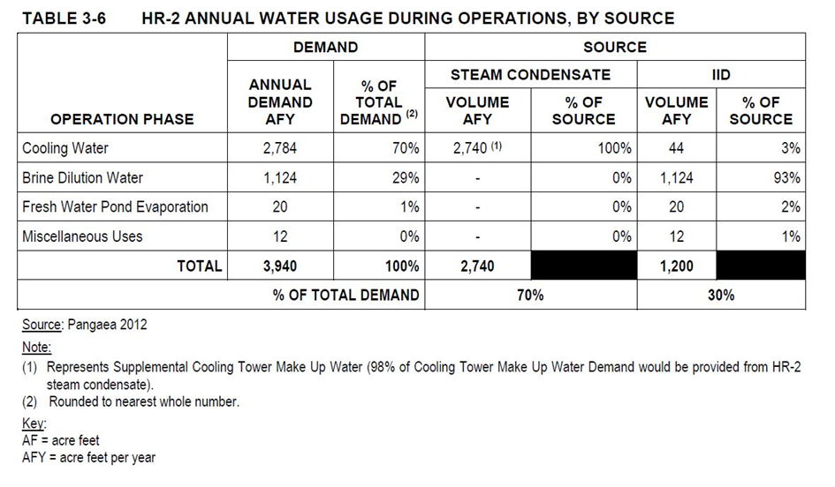

Slide 6
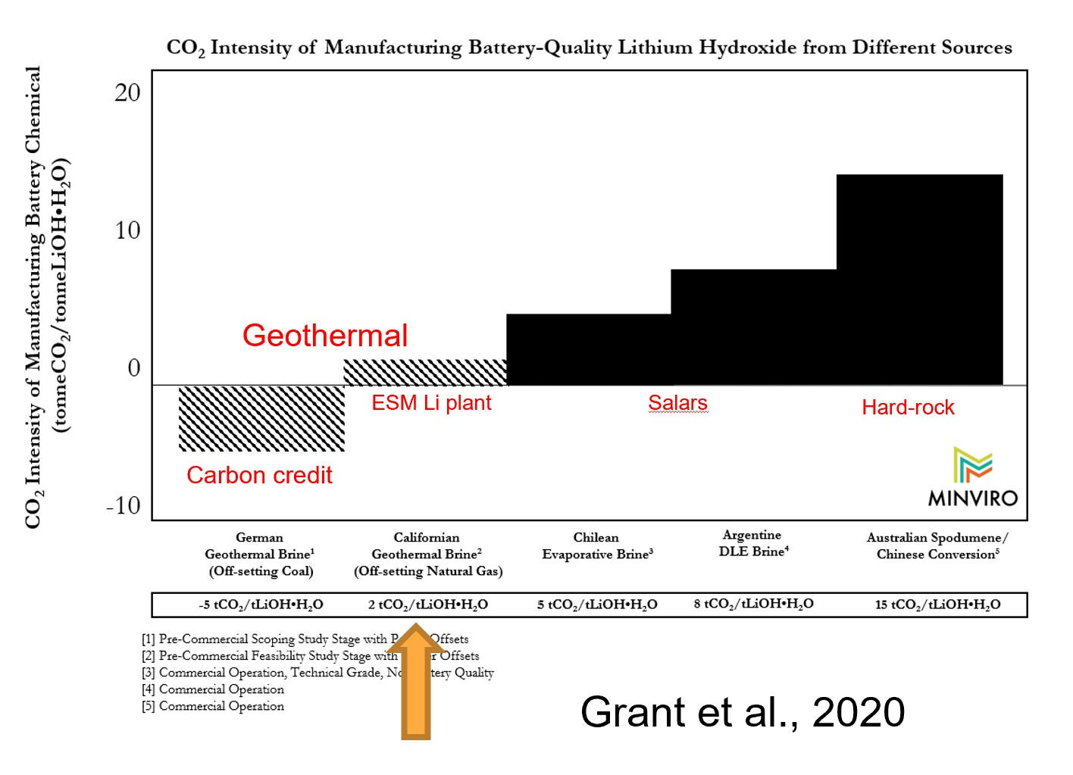
Does geothermal Li extraction itself add any CO₂ emissions?
Only from the added electrical energy used, by adding Li filters to existing power plants.
Most geothermal power plants generate their own electrical power to use, called the
“parasitic power” load, typically 10-20% of the total power produced.
If some of this power can be used for Li extraction, it actually reduces CO₂ emissions that would otherwise be generated by using electricity generated elsewhere from fossil fuels – a carbon credit.

Slide 7
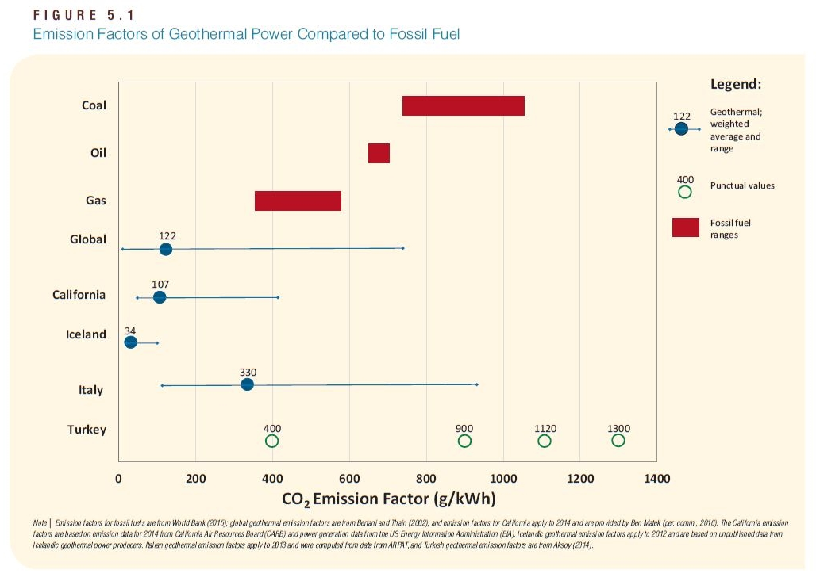
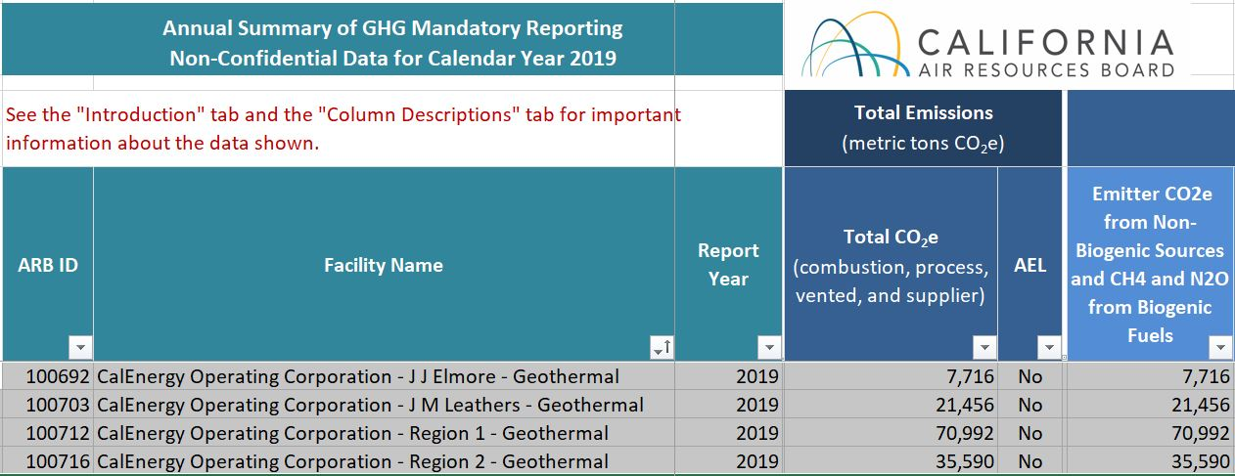
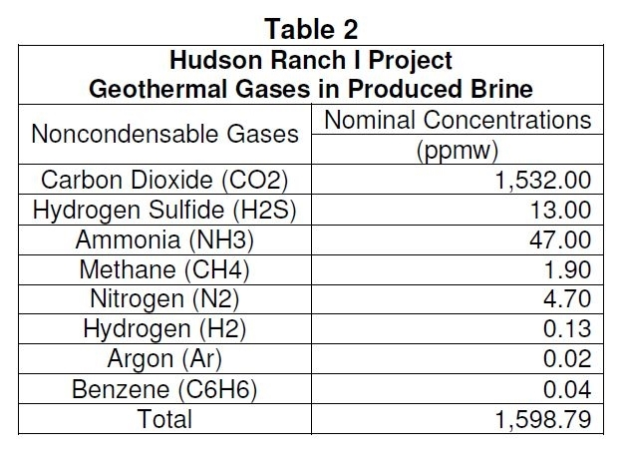
Gas emissions:
World Bank 2016
Geothermal power plants emit 10x to 100x less C and S gases
than fossil fuel power plants – coal is the worst.
Majority of emissions are H₂O (>99%) and CO₂ (0.2%), vented into atmosphere, and trace H₂S (scrubbed).
CA RWQCB 2013
CARB 2019
= avg 14,604 tons/yr per power plant
Chevron’s El Segundo Oil Refinery: 3,000,000 tons/yr
CalPortland Cement plant, Oro Grande: 1,374,930 tons/yr
Spreckels Sugar Co. plant, Brawley: 91,113 tons/yr
U.S. Gypsum Co. plant, Plaster City: 69,943 tons/yr
IID Gas Turbine plant, Niland: 57,533 tons/yr
96%
Above 10
ppm limit
Below 1
ppm limit
CA RWQCB 2013

Slide 8
Summary of advantages of producing metals from geothermal brines:
No drilling, blasting, grinding, rock leaching, tailings piles, pumping or evaporation ponds.
Brine handing infrastructure is already capitalized and in place.
Low areal footprint (~ 50 acres per extraction plant).
Just a few companies own the resource (dominated by BHER).
Other mineral co-products can add to the revenue steam.
The brine reservoir is contiguous and relatively uniform in its composition and metal content. Production has been stable for over 40 years.
Can self-supply low-carbon renewable electricity from power plants.
Can self-supply carbonate from CO₂ in steam for making LCE.
Can self-supply fresh water for Li processing from clean steam condensate.
Spent brine reinjection into the hot reservoir and fast reaction with Li-bearing host rocks may enhance resource sustainability (under evaluation).

